Slide 1
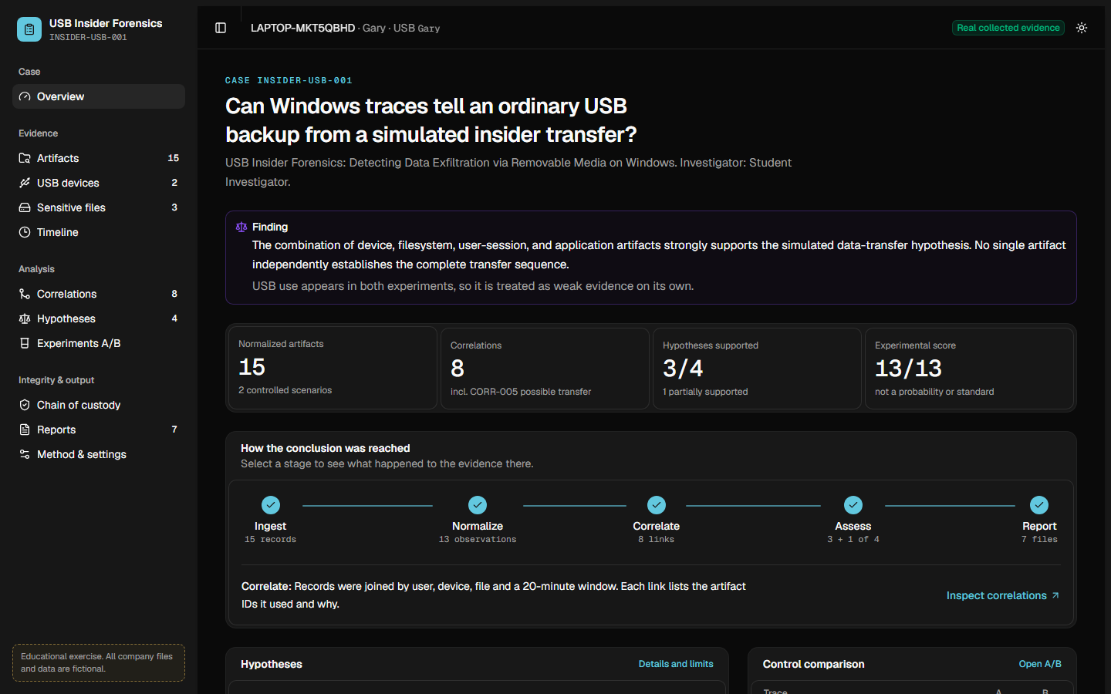
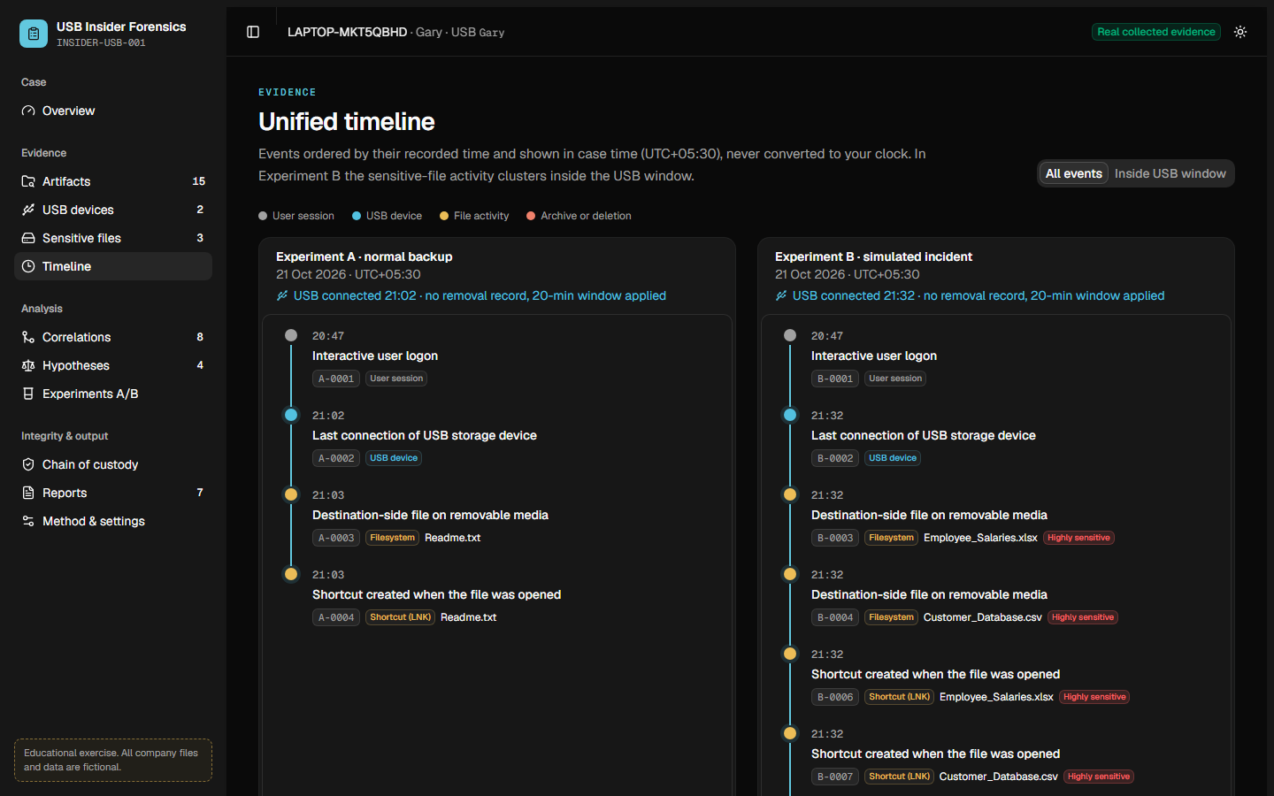
CYBER FORENSICS PROJECT · CASE INSIDER-USB-001
USB Insider Forensics
Detecting data exfiltration via removable media on Windows
User session
USB device
File activity
Archive or deletion
Real Windows evidence · Python analysis engine · React dashboard
Notes:
"Good morning sir. Our project is called USB Insider Forensics: detecting data exfiltration via removable media on Windows.
In simple words, the question is this: if an employee copies company files to a USB drive, can we prove it using only the traces Windows leaves behind on the computer?
We built the complete system ourselves: a tool that collects the evidence from Windows, an analysis engine that links the evidence together and reaches a conclusion, a dashboard to see the results, and reports. And we did not stop at made-up data: we tested it on real Windows evidence from our own laptop with a real USB disk.
What you see on the right is our dashboard. I will show it working live in a few minutes."

Slide 2



The insider already has access. The USB drive is the door
01 · WHY THIS PROJECT
Trusted users
An insider does not hack in. They already have permission to open the files.
RESEARCH QUESTION
Can the traces Windows leaves behind tell an ordinary USB backup apart from an insider copying sensitive company files?
USB is everyday
Backups to a USB drive are normal, so plugging one in proves nothing.
The investigator's problem
Theft and a normal backup can look identical from a single trace.
Answered with a controlled experiment and real Windows evidence.
Notes:
"First, why this problem matters.
Most people imagine data theft as a hacker breaking in from outside. But a lot of data loss comes from insiders: employees who already have permission to open the files. They don't need to hack anything.
The easiest way for an insider to take data out is a USB drive. And here is the real difficulty for an investigator: people also use USB drives for completely normal reasons, like backups. So if we only see that a USB was plugged in, that proves nothing. A normal backup and a theft can look exactly the same from a single trace.
So our research question is the one on the right: can the traces Windows leaves behind tell an ordinary USB backup apart from an insider copying sensitive company files? We answered it with a controlled experiment and real Windows evidence."

Slide 3


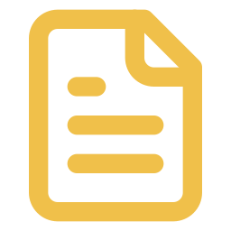

One clue proves nothing. Agreeing clues tell the story
02 · THE CORE IDEA
USB connected
Sensitive file opened
Same USB window
Explainable conclusion
Same file appears on USB
20 minutes, configurable
with confidence, the exact records used, and a stated limit
User logged in
A USB connection appears in both normal and suspicious use. Only independent clues agreeing inside the same window make a strong case.
ZIP made / file deleted
Notes:
"This is the key idea of the whole project.
Windows quietly records many small clues. On the left: a USB drive was connected; a sensitive file was opened; the same file appeared on the USB; which user was logged in; and whether a ZIP was made or a file was deleted.
Each clue on its own is weak. A USB connection happens every day. Opening a file is normal. Even deleting a file can be innocent.
But think of a detective. One footprint means nothing. A footprint, fingerprints and a CCTV recording all pointing to the same person at the same time make a strong case.
That is exactly what our system does. It takes these clues and checks whether they happened inside the same USB time window, which is 20 minutes by default and configurable. When several independent clues agree in that window, we have strong evidence.
And the conclusion is always explainable: it shows a confidence level, the exact records it used, and the limit of what it can claim."

Slide 4
A fair test needs a control
03 · EXPERIMENT DESIGN
Same laptop · same Windows user · same USB drive · same fictional company files
EXPERIMENT A
EXPERIMENT B
Normal backup (control)
Simulated insider
Plug in the USB drive
Open an ordinary Readme.txt
Copy it to the USB
Plug in the USB drive
Open salary, customer and project files
Copy the sensitive files to the USB
Make a ZIP archive
Delete a temporary copy (Recycle Bin)
Expected: USB used, no leak
Expected: corroborated transfer
Notes:
"To test this fairly, we needed a control: a normal case to compare against.
So we ran two experiments, and the top bar is important: same laptop, same Windows user, same USB drive, same fictional company files. Only the behaviour changes.
Experiment A is the normal backup, our control. The user plugs in the USB, opens an ordinary Readme file and copies it to the USB. Our system must not call this a leak.
Experiment B is the simulated insider. The user opens the salary, customer and project files, copies the sensitive ones to the USB, makes a ZIP archive, and deletes a temporary copy into the Recycle Bin. Our system should flag this.
All the company files are fictional. We created them ourselves; no real data was used anywhere."

Slide 5


Five evidence sources, read without changing anything
04 · WHAT WINDOWS REMEMBERS
USB device history
Recycle Bin records
Plug-and-Play records: first install, last connection, removal
$I files holding original path and deletion time
Shows a device was present, not what was copied
Deletion can be innocent; intent is not proven
Files on the USB
Logon events
Listing of the removable volume: names, paths, creation times
Winlogon event 7001 in the System log
The strongest clue: the file reached the drive
Ties the activity to a user session
Recent Items shortcuts
collector\collect_usb_artifacts.ps1
LNK files Windows writes when a document is opened
Runs as a normal user. Read-only. Writes a SHA-256 manifest.
Shows a file was opened, not copied
Notes:
"Where does the evidence come from? Windows saves these clues in five places, and our collector reads all five.
One, USB device history, stored in the Windows Registry under the device's entry. Windows keeps the first-install time, the last connection and the last removal. This shows the device was present, but not what was copied.
Two, the files on the USB itself. The USB's file system records when each file was created. This is the strongest clue, because it shows the file actually reached the drive.
Three, Recent Items shortcuts. When you open a document, Windows automatically creates a small shortcut file in the user's Recent folder. That shows the file was opened, but not copied.
Four, Recycle Bin records. Every deleted file leaves a small record with its original path and the exact deletion time. Deletion can be innocent, so it doesn't prove intent.
Five, logon events in the Windows event log, which tie the activity to a user session.
Each yellow line is the limit of that clue. Our collector is a PowerShell script that reads all of these as a normal user, read-only, so it never changes the computer, and it seals its output with a SHA-256 fingerprint."

Slide 6





From raw Windows traces to an explainable verdict
05 · HOW THE SYSTEM WORKS
1
2
3
4
5
6
7
Collect
Seal
Ingest
Normalize
Correlate
Assess
Present
Read-only PowerShell collector
SHA-256 fingerprint + custody log
Raw record kept untouched
One common format, nothing guessed
Same user, device, file and time window
Four hypotheses with limits
Dashboard, PDF, HTML, CSV
BUILT WITH
PowerShell
Python
SQLite
Flask API
React + ReUI
14 automated tests
Every stage keeps the IDs of the records it used, so any result can be traced back to the original evidence.
Notes:
"This is the full pipeline, from raw Windows traces to a verdict, in seven stages.
Collect: the read-only PowerShell collector gathers the evidence.
Seal: the export gets a SHA-256 fingerprint and a custody record, so any later change would be detected.
Ingest: every record is loaded, and the original raw version is kept untouched.
Normalize: different kinds of records are converted into one common format. If a value is missing, it stays missing. Nothing is guessed.
Correlate: records are linked when they share the same user, device, file and time window.
Assess: the system answers four questions, each with a confidence and a stated limit.
Present: the results go to the dashboard and to PDF, HTML and CSV reports.
We built it with PowerShell for collection, Python for the analysis, SQLite as the database, a Flask API, and a React dashboard. There are 14 automated tests that check all of this works.
The most important design point is at the bottom: every stage keeps the IDs of the records it used, so any result can be traced back to the original evidence."

Slide 7
Each answer comes with its evidence and its limit
06 · FOUR QUESTIONS, NOT ONE VERDICT
 | Question | Evidence required | Limit stated
H1 | Was a USB drive used? | A USB connection record | Normal users plug in USB drives too
H2 | Were the sensitive files opened? | Shortcuts or recent-document records for listed files | Opening is not copying
H3 | Were they copied to the USB? | Sensitive file on the USB inside the connection window, plus a user session | Shows timing and links, not intent
H4 | Was anything hidden? | Archive or deletion records | Zipping and deleting can be innocent
Confidence is Low, Medium or High: project-defined labels, not probabilities. The experimental score is a ranking aid, not a forensic standard.
Notes:
"Instead of giving a single 'guilty' or 'not guilty', the system answers four separate questions.
H1: was a USB drive used? This needs a USB connection record. The limit: normal users plug in USB drives too.
H2: were the sensitive files opened? This needs shortcut or recent-document records for the listed files. The limit: opening is not copying.
H3: were they copied to the USB? This is the strongest one. It needs a sensitive file on the USB inside the connection window, plus a user session. Even then, it shows timing and links, not intent.
H4: was anything hidden? This needs archive or deletion records. The limit: zipping and deleting files can be completely innocent.
The confidence levels, Low, Medium and High, are our own defined labels, not probabilities. And the score is only a ranking aid, not a forensic standard."

Slide 8
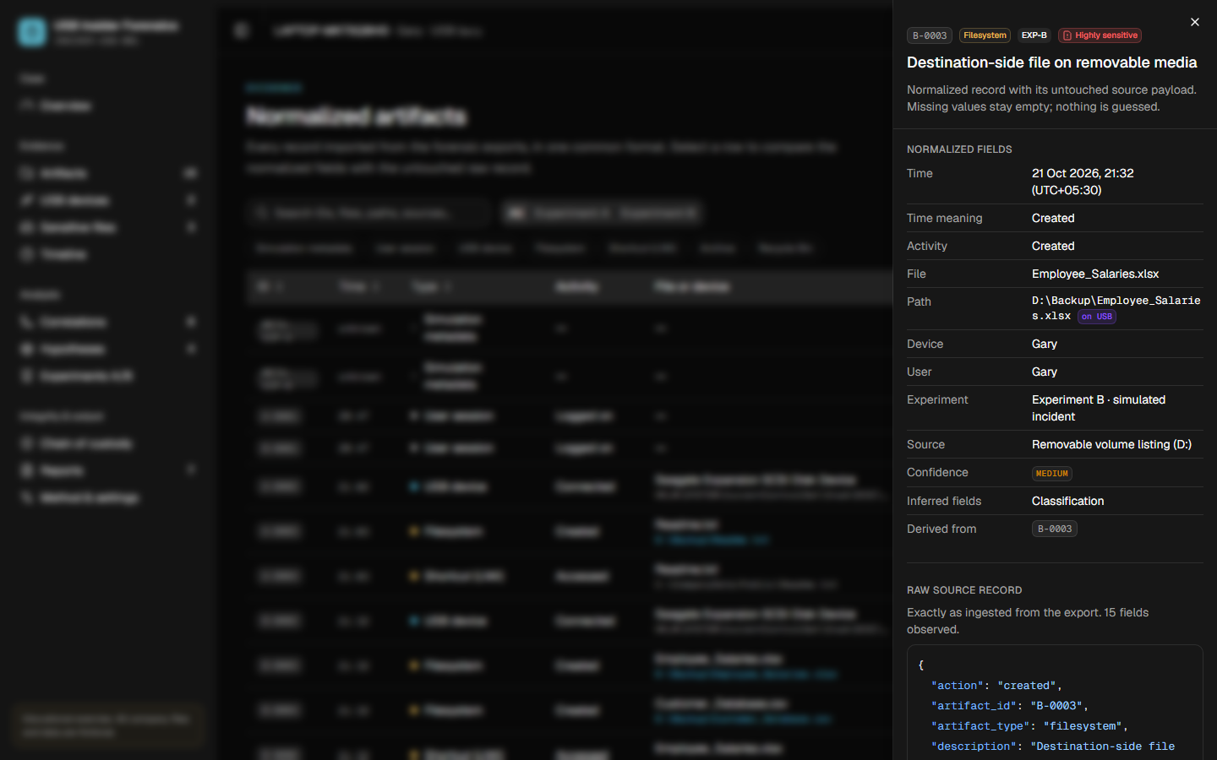


Evidence is preserved, fingerprinted and traceable
07 · FORENSIC SOUNDNESS
Read-only collection
The collector never edits the system it examines.
SHA-256 fingerprint
CA60D5A4ED47…7B9C41 sealed the real Experiment B export. Any later change would show.
Raw record preserved
The untouched source record sits next to the normalized one.
Custody and audit log
Who handled the evidence, when, and every analysis run.
Dashboard evidence drawer: normalized fields above, raw JSON below
Notes:
"In forensics, how you handle evidence matters as much as the result. Four things make our process sound.
First, read-only collection: the collector never edits the system it examines.
Second, a SHA-256 fingerprint. A hash is a digital fingerprint of the file; change even one character and the fingerprint changes completely. This hash, starting CA60D5A4, sealed our real Experiment B evidence.
Third, the raw record is preserved next to the cleaned version, so nothing is lost or invented.
Fourth, a custody and audit log: who handled the evidence, when, and every time the analysis ran.
On the right you can see the dashboard's evidence panel: the normalized fields at the top and the original raw data underneath."

Slide 9
One command performs the whole investigation
08 · LIVE DEMONSTRATION
1
Find the USB drive
PS> .\live_demo.ps1
2
Create fictional company files
Each step prints the exact command and the real code lines it runs, then waits for Enter.
3
Experiment A: normal backup
The USB drive is unplugged and plugged back in before each experiment, so Windows records a genuine connection.
4
Collect evidence for A
5
Experiment B: simulated insider
About 5 minutes. Only fictional files. Everything is cleaned up afterwards.
6
Collect evidence for B
7
Analyse: H1 to H4
8
Clean up, open dashboard
Notes:
"Now I'll show it working live. One command runs the whole investigation in eight steps. At every step it prints the exact command and the actual code it's running, so nothing is hidden. Before each experiment I'll unplug and replug the USB drive, so Windows records a genuine new connection."
[Switch to PowerShell. Type .\live_demo.ps1 and press Enter.]
Start screen: "This is the question we're answering. I'll press Enter to start." [Enter]
Step 1, find the USB drive: "First it asks Windows which drives are USB storage. Here is the command it runs. It found our Seagate external USB disk, which plays the role of the device an employee uses to take data out." [Enter]
Step 2, fictional company files: "Now it creates a fake company folder. These are the actual lines of code that create each file: a salary spreadsheet, a customer database, a project PDF, a strategy document and an ordinary readme. The salary and customer files are classified as highly sensitive in our configuration." [Enter]
Step 3, Experiment A: "This is the control, a normal backup. I'm going to unplug the USB drive and plug it back in, so Windows records a fresh connection." [Eject D: from the taskbar, unplug, wait 5 seconds, plug back in, wait for D: to appear, press Enter.] "You can see Windows recorded the connection at this exact time. Here is every line of the experiment script: it opens the readme and copies it to the USB. And here it is on the USB now." [Enter]
Step 4, collect evidence for A: "Now the collector reads the traces Windows left, limited to just this experiment's minutes. These five lines are the five evidence sources it reads. And here are the real records it found: the logon, the USB connection, the readme on the USB, and the shortcut showing it was opened." [Enter]
Step 5, Experiment B: "Now the insider. Same laptop, same user, same USB. I'll replug the drive again." [Eject, unplug, wait, plug back in, press Enter.] "Here is every line of this script. It opens the three sensitive files, copies two of them to the USB, creates a ZIP archive, and deletes a temporary copy into the Recycle Bin. And here are the files now on the USB." [Enter]
Step 6, collect evidence for B: "The same read-only collector for Experiment B. Look at this: files opened, the same files on the USB, a ZIP, and a deletion, all within seconds. And here is the SHA-256 fingerprint that seals this evidence." [Enter]
Step 7, analysis: "Now the analysis. These are the stages the engine runs, in order. And here are the results: H1, a USB was used, supported. H2, sensitive files were opened, supported. H3, copied to the USB, supported. H4 is only partially supported, because zipping and deleting can be innocent. Most importantly: a possible transfer is flagged only in Experiment B, not in Experiment A. That is exactly the correct answer." [Enter]
Step 8, clean up and dashboard: "The fake files go to the Recycle Bin, but the evidence was preserved and fingerprinted before cleanup, which is how forensic work should be done. And now the dashboard opens on the evidence we just created."
[In the browser.]
Overview: "This is the overview, with the finding and the key numbers. This stepper shows every stage the evidence went through." [Click two or three stages.]
[Click Timeline.] "This is the timeline. On the left, Experiment A: one ordinary file. On the right, Experiment B: everything happens within seconds, all inside the USB window."
[Click Sensitive files.] "Here is the strongest clue. The salary file on the computer, and the same file on the USB drive."
[Click Correlations.] "These are the links the engine made. This one is the key link, the possible transfer session. It lists its reasons in plain English and the exact record IDs it used. So it is not a black box: every conclusion can be checked by hand."
[Click Artifacts, then click any row.] "And for any record, you can see the cleaned version at the top and the original raw evidence underneath. Nothing is lost, and nothing is invented."
[Press Ctrl+C in PowerShell. Return to PowerPoint, slide 10.]

Slide 10
What Windows actually recorded on the project laptop
09 · THE REAL RUN · 21 OCTOBER 2026
Seagate Expansion external USB disk (D:) · laptop LAPTOP-MKT5QBHD · user Gary
EXPERIMENT A
EXPERIMENT B
21:02:07
USB disk connected
21:32:36
USB disk connected
21:03:08
Readme.txt opened (shortcut)
21:32:57
Salaries, customer and Apollo files opened
21:03:08
Readme.txt written to D:\Backup
21:32:57
Two sensitive files written to D:\Backup
21:32:58
Project_Files.zip created on the USB
21:32:59
Apollo copy moved to the Recycle Bin
Open, copy, zip and delete within 3 seconds, inside the USB window.
Notes:
"Before today, we also ran both experiments for real on the 21st of October, on this laptop with our Seagate external USB disk. These are the actual timestamps Windows recorded.
In Experiment A, the disk connected at 21:02:07, and a minute later the readme was opened and written to the USB.
In Experiment B, the disk connected at 21:32:36. Then at 21:32:57 the sensitive files were opened and copied to the USB, at 21:32:58 the ZIP was created, and at 21:32:59 the copy was deleted to the Recycle Bin.
So: open, copy, zip and delete, all within three seconds, all inside the USB window."

Slide 11


Experiment B flagged, Experiment A cleared
10 · RESULTS ON REAL EVIDENCE
EXPERIMENT A
No transfer flagged
USB used, but no sensitive file reached the drive
EXPERIMENT B
Possible transfer: HIGH
CORR-005 links 9 real records inside the USB window
Notes:
"Here is the result on that real evidence.
The chart shows the real Windows records collected for each experiment. Both have a logon and a USB connection; that's normal. But Experiment B has more files on the USB, more shortcuts, an archive and a deletion.
And the verdict: for Experiment A, no transfer was flagged, even though the USB was used. For Experiment B, a possible transfer with HIGH confidence, correlation CORR-005, built from nine real records inside the USB window.
That is exactly the behaviour we designed for: it catches the insider, and it does not accuse the normal user."

Slide 12

Same rules, three kinds of evidence, right every time
11 · CONSISTENCY CHECK
Evidence | H1 USB used | H2 Files opened | H3 Copied to USB | H4 Hidden | Score
Designed dataset, answer known in advance | Supported | Supported | Supported | Partial | 13 / 13
Real run of A and B on the laptop | Supported | Supported | Supported (B only) | Partial | 13 / 13
Same laptop, 30 days, no experiment | Supported | Not supported | Not supported | Partial | 2 / 13
Real evidence reproduced the designed result.
No false alarm: ordinary USB use on a real laptop was not called a leak.
Notes:
"We checked the method three ways, with the same rules each time.
First, on our designed dataset, where we knew the right answer in advance: correct.
Second, on the real run on the laptop: the same verdict, with the transfer only in Experiment B.
Third, on 30 days of normal use of the same laptop, without any experiment: it found real USB use, but correctly said no sensitive files were opened or copied. So there is no false alarm.
Real evidence reproduced the designed result, and normal USB use was not called a leak."

Slide 13
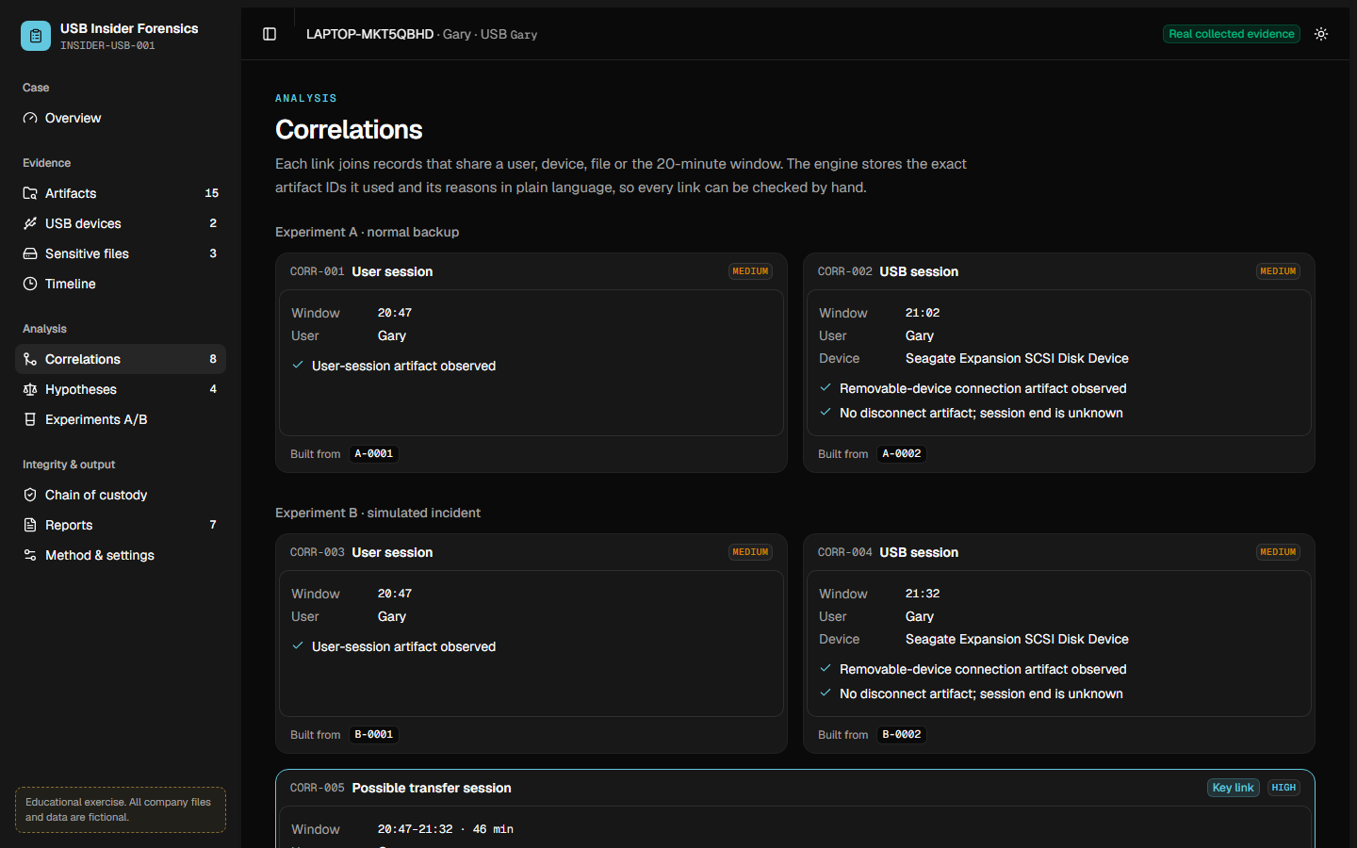
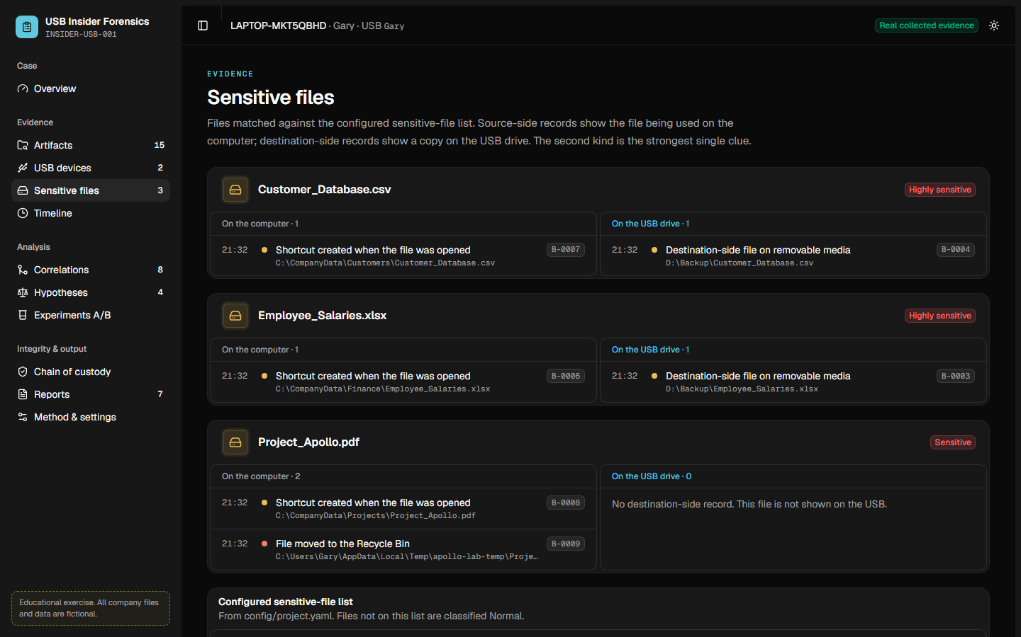
Every conclusion can be checked by hand
12 · THE DASHBOARD
Correlations: each link lists its reasons and the exact record IDs
Sensitive files: the same file on the computer and on the USB drive
11 pages: overview, artifacts, devices, files, timeline, correlations, hypotheses, A/B comparison, custody, reports, method
Notes:
"These are two pages of the dashboard you saw. On the left, the correlations page: each link with its reasons and the exact record IDs. On the right, the sensitive files page: the same file on the computer and on the USB drive.
There are eleven pages in total, plus PDF, HTML, JSON and CSV reports, so the dashboard is not the only output."

Slide 14
What this project does not claim
13 · HONEST LIMITS
It does not prove guilt or intent
Company data is fictional
Evidence can support a transfer; motive is outside forensics.
The Windows traces are real; the salary and customer files are made up.
Live collection touches the system
One laptop, one Windows version
Formal casework should image a powered-off disk and analyse a verified copy.
A larger study would repeat the run on more PCs and USB devices.
The score is not a standard
FUTURE WORK
It ranks findings; it is not a probability.
Disk-image analysis, more devices and Windows versions, and capturing USB removal events.
Notes:
"We want to be clear about what this project does not claim.
It does not prove guilt or intent. It can support that a transfer happened, but why someone did it is outside forensics.
The company data is fictional. The Windows traces are completely real, but the salary and customer files are made up.
Live collection touches the running system slightly. For formal casework, investigators should first make a copy of the powered-off disk and analyse the copy.
It was tested on one laptop and one Windows version. A larger study would repeat it on more PCs and USB devices.
And the score is not a standard. It only ranks findings; it is not a probability.
For future work: analysing full disk images, testing more devices and Windows versions, and capturing USB removal events."

Slide 15
CONCLUSION
5
evidence sources
Several independent clues, agreeing in the same USB window, separate an insider from normal use far better than any single clue
8
correlations
4
hypotheses
and that held on real Windows evidence.
14
automated tests
Thank you · Questions?
Notes:
"To conclude.
Several independent clues, agreeing in the same USB window, separate an insider from normal use far better than any single clue, and that held on real Windows evidence.
The project reads five evidence sources, produces explainable correlations, answers four hypotheses, and is checked by fourteen automated tests.
Thank you, sir. We're happy to take your questions."

