Slide 1
Robotic Sensor Systems (RSS) Project
Group Number 12
Prof. Dr.-Ing. Robert Schmitt
Laboratory for Machine Tools and Production Engineering WZL, RWTH Aachen University
Winter Semester 2025/26

Slide 2



Project Structure
Teleoperation of Simulated Kinova Gen3 Robot
Control 7-DOF simulated robot in real time using wearable sensors, ROS2, and MoveIt2 Servo.
IMU
UDP
Encoder
SERVO
ESP32
IR
wifi_sensor_bridge
arm_servoing
servo_rviz

Slide 3
Sensor Mapping
Components and Mapping:
ESP32 →
IMU – I2C communication
IR – Digital reading
Encoder – Hardware interrupts for dial and digital read for button
IMU MPU6050 sensor →
Calculate Roll, Pitch, Yaw angles
Control node calculates velocities vx, vy and vz respectively.
Control node generates Twist Commands for moveit_servo.
Yaw is used to control opening and closing of gripper.
Rotary Encoder sensor →
Rotary knob is used to switch between 3 control modes (TCP Translation Control (w.r.t. base_link), TCP Orientation Control (w.r.t. end_effector_link). Gripper open/close control.)
The button has 2 modes – toggle between master RUN and master OFF. Long press (> 1 sec) triggers Homing for the robotic arm. (joint_trajectory_controller/joint_trajectory) [Useful in near singularity conditions].
IR Sensor →
The IR sensor is used as an Emergency Stop.
No commands from IMU are accepted when the proximity of iR sensor is triggered.

Slide 4
ROS2 Nodes
wifi_sensor_bridge:
This node accepts the sensor data from esp32 on udp port 5000 and pusblishes it to ROS topics /wifi/imu and /wifi/enc.
arm_servoing:
This is the main controller node that accepts the sensor data from the topics /wifi/imu and /wifi/enc.
The encoder data is then used to define control modes.
The IMU RPY data is used to calculate vx, vy & vz.
moveit_servo:
moveit2 package was cloned from the movit github repo and built in overlay_ws to enable /moveit_servo and its complimentary services and topics.
servo_rviz:
The gen3_servo_config.yaml file contains the important parameters for the servo controller. It defines parameters like move_group_name, singularity_threshold, planning_frame, etc for our kenova gen3 robotic arm.
The servo_rviz.launch.py launches the rviz sim and all the nodes required to make the control pipeline work.

Slide 5
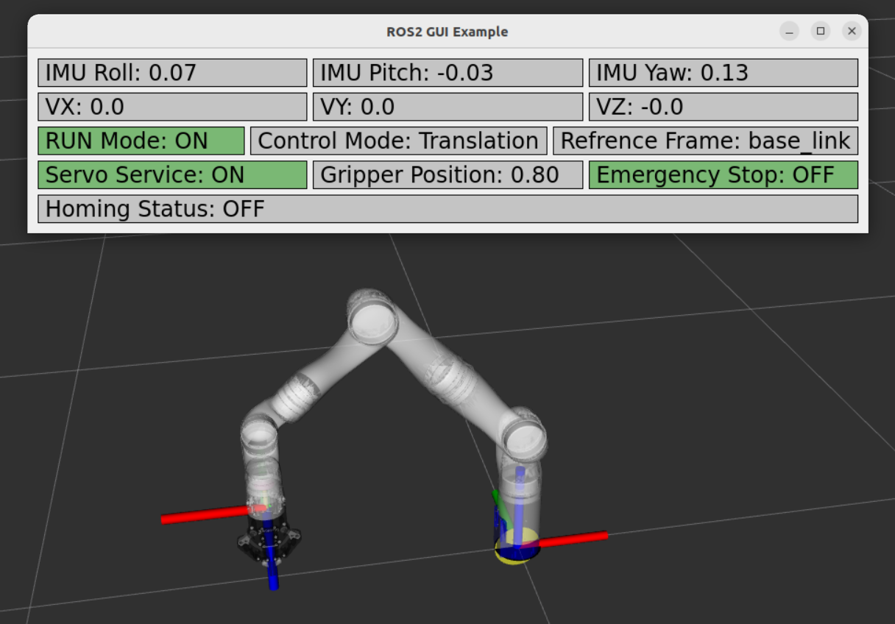
GUI
We have added a GUI to keep track of –
IMU RPY values
Velocities
Run Mode
Control Mode
Reference Frame
Gripper Position
Homing Status
Emergency Stop Status

Slide 6
THANK YOU !

