Slide 1
Breadth First Search(BFS)

Slide 2
Breadth First Search (BFS) for a Graph Algorithm:
Let’s discuss the algorithm for the BFS:
Initialization: Enqueue the starting node into a queue and mark it as visited.
Exploration: While the queue is not empty:
Dequeue a node from the queue and visit it (e.g., print its value).
For each unvisited neighbor of the dequeued node:
Enqueue the neighbor into the queue.
Mark the neighbor as visited.
Termination: Repeat step 2 until the queue is empty.
This algorithm ensures that all nodes in the graph are visited in a breadth-first manner, starting from the starting node.

Slide 3
BFS
The general idea behind a BFS beginning at a starting node is as follows. First we examine the starting node A. then we examine all the neighbors of A. then we examine all the neighbors of the neighbors of A and so on.
We need to keep a track of the neighbors of a node and we need to guarantee that no node is processed more than once. This is accomplished by using a queue to hold node that are waiting to be processed and by using a field STATUS which tells us the current state of any node.

Slide 4
Algorithm
Initialize all nodes to the ready state( STATUS=1)
Put the starting node A in QUEUE and change its status to the waiting state(STATUS=2)
Repeat Steps 4 and 5 until Queue is empty
Remove the front node N of queue. Process N and change the status of N to the processed state( STATUS=3)
Add to the rear of queue all the neighbors of N that are in the steady state( Status =1) and change their status to the waiting state( Status =2)
Exit

Slide 5
Adjacency List
A | F,C,B
B | G,C
C | F
D | C
E | D,C,J
F | D
G | C,E
J | D,K
K | E,G
A
F
C
B
E
G
D
J
K

Slide 6
Initially, add A to queue and add NULL to ORIG as follows FRONT=1 Rear=1 Queue: A ORIG: 0
Remove the front element A from Queue by setting Front=Front+1 and add to Queue neighbors of A as follows: FRONT=2 REAR=4 Queue=A,F,C,B ORIG: 0,A,A,A . The origin A of each of the three edges is added to Orig
Remove the front element F from Queue by setting Front=Front+1 and add to Queue neighbors of F as follows FRONT=3 ,REAR=5 Queue: A,F,C,B,D Orig: 0,A,A,A,F
Remove the front element C from Queue by setting Front=Front+1 and add to Queue neighbors of C as follows FRONT=4 ,REAR=5 Queue: A,F,C,B,D Orig: 0,A,A,A,F
Note The neighbor F of C is not added to QUEUE Since F is not in the ready state( Because F has already been added to queue)
5) Remove the front element B from Queue by setting Front=Front+1 and add to Queue neighbors of B as follows FRONT=5 ,REAR=6 Queue: A,F,C,B,D,G Orig: 0,A,A,A,F,B
Note that only G is added to queue since the other neighbor C is not in the ready state.

Slide 7
Remove the front element D from Queue by setting Front=Front+1 and add to Queue neighbors of D as follows FRONT=6 ,REAR=6 Queue: A,F,C,B,D,G Orig: 0,A,A,A,F,B
Remove the front element G from Queue by setting Front=Front+1 and add to Queue neighbors of G as follows FRONT=7 ,REAR=7 Queue: A,F,C,B,D,G,E Orig: 0,A,A,A,F,B,G
Remove the front element E from Queue by setting Front=Front+1 and add to Queue neighbors of E as follows FRONT=8 ,REAR=8 Queue: A,F,C,B,D,G,E,J Orig: 0,A,A,A,F,B,G,E
We stop as soon as J is added to Queue, since J was final destination. Now we backtrack from J using the array Orig to find path P.
Thus, J E G B A
Is the required path

Slide 8
Adjacency List
A | F,C,B
B | G,C
C | F
D | C
E | D,C,J
F | D
G | C,E
J | D,K
K | E,G
A
F
C
B
E
G
D
J
K

Slide 9
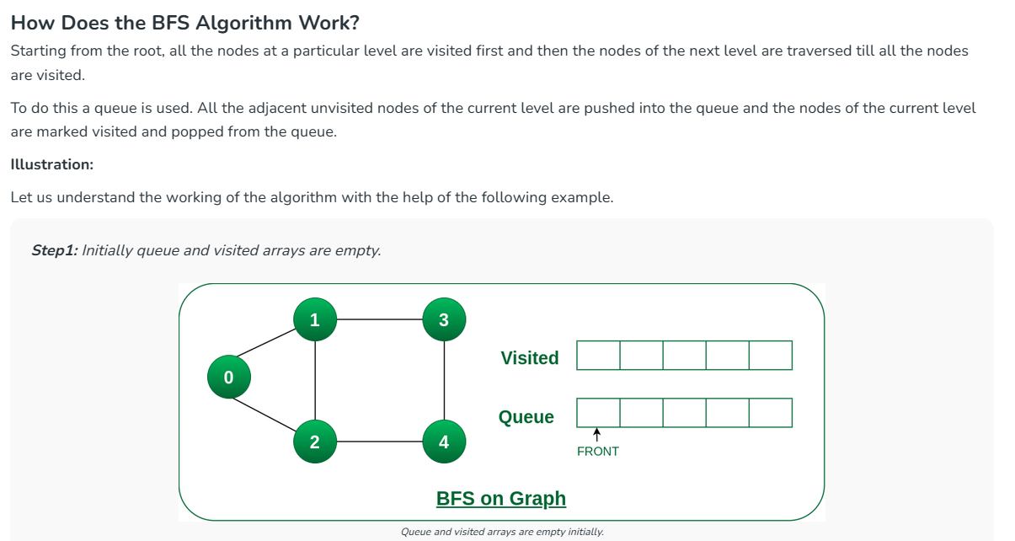

Slide 10
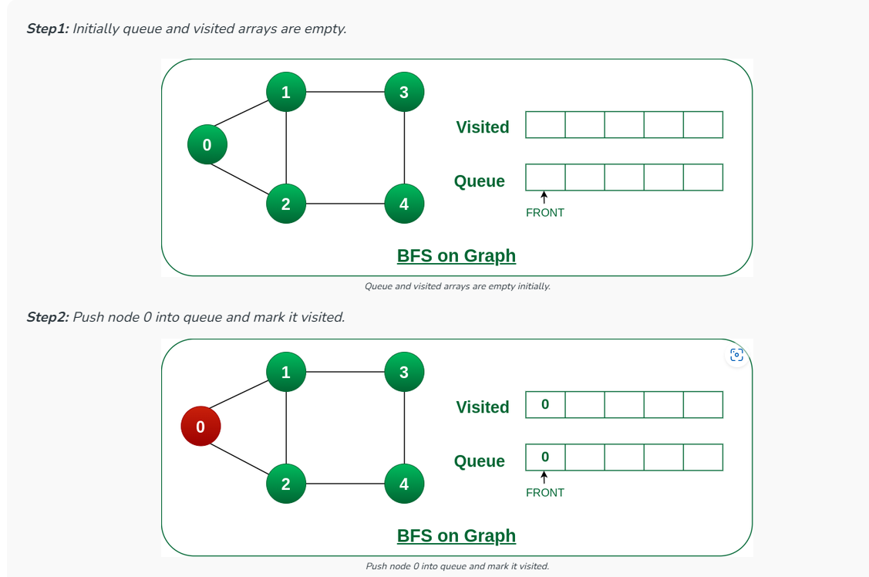

Slide 11
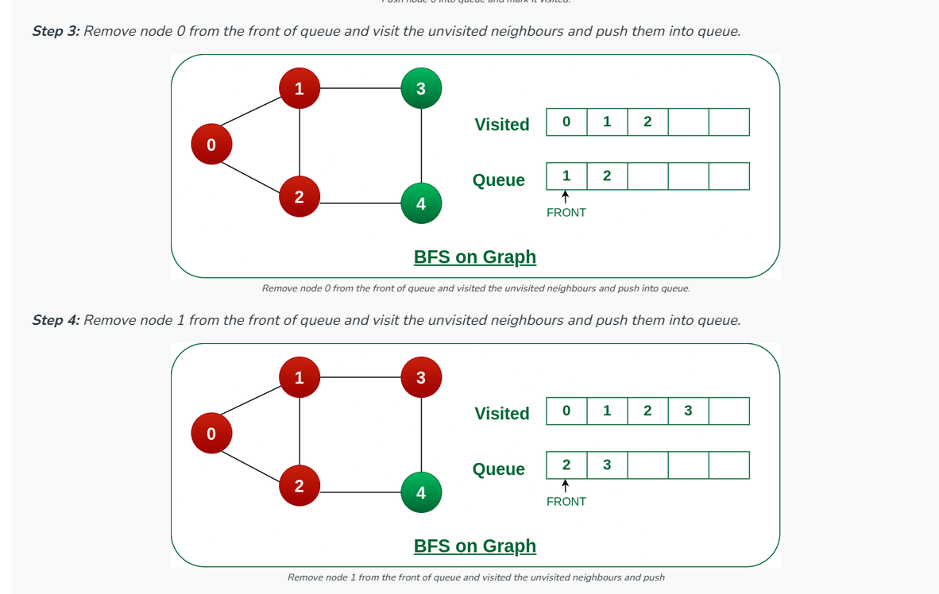

Slide 12
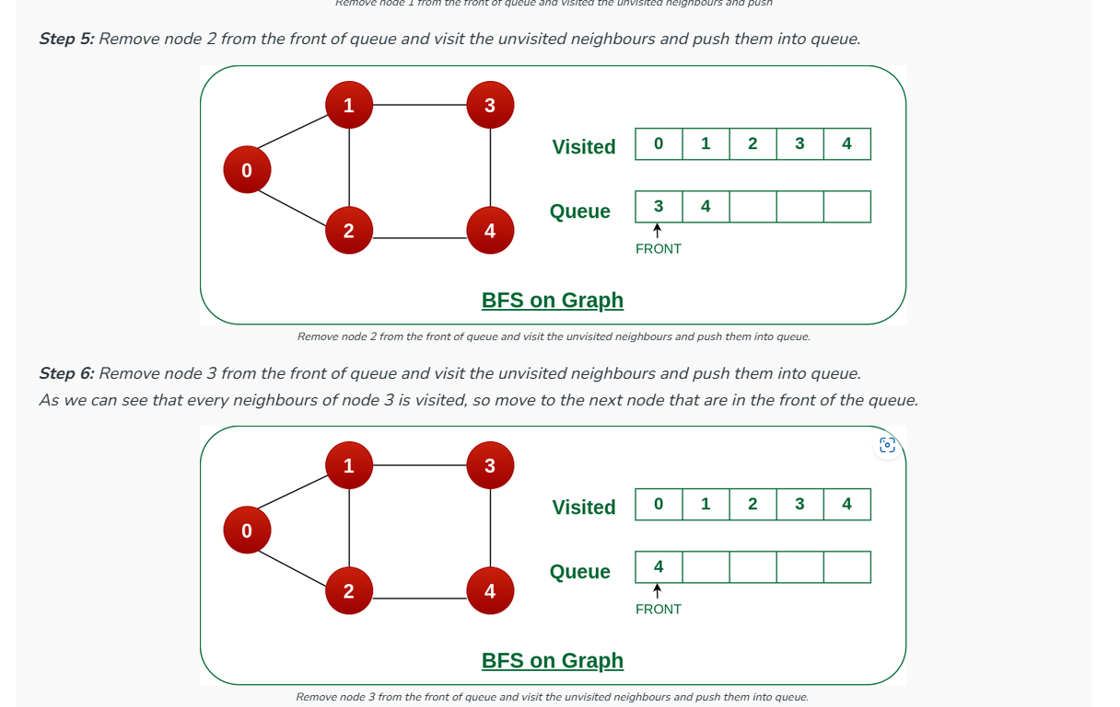

Slide 13
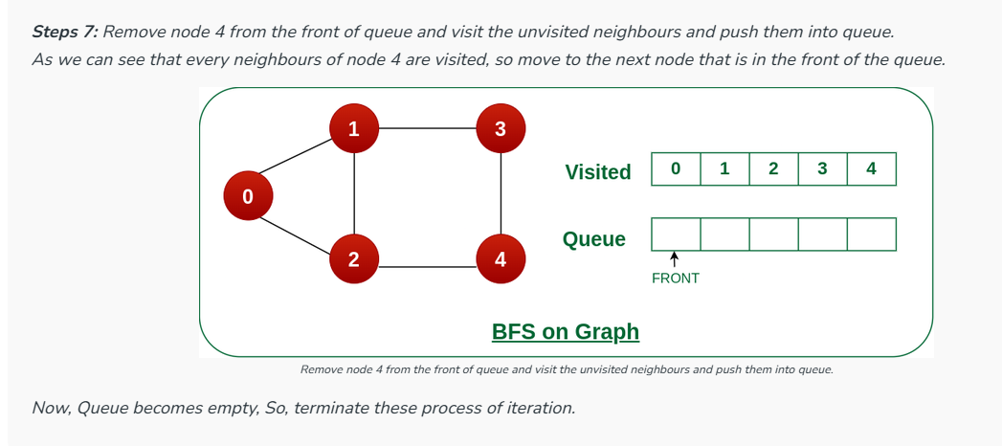

Slide 14
#include <iostream>
using namespace std
int adjMatrix[4][4] ;
int numVertices = 4; // Predefined number of vertices
// Add edges
void addEdge(int i, int j) {
adjMatrix[i][j] = 1;
adjMatrix[j][i] = 1;
}
// Print the matrix
void printGraph() {
for (int i = 0; i < numVertices; i++) {
cout << i << " : ";
for (int j = 0; j < numVertices; j++)
cout << adjMatrix[i][j] << " ";
cout << "\n";
}
}

Slide 15
int main() {
addEdge(0, 1);
addEdge(0, 2);
addEdge(1, 2);
addEdge(2, 0);
addEdge(2, 3);
printGraph();
return 0;
}

Slide 16
#include <iostream>
#include <queue>
#include <vector>
using namespace std;
int adjMatrix[4][4];
int numVertices = 4; // Predefined number of vertices
// Add edges
void addEdge(int i, int j) {
adjMatrix[i][j] = 1;
adjMatrix[j][i] = 1;
}
// Perform Breadth First Search traversal
void bfs(int startVertex) {
bool visited[numVertices] = {false};
queue<int> bfsQueue;
visited[startVertex] = true;
bfsQueue.push(startVertex);
while (!bfsQueue.empty()) {
int currentVertex = bfsQueue.front();
cout << currentVertex << " ";
bfsQueue.pop();
for (int i = 0; i < numVertices; ++i) {
if (adjMatrix[currentVertex][i]==1 && visited[i]==false) {
visited[i] = true;
bfsQueue.push(i);
}
}
}
}
int main() {
addEdge(0, 1);
addEdge(0, 2);
addEdge(1, 2);
addEdge(2, 0);
addEdge(2, 3);
cout << "BFS traversal starting from vertex 0: ";
bfs(0);
cout<<endl;
cout << "BFS traversal starting from vertex 0: ";
//STRTING VERTEX : 1
bfs(3);
return 0;
}

Slide 17
//CODE FOR BFS
#include <iostream>
#include <queue>
#include <vector>
using namespace std;
int adjMatrix[4][4];
int numVertices = 4; // Predefined number of vertices
// Add edges
void addEdge(int i, int j) {
adjMatrix[i][j] = 1;
adjMatrix[j][i] = 1;
}
// Perform Breadth First Search traversal
void bfs(int startVertex) {
bool visited[numVertices] = {false};
queue<int> bfsQueue;
visited[startVertex] = true;
bfsQueue.push(startVertex);
while (!bfsQueue.empty()) {
int currentVertex = bfsQueue.front();
cout << currentVertex << " ";
bfsQueue.pop();
for (int i = 0; i < numVertices; ++i) {
if (adjMatrix[currentVertex][i]==1 && visited[i]==false) {
visited[i] = true;
bfsQueue.push(i);
}
}
}
}

Slide 18
int main() {
addEdge(0, 1);
addEdge(0, 2);
addEdge(1, 2);
addEdge(2, 0);
addEdge(2, 3);
cout << "BFS traversal starting from vertex 0: ";
bfs(0);
cout<<endl;
cout << "BFS traversal starting from vertex 0: ";
//STRTING VERTEX : 1
bfs(3);
return 0;
}

Slide 19
Depth First Search (DFS)

Slide 20
Adjacency List
A | F,C,B
B | G,C
C | F
D | C
E | D,C,J
F | D
G | C,E
J | D,K
K | E,G
A
F
C
B
E
G
D
J
K

Slide 21
DFS
1) Initialize all nodes to the ready state (Status=1)
2) Push the starting node A on to Stack and change its status to the waiting state(Status=2)
3) Repeat Steps 4 and 5 until stack is empty .
4) Pop the top node N of Stack Process N and Change its Status to the Processed state( Status=3)
5) Push on to stack all the neighbors of N that are still in the ready state(status=1) and change their status to the waiting state( status=2)
6 Exit

Slide 22
Adjacency List
A | F,C,B
B | G,C
C | F
D | C
E | D,C,J
F | D
G | C,E
J | D,K
K | E,G
A
F
C
B
E
G
D
J
K

Slide 23
DFS
Initially, push J onto stack
Stack: J
(b) Pop and print the top element J, and push onto stack all the neighbours of J which are in ready state
Print J Stack: D, K
(c) Pop and print the top element K, and push onto stack all the neighbours of K which are in ready state
Print K Stack: D, E, G
(d) Pop and print the top element G, and push onto stack all the neighbours of G which are in ready state
Print G Stack: D, E, C

Slide 24
DFS
(e) Pop and print the top element C, and push onto stack all the neighbours of C which are in ready state
Print C Stack: D, E, F
(f) Pop and print the top element F, and push onto stack all the neighbours of F which are in ready state
Print F Stack: D, E
(g) Pop and print the top element E, and push onto stack all the neighbours of E which are in ready state
Print E Stack: D
(h) Pop and print the top element D, and push onto stack all the neighbours of D which are in ready state
Print D Stack: Empty

Slide 25
ADepth First Search Algorithm
standard DFS implementation puts each vertex of the graph into one of two categories:
Visited
Not Visited
The purpose of the algorithm is to mark each vertex as visited while avoiding cycles.
The DFS algorithm works as follows:
Start by putting any one of the graph's vertices on top of a stack.
Take the top item of the stack and add it to the visited list.
Create a list of that vertex's adjacent nodes. Add the ones which aren't in the visited list to the top of the stack.
Keep repeating steps 2 and 3 until the stack is empty.

Slide 26
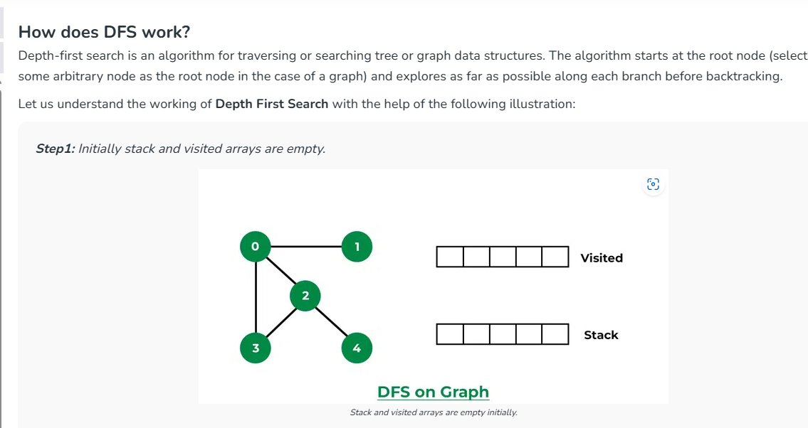

Slide 27
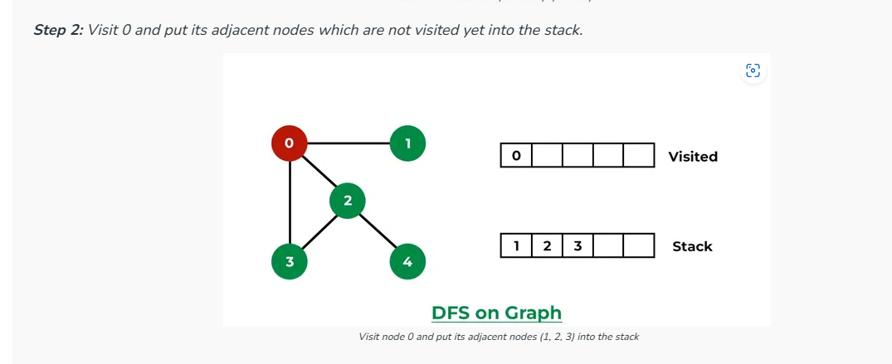

Slide 28
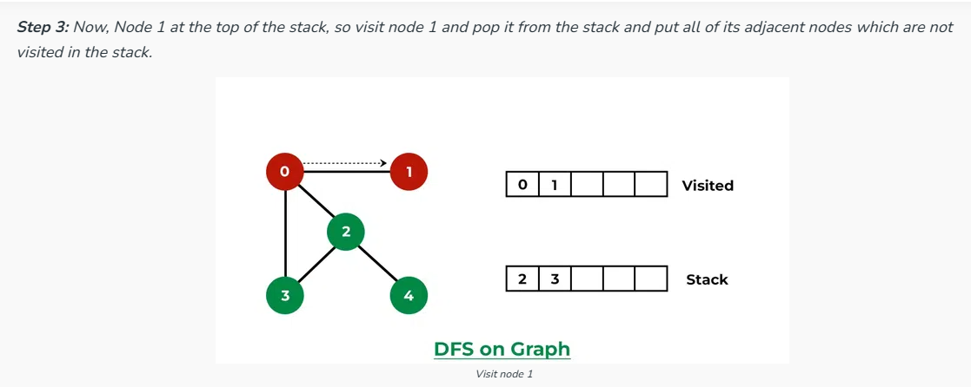

Slide 29
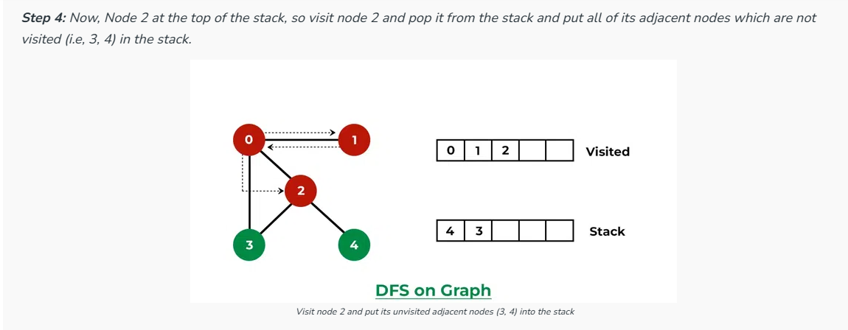

Slide 30
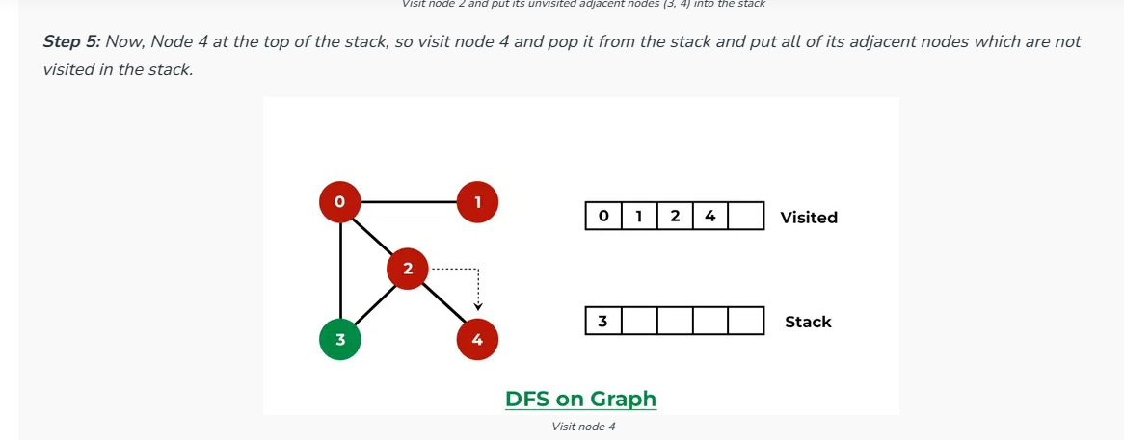

Slide 31
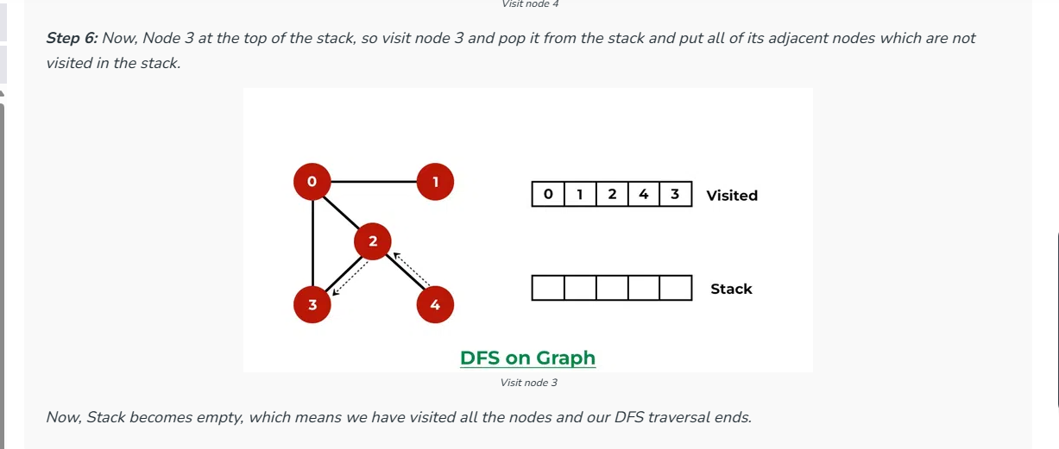

Slide 32
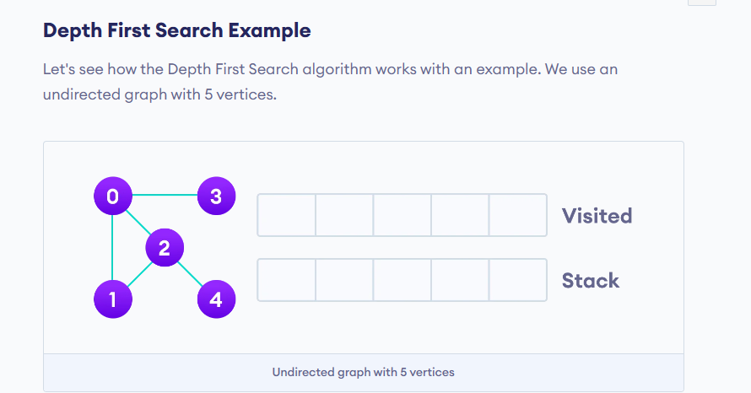

Slide 33
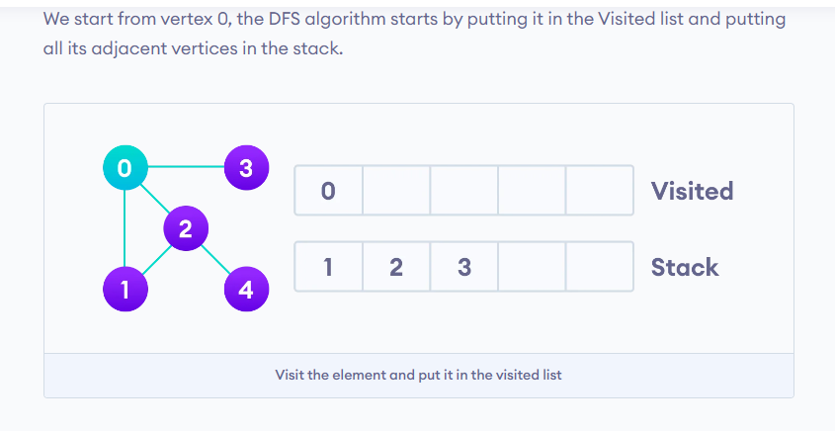

Slide 34
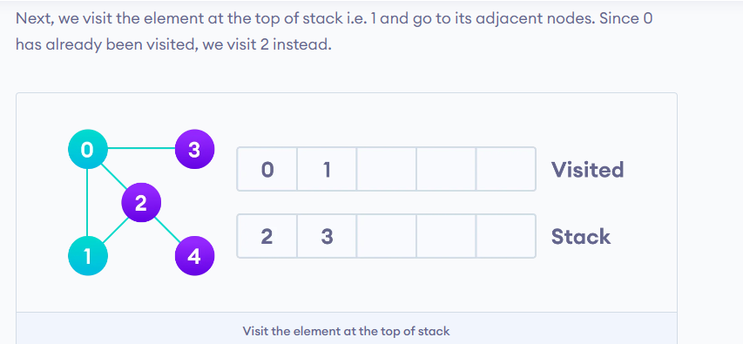

Slide 35
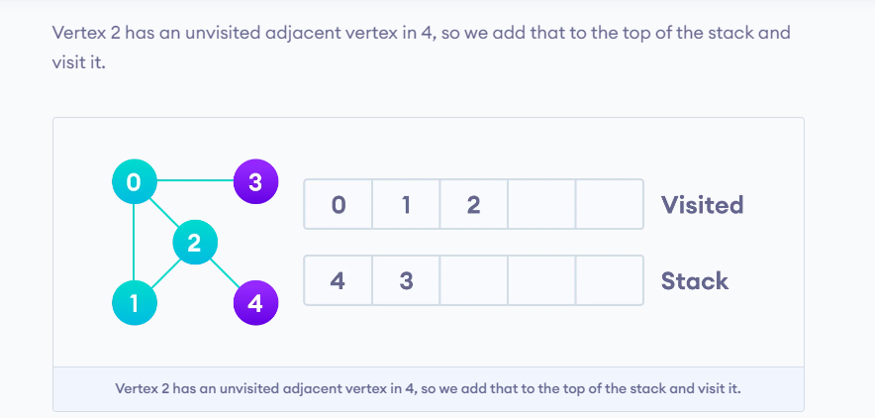

Slide 36
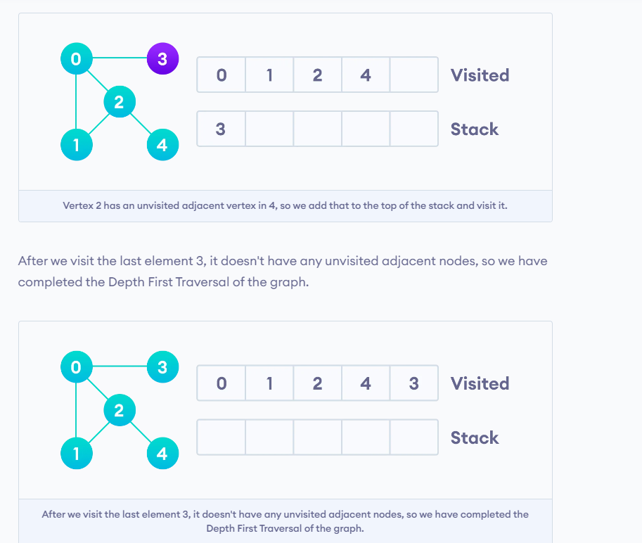

Slide 37
// DFS traversal
void DFS(int start) {
bool visited[numVertices] = {false};
stack<int> stack;
stack.push(start);
visited[start] = true;
while (!stack.empty()) {
int current = stack.top();
stack.pop();
cout << current << " ";
for (int i = 0; i < numVertices; ++i) {
if (adjMatrix[current][i] && !visited[i]) { // if (adjMatrix[current][i]==1&& visited[i]==false)
stack.push(i);
visited[i] = true;
}
}
}
}
int adjMatrix[4][4];
int numVertices = 4; // Predefined number of vertices
// Add edges
void addEdge(int i, int j) {
adjMatrix[i][j] = 1;
adjMatrix[j][i] = 1;
}

Slide 38
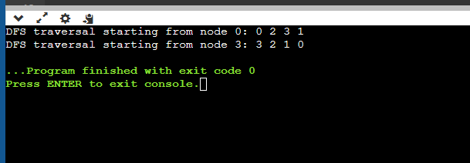
int main() {
addEdge(0, 1);
addEdge(0, 2);
addEdge(1, 2);
addEdge(2, 0);
addEdge(2, 3);
cout << "DFS traversal starting from node 0: ";
DFS(0);
cout << endl;
cout << "DFS traversal starting from node 3: ";
DFS(3);
return 0;
}

Slide 39
#include <iostream>
#include <stack>
using namespace std;
int adjMatrix[4][4];
int numVertices = 4; // Predefined number of vertices
// Add edges
void addEdge(int i, int j) {
adjMatrix[i][j] = 1;
adjMatrix[j][i] = 1;
}
// DFS traversal
void DFS(int start) {
bool visited[numVertices] = {false};
stack<int> stack;
stack.push(start);
visited[start] = true;
while (!stack.empty()) {
int current = stack.top();
stack.pop();
cout << current << " ";
for (int i = 0; i < numVertices; ++i) {
if (adjMatrix[current][i] && !visited[i]) {
stack.push(i);
visited[i] = true;
}
}
}
}
int main() {
addEdge(0, 1);
addEdge(0, 2);
addEdge(1, 2);
addEdge(2, 0);
addEdge(2, 3);
cout << "DFS traversal starting from node 0: ";
DFS(0);
cout << endl;
cout << "DFS traversal starting from node 3: ";
DFS(3);
return 0;
}

Slide 40
#include <iostream>
#include <limits> // for numeric_limits
using namespace std;
const int numVertices = 4; // Predefined number of vertices
int adjMatrix[numVertices][numVertices];
// Add weighted edge
void addEdge(int i, int j, int weight) {
adjMatrix[i][j] = weight;
adjMatrix[j][i] = weight;
}
// Print the matrix
void printGraph() {
for (int i = 0; i < numVertices; ++i) {
cout << i << " : ";
for (int j = 0; j < numVertices; ++j) {
cout << adjMatrix[i][j] << " ";
}
cout << "\n";
}
}

Slide 41
int main() {
// Add weighted edges
addEdge(0, 1, 1);
addEdge(0, 2, 3);
addEdge(1, 2, 2);
addEdge(2, 0, 4);
addEdge(2, 3, 5);
// Print the graph
printGraph();
return 0;
}

Slide 42
#include <iostream>
#include <limits> // for numeric_limits
using namespace std;
const int numVertices = 4; // Predefined number of vertices
int adjMatrix[numVertices][numVertices];
// Add weighted edge
void addEdge(int i, int j, int weight) {
adjMatrix[i][j] = weight;
adjMatrix[j][i] = weight;
}
// Print the matrix
void printGraph() {
for (int i = 0; i < numVertices; ++i) {
cout << i << " : ";
for (int j = 0; j < numVertices; ++j) {
cout << adjMatrix[i][j] << " ";
}
cout << "\n";
}
}
int main() {
// Add weighted edges
addEdge(0, 1, 1);
addEdge(0, 2, 3);
addEdge(1, 2, 2);
addEdge(2, 0, 4);
addEdge(2, 3, 5);
// Print the graph
printGraph();
return 0;
}

Slide 43
#include <iostream>
#include <limits> // for numeric_limits
using namespace std;
const int numVertices = 4; // Predefined number of vertices
int adjMatrix[numVertices][numVertices];
// Initialize adjacency matrix with infinite weights
void initGraph() {
for (int i = 0; i < numVertices; ++i) {
for (int j = 0; j < numVertices; ++j) {
if (i == j)
adjMatrix[i][j] = 0; // Weight for self-loop
else
adjMatrix[i][j] = numeric_limits<int>::max(); // Infinite weight
}
}
}
// Add weighted edge
void addEdge(int i, int j, int weight) {
adjMatrix[i][j] = weight;
adjMatrix[j][i] = weight;
}
// Print the matrix
void printGraph() {
for (int i = 0; i < numVertices; ++i) {
cout << i << " : ";
for (int j = 0; j < numVertices; ++j) {
if (adjMatrix[i][j] == numeric_limits<int>::max())
cout << "INF ";
else
cout << adjMatrix[i][j] << " ";
}
cout << "\n";
}
}
int main() {
// Initialize the adjacency matrix
initGraph();
// Add weighted edges
addEdge(0, 1, 1);
addEdge(0, 2, 3);
addEdge(1, 2, 2);
addEdge(2, 0, 4);
addEdge(2, 3, 5);
// Print the graph
printGraph();
return 0;
}

