Slide 1
Collision

Slide 2
What is Collision?
There is a possibility that two keys result in the same value. The situation where a newly inserted key maps to an already occupied slot in the hash table is called collision and must be handled using some collision handling technique.
There are mainly two methods to handle collision:
Separate Chaining
Open Addressing

Slide 3
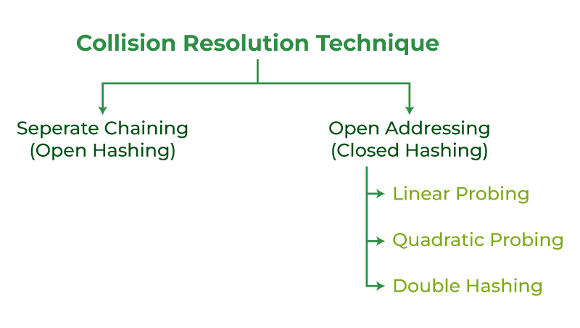

Slide 4
Separate Chaining:
The idea behind separate chaining is to implement the array as a linked list called a chain. Separate chaining is one of the most popular and commonly used techniques in order to handle collisions.
Example: Let us consider a simple hash function as “key mod 7” and a sequence of keys as 50, 700, 76, 85, 92, 73, 101

Slide 5
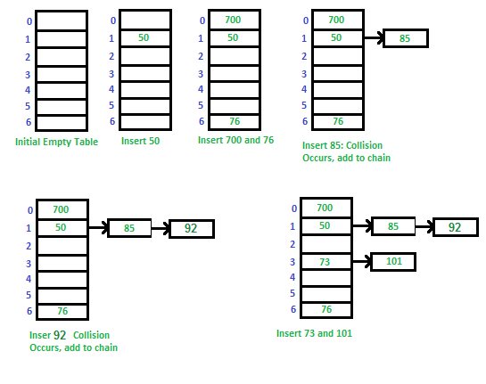

Slide 6
Advantages:
Simple to implement.
Hash table never fills up, we can always add more elements to the chain.
It is mostly used when it is unknown how many and how frequently keys may be inserted or deleted.

Slide 7
Disadvantages:
The cache performance of chaining is not good as keys are stored using a linked list. Open addressing provides better cache performance as everything is stored in the same table.
Wastage of Space (Some Parts of the hash table are never used)
If the chain becomes long, then search time can become O(n) in the worst case
Uses extra space for links

Slide 8
Open Addressing(Closed Hashing)
Like separate chaining, open addressing is a method for handling collisions. In Open Addressing, all elements are stored in the hash table itself. So at any point, the size of the table must be greater than or equal to the total number of keys (Note that we can increase table size by copying old data if needed). This approach is also known as closed hashing. This entire procedure is based upon probing.

Slide 9
Different ways of Open Addressing:
Linear Probing:
2. Quadratic Probing
3. Double Hashing
1. Linear Probing:
In linear probing, the hash table is searched sequentially that starts from the original location of the hash. If in case the location that we get is already occupied, then we check for the next location.
The function used for rehashing is as follows:
rehash(key) = (n+i)table-size.

Slide 10
Let hash(x) be the slot index computed using a hash function and S be the table size
(i)If slot hash(x) % S is full, then we try (hash(x) + 1) % S
(ii)If (hash(x) + 1) % S is also full, then we try (hash(x) + 2) % S
(iii)If (hash(x) + 2) % S is also full, then we try (hash(x) + 3) % S

Slide 11
Let us consider a simple hash function as “key mod 7” and a sequence of keys as 50, 700, 76, 85, 92, 73, 101,
which means hash(key)= key% S, here S=size of the table =7,indexed from 0 to 6.We can define the hash function as per our choice if we want to create a hash table , although it is fixed internally with a pre-defined formula.

Slide 12
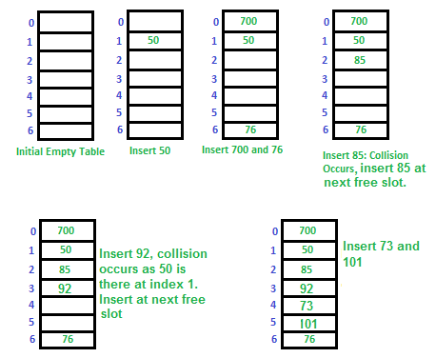

Slide 13
Applications of linear probing:
Symbol tables: Linear probing is commonly used in symbol tables, which are used in compilers and interpreters to store variables and their associated values. Since symbol tables can grow dynamically, linear probing can be used to handle collisions and ensure that variables are stored efficiently.
Caching: Linear probing can be used in caching systems to store frequently accessed data in memory. When a cache miss occurs, the data can be loaded into the cache using linear probing, and when a collision occurs, the next available slot in the cache can be used to store the data.
Databases: Linear probing can be used in databases to store records and their associated keys. When a collision occurs, linear probing can be used to find the next available slot to store the record.
Compiler design: Linear probing can be used in compiler design to implement symbol tables, error recovery mechanisms, and syntax analysis.
Spell checking: Linear probing can be used in spell-checking software to store the dictionary of words and their associated frequency counts. When a collision occurs, linear probing can be used to store the word in the next available slot.

Slide 14
Quadratic Probing
Quadratic probing is an open-addressing scheme where we see for the i²‘th slot in the i’th iteration if the given hash value x collides in the hash table.
(i)If the slot hash(x) % S is full, then we try (hash(x) + 1*1) % S.
(ii)If (hash(x) + 1*1) % S is also full, then we try (hash(x) + 2*2) % S.
(iii)If (hash(x) + 2*2) % S is also full, then we try (hash(x) + 3*3) % S.
This process is repeated for all the values of i until an empty slot is found.
For example: Let us consider a simple hash function as “key mod 7” and sequence of keys as 50, 700, 76, 85, 92, 73, 101

Slide 15
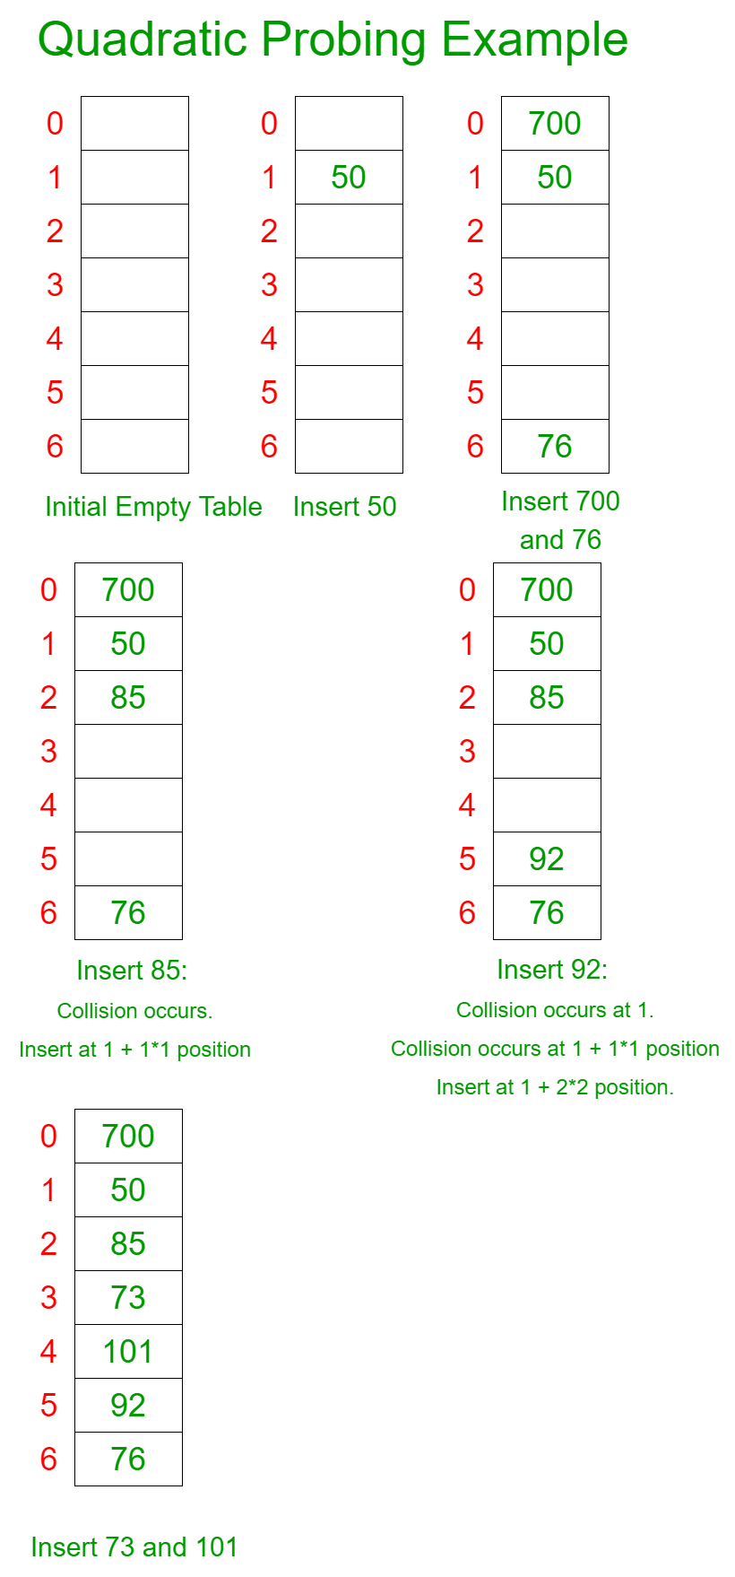

Slide 16
Let's say we have a hash table of size 10 and we want to insert the following keys: 12, 22, 32, 42, 52, 62, 72, 82, 92, 102.

Slide 17
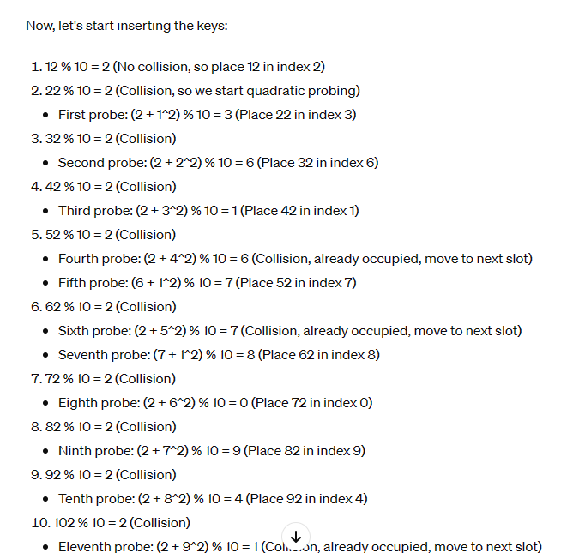

Slide 18
Double hashing
Double hashing is a collision resolution technique used in hash tables. It works by using two hash functions to compute two different hash values for a given key. The first hash function is used to compute the initial hash value, and the second hash function is used to compute the step size for the probing sequence.
Double hashing has the ability to have a low collision rate, as it uses two hash functions to compute the hash value and the step size. This means that the probability of a collision occurring is lower than in other collision resolution techniques such as linear probing or quadratic probing.

Slide 19
Advantage/Disadvantage of Double hashing
(i)The advantage of Double hashing is that it is one of the best forms of probing, producing a uniform distribution of records throughout a hash table.
(ii)This technique does not yield any clusters.
(iii)It is one of the effective methods for resolving collisions.

Slide 20
Disadvantages
(i)it requires the use of two hash functions, which can increase the computational complexity of the insertion and search operations.
(ii)It requires a good choice of hash functions to achieve good performance. If the hash functions are not well-designed, the collision rate may still be high.

Slide 21
Double hashing can be done using : (hash1(key) + i * hash2(key)) % TABLE_SIZE Here hash1() and hash2() are hash functions and TABLE_SIZE is size of hash table. (We repeat by increasing i when collision occurs)
Method : First hash function is typically hash1(key) = key % TABLE_SIZE A popular second hash function is hash2(key) = PRIME – (key % PRIME) where PRIME is a prime smaller than the TABLE_SIZE.

Slide 22
