Slide 1
Queue

Slide 2
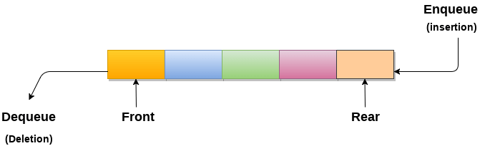
Queue
A queue can be defined as an ordered list which enables insert operations to be performed at one end called REAR and delete operations to be performed at another end called FRONT.
2. Queue is referred to be as First In First Out list.
3. For example, people waiting in line for a rail ticket form a queue.

Slide 3
A queue is like a line of people waiting for a bank teller. The queue has a front and a rear ends.
New people must enter the queue at the rear. To insert an element in queue is called enqueue operation.
People must leave from the queue at the front. To insert an element in queue is called dequeue operation.
$ $
Front
Rear
Notes:
Don’t ask me why the C++ STL used the name push. It only confuses matters with a stack. In any case, when a new item enters a queue, it does so at the rear.

Slide 4
Applications of Queue
Due to the fact that queue performs actions on first in first out basis which is quite fair for the ordering of actions. There are various applications of queues discussed as below.
Queues are widely used as waiting lists for a single shared resource like printer, disk, CPU Scheduling algorithms .
Queues are used as buffers in most of the applications like MP3 media player, CD player, etc.
Queues are used to maintain the playlist in media players to add and remove the songs from the play-list.
Queues are used in operating systems for handling interrupts.

Slide 5
Types of Queues
Before understanding the types of queues, we first look at 'what is Queue'.
What is the Queue?
A queue in the data structure can be considered similar to the queue in the real-world. A queue is a data structure in which whatever comes first will go out first. It follows the FIFO (First-In-First-Out) policy. In Queue, the insertion is done from one end known as the rear end or the tail of the queue, whereas the deletion is done from another end known as the front end or the head of the queue. In other words, it can be defined as a list or a collection with a constraint that the insertion can be performed at one end called as the rear end or tail of the queue and deletion is performed on another end called as the front end or the head of the queue.

Slide 6
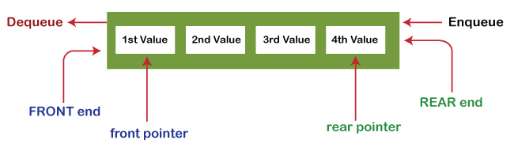
Operations on Queue
There are two fundamental operations performed on a Queue:

Slide 7
OPERATIONS :
Enqueue: The enqueue operation is used to insert the element at the rear end of the queue. It returns void.
Dequeue: The dequeue operation performs the deletion from the front-end of the queue. It also returns the element which has been removed from the front-end. It returns an integer value. The dequeue operation can also be designed to void.
Peek: This is the third operation that returns the element, which is pointed by the front pointer in the queue but does not delete it.
Queue overflow (isfull): When the Queue is completely full, then it shows the overflow condition.
Queue underflow (isempty): When the Queue is empty, i.e., no elements are in the Queue then it throws the underflow condition.

Slide 8
Implementation of Queue
There are two ways of implementing the Queue:
Sequential allocation: The sequential allocation in a Queue can be implemented using an array. Linked list allocation: The linked list allocation in a Queue can be implemented using a linked list.

Slide 9
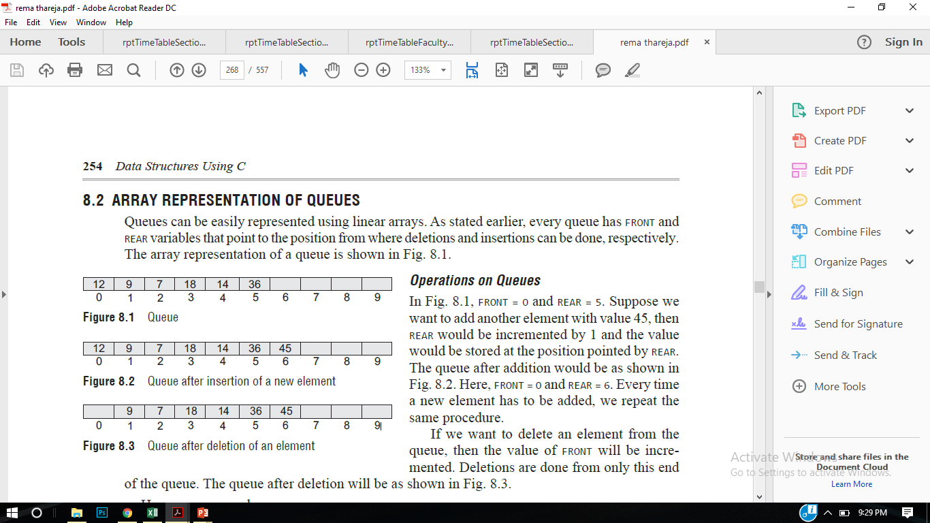
Queue Implementation
Queues can be implemented in two ways:-
Arrays
Linked List
Way I: Queues can be easily represented using linear arrays.
In an array of size 6 , FRONT = 0 and REAR = 5.
Suppose we want to add another element with value 45, then REAR would be incremented by 1 and the value would be stored at the position pointed by REAR.
FRONT = 0 and REAR = 6
If we want to delete an element from the queue, then the value of FRONT will be incremented.
3
6

Slide 10
Queue Operations #include<iostream> #define MAX 10 using namespace std; int queue[MAX]; int front = -1, rear =-1; void insert_element(int value); int delete_element(); int peek(); void display(); int main() { int option, val; char choice='Y'; while(choice=='Y') { cout<<endl<<" ***** MAIN MENU *****"; cout<<endl<<" 1. Insert an element"; cout<<endl<< "2. Delete an element"; cout<<endl<< "3. Peek"; cout<<endl<<" 4. Display the queue"; cout<<endl<<" Enter your option : "; cin>>option; | switch(option) { case 1: cout<<"enter the value to insert"; cin>>val; insert_element(val); break; case 2: val = delete_element(); if (val != -1) cout<<"\n The number deleted is :"<< val<<endl; break; case 3: val = peek(); if (val != -1) cout<<"\n The first value in queue is : "<< val<<endl; break; case 4: display(); break; } cout<<"Enter choice"; cin>>choice; } return 0; }

Slide 11
Queue Operations void insert_element(int value) // Enqueue { if(rear == MAX-1) cout<<"\n OVERFLOW"; else if(front == -1 && rear == -1) front = rear = 0; else rear++; queue[rear] = value; } int delete_element() // Dequeue { int val; if(front == -1) { cout<<"\n UNDERFLOW"; return -1; } else { val = queue[front]; front++; return val; }} | int peek() // To find the first element { if(front==-1 ) { cout<<"\n QUEUE IS EMPTY"; return -1; } else { return queue[front]; } } void display() // To show the data of queueu { int i; cout<<"\n"; if(front == -1 ) cout<<"\n QUEUE IS EMPTY"; else { for(i = front; i <= rear; i++) cout<<"\t "<< queue[i]; } }

Slide 12
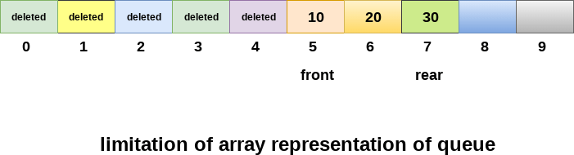
Drawback of array implementation
Although, the technique of creating a queue is easy, but there are some drawbacks of using this technique to implement a queue.
Memory wastage : The space of the array, which is used to store queue elements, can never be reused to store the elements of that queue because the elements can only be inserted at front end and the value of front might be so high so that, all the space before that, can never be filled.

Slide 13
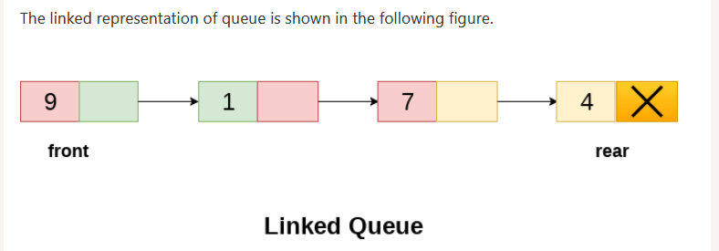
Queue Implementation with Linked List
Way II: Queues can be easily represented using single linked list.
In case of an array, In a linked queue, every element has two parts, one that stores the data and another that stores the address of the next element. The START pointer of the linked list is used as FRONT. Here, we will also use another pointer called REAR, which will store the address of the last element in the queue.
3
6

Slide 14
Queue Operations #include<iostream> #include<stdlib.h> using namespace std; struct queue { int data; struct queue *next; }; struct queue *temp,*front,*rear; void enqueue(int value); void dequeue(); void display(); int main() { int option, val; char choice='Y'; while(choice=='Y') { cout<<endl<<" ***** MAIN MENU *****"; cout<<endl<<" 1. Insert an element"; cout<<endl<< "2. Delete an element"; cout<<endl<<" Enter your option : "; cin>>option; | switch(option) { case 1: cout<<"enter the value to insert"; cin>>val; enqueue(val); break; case 2: dequeue(); break; case 3: display(); break; } cout<<"Enter choice"; cin>>choice; } return 0; }

Slide 15
void enqueue(int value) { temp=new queue(); temp->data =value; temp->next=null; if(front ==NULL && rear ==NULL) // empty queue { front = rear = temp; } else { rear->next =temp; rear++; } } void dequeue() { temp = front; if(front == NULL) { cout<<“underflow”; break; } else { front= temp->next; free(temp); }} | void display() // To show the data of queue { temp =front; cout<<"\n"; if(front == NULL ) cout<<"\n QUEUE IS EMPTY"; else { while(temp!=NULL) { cout<<temp->data; temp=temp->next; } }

Slide 16
Ques
Ques : Write an algorithm/program to implement enqueue and dequeue.
Ques : How many types of queue are there ? Explain
Ques : Implement the queue using Linked List.
Notes:
A quick summary . . .

Slide 17
Inbuilt functions
#include <iostream>
#include <queue>
using namespace std;
// Print the queue and dequeue one element
void print_queue(queue<int> q)
{
// While the queue is not empty
while (!q.empty()) {
// Print the front element
cout << q.front() << " ";
// Remove the front element (dequeue operation)
q.pop();
}
cout << '\n';
}

Slide 18
int main()
{
queue<int> q1;
q1.push(1);
q1.push(2);
q1.push(3);
cout << "The first queue is : ";
print_queue(q1);
queue<int> q2;
q2.push(4);
q2.push(5);
q2.push(6);
cout << "The second queue is : ";
print_queue(q2);
return 0;
}

Slide 19
DEQUES(Double Ended Queue)
A deque is a linear list in which elements can be added or removed at either end but not in middle( Left ,Right pointer).
There are two variation of a Deque- namely an Input Restricted and an output-Restricted deque.
An input restricted deque is a deque which allows insertions at only one end of a list but allows deletions on both the ends of the list
An output restricted Deque is a deque which allows deletions at only one end of the list but allows insertions at both the ends of the list.

Slide 20
APPLICATION OF DEQUEUE
PALIDROME CHECKER
BFS
UNDO REDO
Multiprocessor

Slide 21
https://www.programiz.com/dsa/deque

Slide 23
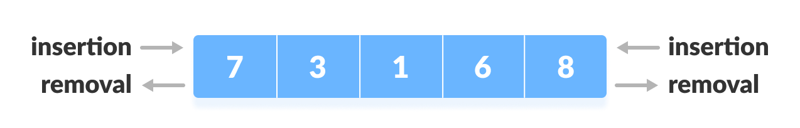
Deque
The dequeue stands for Double Ended Queue. In the queue, the insertion takes place from one end while the deletion takes place from another end. The end at which the insertion occurs is known as the rear end whereas the end at which the deletion occurs is known as front end.
Deque or Double Ended Queue is a type of queue in which insertion and removal of elements can be performed from either from the front or rear. Thus, it does not follow FIFO rule (First In First Out).

Slide 24
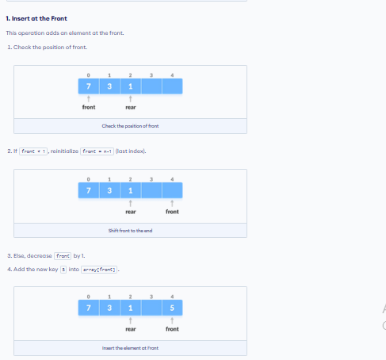

Slide 25
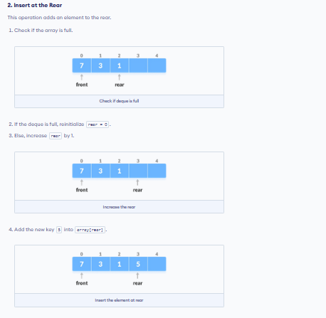

Slide 27
Priority Queue
A priority queue is a collection of elements such that each element has been assigned priority and such that the order in which elements are deleted and processed comes from the following rules:
1) An element of higher priority is processed before any element of lower priority.
2) Two elements with the same priority are processed according to the order in which they were added to the queue.
Priority queue can be implemented with one –way list and arrays:
Each node in the list contains three items of information: an information field info, priority number PRN and a link number link.
A node X precedes a node a node Y in the list 1) when X has higher priority than Y or 2) When both have the same priority but X was added to the list before Y.
A
1
2
B
2
3
C
2
Null

Slide 28
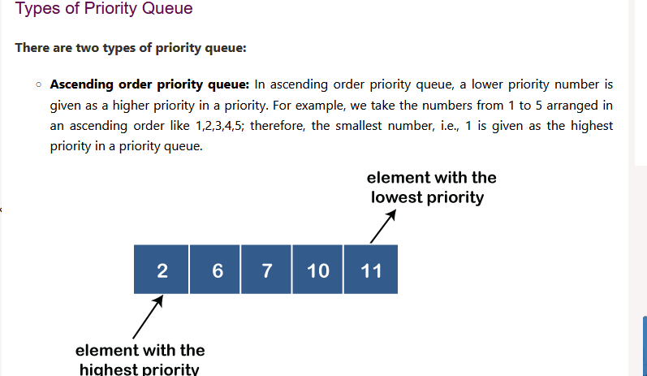

Slide 29
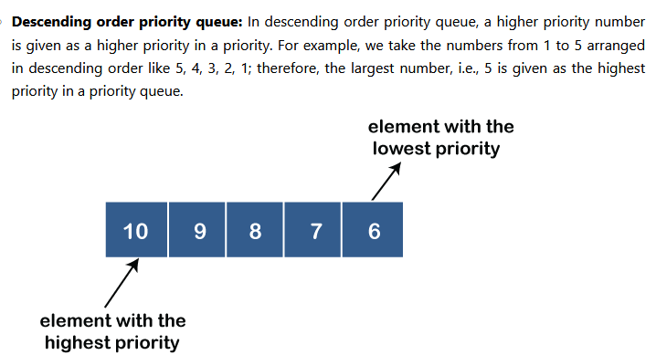

Slide 30
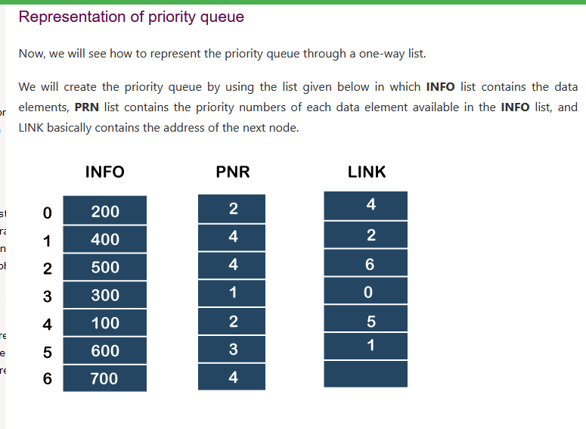

Slide 31
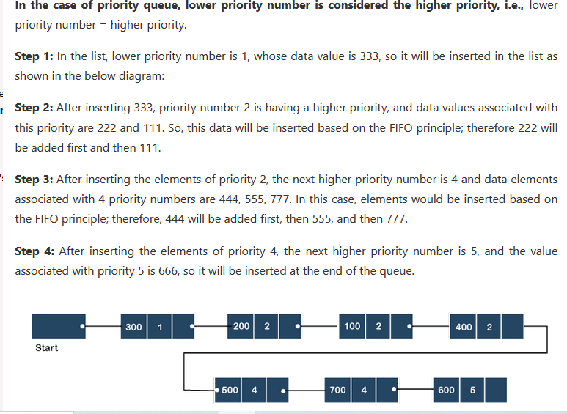

Slide 32
Applications:
Dijkstra’s Shortest Path Algorithm using priority queue: When the graph is stored in the form of adjacency list or matrix, priority queue can be used to extract minimum efficiently when implementing Dijkstra’s algorithm.
Prim’s algorithm: It is used to implement Prim’s Algorithm to store keys of nodes and extract minimum key node at every step. Data compression : It is used in Huffman codes which is used to compresses data.
Artificial Intelligence : A* Search Algorithm : The A* search algorithm finds the shortest path between two vertices of a weighted graph, trying out the most promising routes first.
The priority queue (also known as the fringe) is used to keep track of unexplored routes, the one for which a lower bound on the total path length is smallest is given highest priority.
Heap Sort : Heap sort is typically implemented using Heap which is an implementation of Priority Queue.
Operating systems: It is also used in Operating System for load balancing (load balancing on server), interrupt handling.
Optimization problems: Priority Queue is used in optimization problems such as Huffman coding, Kruskal’s Algorithm and Prim’s Algorithm
Robotics: Priority Queue is used in robotics to plan and execute tasks in a priority-based manner.
Event-driven simulations: Priority queues are used in event-driven simulations, such as network simulations, to determine which events should be processed next.
Medical systems: Priority queues are used in medical systems, such as triage systems in emergency departments, to prioritize patients based on the urgency of their condition.

Slide 33
Operations of a Priority Queue:
A typical priority queue supports the following operations:
1) Insertion in a Priority Queue
When a new element is inserted in a priority queue, it moves to the empty slot from top to bottom and left to right. However, if the element is not in the correct place then it will be compared with the parent node. If the element is not in the correct order, the elements are swapped. The swapping process continues until all the elements are placed in the correct position.
2) Deletion in a Priority Queue
As you know that in a max heap, the maximum element is the root node. And it will remove the element which has maximum priority first. Thus, you remove the root node from the queue. This removal creates an empty slot, which will be further filled with new insertion. Then, it compares the newly inserted element with all the elements inside the queue to maintain the heap invariant.
3) Peek in a Priority Queue
This operation helps to return the maximum element from Max Heap or the minimum element from Min Heap without deleting the node from the priority queue.

Slide 34
Program
1) using array (geeks for geeks)
2) linked list (geeks for geeks )
3) Heap
4) Binary serach tree

Slide 35
struct item {
int value;
int priority;
};
// Store the element of a priority queue
item pr[10];
// Pointer to the last index
int size = -1;
void enqueue(int value, int priority)
{
// Increase the size
size++;
// Insert the element
pr[size].value = value;
pr[size].priority = priority;
}

Slide 37
Why was the concept of the circular queue introduced?
There was one limitation in the array implementation of Queue. If the rear reaches to the end position of the Queue then there might be possibility that some vacant spaces are left in the beginning which cannot be utilized. So, to overcome such limitations, the concept of the circular queue was introduced.

Slide 38
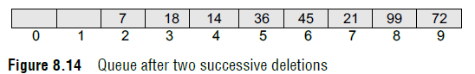
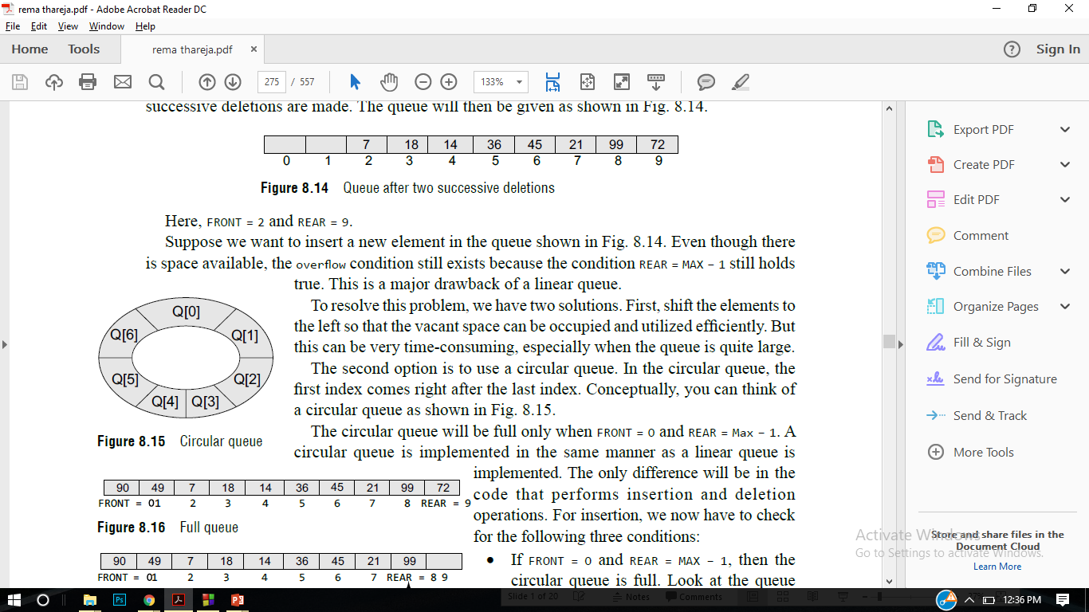
Circular Queue
If you want to insert another value, it will not be possible because the queue is completely full. There is no empty space where the value can be inserted. Consider a scenario in which two successive deletions are made.
front = 2 and REAR = 9.
Even though there is space available, the overflow condition still exists because the condition rear = MAX – 1 still holds true. This is a major drawback of a linear queue.
The second option is to use a circular queue. In the circular queue, the first index comes right after the last index.

Slide 39
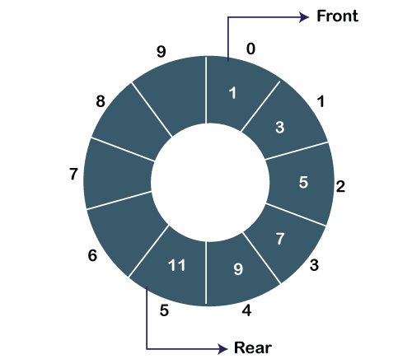
Circular Queue
In Circular Queue, all the nodes are represented as circular. It is similar to the linear Queue except that the last element of the queue is connected to the first element. It is also known as Ring Buffer as all the ends are connected to another end. The circular queue can be represented as:

Slide 40
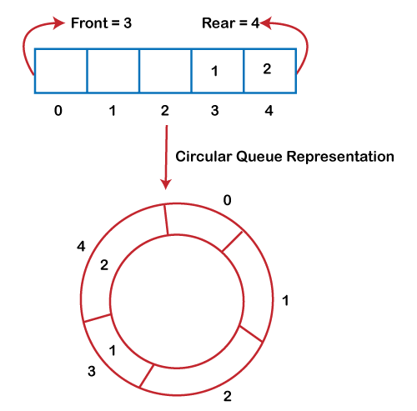

Slide 41
The drawback that occurs in a linear queue is overcome by using the circular queue. If the empty space is available in a circular queue, the new element can be added in an empty space by simply incrementing the value of rear.

Slide 42
Applications of Circular Queue
The circular Queue can be used in the following scenarios:
Memory management: The circular queue provides memory management. As we have already seen that in linear queue, the memory is not managed very efficiently. But in case of a circular queue, the memory is managed efficiently by placing the elements in a location which is unused.
CPU Scheduling: The operating system also uses the circular queue to insert the processes and then execute them.(Round Robin algorithm )
Traffic system: In a computer-control traffic system, traffic light is one of the best examples of the circular queue. Each light of traffic light gets ON one by one after every jinterval of time. Like red light gets ON for one minute then yellow light for one minute and then green light. After green light, the red light gets ON.

Slide 43
Applications of Circular Queue
The circular Queue can be used in the following scenarios:
Memory management: The circular queue provides memory management. As we have already seen that in linear queue, the memory is not managed very efficiently. But in case of a circular queue, the memory is managed efficiently by placing the elements in a location which is unused.
CPU Scheduling: The operating system also uses the circular queue to insert the processes and then execute them.
Traffic system: In a computer-control traffic system, traffic light is one of the best examples of the circular queue. Each light of traffic light gets ON one by one after every jinterval of time. Like red light gets ON for one minute then yellow light for one minute and then green light. After green light, the red light gets ON.

Slide 44
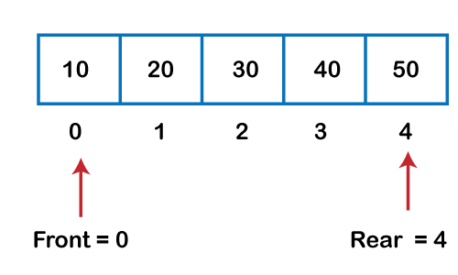
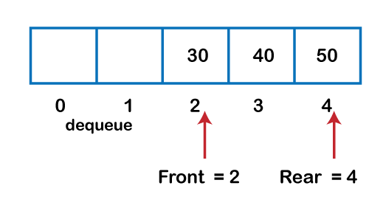

Slide 45
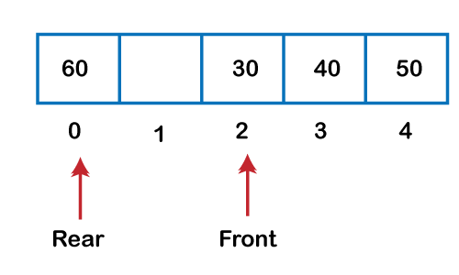
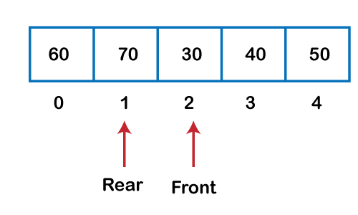

Slide 46
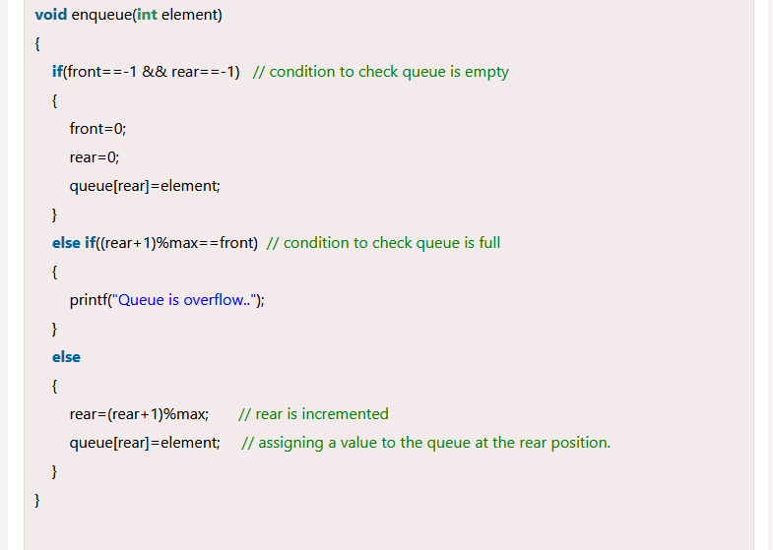

Slide 47
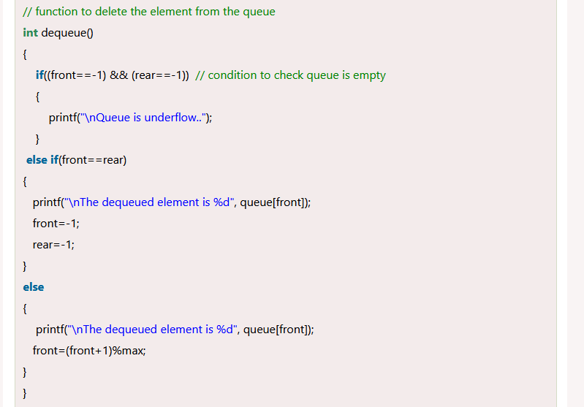

Slide 48
Circular queue linked list

Slide 49
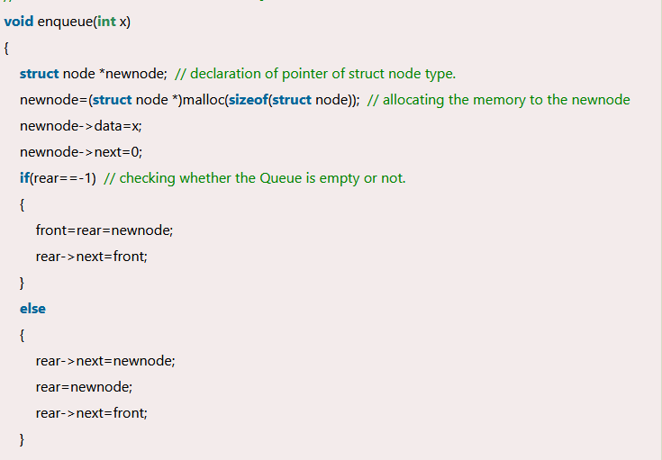

Slide 50
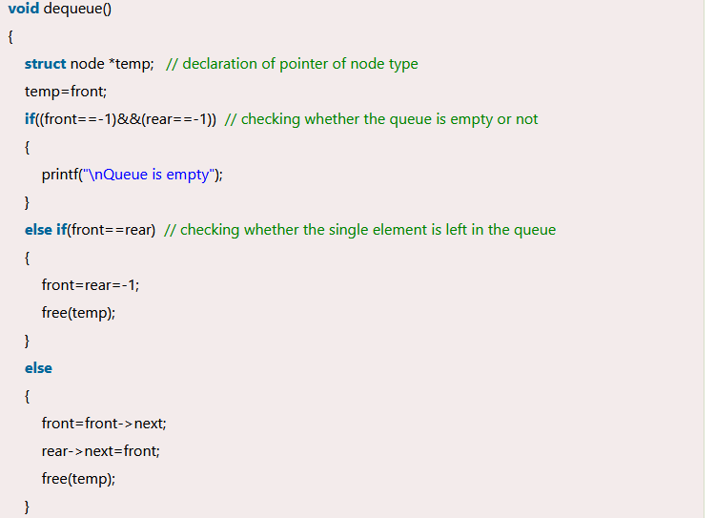

Slide 51
Thanks

