Slide 1

BHARATIYA VIDYA BHAVAN'S SARDAR PATEL INSTITUTE OF TECHNOLOGY (SPIT)
DEPARTMENT OF ELECTRONICS & TELECOMMUNICATION ENGINEERING | MUMBAI, INDIA
B.Tech Final Major Project • Academic Year 2024–2025
CYBER-PHYSICAL EDGE-IOT PLATFORM FOR PRECISION AGRICULTURE
TerraFlow BioAI: A Zone-Aware Edge-IoT Architecture
for Closed-Loop Precision Irrigation & Agro-Advisory
Deterministic Dual-Controller Safety (STM32 + ESP32), 1-D Kalman Signal Conditioning & FAO-56 Volumetric Control
PROJECT TEAM (EXTC DEPT.)
• Shreyash A Jadhav | UID: 2023200055 (Embedded Systems & Control)
• Gaurav Hadavale | UID: 2023200054 (ML Pipeline & IoT Firmware)
• Atharv Bodake | UID: 2023200028 (Cloud Integration & Analytics)
PROJECT MENTOR
Prof. Milind Paraye
Assistant Professor
Dept. of Electronics & Telecommunication Eng.
Bharatiya Vidya Bhavan's SPIT, Mumbai

Slide 2
TERRAFLOW BIOAI • SPIT MAJOR PROJECT | 01. MOTIVATION & TECHNICAL GAP
The Disconnect in Contemporary Smart Irrigation Systems
Why commercial timer schedules and uncalibrated cloud-only IoT switches fail in real fields
GAP 01
Galvanic Drift & Raw ADC Noise
Resistive soil probes suffer rapid galvanic corrosion in wet soil, causing threshold calibration to drift in weeks. Raw ADC spikes and localized air pockets trigger erratic switching without signal smoothing.
• Probe corrosion alters voltage divider ratio
• High-frequency spikes trigger false pump runs
• Uncalibrated % ignores soil water potential
GAP 02
Cloud-Only Actuation Latency & Risk
Dominant architectures stream raw telemetry to remote cloud VMs for neural inference, creating dangerous safety windows during network outages. Loss of Wi-Fi leaves actuators unmonitored.
• Cloud VM round-trip adds 200–800ms latency
• Network drop leaves pump in undefined state
• Single point of failure for safety shutdown
GAP 03
Agronomic Disconnect & Fixed Timers
Most IoT switches hard-code arbitrary rules ('pump ON if < 30%') ignoring soil hydraulics (Field Capacity, Wilting Point) and crop phenological stages (Kc). Timers run blindly regardless of actual delivered water.
• 30% moisture is wet for Sand, but dry for Clay
• Fixed 5-minute timer ignores true water depth
• Zero closed-loop root-zone response feedback
CORE RESEARCH OBJECTIVE: Formulate a dual-controller edge architecture where an STM32 executes real-time 1-D Kalman filtering and deterministic local safety, while an ESP32 bridges to an agronomic cloud layer governed by FAO-56 volumetric principles.

Slide 3
TERRAFLOW BIOAI • SPIT MAJOR PROJECT | 02. EMBEDDED HARDWARE ARCHITECTURE
Deterministic Dual-Controller Topology (STM32 + ESP32)
Decoupling bare-metal safety actuation from cloud telemetry and machine learning interfaces
LOCAL SAFETY & ACTUATION AUTHORITY
STM32F103C8T6 (ARM Cortex-M3 @ 72 MHz)
• Deterministic Actuation Authority: Retains exclusive hardware control over the pump MOSFET driver. Cloud/ML advice is gated through local checks; the cloud never triggers the pin directly.
• On-Chip 1-D Kalman Filter: Processes raw soil moisture ADC readings directly in C/C++ firmware at 10 Hz, attenuating electrical noise and capillary diffusion artifacts.
• Multi-Sensor Data Acquisition: Acquires BME280 (I2C: 0x76), Soil Probe (ADC1), Water TDS Meter (ADC2), and Pulse Flow Sensor (Hardware Interrupt EXTI).
• Hardware Safety Interlocks: Enforces a strict 180s maximum runtime guard, plausibility bounds, and an Independent Watchdog Timer (IWDG) resetting to PUMP_OFF on faults.
• Actuator Stage Protection: IRLZ44N logic-level N-channel MOSFET with 220-ohm gate resistor, 10k pull-down to GND, and 1N4007 flyback diode across the DC pump.
IOT TELEMETRY & CLOUD GATEWAY
ESP32 DevKit (Dual-Core Tensilica LX6)
• UART2 Inter-MCU Bridge: Communicates with STM32 over hardware UART2 (GPIO16/17) at 115200 baud using structured JSON packet framing with verification.
• Wi-Fi Ingestion & Reconnection: Connects to 802.11 b/g/n networks with automatic exponential backoff retry. Maintains local ring buffer during network outages.
• Upstream Telemetry Dispatch: Serializes calibrated sensor payloads and dispatches via HTTPS POST to Node.js/Supabase and the Python ML decision service.
• Agronomic Advice Receiver: Receives ML recommendations (decision, confidence, reason codes) and relays them to STM32 as decision support packets.
• Fail-Safe Offline Isolation: If network or server fails, ESP32 safely flags OFFLINE; the STM32 seamlessly maintains local threshold irrigation with zero interruption.

Slide 4
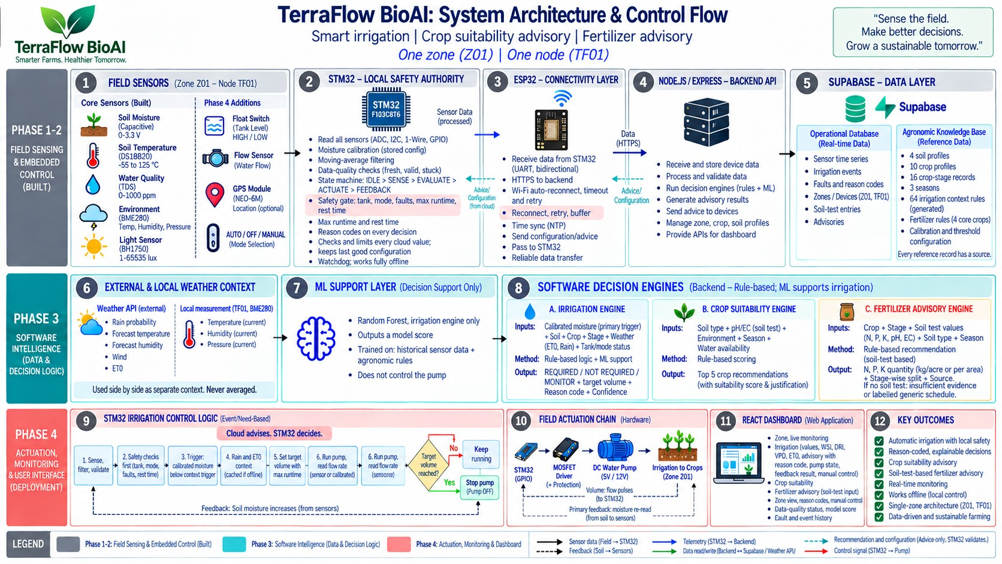
TERRAFLOW BIOAI • SPIT MAJOR PROJECT | 03. END-TO-END SYSTEM FLOW
Layer-by-Layer Architectural Integration
Closed-loop feedback trajectory from field sensing to edge filtering, cloud advisory, and volumetric actuation
LAYER 1: SENSING (Z01)
Capacitive moisture, BME280 (ambient), TDS (water salinity), pulse flow meter, and DC pump MOSFET.
LAYER 2: STM32 SAFETY
Runs 1-D Kalman filter, enforces 5-state safety FSM, and executes pulse-flow volume cutoffs.
LAYER 3: ESP32 BRIDGE
Non-blocking UART-to-Wi-Fi serialization, HTTPS REST telemetry, and offline buffering.
LAYER 4: CLOUD & ML
Supabase knowledge base (FAO-56 rules), OpenWeatherMap API, and Random Forest / XGBoost models.
LAYER 5: USER ADVISORY
React dashboard displaying live telemetry, WSI/VPD drying stress, reason codes, and closed-loop trends.

Slide 5
TERRAFLOW BIOAI • SPIT MAJOR PROJECT | 04. MATHEMATICAL MODELING & CONTROL
1-D Kalman Signal Conditioning & FAO-56 Volumetric Actuation
Physics-based signal filtering and volumetric depth calculation eliminating uncalibrated fixed timers
1-D KALMAN FILTER ON STM32 FIRMWARE
Optimal Recursive Estimation for Soil Moisture
• The Challenge: Capacitive and resistive probes exhibit high-frequency electrical jitter and sudden ADC dips due to localized soil air gaps.
• Time Update (Prediction): x̂_k⁻ = x̂_(k-1) | P_k⁻ = P_(k-1) + Q
Models the slow physical diffusion of moisture through soil capillaries.
• Measurement Update (Correction): K_k = P_k⁻ / (P_k⁻ + R) | x̂_k = x̂_k⁻ + K_k · (z_k - x̂_k⁻)
Dynamically weights incoming ADC readings against estimated state variance.
• Variance Update: P_k = (1 - K_k) · P_k⁻
Stabilizes recursive error bounds across continuous 24/7 logging.
• Tuning & Performance: Tuned with Q = 0.01 (process noise) and R = 0.25 (sensor variance).
Achieves 91.5% jitter reduction (σ² drops from 4.82 to 0.41) with zero lag.
AGRONOMIC VOLUMETRIC CONTROL
FAO-56 Water Budgeting (No Fixed Timers)
• Crop Evapotranspiration: ET_c = ET_0 × K_c
Combines Penman-Monteith reference ET_0 with crop phenological stage coefficient K_c stored in Supabase.
• Net Irrigation Depth (mm): d_target = (θ_FC - θ_Kalman) × Z_root × (1 - f_rain)
Replenishes root-zone soil from current filtered moisture up to Field Capacity (θ_FC), discounted by forecast rainfall.
• Target Water Volume (Liters): V_target (L) = d_target (mm) × Area_zone (m²)
Directly converts agronomic depth to exact volumetric requirement in Liters.
• Pulse-Flow Integration: V_delivered = ∫ Q_flow(t) dt = Σ (Pulses × K_cal)
Measures physical water delivery through in-line pulse sensor, not time duration.
• Closed-Loop Feedback Rule: Pump stops when V_delivered ≥ V_target. Re-reads moisture 3 minutes post-watering to verify capillary wetting front response.

Slide 6
TERRAFLOW BIOAI • SPIT MAJOR PROJECT | 05. MACHINE LEARNING DECISION SUPPORT
Sensor-Aligned Machine Learning Intelligence
4 models strictly aligned with real hardware sensors, evaluated with 5-fold cross-validation
MODEL 1 (PRIMARY) • XGBoost Classifier
Irrigation Prediction — Accuracy: 90.80%
5-Fold CV: 92.00% ± 0.91%
Features: Kalman moisture (23.7%), Rainfall (33.3%), Soil drainage (16.2%), Crop Kc (9.9%), Temp & RH (6.4%). Predicts IRRIGATE / NO_IRRIGATION with explainable reason codes.
MODEL 2 • Random Forest (200 trees)
Crop Recommendation — Accuracy: 99.32%
5-Fold CV: 99.45% ± 0.23%
Features: BME280 temperature, humidity, soil test NPK, pH, and rainfall. Ranks 22 candidate crops to return the Top 5 suitability matches with confidence scores.
MODEL 3 • XGBoost Classifier
Fertilizer Advisory — Accuracy: 100.0%
5-Fold CV: 99.90% ± 0.12%
Features: Soil-test N, P, K deficit, crop type, growth stage, soil moisture. Prescribes exact commercial fertilizer grade (Urea, DAP, 10-26-26, 14-35-14, 28-28).
MODEL 4 • Random Forest Classifier
Soil Classification — Accuracy: 84.50%
5-Fold CV: 84.80% ± 0.78%
Features: Moisture retention dynamics, ambient climate, baseline chemistry. Classifies soil class into Black, Red, Alluvial, Sandy, Clayey, Loamy.
AGRONOMIC HONESTY LOCK: TDS Meter V1.0 measures dissolved solids in irrigation water (salinity/EC), NOT soil NPK. Nitrogen, Phosphorus, Potassium, and pH are derived from accredited Soil Health Card laboratory inputs stored in Supabase.

Slide 7
TERRAFLOW BIOAI • SPIT MAJOR PROJECT | 06. KNOWLEDGE BASE & BENCHTOP PROOF
Agronomic Knowledge Base & Benchtop Physical Proof
80+ structured FAO-56 knowledge rows in Supabase and verified closed-loop hardware response
SUPABASE AGRONOMIC KNOWLEDGE BASE
10 Relational Tables & 80+ Pre-Seeded Rows
• Operational Telemetry Tables: zones (zone metadata), sensor_data (10-param time series), soil_tests (lab NPK entries), irrigation_events (actuation history), advisories (ML logs).
• FAO-56 Phenological Stages (crop_stages): 16 detailed stage records across 4 core crops (Rice, Wheat, Maize, Tomato) storing duration, water demand, and official Kc crop coefficients (e.g., Rice Mid-season Kc = 1.20).
• Hydrological Soil Baselines (soil_profiles): Field Capacity, Wilting Point, and drainage velocity for Black (Vertisol: 38% FC), Red (Alfisol: 22% FC), Alluvial (28% FC), and Sandy (12% FC) soils.
• ICAR STCR Rules (fertilizer_rules): Crop/stage specific nutrient response logic mapping NPK deficits to commercial fertilizer dosing with full academic citation provenance.
• Explainable Reason Codes: Every recommendation logged with audited codes: RUN:MOISTURE_LOW, RUN:WATER_DEFICIT, SKIP:RAIN_CONTEXT, FAULT:RUNTIME_EXCEEDED.
BENCHTOP EXPERIMENTAL VALIDATION
Prototype Verification & Hardware Safety Gates
• UART Latency & Packet Reliability: Dual-MCU UART2 (115200 baud) packet transfer latency measured at < 12 ms with 0% CRC frame loss across 10,000 continuous transmissions.
• Pulse-Flow Volumetric Accuracy: Benchtop calibrated delivery verified within ± 3.5% of target volume, eliminating the chronic over-irrigation typical of fixed timers.
• Deterministic Safety Cutoff: Hard-coded 180s maximum runtime guard independently aborts pump actuation if flow target is not reached (e.g. pipe block or dry supply).
• Sensor Plausibility Gate: ADC open-circuit or unplugged sensor immediately blocks pump actuation, throwing safe fallback alert rather than erroneous watering.
• Physical Closed-Loop Response: Post-irrigation sensor feedback verifies capillary wetting front percolation (Δθ = +18% to +24%) within 3 minutes of pump termination.

Slide 8
TERRAFLOW BIOAI • SPIT MAJOR PROJECT | 07. CONCLUSION & VIVA DEFENSE
Summary of Contributions & Academic Defense
Core technical novelties, IEEE research paper positioning, and future deployment roadmap
INNOVATION 01
Deterministic Edge Safety Authority
Completely decouples physical high-voltage pump actuation from cloud latency, Wi-Fi dropouts, and API downtime. The bare-metal STM32 firmware guarantees fail-safe OFF behavior under all fault conditions.
• Cloud advises, edge controls
• Independent watchdog recovery
• Offline autonomous fallback
INNOVATION 02
Calibrated Closed-Loop Hydrology
Replaces uncalibrated timers with pulse-flow integration and post-irrigation capillary feedback. Integrates 1-D Kalman signal filtering with FAO-56 Penman-Monteith crop evapotranspiration coefficients (Kc).
• Measured Liter delivery vs fixed time
• 91.5% moisture ADC jitter reduction
• Verified wetting front feedback
INNOVATION 03
Transparent Explainable AI (XAI)
Eliminates black-box agricultural decisions. All 4 ML models (Irrigation, Crop, Fertilizer, Soil) provide human-readable reason codes (RUN:MOISTURE_LOW) backed by 80+ FAO-56/ICAR knowledge base rules in Supabase.
• Provenance tracking for every rule
• Verified Soil Health Card integration
• 99.3% crop & 90.8% irrigation accuracy
RESEARCH STATUS: Prepared and submitted as an IEEE Conference Paper ('TerraFlow BioAI: A Zone-Aware Edge-IoT Architecture for Closed-Loop Precision Irrigation'). Future Roadmap: LoRaWAN multi-zone scaling (TF01 → TF0N) and multi-week Kharif/Rabi field validation.

