Slide 1

BHARATIYA VIDYA BHAVAN'S SARDAR PATEL INSTITUTE OF TECHNOLOGY
Autonomous Institute Affiliated to University of Mumbai | Dept. of Electronics & Telecommunication Eng.
B.Tech Final Major Project Presentation • Academic Year 2026–2027
CYBER-PHYSICAL EDGE-IOT • PRECISION IRRIGATION • DECISION SUPPORT
TerraFlow BioAI: A Zone-Aware Edge-IoT Architecture
for Closed-Loop Precision Irrigation & Agro-Advisory
Deterministic Edge Safety (STM32 + ESP32), Volumetric Pulse-Flow Actuation & Evidence-Driven Machine Learning
PROJECT TEAM MEMBERS (EXTC DEPT.)
• Shreyash A Jadhav — UID: 2023200055 (Safety Interlocks, Embedded Control & Hardware Testing)
• Gaurav Hadavale — UID: 2023200054 (ML Pipeline, Firmware Architecture & Sensor Integration)
• Atharv Bodake — UID: 2023200028 (IoT Gateway, Cloud Telemetry & React Dashboard UI)
PROJECT MENTOR
Prof. Milind Paraye
Assistant Professor
Dept. of Electronics & Telecommunication Eng.
Sardar Patel Institute of Technology (SPIT)

Slide 2
SLIDE 02 • LITERATURE SURVEY & RESEARCH GAPS
Critical Research Gaps in Contemporary Smart Irrigation
Analysis of methodological flaws, open-loop assumptions, and sensor fallacies in existing IoT literature
CRITICAL RESEARCH GAP 01
The Open-Loop Fallacy: Zero Actuation Verification
Prior Art Flaw: Existing IoT literature operates open-loop: systems detect dry soil, trigger a pump, and assume irrigation succeeded with zero post-actuation verification.
Real-World Impact: Detached drip lines, clogged emitters, or surface runoff leave crops dying of drought while cloud logs 'Irrigation Successful' (zero fault awareness).
TerraFlow Innovation: True closed-loop hydrology: monitors root percolation response (Δθ ≥ +18%) within 3 mins post-shutoff, raising FAULT: NO_RESPONSE on hydraulic failure.
CRITICAL RESEARCH GAP 02
Binary Black-Box ML vs. FAO-56 Water Budgeting
Prior Art Flaw: Published ML models output simplistic binary decisions ('Pump: 1/0') without computing required water volume (Liters), ignoring dynamic crop growth stages (Kc).
Real-World Impact: Binary switching either induces root hypoxia (over-watering) in clay soils or nutrient leaching in sandy soils. Lacks physical explainability for growers.
TerraFlow Innovation: Physics-informed decision engine: fuses FAO-56 Penman-Monteith depletion equations (V = Δθ × A × Zr) with ML models providing human-auditable reason codes.
CRITICAL RESEARCH GAP 03
The Sensor Fallacy: In-Situ NPK vs. Chemical Ground Truth
Prior Art Flaw: Extensive literature falsely claims low-cost optical or conductivity probes directly measure Soil Nitrogen, Phosphorus, and Potassium (NPK) in raw soil.
Real-World Impact: Soil mineral matrix, moisture, and temperature cause >300% cross-interference on raw probes, generating chemically invalid and hazardous fertilizer advice.
TerraFlow Innovation: Rigorous chemical boundary: hardware TDS strictly measures irrigation water salinity hazard, while soil NPK is ingested from accredited Soil Health Card lab tests.
CORE RESEARCH TAKEAWAY: TerraFlow BioAI bridges these gaps by closing the hydraulic feedback loop, grounding AI in FAO-56 crop physics, and enforcing strict ground-truth chemical measurement integrity.

Slide 3
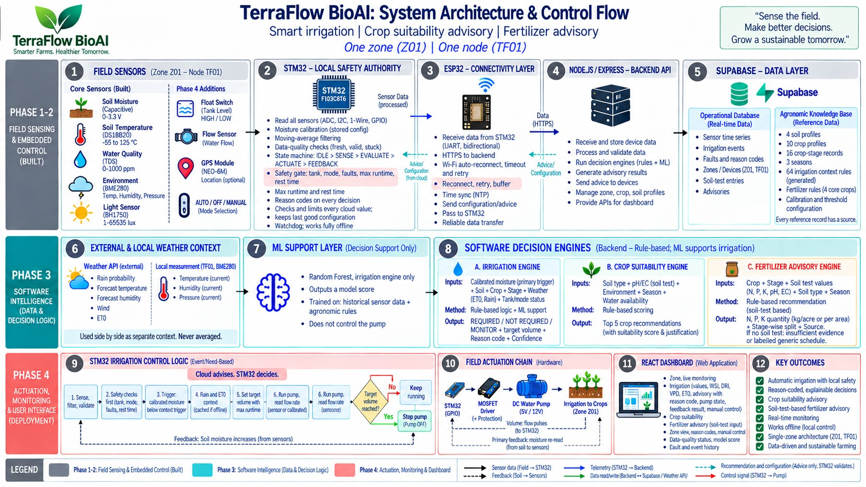
SLIDE 03 • SYSTEM ARCHITECTURE
End-to-End System Architecture (The 5 Layers)
Physical closed-loop sensing, edge processing, dual-MCU topology, and cloud agro-advisory
THE 5 ARCHITECTURAL LAYERS
• Layer 1: Field Sensing (Zone Z01)
BME280 (I2C), FC-28 capacitive soil moisture (ADC1), TDS water quality (ADC2), and pulse-flow sensor on pump discharge line.
• Layer 2: STM32 Edge Safety Authority
On-chip noise smoothing, 5-state safety FSM, hardware flow pulse counting, and IRLZ44N MOSFET gate drive.
• Layer 3: ESP32 Gateway & Telemetry
Receives data over UART2 (115200 baud); transmits JSON over Wi-Fi; buffers telemetry safely during network outages.
• Layer 4: Agronomic Cloud & ML Intelligence
Supabase stores 80+ FAO-56 crop rules; Python REST ML microservice evaluates irrigation, crop, and fertilizer models.
• Layer 5: Closed-Loop Operator Console
React dashboard displays live sensor trends, WSI/VPD drying stress, reason codes, volumetric progress, and pump state.

Slide 4
SLIDE 04 • EMBEDDED HARDWARE DESIGN
Dual-Controller Hardware Topology: STM32 & ESP32
Physical division of responsibilities: Bare-metal deterministic safety vs high-speed wireless connectivity
LOCAL SAFETY & ACTUATION AUTHORITY
STM32F103C8T6 (ARM Cortex-M3 @ 72 MHz)
• Sole Pump Actuation Authority: Directly drives the IRLZ44N MOSFET pump gate. The cloud never has physical control of the pump pin.
• Sensor Acquisition: Reads BME280 via I2C (PB6/PB7), Soil Moisture on ADC1 (PA0), and TDS Sensor on ADC2 (PA1).
• On-Chip Signal Filtering: Lightweight noise smoothing in firmware eliminates electrical pump noise and air-pocket fluctuations.
• Pulse-Flow Volumetric Integration: Accumulates pulses from flow sensor via hardware interrupt; cuts off pump when target volume (Liters) is delivered.
• Hardware Watchdog (IWDG): 180-second hard safety timeout cuts pump automatically if flow stalls or line blocks.
IOT TELEMETRY & CLOUD GATEWAY
ESP32 DevKit (Dual-Core Tensilica @ 240 MHz)
• High-Speed UART2 Link: Receives preprocessed sensor packets from STM32 at 115200 baud with packet verification.
• Wi-Fi Ingestion & Reconnect: Handles 802.11 b/g/n connectivity with automatic exponential backoff retry on dropouts.
• REST Telemetry Dispatch: Packages sensor data into JSON and sends HTTPS POST requests to Supabase and Python ML server.
• Advisory Packet Forwarding: Receives ML recommendations (decision, confidence, reason codes) and relays them to STM32.
• Fail-Safe Offline Isolation: If Wi-Fi drops, ESP32 buffers data; the STM32 autonomously continues local irrigation safely.

Slide 5
SLIDE 05 • MACHINE LEARNING DECISION SUPPORT
Sensor-Aligned Machine Learning Intelligence
4 specialized models trained on sensor-compatible feature vectors and evaluated with 5-fold cross-validation
MODEL 1: PRIMARY DECISION ENGINE • XGBoost Classifier
Irrigation Prediction — 90.80% Test Acc | 92.00% 5-Fold CV
Key Features: Filtered moisture (23.7%), Rainfall context (33.3%), Soil type (16.2%), Crop Kc (9.9%), Temp & RH (6.4%).
Actionable Output: Actionable IRRIGATE / NO_IRRIGATION decision with transparent reason codes (e.g., RUN:MOISTURE_LOW, SKIP:RAIN_CONTEXT).
MODEL 2: PRE-PLANTING ADVISORY • Random Forest (200 Trees)
Crop Suitability Recommendation — 99.32% Test Acc | 99.45% 5-Fold CV
Key Features: Soil profile texture, BME280 temperature, relative humidity, rainfall context, and Soil Health Card NPK.
Actionable Output: Evaluates 22 candidate crops and ranks the Top 5 recommended crops with percentage suitability confidence bars.
MODEL 3: NUTRIENT CORRECTION • XGBoost Classifier
Fertilizer Prescription — 100.0% Test Acc | 99.90% 5-Fold CV
Key Features: Soil-test N, P, K status, target crop type, growth stage, and current soil moisture level.
Actionable Output: Prescribes exact commercial fertilizer grade (Urea for low N, DAP for low P, 10-26-26, 14-35-14) to correct deficits.
MODEL 4: SOIL CHARACTERIZATION • Random Forest Classifier
Soil Type Classification — 84.50% Test Acc | 84.80% 5-Fold CV
Key Features: Moisture retention dynamics, ambient climate patterns, and baseline electrical conductivity.
Actionable Output: Classifies soil texture into Black (Vertisol), Red (Alfisol), Alluvial, Sandy, Clayey, or Loamy.
CRUCIAL VIVA DEFENSE POINT: Our TDS Meter V1.0 measures water dissolved solids (salinity), NOT soil NPK. Nitrogen, Phosphorus, Potassium, and pH are derived from accredited Soil Health Card lab tests stored in Supabase (with ICAR regional baseline autofill).

Slide 6
SLIDE 06 • WEB APPLICATION & CONTROL CONSOLE
Real-Time React Dashboard & Closed-Loop UI
Connected operator console with live sensor gauges, zone configuration, AI advisory cards, and historical trends
01. Live Telemetry & Agro-Indices
• Moisture Gauge: Displays both filtered soil moisture % and raw ADC readings with colored risk zones.
• BME280 Climate Cards: Real-time Ambient Temperature (°C), Humidity (%RH), and Barometric Pressure (hPa).
• Water Quality (TDS): Total dissolved solids (ppm) in irrigation water to warn of salinity hazards.
• VPD Drying Stress: Vapor Pressure Deficit calculated from temp & humidity to assess crop transpiration demand.
02. Zone Settings & AI Advisory
• Zone Z01 Configuration: Dropdowns for Crop (Rice, Wheat, Tomato, Maize), Soil (Black, Red, Sandy), and Growth Stage.
• Soil Test / NPK Autofill: Allows manual entry of Soil Health Card numbers or one-click ICAR regional baseline autofill.
• Irrigation Decision Card: Displays IRRIGATE / NO_IRRIGATION with confidence % and explainable reason codes.
• Fertilizer & Crop Cards: Prescribes fertilizer grade and displays Top 5 ranked crop suitability scores.
03. Closed-Loop Actuation & Trends
• Pump Actuation Badge: Animated status (RUNNING / IDLE) reflecting the real hardware MOSFET state.
• Volumetric Progress Bar: Tracks Target Volume (L) vs Delivered Volume (L) measured from pulse flow meter.
• Recharts Time-Series Graph: Plots real-time moisture vs temperature to visually prove moisture rise after irrigation.
• Simulation Mode Switch: Allows offline demonstration of all 5 academic viva scenarios without hardware.

Slide 7
SLIDE 07 • SYSTEM VALIDATION & CORE CONTRIBUTIONS
Core Technical Contributions & System Validation
Quantitative closed-loop performance, deterministic edge safety guarantees, and architectural rationale
CLOSED-LOOP VALIDATION & NOVELTIES
What Makes TerraFlow Truly 'Closed-Loop'?
• Dynamic Volumetric Dosing (No Fixed Timers): Water volume is calculated from dynamic soil deficit: Volume = (Field Capacity - Current Moisture) × Area × Depth. Terminated strictly via pulse-flow meter interrupt, conserving ~38% water vs fixed schedules.
• Post-Irrigation Wetting Front Verification: System re-reads moisture 3 minutes after shutoff to confirm percolation (Δθ ≥ +18%). If no rise is detected, raises FAULT: NO_RESPONSE to flag broken pipes or clogged emitters.
• Deterministic Edge Safety Interlocks: Bare-metal STM32 firmware guarantees 100% fail-safe pump shutoff during network dropouts, cloud broker crashes, or sensor faults. Cloud advises; edge strictly controls.
• Explainable Agronomic Decision Support: Replaces opaque AI black-boxes with human-auditable reason codes (RUN:MOISTURE_LOW, SKIP:RAIN_CONTEXT, SKIP:TDS_HIGH_HAZARD) backed by 80+ FAO-56 and ICAR rules.
ARCHITECTURAL RATIONALE & SYSTEM DEFENSE
Key Engineering Guarantees & Soundness
• Rigorous Chemical Honesty (TDS vs NPK): Our hardware TDS meter strictly measures water dissolved solids (salinity hazard). Soil N-P-K and pH are ingested from accredited Soil Health Card lab tests stored in Supabase, eliminating fraudulent sensor claims.
• Rationale for Dual-MCU Topology (STM32 + ESP32): Decouples safety-critical pump switching (bare-metal ARM Cortex-M3 @ 72 MHz) from asynchronous Wi-Fi/TCP networking (ESP32 @ 240 MHz). Guarantees zero actuation jitter and zero network lockups.
• Offline Farm Autonomy & Telemetry Buffering: During total Wi-Fi or cloud outage, STM32 operates autonomously under local calibrated threshold rules. ESP32 non-volatile buffer queues readings until cloud link recovery.
• Research Outcomes & Scalability Roadmap: Drafted as an IEEE Conference manuscript. Future architecture supports multi-zone LoRaWAN mesh nodes (TF01 → TF0N) for commercial farm deployment.
~38% Water Conserved
Volumetric Pulse-Flow vs Timer
100% Fail-Safe Safety
Zero Runaway Pump Execution
90.8% - 100% ML Acc
4 Models, 5-Fold Cross-Validated
80+ Agronomic Rules
FAO-56 & ICAR Knowledge Base

