Slide 1
PAN INDIAN MODEL TO PREDICT RAINFALL
BY : GAURAV CHOUDHARY
MENTOR: DR UPASANA TALUKDAR

Slide 2
PROBLEM STATEMENT
Accurate rainfall prediction is critical for various sectors, including agriculture, water management, and disaster preparedness. Traditional meteorological approaches used by IMD often rely on statistical models, which, while effective, can be limited in their ability to capture complex patterns in data, especially in non-linear time series.

Slide 3
DATA OVERVIEW
AGROMET data is used from 38 location in india that provides:
RAINFALL
SUNSHINE HOURS
MAX/MIN TEMP
WINDSPEED MEASUREMENT (1,2,3,4)
RELATIVE HUMIDITY (1,2)

Slide 4
DATA OVERVIEW
CORRELATIONS (THE CURRENT IMD model has similar CC)
MTMP (Mean Temperature): 0.45
WSM1 (Wind Speed Measurement 1): 0.38
WSM2 (Wind Speed Measurement 2): 0.33
WSM3 (Wind Speed Measurement 3): 0.31
WSM4 (Wind Speed Measurement 4): 0.27

Slide 5
INITIAL MODEL
Categorical model that takes previous rf data using LSTM
Accuracy : .982
But the same result is not seen when the amount of rainfall is being predicted.
MEAN PERCENTAGE ERROR > 250 %
For comparison imd stastical model has less than 8% error.

Slide 6
CHALLENGES
DATA VARIETY
CORRELATION COEFFICIENT
NO CONNECTION BETWEEN STATIONS
OUTSIDE INFLUENCE

Slide 7
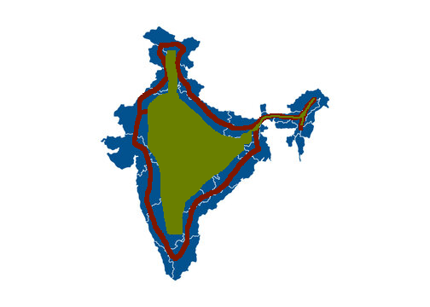
SOLUTIONS
DIVIDING STATION INTO OUTER AND INNER
OUTER : RAINFALL, TEMP, WINDSPEED
INNER : RAINFALL
New variable that clusters using geo location.

Slide 8
SOLUTIONS
PROCEDURE TO PROCURE RAINFALL DATA OF OVER 150 STATIONS IN CURRENT PIPELINE.
CURRENTLY RESEARCHING THE OUTSIDE INFLUENCE WHICH SHOULD BE TAKEN IN ACCOUNT.

Slide 9
ANY QUESTIONS

