Slide 1
“ nurse scheduling problem using Quantum Annealing” presented by: Aman Azeem (2101026) guidance under: Dr. Nilotpal Chakraborty

Slide 2
A brief Introduction to Quantum Computing
Quantum computing is a rapidly emerging technology that utilizes the principles of quantum mechanics to perform computations. Unlike classical computers that use bits to represent information as either 0 or 1, quantum computers use qubits, which can represent both 0 and 1 simultaneously due to a phenomenon called superposition.
This allows Quantum Computers to process information in parallel through multiple states (For n bits, no of states is 2^n). This makes quantum computers several million times more powerful than current generation computers/laptops.

Slide 3
Nurse Scheduling Problem
The Nurse Scheduling Problem (NSP) is a well-known optimization problem in the field of operations research and scheduling. It involves assigning shifts to a group of nurses over a specified time period while satisfying various constraints and objectives. The goal is to create an efficient and fair schedule that meets the staffing requirements of a healthcare facility, minimizes costs, and ensures that each nurse is assigned a reasonable workload.

Slide 4
The key elements and challenges of the Nurse Scheduling Problem include:
Shifts and Workload: The problem typically involves different types of shifts (e.g., day shifts, night shifts and late night shifts) and each nurse has preferences or constraints on the types and number of shifts they are willing or allowed to work. The total workload and the distribution of shifts among nurses must be balanced.
2) Skills and Constraints: Nurses often have different skill sets or certifications, and certain shifts may require specific skills. Some constraints are listed below:
One nurse is newly qualified so, she must be paired with an experienced nurse.
Two nurses dislike each other and thus cannot work on the same shift because of that.
A nurse may not be comfortable with late-night shifts.
Certain no of nurses should be 24x7 assigned in the emergency ward.

Slide 5
e. A nurse might be taking a leave on a certain day. So, the algorithm should divide her shifts to other nurses for the respective day.
The scheduling solution must ensure that the necessary skills are present during each shift.
Fairness: Fairness considerations may be included in the objective function. For example, the schedule should aim to distribute undesirable shifts (such as night shifts) fairly among the nursing staff.
4) Costs and Optimization Objectives: The objective of the scheduling problem is often to minimize costs associated with overtime, underutilization of nurses, or other factors. This involves finding an optimal balance between meeting the demand for nursing coverage and minimizing associated costs.

Slide 6
MOTIVATION
Several mathematical models, algorithms, and software tools have been developed to address the Nurse Scheduling Problem, ranging from exact optimization techniques to heuristic approaches. The complexity of the problem can vary based on the size of the nursing staff, the number of shifts, and the specific constraints and objectives considered. Efficient nurse scheduling is crucial for maintaining a well-functioning healthcare system by ensuring that the right number of qualified nurses is available at all times.

Slide 7
Quantum Annealing and Simulated Annealing
Annealing is a technique used to make quality iron products by heating the material to a certain degree of temperature and cooling it down slowly. The iron’s mechanical characteristics are altered through heat treatment, which reduces the hardness and increases the elasticity.
Simulated annealing (SA) is a probabilistic technique whose name and idea are derived from annealing in material science.
Quantum annealing (QA) is an algorithm to solve combinatorial optimization problems mainly. Instead of using temperature to explore the problem space, Quantum Annealing uses the laws of quantum mechanics to measure the energy state.

Slide 8
Problems that can be optimized by Quantum Annealing
An Amazon delivery person needs to find the most optimal route to deliver all parcels given for the day. The objective is to find a route with the shortest distance to visit all the delivery addresses. We can treat the distance as the energy in the quantum annealing context and find the path that reaches the ground state.
We can also think of a futuristic example where multiple autonomous cars are navigated to optimize the traffic in a specific city area with heavy traffic jams. The objective is to reduce the traffic by minimizing the number of overlaps of cars taking the same route simultaneously while each car aims to optimize the travel time to a destination.

Slide 9
NURSE SCHEDULING PROBLEM
Problem Statement:
A hospital needs to schedule its nursing staff for a period of 28 days, ensuring that each shift is adequately staffed while meeting specific constraints and requirements. The goal is to minimize the total number of assigned nurses while ensuring that all shifts are covered and various constraints are satisfied.

Slide 10
Constraints:
a) no of nurses = 27
b) number of shifts in each day = 3
c) number of days in each scheduling duration = 28
d) min working days for each nurse in each scheduling duration = 7
e) max working days for each nurse in each scheduling duration = 20
f) min no of night shifts for each nurse in each scheduling duration = 4
g) max no of night shifts for each nurse in each scheduling duration = 8
types of shifts
day no no of morning shifts no of afternoon shifts no of night shifts
1 5 7 2
2 6 5 3
3 5 8 3
4 5 3 6
5 9 3 4
6 8 4 2
7 7 6 2
8 10 8 6

Slide 11
9 7 5 3
10 5 7 5
11 7 6 6
12 9 3 3
13 5 7 2
14 6 5 3
15 5 5 4
16 10 8 4
17 9 6 6
18 8 5 3
19 6 7 5
20 5 8 6
21 9 7 3
22 6 6 3
23 5 5 3
24 9 5 2
25 5 5 2
26 7 7 6
27 7 3 4
28 10 3 3

Slide 12
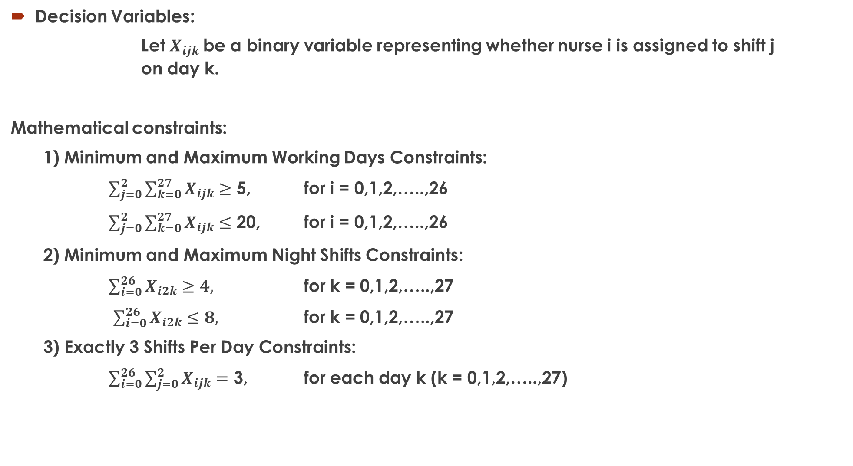
Decision Variables:
Let $X_{ijk}$be a binary variable representing whether nurse i is assigned to shift j on day k.
Mathematical constraints:
1) Minimum and Maximum Working Days Constraints:
$\sum_{j=0}^{2}{\sum_{k=0}^{27}{X_{ijk}}}$ $≥$ 5, for i = 0,1,2,…..,26
$\sum_{j=0}^{2}{\sum_{k=0}^{27}{X_{ijk}}}$ $≤$ 20, for i = 0,1,2,…..,26
2) Minimum and Maximum Night Shifts Constraints:
$\sum_{i=0}^{26}{X_{i2k}}≥4,$ for k = 0,1,2,…..,27
$\sum_{i=0}^{26}{X_{i2k}}≤8,$ for k = 0,1,2,…..,27
3) Exactly 3 Shifts Per Day Constraints:
$\sum_{i=0}^{26}{\sum_{j=0}^{2}{X_{ijk}}}$ $=$ 3, for each day k (k = 0,1,2,…..,27)
Variables | Range | Description
i | 0 to 26 | 27 nurses
j | 0 to 2 | 3 shifts per day
k | 0 to 27 | 28 days

Slide 13
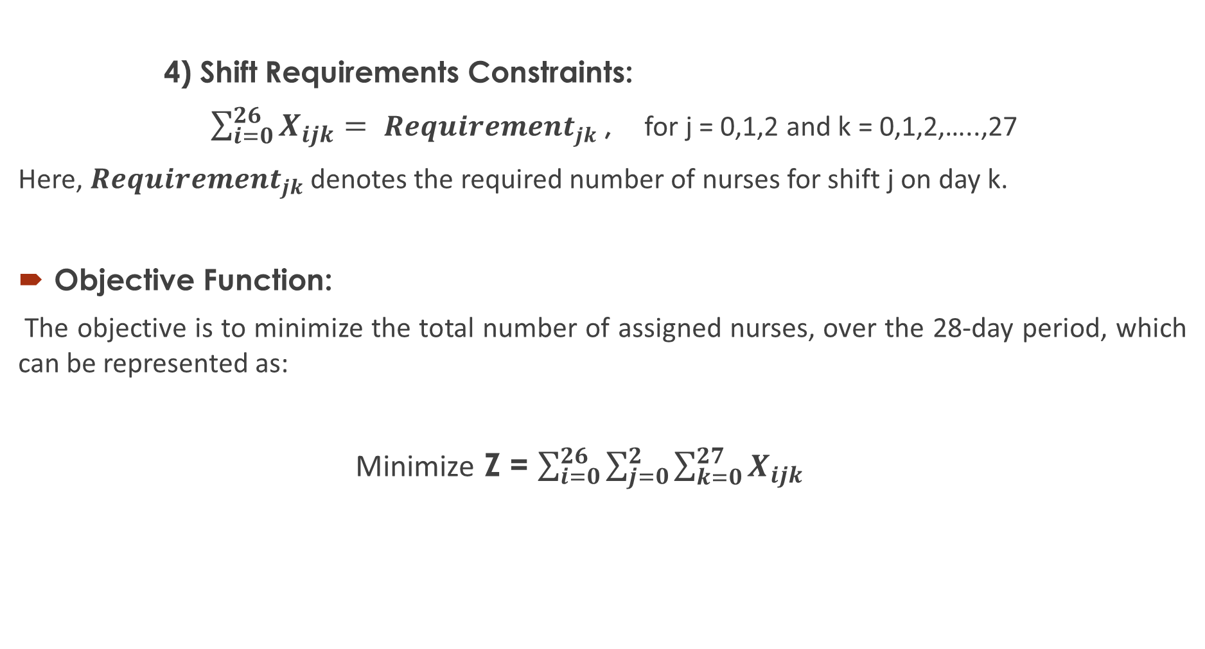
4) Shift Requirements Constraints:
$\sum_{i=0}^{26}{X_{ijk}}= {Requirement}_{jk}$, for j = 0,1,2 and k = 0,1,2,…..,27
Here, ${Requirement}_{jk}$ denotes the required number of nurses for shift j on day k.
Objective Function:
The objective is to minimize the total number of assigned nurses, over the 28-day period, which can be represented as:
Minimize Z = $\sum_{i=0}^{26}{\sum_{j=0}^{2}{\sum_{k=0}^{27}{X_{ijk}}}}$

Slide 14
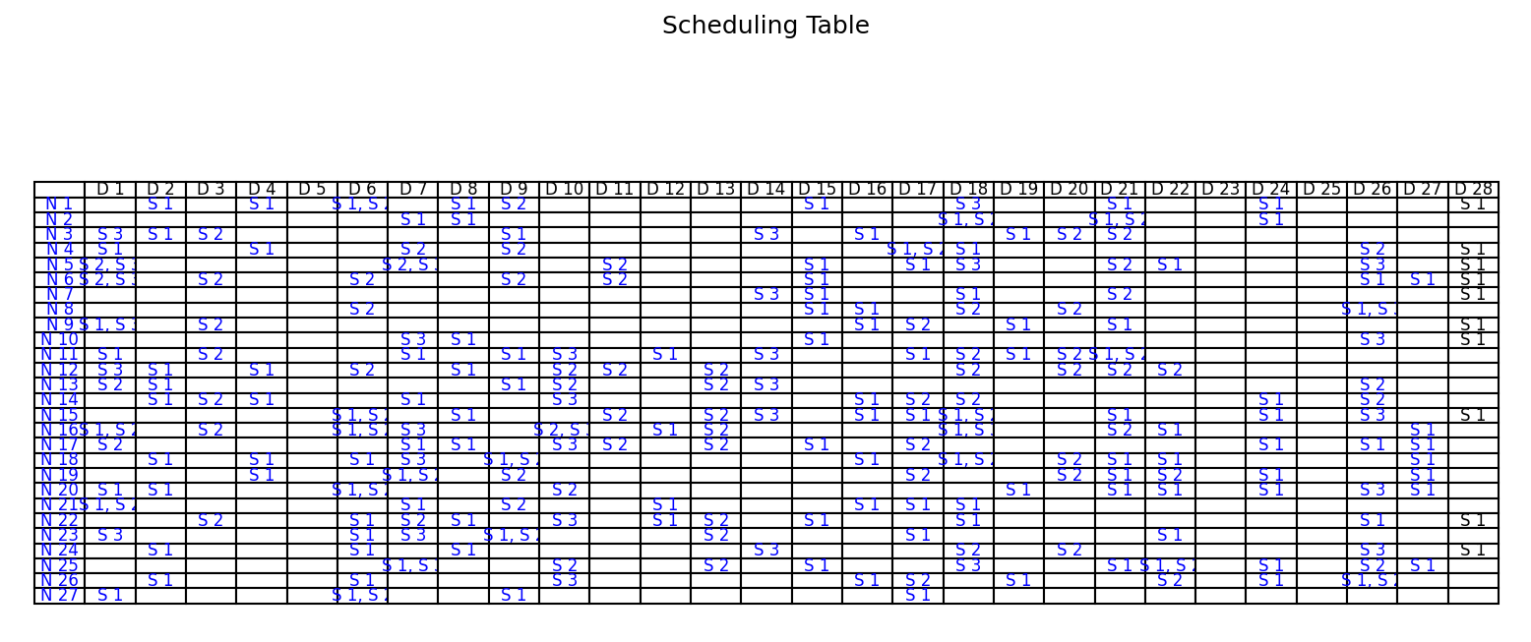
Significance of Plots:
1) Scheduling Table: Provides a detailed overview of nurse assignments for each day and shift, facilitating easy interpretation of the scheduling solution.

Slide 15
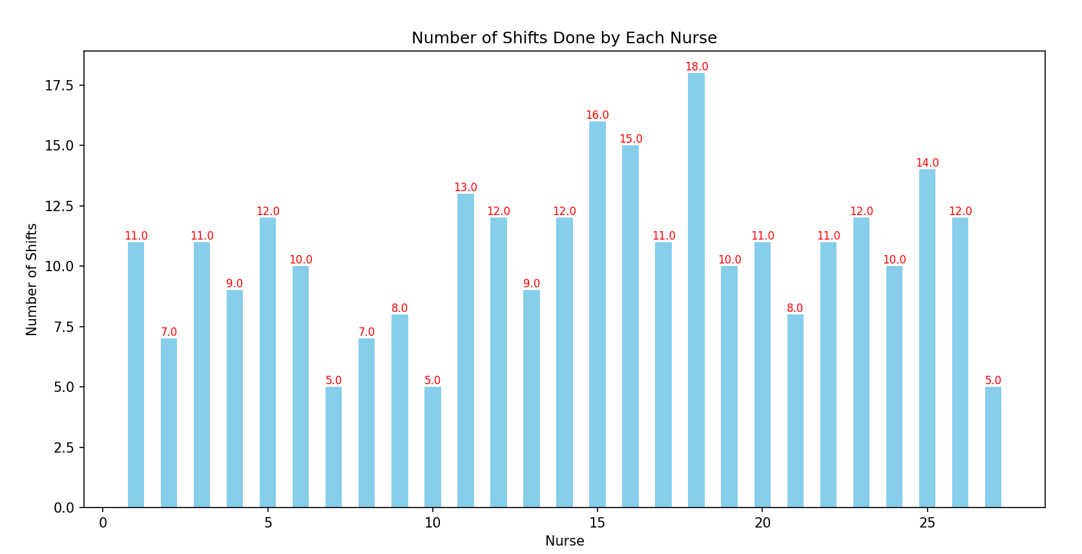
2) Bar Graph of the Number of Shifts Done by Each Nurse:
Highlights the workload distribution among nurses, identifying any disparities in the number of shifts worked.

Slide 16
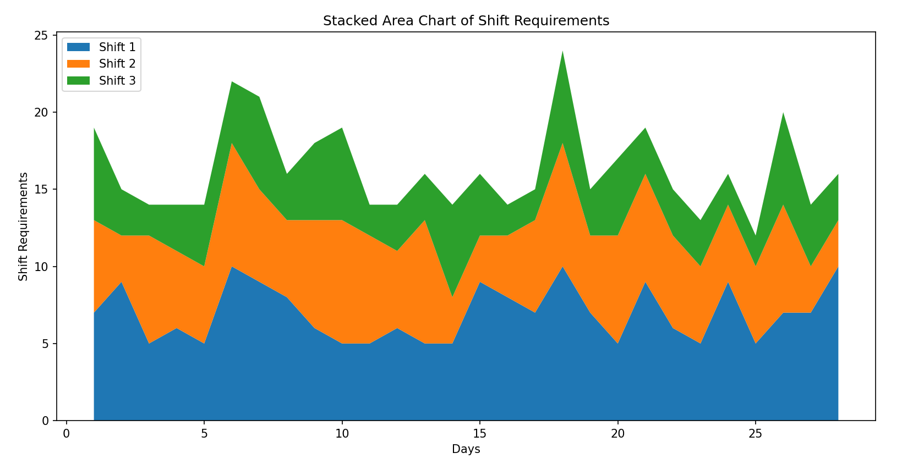
3) Stacked Area Chart of Shift Requirements:
Compares shift requirements over the 28-day period, aiding in understanding the demand for different shift types.

Slide 17
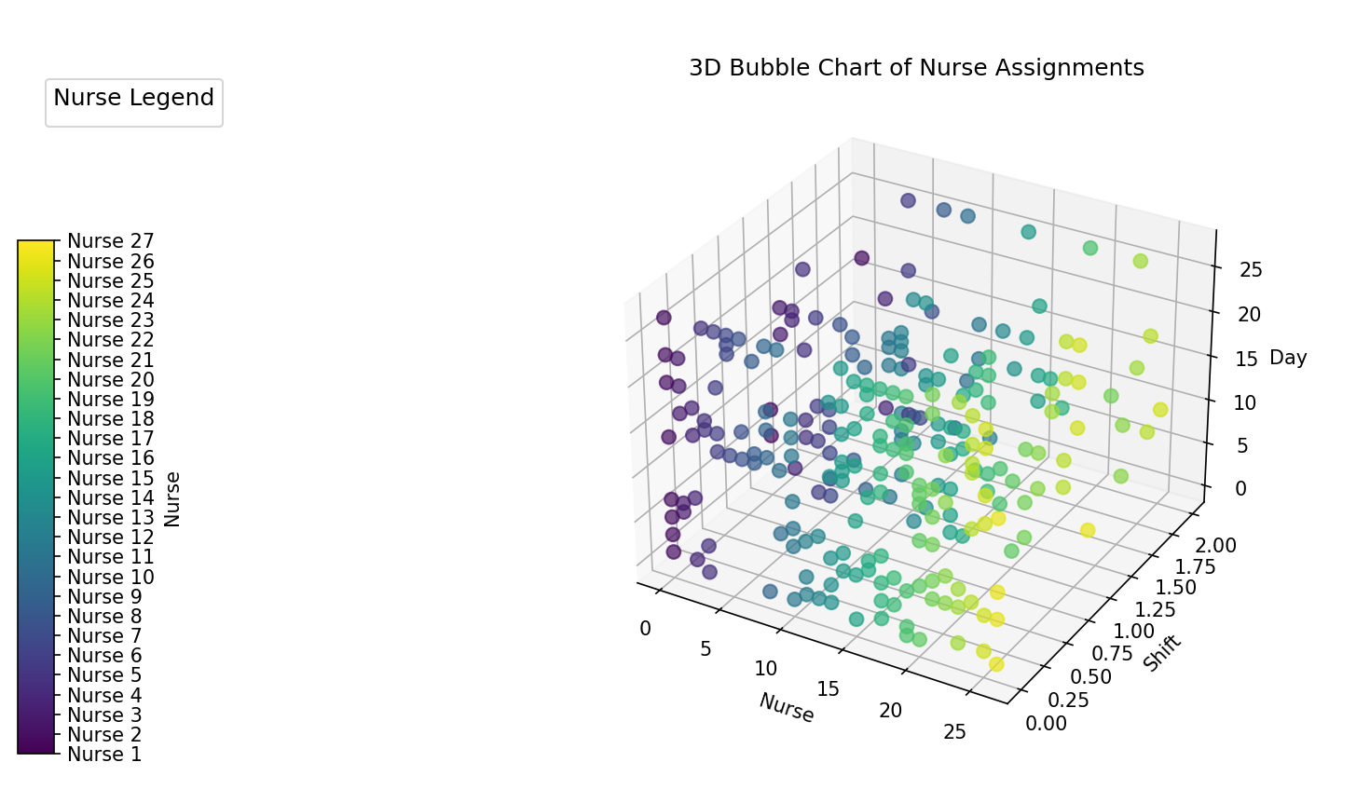
4) 3D Bubble Chart of Nurse Assignments:
Provides a comprehensive view of nurse assignments across shifts and days, allowing for easy identification of nurse allocations and coverage.

Slide 18
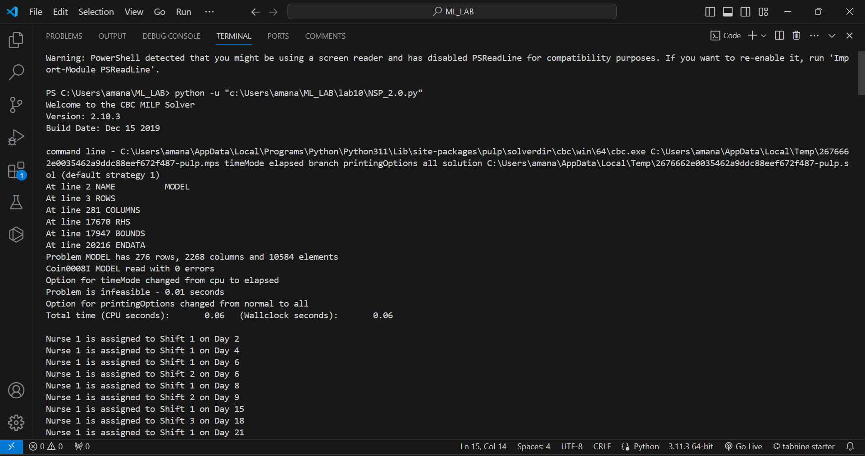
CMD OUTPUT

Slide 19
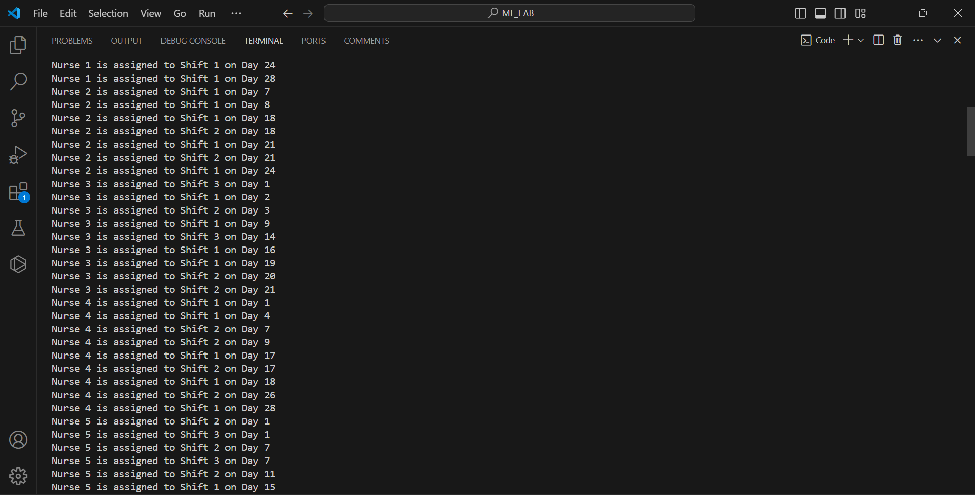

Slide 20
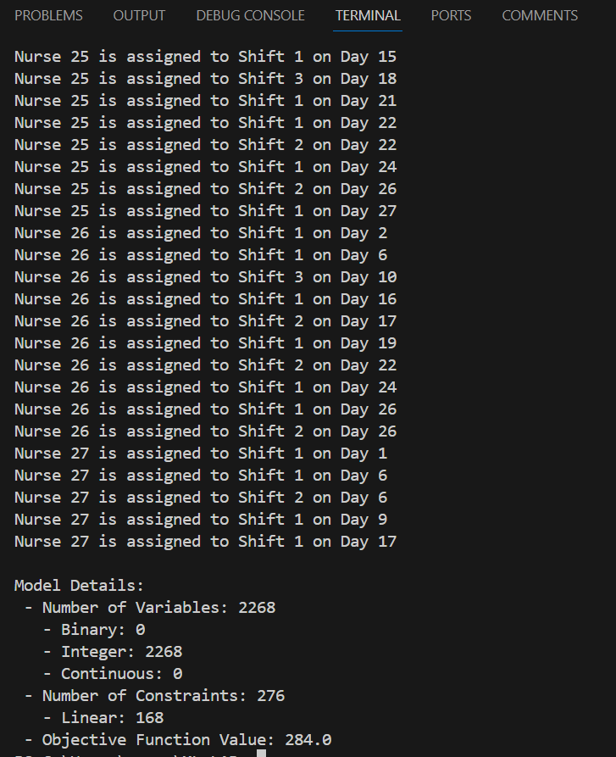
Future Goal We are currently working to develop a greedy algorithm to obtain scalable solutions efficiently.

Slide 21
MODELLERS USED IN SOURCE CODE
pulp: This is a Linear Programming (LP) modeler written in Python. It is used to define and solve LP problems. In our code, it's used to define the optimization problem and solve it.

Slide 22
Thank you

