Slide 1
Project Report : CSE 362 DATA MINING
Deepak Gokharu | Rajat Khandelwal | Md Kamran Siddiqui | Gaurav Kumar

Slide 2



Improving Retailer Consumer connectivity Data Mining Techniques
OFFline ONline

Slide 3

Retailer in the Digital era
With the growth of e-commerce websites, retailers tend to fail to attract more and more consumers.
With an increase in globalization and competitiveness, retailers are seeking a better market campaign
Retail industry is looking at a strategy wherein they can target the right customers who may be profitable to them.

Slide 4

Retailer in the Digital era
Retailing in the Digital age
With the growth of e-commerce websites, retailers tend to fail to attract more and more consumers.
With an increase in globalization and competitiveness, retailers are seeking a better marketing campaign and sales campaign
Retail industry is looking at a strategy wherein they can target the right customers who may be profitable to them.

Slide 5




Solution through Data Mining
Prioritize
Analyze
Monetize
Study Sales data customer behavior towards products
Time-series product analysis, product associativity, P&L on combinations
Employ targeted marketing techniques based on analysis by data mining
Our project deals with sales data and other features from Walmart's 45 stores in the US. Now we will use that data to analyze & finding knowledge using Data mining concepts and methods. This KDD process will be the same for all retailers.

Slide 6

Slide 1
Data & Process flow preparation
Data Preprocessing
Applying ML Algorithms
Data Visualization
Knowledge Discovery from Data
Solving Retailers’ dilemma
PREPROCESSING:
Checking null values
Removing outliers
Converting data into usable format to apply algorithms
Visualization:
Plotting sales data
Plotting stores & features data with sales
When scaling, group all elements to be scaled. Scale as needed. Use the “Increase Font Size,” “Decrease Font Size” buttons or manually change the font size for the editable text. Delete unwanted elements. Change the line weight of the circles or connecting bars as needed.

Slide 7

3 Paths to KDD
Anlaysis of sales data will give us a detailed description about how much & from where are the customers in proximity buying the products
P&L details from each & every store, product performance in SALEs & discounts
Product support & prediction using fbprophet to decide what should be done to increase sales and targeted marketing.
Knowledge Discovery from Data

Slide 8
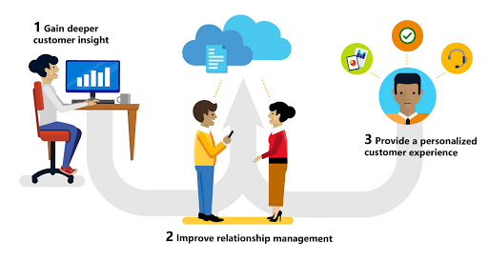
Project Goals
Ultimate goal of project.
Relationship to other projects.
High-level timing goals.

