Slide 1



Amazon Review Data Analysis
Digital Music and Musical Instrument

Slide 2
Table of content
Business Objective
About Data set
Glimpse of the data
EDA (Exploratory Data Analysis)
Word Cloud on Positive Reviews
Classification Algorithms
Clustering Algorithms
Time Series Analysis
Conclusion
1

Slide 3
Business Objective
To Classify the reviews into particular categories based on different sentiments
To Identify top brands and genre liked by the customers by clustering techniques
To Recommend engaging content to the customers by forecasting
2

Slide 4

About Dataset
Digital Music Product
5 Core Data
Reviews Data
Meta Data
1,69,781 Reviews
5541 unique Product ID’s
2. Musical Instrument Product
5 Core Data
Reviews Data
Meta Data
2,31,392 Reviews
6297 unique Product ID’s
3

Slide 5



Data Dictionary
The Dataset contains the following features
Reviewer ID : Unique ID of each review
Asin : Unique Product Id
Rating : Reviewer rating for all the Product
Review Time : Time of Review
Main Category : Category
Review Text : Reviews on the Product
Summary : Brief Statement of the Review Text
Verified : Boolean Data (Yes/No)
Brand : Brand of Particular Product
4

Slide 6
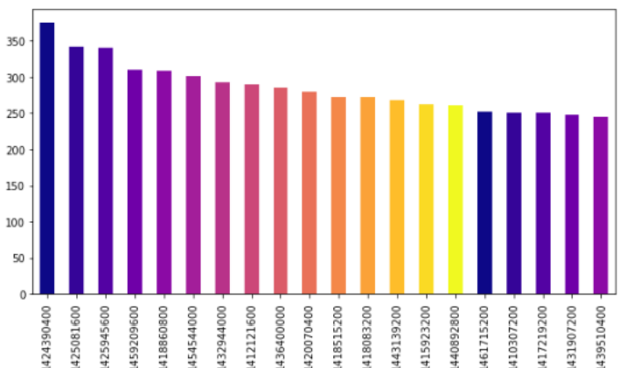
Exploratory Data Analysis(EDA)
Highly Reviewed products
Count of Reviews
Product ID
5

Slide 7
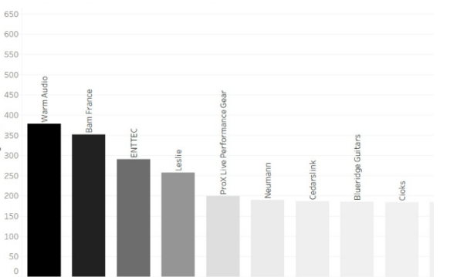
Highly Reviewed Brands
Count of Reviews
Brands
6

Slide 8
Dashboard using tableau for Musical Instrument and Digital Music
7

Slide 9
Work flow of Review Categorization
Data Cleaning
Data Preprocessing, feature selection
Tokenization
&
Lemmatization
Text Preprocessing , NLP , NLTK
Sentiments (Polarity Score)
Sentiments score using TextBlob
Review Categorization
Sentiment analysis
6

Slide 10
Analysis of the Reviews
Input Text | Filtered words from the text | Polarity Score | Sentiments
This is awesome to listen to, A must-have for all fans.. needed to be a triple disc set..They have so many hits!! | Awesome , needed | 0.35 | Positive
It was great to hear the old stuff again and I like the new stuff too. I recommend it to any Slayer fan.SLAYER | Great , new , fan , recommend | 0.40 | Positive
Never had caviar before... Shouldn't have started with cheap stuff but hate to buy expensive and possibly not like it | Cheap , hate , expensive | -0.50 | Negative
poor quality ,came wrapped in tapepoor quality, came wrapped in | Poor | -0.37 | Negative
7

Slide 11
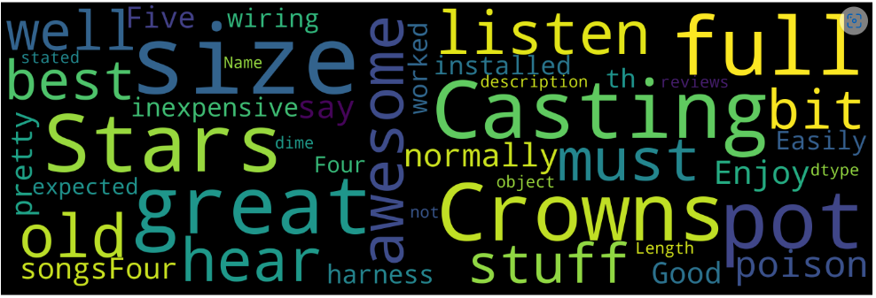
Word cloud of positive sentiments
Positive Words
Great
Well
Best
Awesome
Dime
Enjoy
Worked
Good
Inexpensive
8

Slide 12
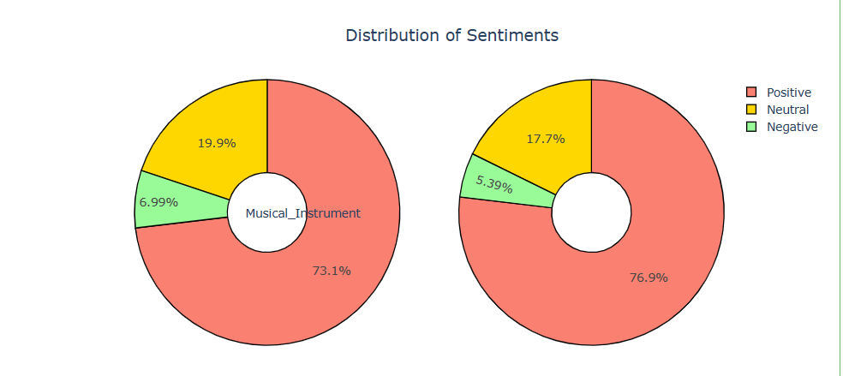
Sentiment Analysis
Digital_Music
9

Slide 13
Comparison of Classification Algorithms
Models | Classes | Accuracy
Logistic Regression | Negative Neutral Positive | 92%
MultinomialNB | Negative Neutral Positive | 90%
Decision Tree Classifier | Negative Neutral Positive | 87%
10

Slide 14
Clustering
Algorithms | Silhouette Score
KMeans | 30.5%
Agglomerative | 34.9%
DBSCAN | 34.2%
11

Slide 15
Clusters Attained
Clusters Formed | Brands/Artist | Insights
Average | Yamaha , Gator | These Brands have lower rating and lower Polarity Score
Good | Levy's Leathers , Musically | These Brands have comparatively good rating
Best | Fender , JIM DUNLOP , D'Addario | These Brands have Best rating and Feedback among others
12

Slide 16


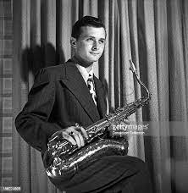
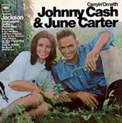
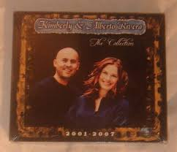


Highly Recommended Category and Price
Stan Gertz
Price: $183.97
June Carter & Johnny Cash
Price: $168
Kimberly and Alberto Rivera
Price: $165
Paul English
Price: $135
101 StringOrchestra
Price:$99
13

Slide 17
Work flow of Product Forecasting
Resample the data quarterly
1
Check for trend and seasonality
2
Build multiple models
3
Select the best model
4
Forecast the trend
5
14

Slide 18
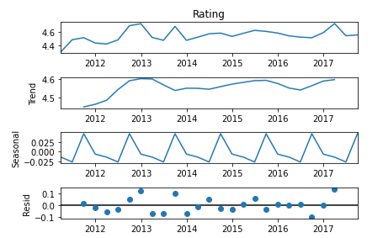
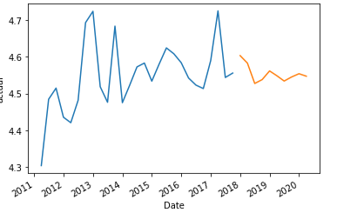
Forecasting of Highly Reviewed Brand
Brand – Fender
Data decomposition
Sarima
Rating
We find a positive trend for Fender
15

Slide 19
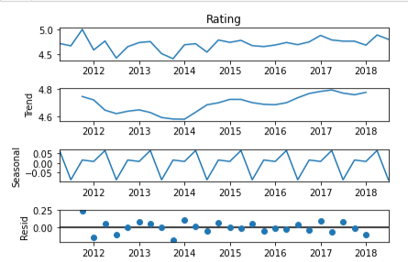
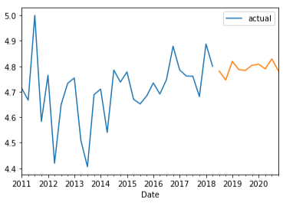
Forecasting Highly demanded Brand from Musical Instrument
Brand – D’Addario
Data decomposition
Sarima
Rating
We find a positive trend for D’Addario
16

Slide 20
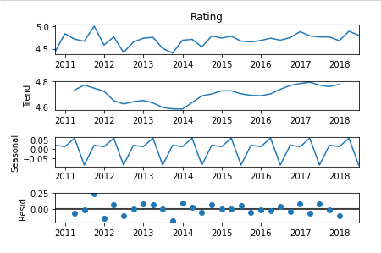
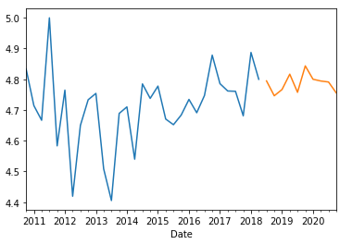
Forecasting Highly Recommended Brand from Digital Music
Brand – Stan Gertz
Data decomposition
Sarima
Rating
We find a positive trend for Stan Gertz
17

Slide 21
Conclusion
After observing the sentiments of reviews, we found that most of the reviews are positive
Almost all the categories have verified customers, hence the reviews are genuine and trustworthy
Even though the price of positively reviewed products is not low as compared to the negatively reviewed products, customers liked them because of the quality.
18

Slide 22

Thank you
Flora@contoso.com
http://www.contoso.com/

