Slide 1
INSTITUTE FOR ADVANCED COMPUTING AND SOFTWARE DEVELOPMENT, AKURDI, PUNE
StaySphere
A Property Rental, Booking & Payment Management Platform
PGCP-AC Feb - 2026
Submitted By
1. Gaurav Jadhav - 262033
2. Uddhav Gawali - 262105
Project Guide: [_______________]
Centre Coordinator: [_______________]

Slide 2
Index
01
Introduction
02
Technologies
03
Users and Roles
04
Use Case Diagrams
05
Future Scope and Extensions
06
Screenshots
07
Conclusion
PG-DAC Project
StaySphere

Slide 3
Introduction
StaySphere is a role-based property rental and booking management platform that brings property owners and tenants onto a single, secure web application — covering rooms, PGs, flats and hostels.
Three Roles, One Platform
Tenant
Search, book & pay online
Purpose
Give owners and tenants one reliable platform to list, discover, book and pay for a stay — with a full auditable trail.
Property Owner
Scope
List, manage & approve bookings
Property management, tenant booking workflow, owner dashboard, admin moderation, and online/offline payments via Razorpay.
Admin
Architecture
Moderate users, properties & audit
React front end + Spring Boot backend, with a dedicated Payment Microservice isolating gateway credentials from core logic.
Introduction
StaySphere

Slide 4
Technologies
The stack behind StaySphere's three cooperating services
Backend (Core)
Java 21 · Spring Boot 3.5 · Spring Web · Spring Data JPA · Spring Security · JJWT · springdoc-openapi
Payment Microservice
Java · Spring Boot 3.3 · Spring Web · Spring Data JPA · Razorpay REST integration
Frontend
React 18 · Vite · React Router · Axios
Database
MySQL 8 — staysphere_db & payment_db (database-first schema)
Tooling
Maven · Lombok · Spring Boot DevTools · Postman / Swagger (OpenAPI UI)
Technologies
StaySphere

Slide 5
Users and Roles
Access is enforced at the API layer via Spring Security method-level authorisation
Tenant
Property Owner
Admin
Search & filter properties
List & manage properties, images and facilities
Manage user accounts (suspend / reset password)
Request a booking
Confirm / reject booking requests
Moderate & approve properties
Pay online (Razorpay) or track offline payment
Record offline (cash/UPI) payments
Monitor all bookings platform-wide
View booking history & manage profile
Configure payout account
Review the append-only audit log
Users and Roles
StaySphere

Slide 6
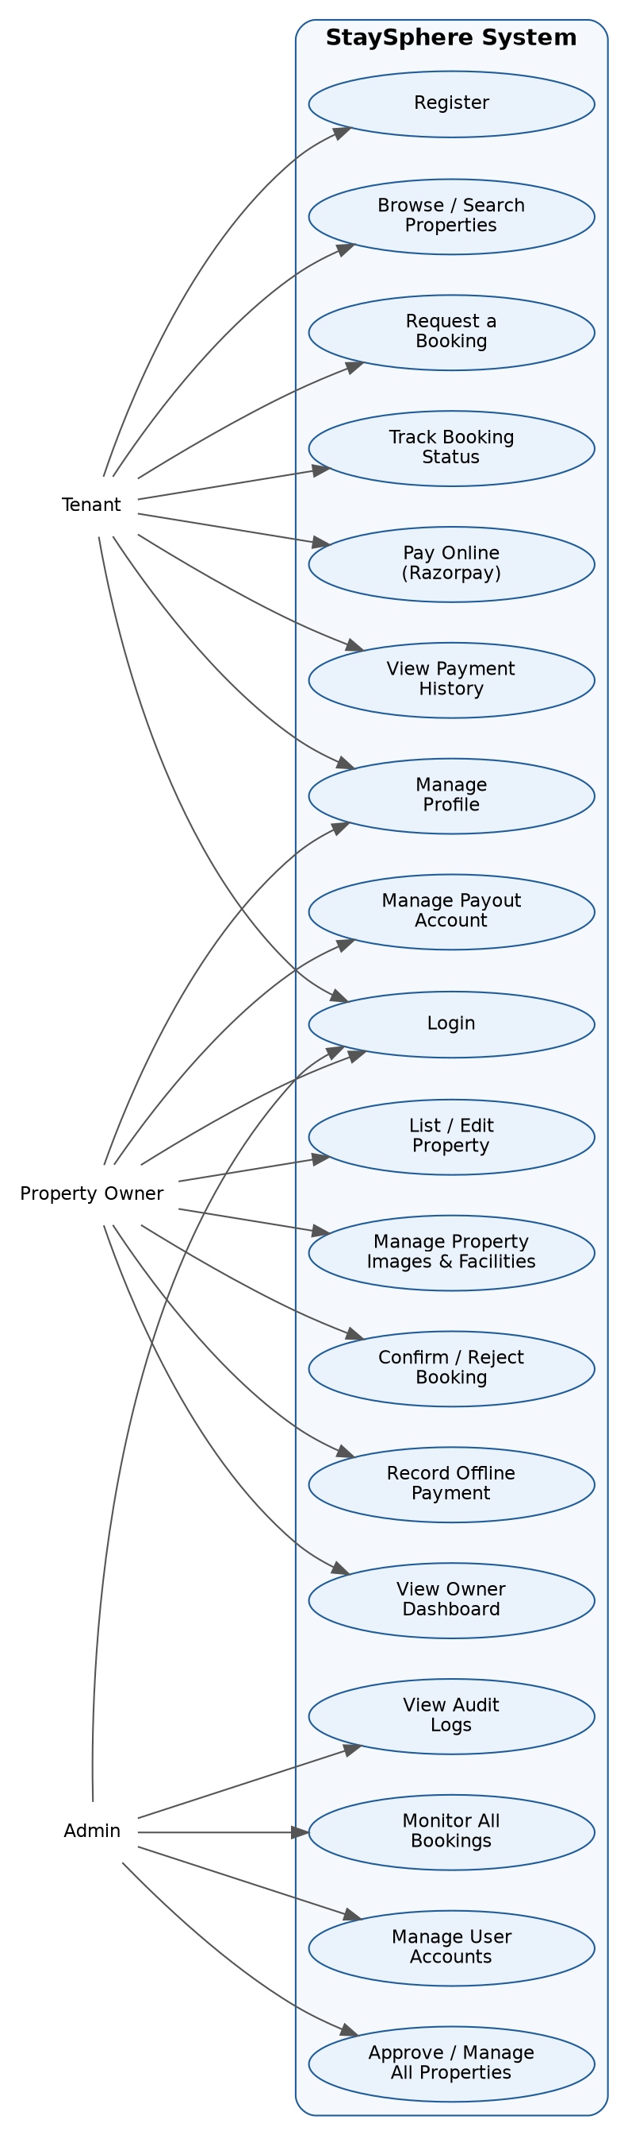
Use Case Diagram
All three actors and their interactions with the StaySphere system
Use Case Diagram
StaySphere

Slide 7
Use Cases by Role
Tenant
Property Owner
Admin
› Register / Login
› Login
› View audit logs
› Browse & search properties
› List / edit property
› Monitor all bookings
› Request a booking
› Manage images & facilities
› Manage user accounts
› Track booking status
› Confirm / reject booking
› Approve / manage all properties
› Pay online (Razorpay)
› Record offline payment
› View payment history
› View owner dashboard
› Manage profile
› Manage payout account
Use Cases by Role
StaySphere

Slide 8
Future Scope and Extensions
1
Instalment-based Rent
2
Automated Payouts
Scheduled partial rent payments with automated reminders, instead of one-shot collection.
A fully automated settlement pipeline that pays owners directly instead of manual offline recording.
3
Reviews & Ratings
4
Notifications
Let tenants rate properties and owners to build trust signals across the marketplace.
Email / SMS / push alerts for booking status changes, payment confirmations and reminders.
5
Mobile App
6
Advanced Search
A companion Android/iOS app built on the existing REST API for on-the-go booking and management.
Map-based discovery, saved searches, and recommendation-driven property ranking.
Future Scope and Extensions
StaySphere

Slide 9
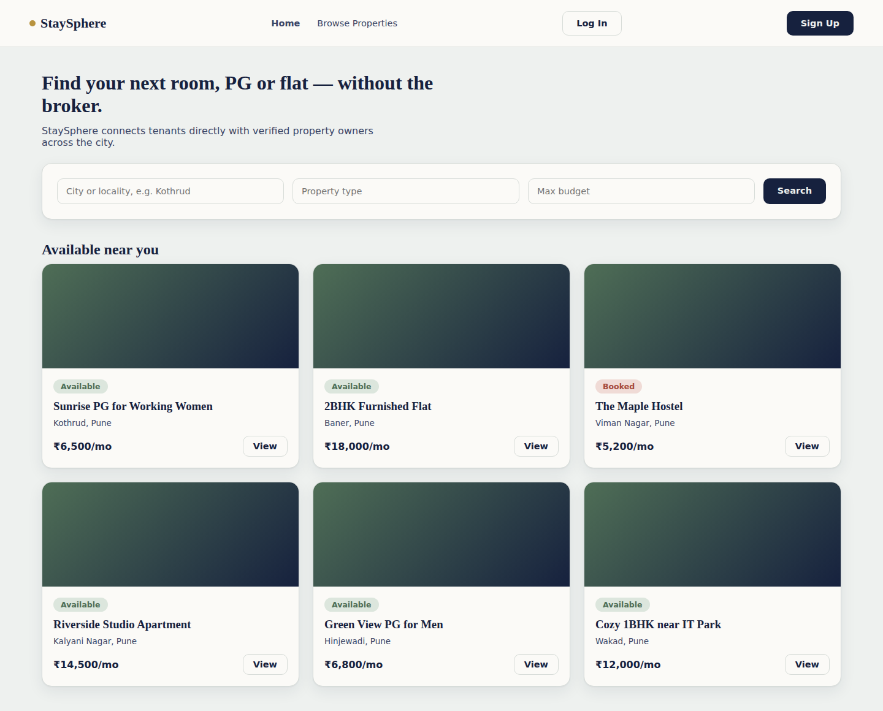
Screenshot — Homepage
Public landing page with search and available properties
Screenshot — Homepage
StaySphere

Slide 10
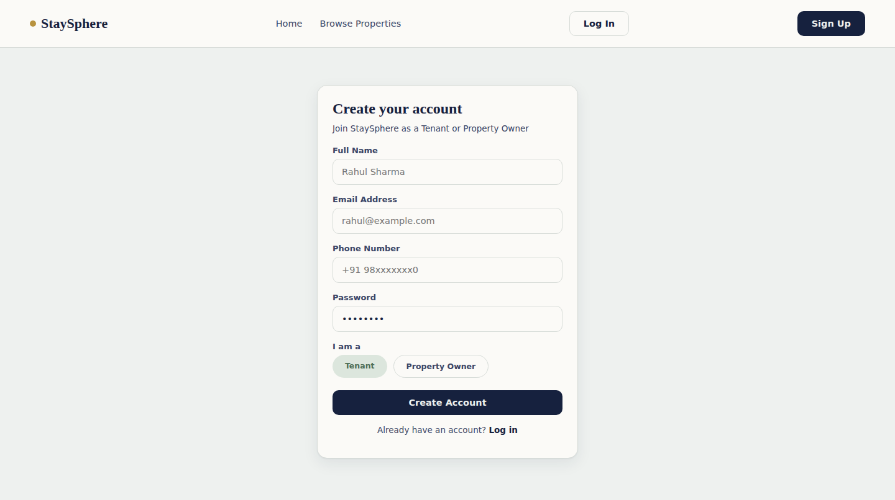
Screenshot — Sign Up
New tenants and owners register with role selection
Screenshot — Sign Up
StaySphere

Slide 11
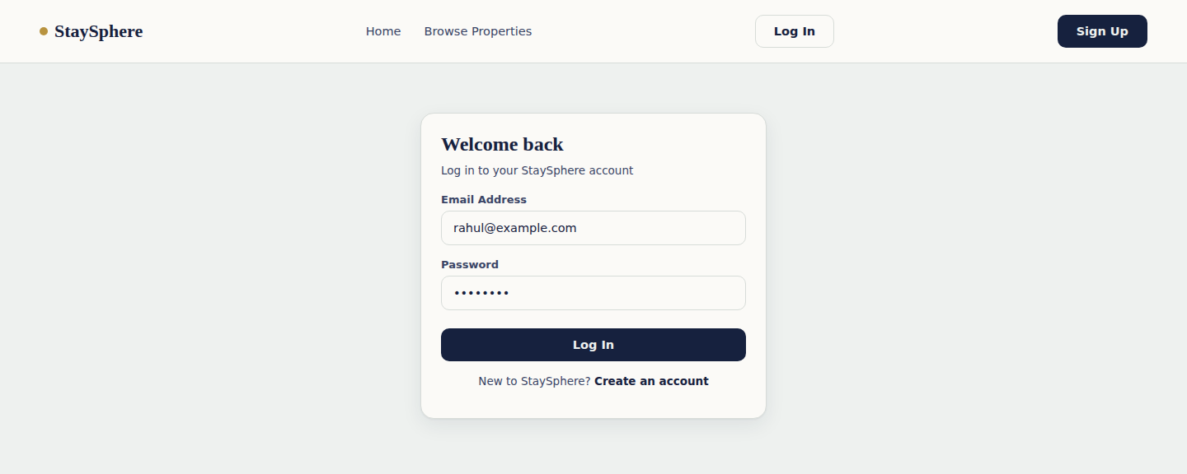
Screenshot — Login
Stateless JWT-based authentication
Screenshot — Login
StaySphere

Slide 12
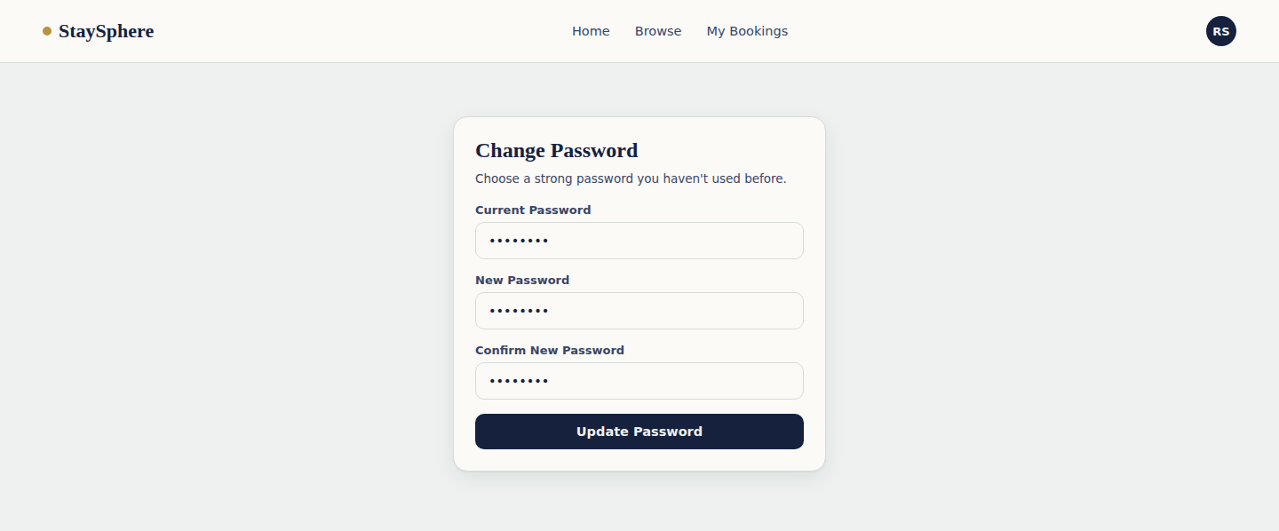
Screenshot — Change Password
Users can securely update their password
Screenshot — Change Password
StaySphere

Slide 13
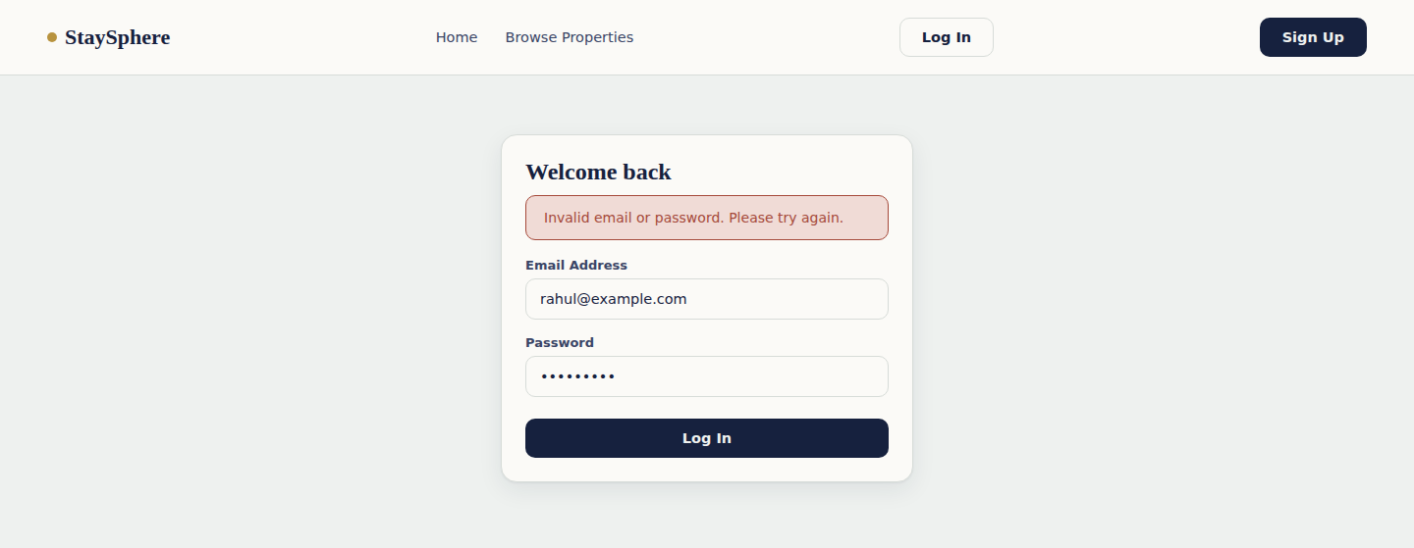
Screenshot — Unsuccessful Login
Invalid credentials are rejected with a clear error message
Screenshot — Unsuccessful Login
StaySphere

Slide 14
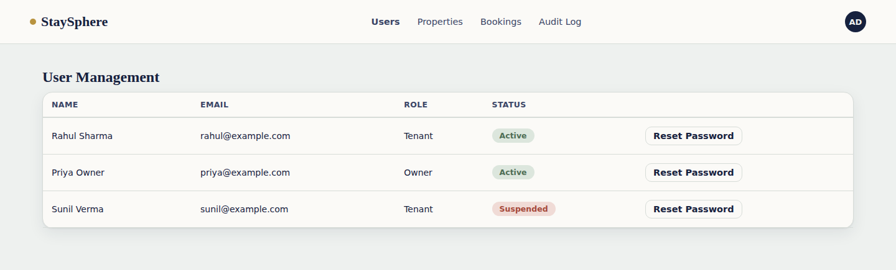
Screenshot — Admin Dashboard
Admins manage users, properties, bookings and the audit trail
Screenshot — Admin Dashboard
StaySphere

Slide 15
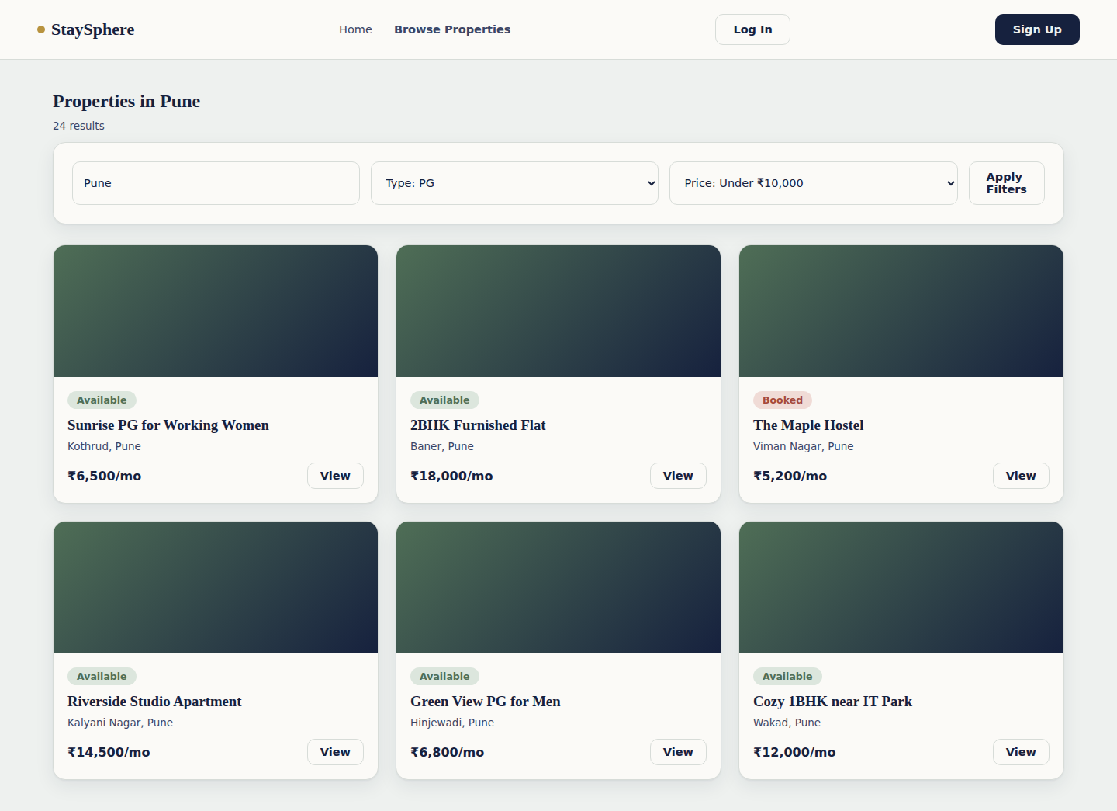
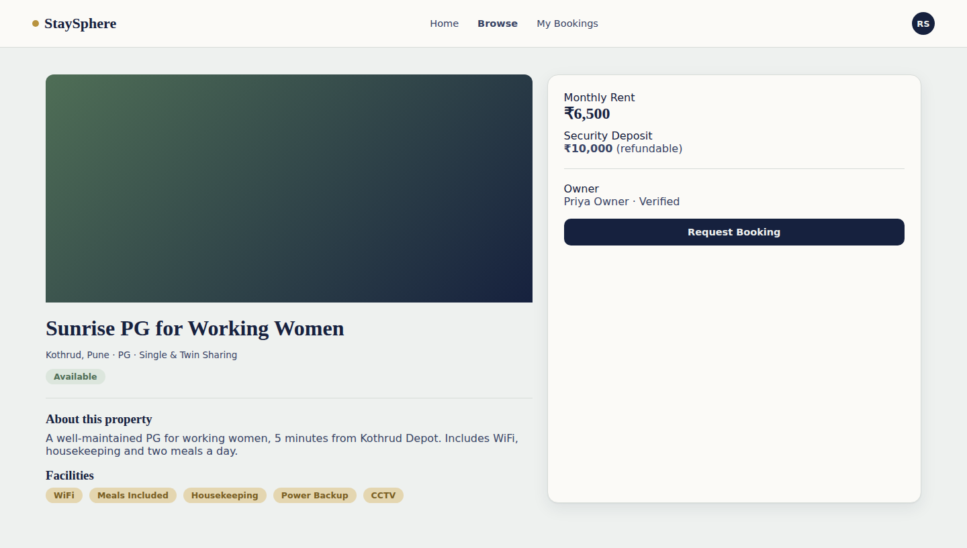
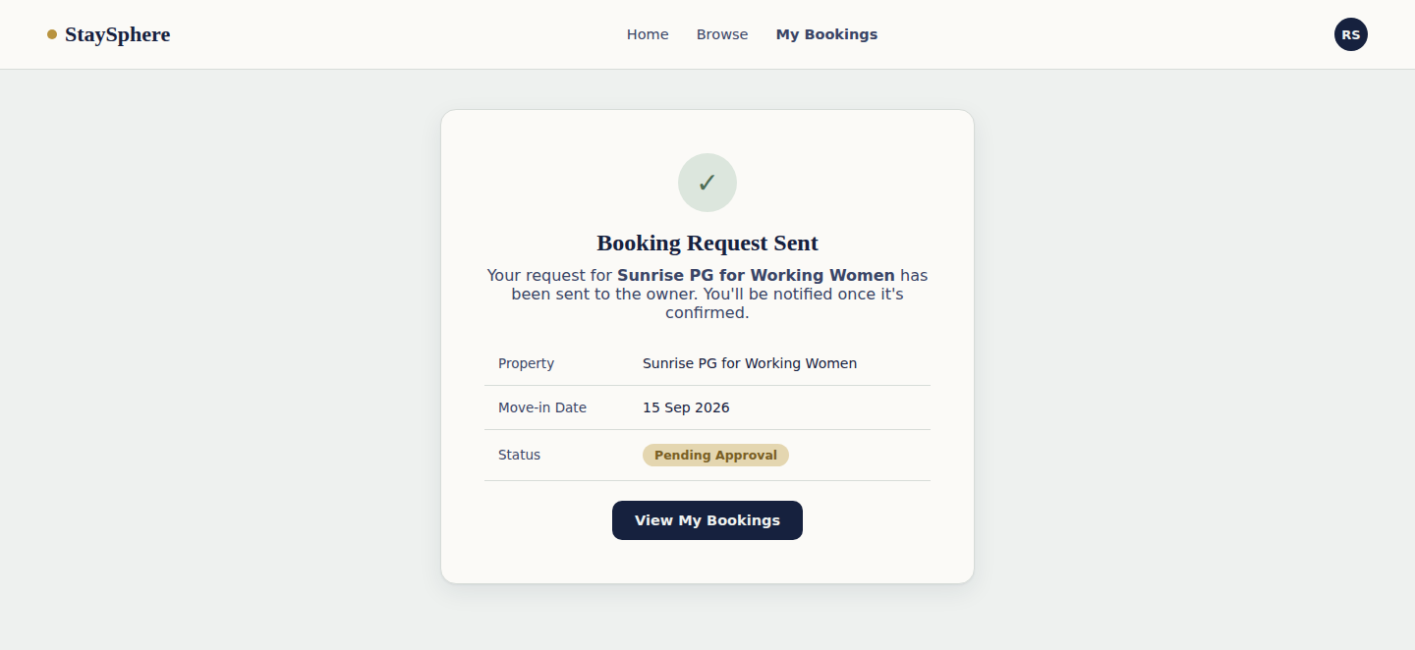
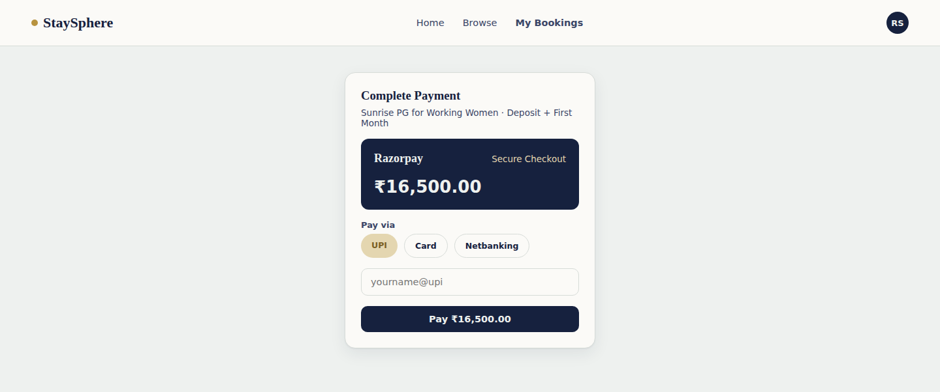
Screenshots — Tenant Functionality
Browsing, booking and paying for a stay
Screenshots — Tenant Functionality
StaySphere

Slide 16
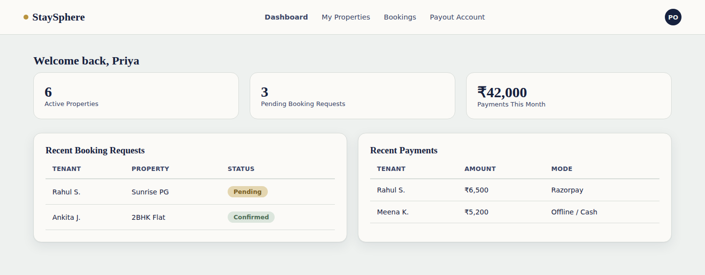
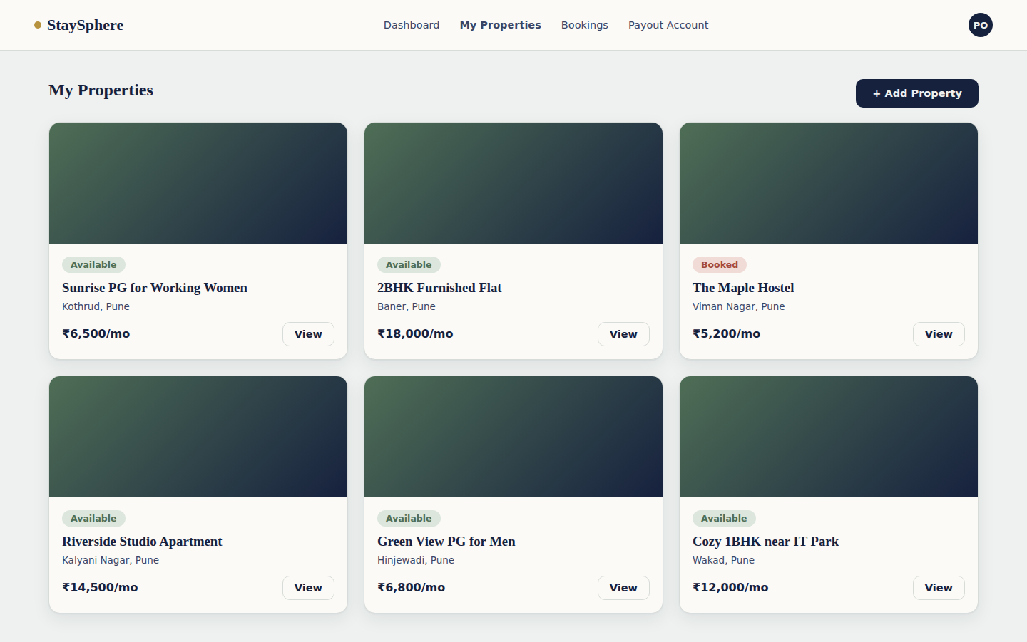
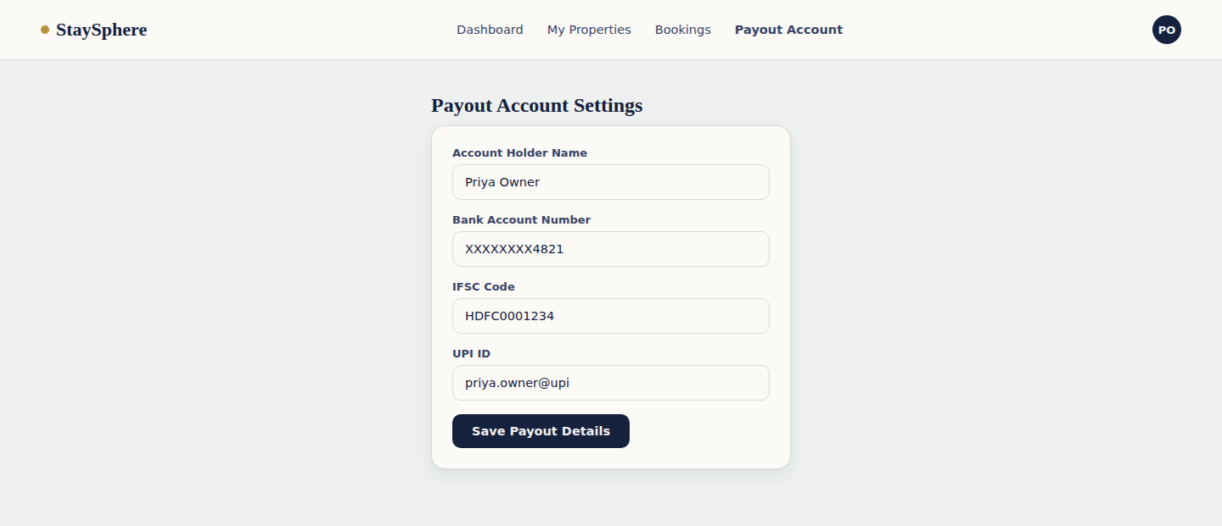
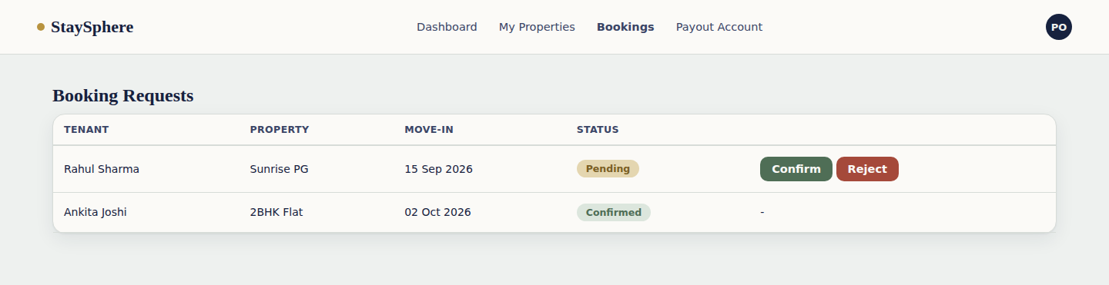
Screenshots — Owner Functionality
Managing properties, bookings and payouts
Screenshots — Owner Functionality
StaySphere

Slide 17
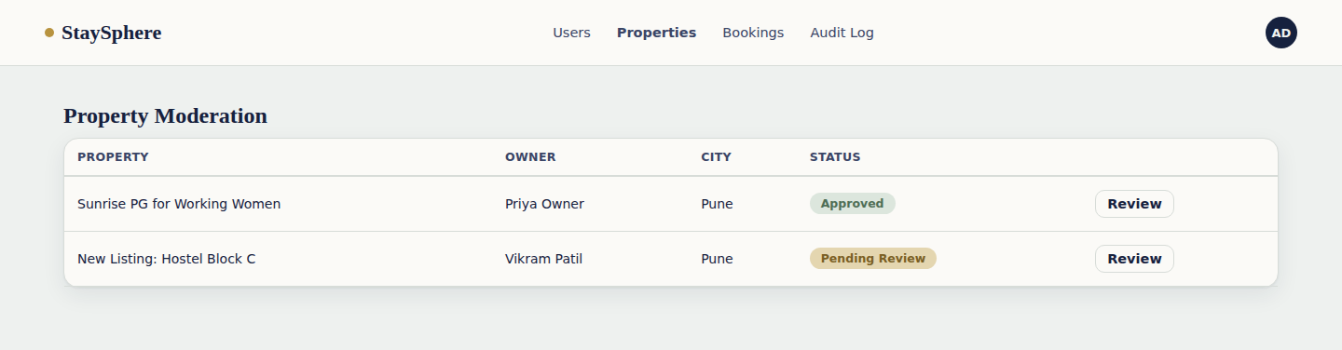
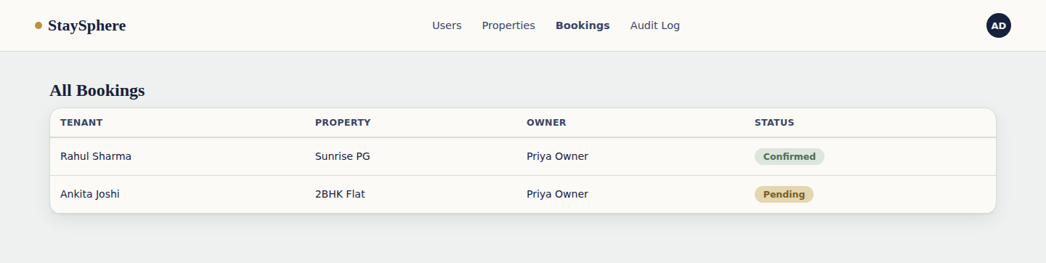
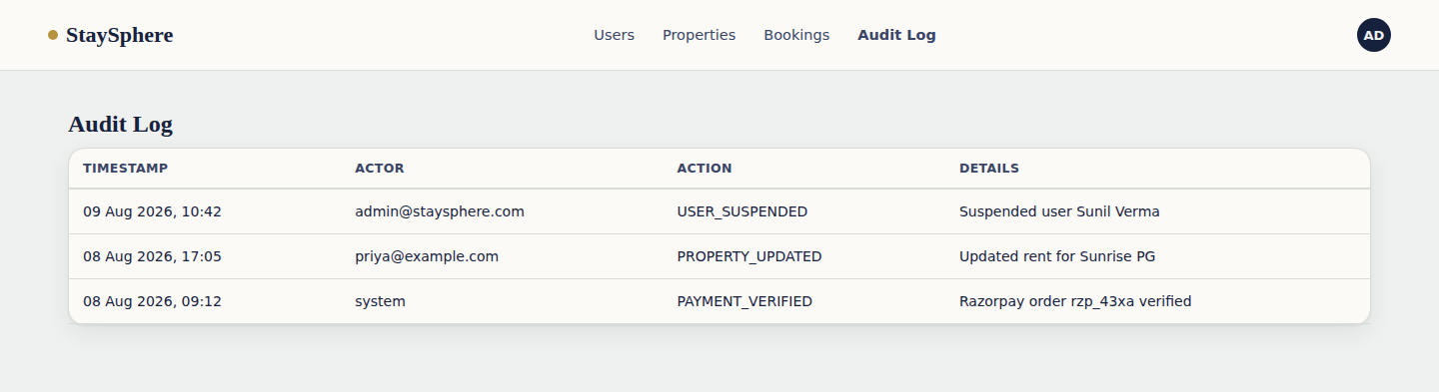
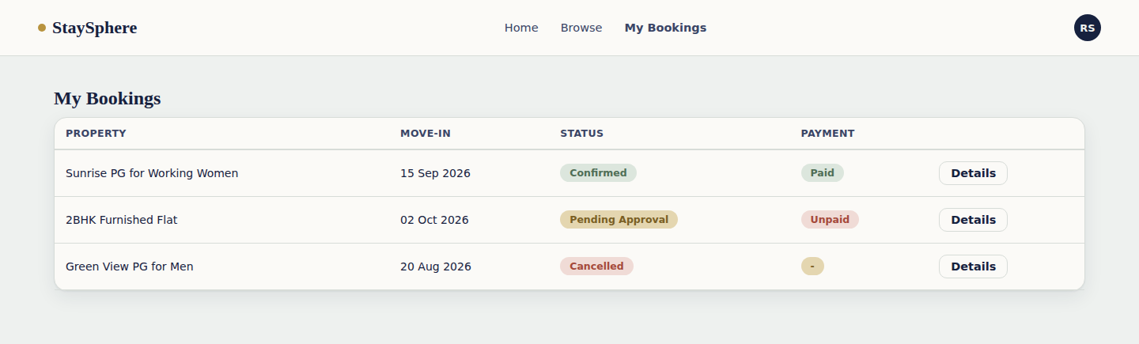
Screenshots — Admin Functionality
Moderation, oversight and the audit trail
Screenshots — Admin Functionality
StaySphere

Slide 18
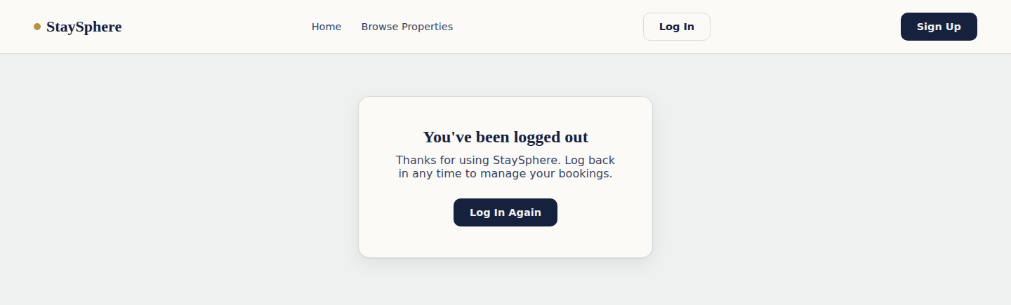
Screenshot — Logout
Confirmation screen after a user signs out
Screenshot — Logout
StaySphere

Slide 19
Conclusion
StaySphere brings property owners and tenants onto a single, secure platform — covering the full rental journey from listing and discovery through booking, approval and payment.
Built With
• React 18 + Vite
• Spring Boot 3.5 (Java 21)
Role-based access control via Spring Security & stateless JWT authentication
• Spring Security + JWT
A dedicated Payment Microservice isolates Razorpay credentials from core logic
• MySQL 8
Supports both gateway-verified online payments and owner-recorded offline payments
• Razorpay Payment Gateway
An append-only audit log gives admins full traceability over sensitive actions
Conclusion
StaySphere

