Slide 1
RECYCLING, Reducing and Reusing OF WASTE CO₂ And Its Management
A GPD PROJECT
A Growing Power Developing Project

Slide 2
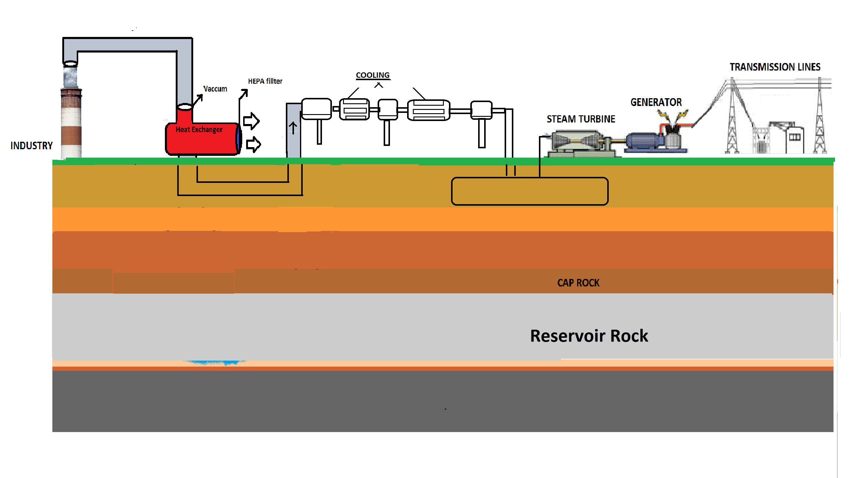
Type of Project: Project Presentation
COMPRESSOR
Liquefy CO₂

Slide 3
Problem!
Melting glaciers
Climate change
Global warming
Air Pollution

Slide 4
Affected Community
Metropolitan Areas.
Industrial Areas.
Human Health.
Ecosystem.
Development in rural Areas causes depletion in Forest resulting CO2 increase.

Slide 5
How Long We Are Working On This Idea
We have working since 4 months on this project.
This is because when I migrate from Delhi to Jaipur(to get admission in college) I had to face many bronchial sufferings due to this I have to spent many money.
After that I am concerned with this problem which causing emission i.e., industries, vehicles and many more releasing a high amount of Co2.
That’s why I aware my friends and started working on this Project.

Slide 6
Our Idea is original!
The idea is original, it includes derived process taking from concept of Chemistry.

Slide 7
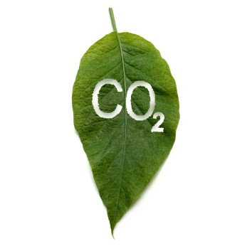
Our Project is based on State of Art..

Slide 8
Basic Slide: 1
Our Idea!
Excessive emission of CO2 causes
Global warming,
Melting of glaciers,
Climate Change.
Extinction of fossils.
Decrement in crop yield.
Excess of CO2 is highly misscible in human blood than O2.

Slide 9
Basic Slide: 2
Growing Power Developing Idea(GPD)
Our idea is concerned with Reducing, Reusing and Recycling of CO2.
This CO2 is captured from stationary factories, Industries, and Thermal Power Plants.
This will eventually result in reducing fossils consumption
and balancing Ecosystem.
Not only this we are also transporting CO2 in all over states through pipelines.
(a dream project) to generate Electricity providing to Industries, and Power plants.
CO2 pipelines will results in replacing the technique of Fire Extinguisher.

Slide 10
Details Of Recycling CO2 And its Management
A GPD Project
Concept
It is concerned with reducing excessive emission of Co2 which is becoming
Harmful nowadays. The basic theme is to conserve fossils and enhancing
Hydrocarbon recovery , oil recovery and a new idea to prevent damage from fire,
As CO2 will work as fire extinguisher also.

Slide 11
Major Steps To Be Taken
1.
Separation of CO2 from other gases
2.
Transportation to Storage Location.
3.
Storage And Long Term Isolation From Atmosphere.

Slide 12
Methodologies
SUCTION OF HARMFUL POLLUTANT GASES FROM INDUSTRY BY VACCUM.
Separation of CO2 gas from pollutant gases by the help of Heat Exchanger.
Removal of Harmful Gases by purring it into fresh air with the help of HEPA FILTER.
The purified CO2 is then transferred into compressor then coolant. Now the CO2 comes into
liquefied gas.
The liquid is then stored into efficient container.
Finally, the CO2 is then pressurized by the phenomena of Aerosols which is connected to Rotate turbine then generating Electricity.

Slide 13
Feasibility
Approximately 91% of CO2 can be captured and stored that means it is
highly efficient.

Slide 14
Implementation
Small Scale Oriented Energy Conservation And Utilization Model
COMPRESSOR
Liquefy CO₂

Slide 15
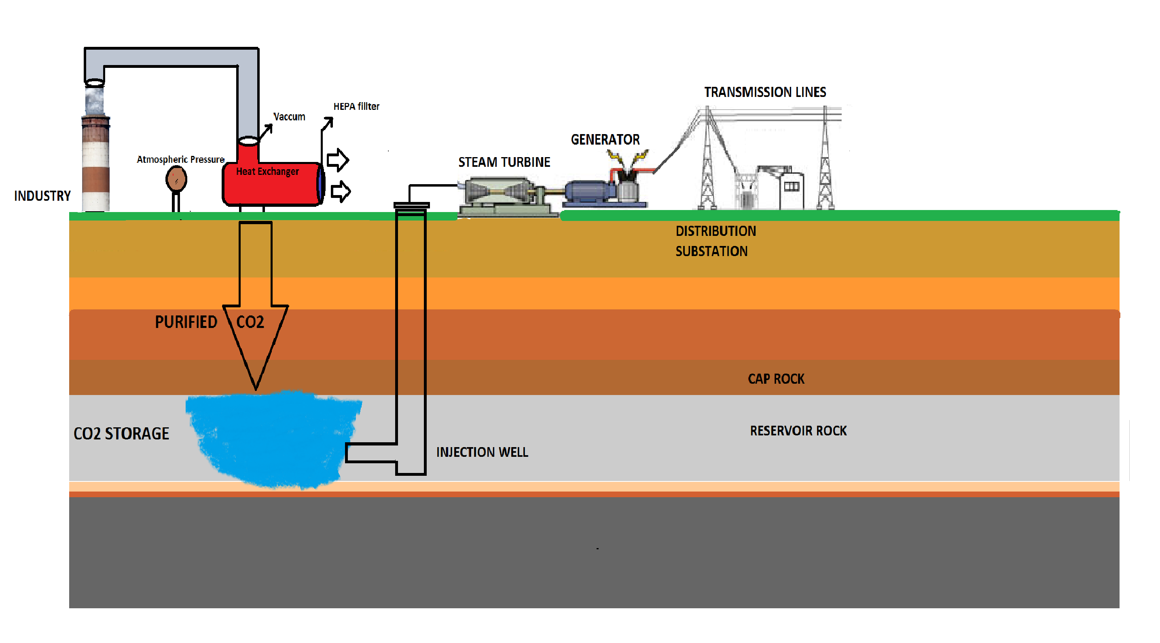
DREAM MODEL : Large Scale --CAPTURE, STORAGE AND
TRANSMISSION OF CO₂

Slide 16
Timeline
Small Scale project needs approx:- 15 days.
Big scale Dream Project needs approx:- 10-12 months.

Slide 17
Challenges
This technology needs proper attention.
It requires one time Investment.
Indeed this newer technology needs awareness to Govt., Non-govt. and industrial representators.

Slide 18
Market Competitiveness
This technique is highly beneficial for future Generation and only needs a good investment.

Slide 19
Costing Estimation/ton of CO₂
CO2 Separation cost – Rs. 1920 to Rs. 4160
Transportation to storage location –Rs. 80 to 480
Storage- Rs.2240 to Rs. 3360

Slide 20
Socio economic Impact
This project and Technology is a key tool in :
Tackling climate change.
Providing energy security.
Creating jobs, and
Economic prosperity.

Slide 21
S.W.O.T
Strength:- Highly Efficient.
WEAKNESS:- Needs a good investment.
OPPORTUNITIES:- Once implemented will results in greater energy production, replacing current techniques of Fire extinguisher.
THREAT:- Maintenance is required.

Slide 22
Probable Outcomes
Controlling air Pollution
Generating Electricity.
Use as a Fire Extinguisher.
Maintaining Climate Change.
Enhancing hydrocarbon recovery.
Conserving Fossils such as Coal for future generation.

Slide 23
Future Aspects
Controlling Global warming and melting of Glaciers.
Reduction in pollution results in improving health of humans and Animal.
Saving of Water(water generation electicity)

Slide 24
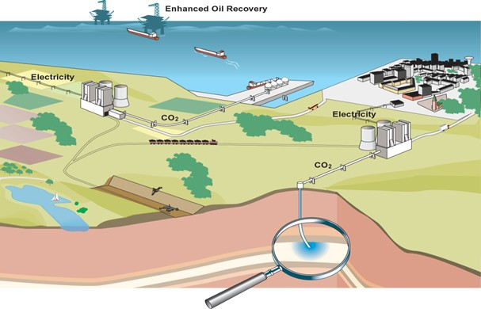
Future Aspects

