Slide 1
Masterpraktikum Scientific Computing –
High Performance Computing
SWE Project Presentation and Results
Gaurav Kukreja
Evangelos Drossos
21.01.2014

Slide 2
Optimizations Performed
Instrumentation with Scalasca
Vectorization with Intel Cilk
OpenMP optimization
MPI optimization

Slide 3
Instrumentation
Instrumented different variants of the code to get a better understanding of performance issues and improvement potential
We analyzed the code for every round of optimizations we performed until reaching the final status (Cilk + OpenMP + MPI)

Slide 4
Vectorization
Vectorization using Intel Cilk
Idea: compute net updates for a number of cells at each iteration and use Intel Cilk in the computeNetUpdates function. Assume that compiler will efficiently vectorize
After testing we determined an optimal vector length of 8

Slide 5
OpenMP
Some OpenMP optimization was already present in the original code
Fusion of loops performing the calculations for the vertical and horizontal edge updates
We used OMP threads on the cores on one node to utilize shared L2 cache

Slide 6
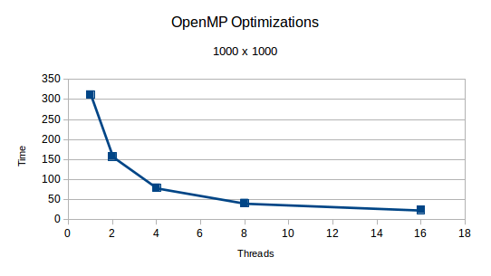

Slide 7
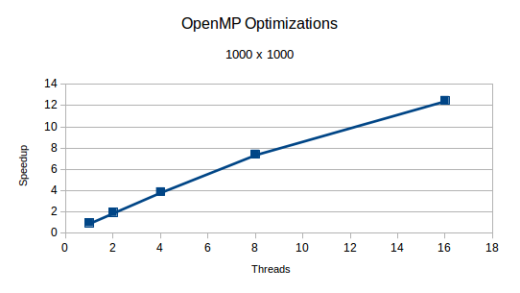

Slide 8
MPI
Some MPI code already present in original code
Goal: overlap communication with computations
Slight improvement in performance
Instrumentation showed that the time needed for communication is insignificant compared to the time for computation

Slide 9
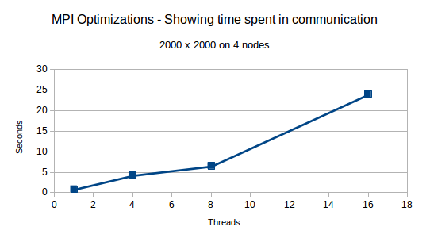

Slide 10
