Slide 1
Assignment 2
Gaurav Kukreja
Evangelos Drossos

Slide 2
Exercise 5

Slide 3
Exercise 6 – Matrix Multiplication
Optimizations Performed
Vector Intrinsics
  Improved the performance using Vector Intrinsics by calculating 2x8 matrix, in one loop iteration, using 12 vector registers.
  Performance increased from ~4.8 GFLOPs to ~7.9 GFLOPs
OpenMP Parallelization
  Parallelized at block level

Slide 4
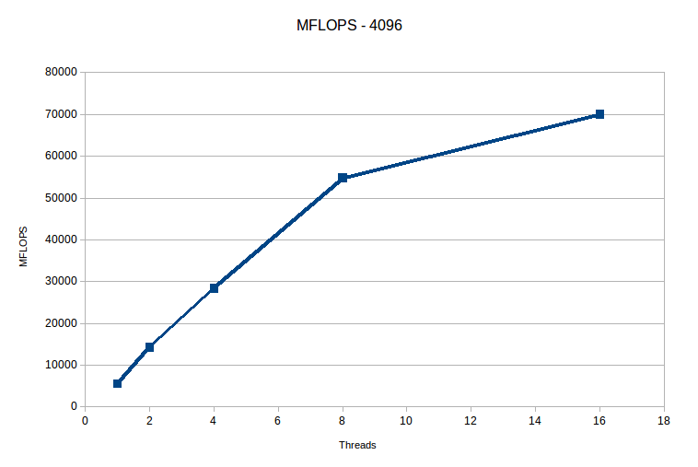
Matrix Multiplication - Speedup

Slide 5
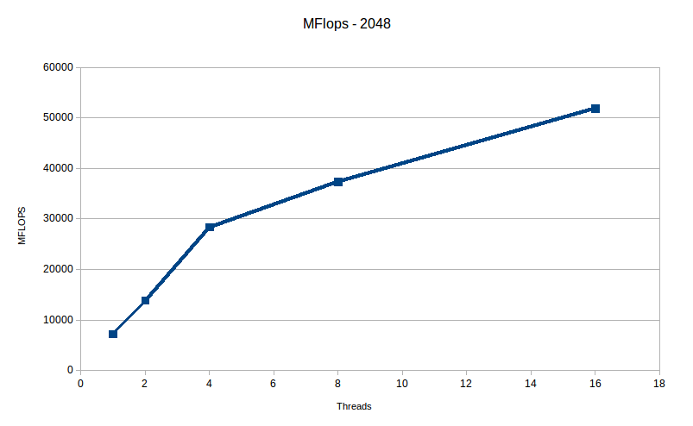
Matrix Multiplication - Speedup

Slide 6
Matrix Multiplication - Speedup

