Slide 1
High Performance Computing
Project Progress
Gaurav Kukreja
Evangelos Drossos

Slide 2
Planned Approach
Scalasca Instrumentation – partially done
Vectorization using Intrinsics – analyzing alternative approach using Intel Cilk
Parallelization using OpenMP in SWE_Block - done
Optimization of swe_mpi.c by overlapping communication and computation – in progress

Slide 3
Scalasca Instrumentation
We have manually instrumented the SWE code
To start with, we have made an analysis of the current implementation.
As we optimize, we will compare our results and analyze the improvement.

Slide 4
Vectorization
We are working on FwaveVec solver.
We initially planned to use intrinsics to optimize vectorization.
Instead, we will now use Intel Cilk for following reasons
  Code is more readable, and easy to modify
  Compiler should be able to exploit vectorization.

Slide 5
OpenMP
Made appropriate changes to Sconstruct to make the existing OpenMP code compile.
Minor optimizations like using schedule(static)
Efficiency ~0.66 for 16 threads, with problem size 800 x 800
  Reasons?
Fused the loops inside computeNumericalFluxes, for a minor performance gain.
Looking for further optimizations

Slide 6
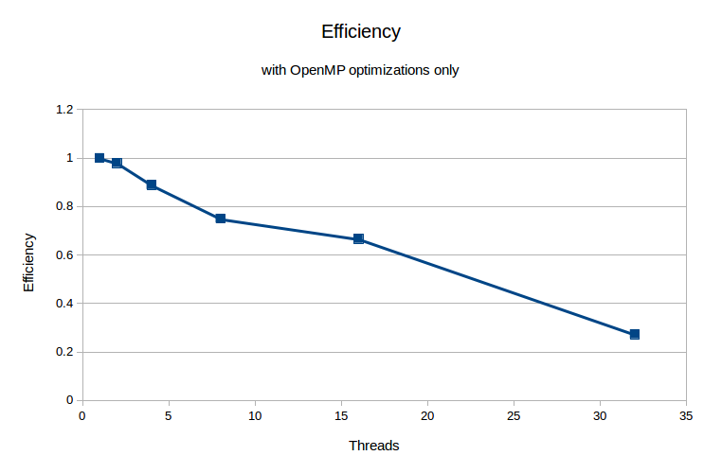
OpenMP Results
* Problem Size 800x800

Slide 7
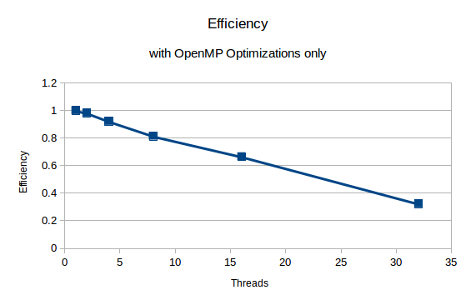
OpenMP Results
* Problem Size 1600x1600

Slide 8
MPI Optimization
Studied the code in swe_mpi.c
Identified points of improvement
  Synchronous communication can be changed to asynchronous
    Asynchronously send and receive Ghost Layers to/from appropriate threads
    Perform computation of inner blocks
    Ensure that Ghost Layers have been transferred
    Perform computation of border edges

Slide 9
Cache Blocking
After MPI and OpenMP hybrid implementation is working, we will analyze for what problem size does Cache Size become a bottleneck.
We will perform Cache Blocking Optimization, to remove bottleneck issues.

Slide 10
Recommendations ?
Questions ?

