Slide 1
Assignment 2
Gaurav Kukreja
Evangelos Drossos

Slide 2
Exercise 5 – Pi Calculation
Pi Value = 3.141593
Problem Size tried from 1*10^8 to 8*10^8.
Important Observation from OpenMP Parallelization
  Reduction provides near linear speedup
  Critical is much worse than even Serial Implementation

Slide 3
Analysis of result using critical
Using critical primitive for combining the values calculated by threads, is disastrous.
Leads to serialization of code.
Much worse performance than even Serial Implementation, because threads wait for each other. The synchronization is an overhead.

Slide 4
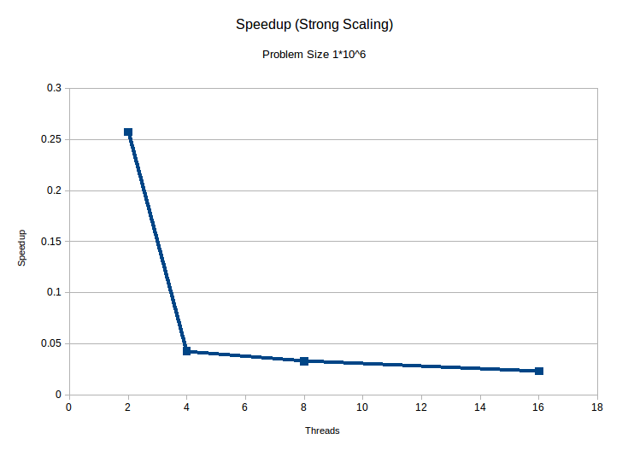
Analysis of result using critical

Slide 5
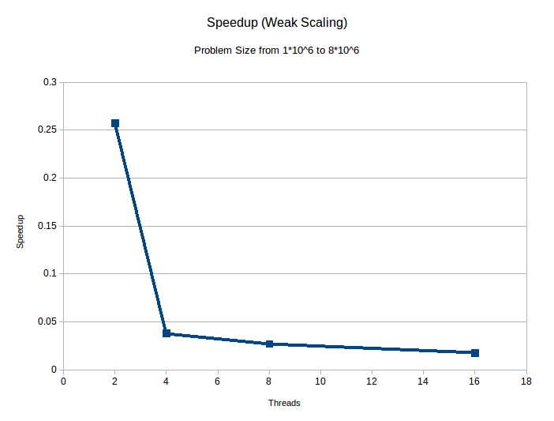
Analysis of result using critical
Weak Scaling : The problem size doubles from 1*10^6 to 8*10^6 while number of threads double from 2 to 8.

Slide 6
Analysis of result using reduction
Using reduction for combining the results obtained by threads is optimal.
Compiler creates private copies of variable, and combines them after each thread executes the loop.
Near Linear Speedup achieved.

Slide 7
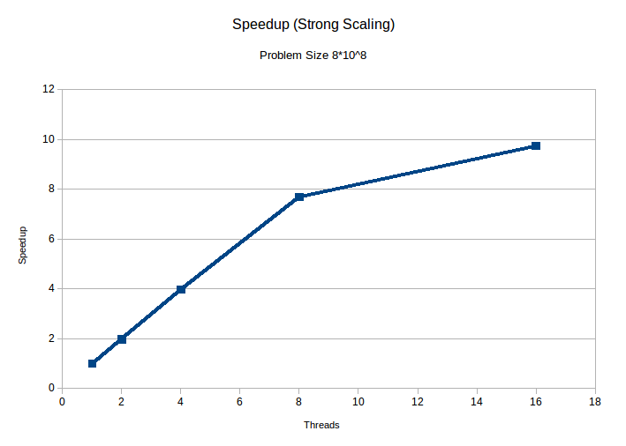
Analysis of result using reduction

Slide 8
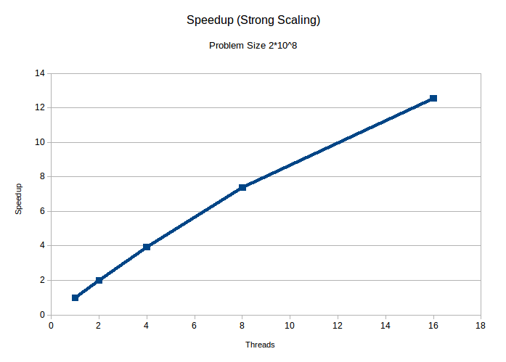
Analysis of result using reduction

Slide 9
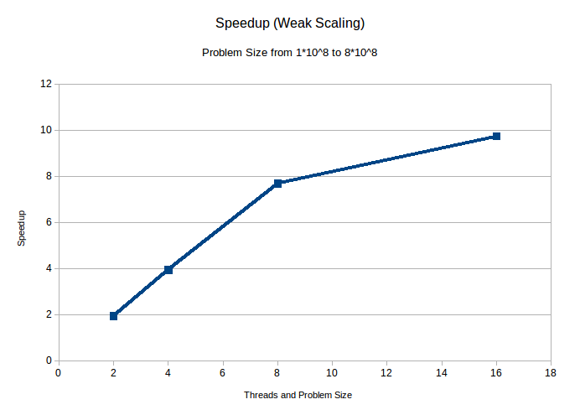
Analysis of result using reduction
Weak Scaling : The problem size doubles from 1*10^8 to 8*10^8 while number of threads double from 2 to 8.

Slide 10
Exercise 6 – Matrix Multiplication
Optimizations Performed
Vector Intrinsics
  Improved the performance using Vector Intrinsics by calculating 2x8 matrix, in one loop iteration, using 12 vector registers.
  Performance increased from ~4.8 GFLOPs to ~7.9 GFLOPs
OpenMP Parallelization
  Parallelized at block level

Slide 11
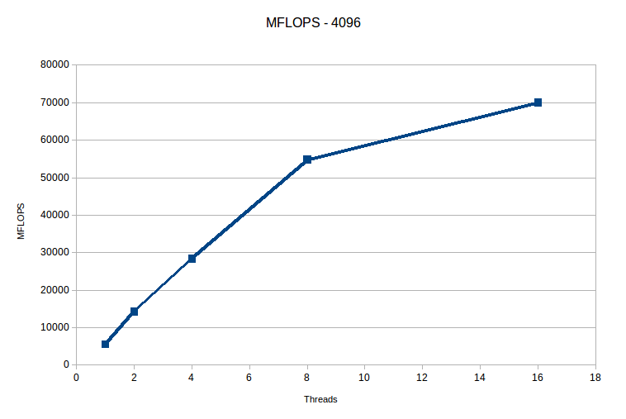
Matrix Multiplication - Speedup

Slide 12
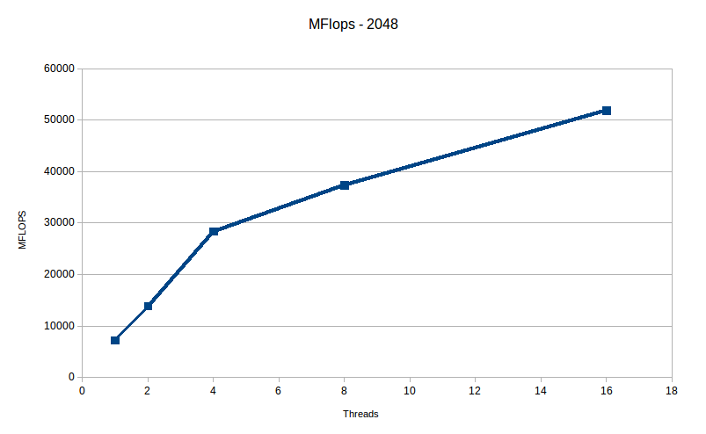
Matrix Multiplication - Speedup

Slide 13
Matrix Multiplication - Speedup

Slide 14
Exercise 7 - Quicksort
OpenMP tasks used
final clause stops parallelization of recursion when cur_array_length < (init_length/max_num_threads * 16)
(final_quicksort.c)
Code implemented using if-else construct in place of final
-> results significantly better for all problem sizes and # of threads tested

Slide 15
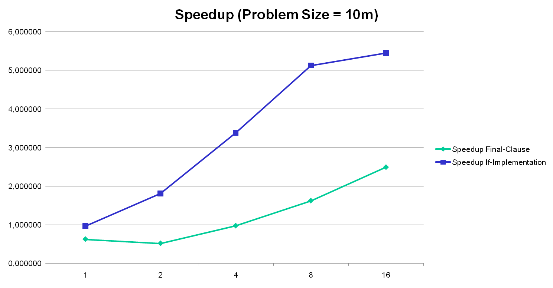
Quicksort – Strong Scaling 1

Slide 16
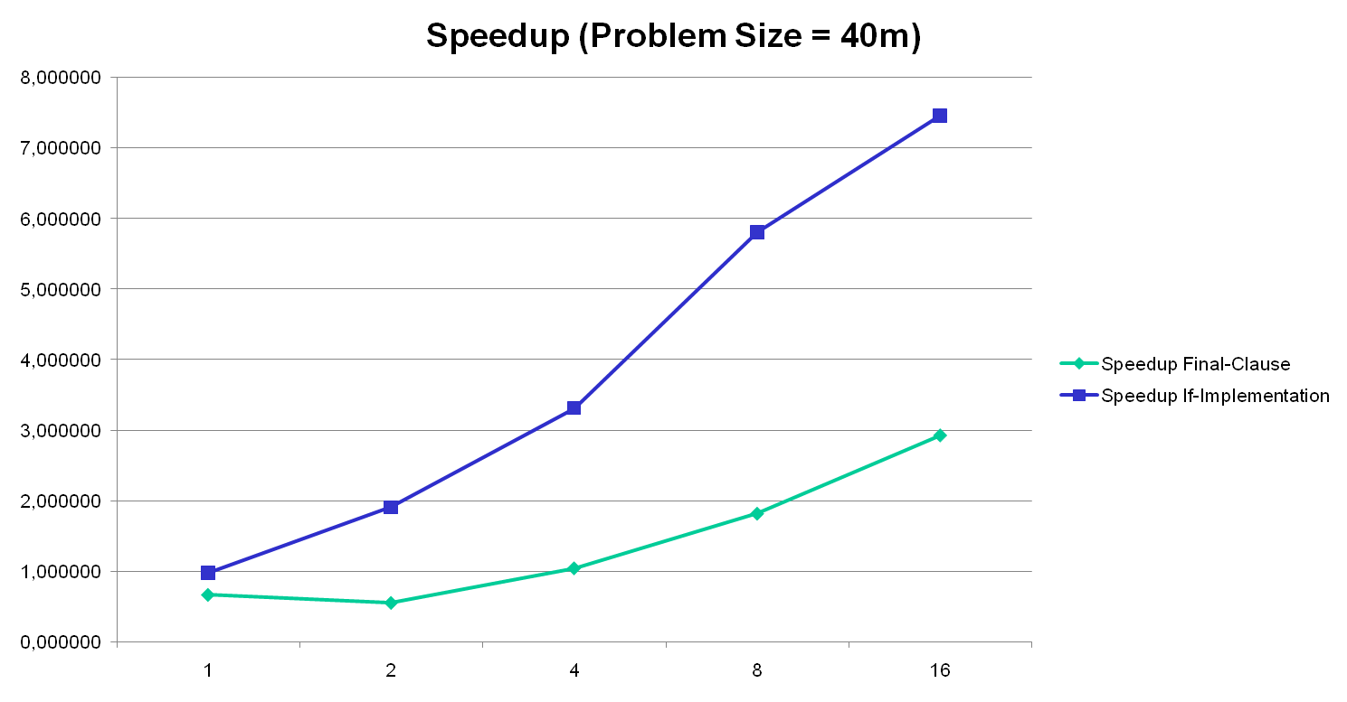
Quicksort – Strong Scaling 2

Slide 17
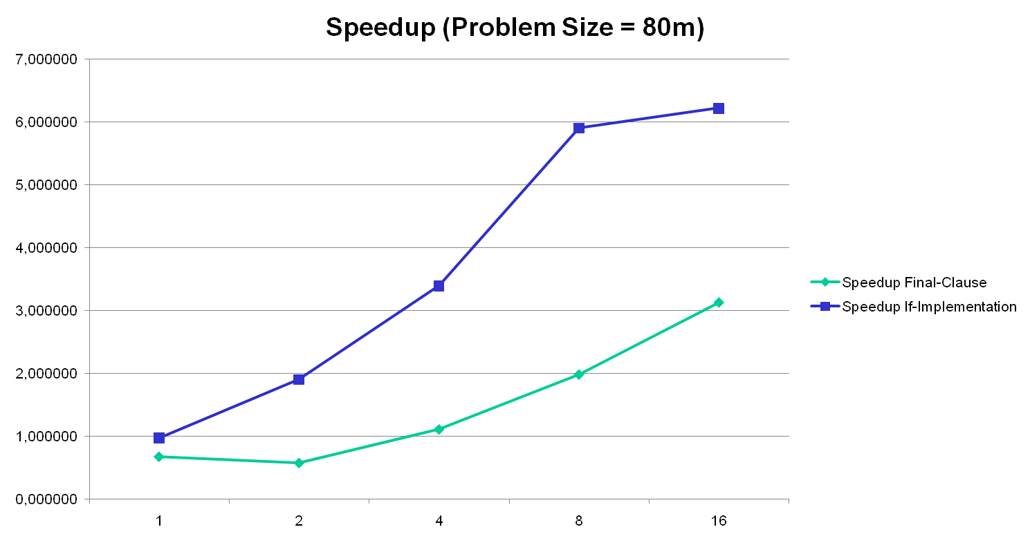
Quicksort – Strong Scaling 3

Slide 18
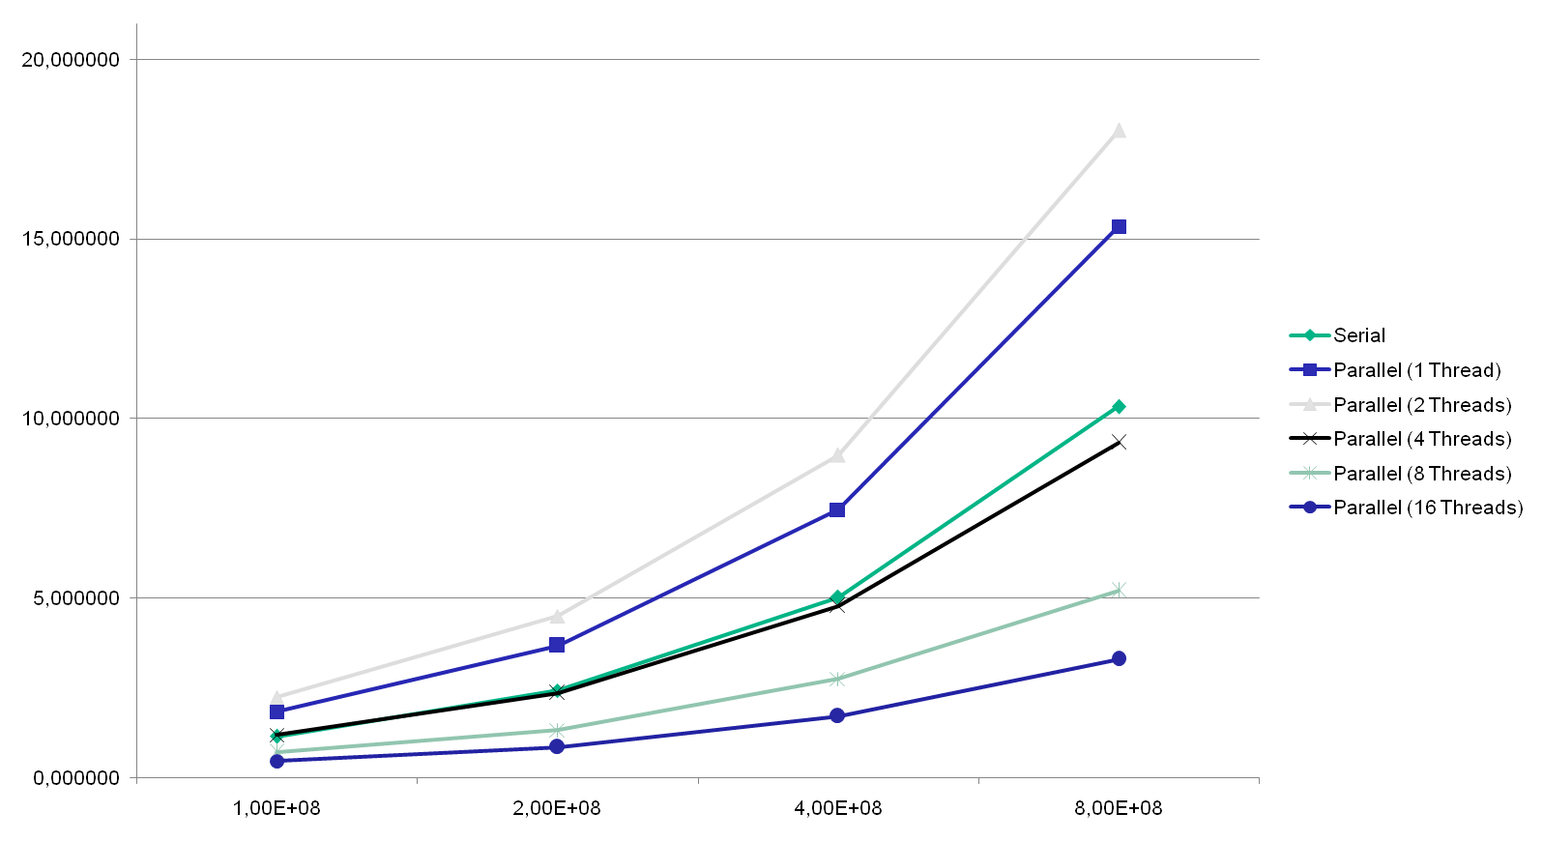
Quicksort - Elapsed Time to Different Problem Sizes (final)

Slide 19
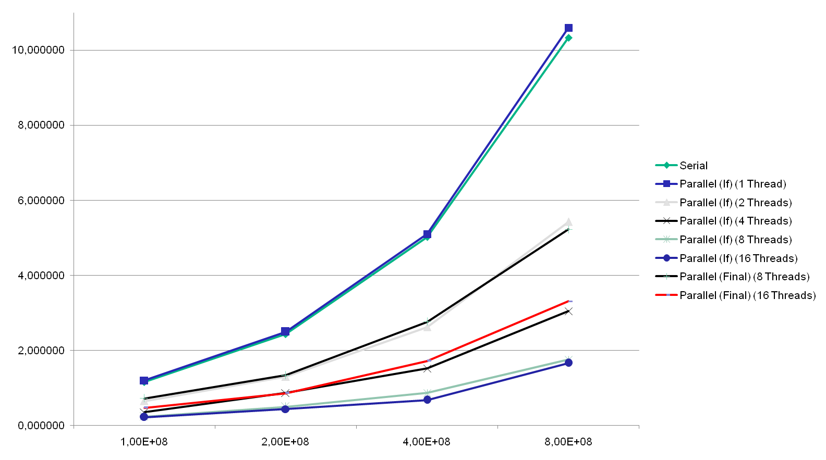
Quicksort - Elapsed Time to Different Problem Sizes (if-else)

