Slide 1
Heat Simulation using MPI
Group 6
Gaurav Kukreja
Umbreen Sabir
Viktor Bogischef

Slide 2
Heat Simulation using MPI
Utilized Functions
Creating a 2d cartesion topology:
int MPI_Cart_create(MPI_Comm comm_old, int ndims, int *dims, int *periods,
int reorder, MPI_Comm *comm_cart)
Converting between coordinates and rank:
int MPI_Cart_rank(MPI_Comm comm, int *coords, int *rank)
int MPI_Cart_coords(MPI_Comm comm, int rank, int maxdims, int *coords)
Nonblocking send and receive commands:
int MPI_Isend(void *buf, int count, MPI_Datatype datatype, int dest, int tag,
MPI_Comm comm, MPI_Request *request)
int MPI_Irecv(void *buf, int count, MPI_Datatype datatype, int source,
int tag, MPI_Comm comm, MPI_Request *request)
int MPI_Wait(MPI_Request *request, MPI_Status *status)
Send and resceive buffers to transfer columns of the matrix
// Example: Receiving the left border
for (i = 1; i < size_y -1 ; i++)
u[i*size_x] = recvbuf_left[i-1];

Slide 3



Heat Simulation using MPI
Code Jacobi
For each iteration do:
Calculate the borders
Send border values to neighbors
Calculate the inner part
Receive border values from neighbors
1.
2.
3.

Slide 4

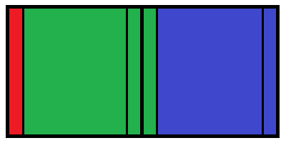


Heat Simulation using MPI
Code 1D-Gauss
For each iteration do:
Receive border values from left neighbor
Calculate left border
Send border values to left neighbor
Calculate inner part
Receive border values from right neighbor
Calculate right border
Send border values to right neighbor
1.
2.
3.
4.

Slide 5
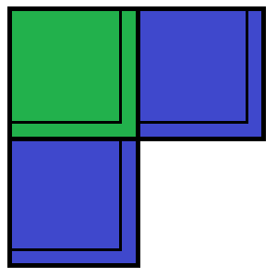
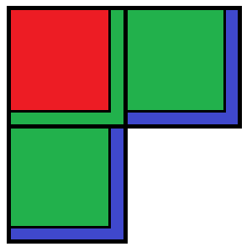
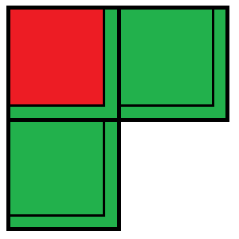

Heat Simulation using MPI
Code 2D-Gauss
For each iteration do:
Receive border values from top and left neighbor
Calculate top and left border and inner part
Receive border values from right and bottom neighbor
Calculate bottom and right border
Send border values to all neighbors
1.
2.
3.
4.

Slide 6
Heat Simulation using MPI
Results Jacobi
„Basic“ means that the blocks are not devided into inner part and border, but calculated at once.

Slide 7
Heat Simulation using MPI
Results Gauss
„Basic“ means that the blocks are not devided into upper left part and lower right border, but calculated at once.

Slide 8
Raw Results in MFlops (Gauss)
4 Threads
Resolution | Seial | 2x2 | 4x1 (spec) | 1x4 (spec)
256 | 842 | 3068 | 3202 | 3152
4096 | 819 | 3104 | 3118 | 3139
16 Threads
Resolution | Serial | 4x4 | 16x1 (spec) | 1x16 (spec)
256 | 842 | 9657 | 12425 | 11443
4096 | 819 | 12281 | 11987 | 12234
64 Threads
Resolution | Serial | 8x8
256 | 842 | 22521
4096 | 819 | 48842

Slide 9
Raw Results in MFlops (Jacobi)
4 Threads
Resolution | 1 | 2x2 | 4x1 | 1x4
256 | 2943 | 4215 | 4151 | 4252
4096 | 2587 | 4151 | 4102 | 4137
16 Threads
Resolution | 1 | 4x4 | 16x1 | 1x16
256 | 2943 | 11632 | 11871 | 12706
4096 | 2587 | 16078 | 15532 | 16202

