Slide 1
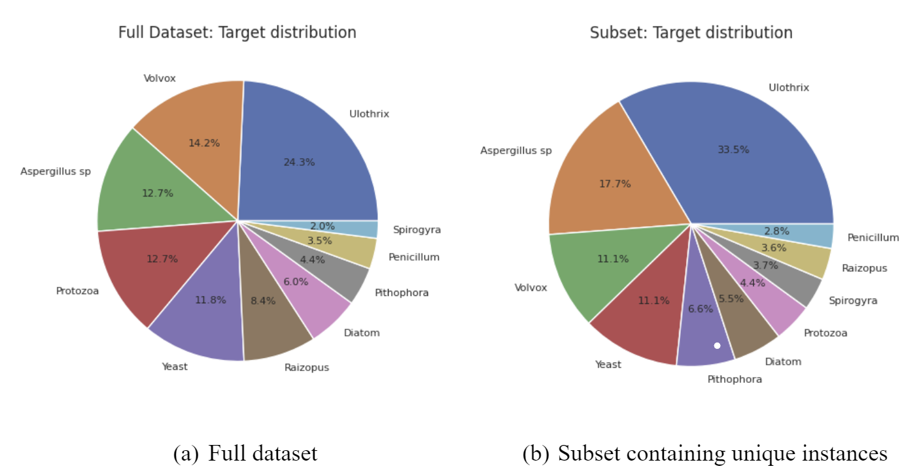
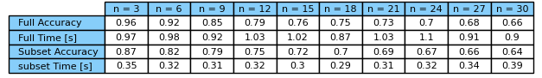
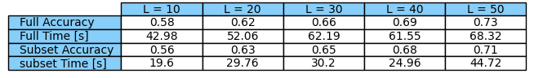
Classification of Microorganisms Using Various Machine Learning Methods
Gaurav Kumar University of Delaware | Data Science
Dataset
“Microbes Dataset” from Kaggle
30,527 instances in the full dataset with about 84% duplicates
4,874 unique instances for subset dataset
25 different attributes
10 different microbes as target values
Summary
K-Nearest Neighbor has the highest accuracy and lower runtime compared to other two methods
Since no training is involved in K-nearest neighbor, this method had a lower runtime
Using the subset dataset provided quicker runtimes
Due to the nature of the problem, a K-nearest neighbor model is suggested
Introduction
Machine Learning has been applied to biomedical and genetics research
DNA sequencing is used to develop antibiotics for bacterial infections
Gradient Boosting
Number of boosting steps set to 1000
Learning rate of 0.1
Base learner depth of 3
Ran one time for full dataset and subset dataset
Objectives
Compare the results of applying K-Nearest Neighbor, Multilayer Perceptron, and Gradient Boosting to gene identification
Compare the methods’ accuracy and runtime
Evaluate effect of duplicate instances within the dataset
Results
K-Nearest Neighbor
Highest accuracy obtained for three neighbor for both full dataset and subset dataset.
Distant weight function produces highest accuracy
Future Work
Repeat gradient descent method for more accurate timing
Perform feature selection to reduce collinearity among attributes
Perform hyperparameter tuning for each model
Motivation and Related Works
Gene sequencing needs to be done accurately and efficiently
Delay in gene identification drastically increases patient risk
Dhinda et al. were the first to use this dataset on multiple machine learning methods
Chen and Boggess compared performances of neural networks on gene classification
Wang developed a sequential self-optimization structure and bootstrapping technique to improve accuracy
Experiment
Processing dataset
Balanced sample size with SMOTE
Scaled attribute
80% and 20% split of the data
K-Nearest Neighbor
Varied number of neighbors from 3 to 30 in increments of 3
Compare “uniform” and “distance” weights
Repeated 10 times for timing
Multilayer Perceptron
Varied number of hidden layers from 10 to 50 in increments of 10
Repeated 5 times for timing
Multilayer Perceptron
Increase in hidden layer increases the accuracy
Runtime of subset is higher then full dataset
97.8% accuracy obtained using 500 hidden layer on the full dataset
References
Dhindsa, Anaahat, et al. (2020), “Dataset for Efficient Microbes Classification System ”, Mendeley Data, V3, doi: 10.17632/f9m85ptmvc.3
Sayan Saha, “Microbes Dataset.” Kaggle, 2020. https://www.kaggle.com/datasets/ sayansh001/microbes-dataset
Dhindsa, Anaahat, et al. “An Improvised Machine Learning Model Based on Mutual Information Feature Selection Approach for Microbes Classification.” Entropy, vol. 23, no. 2, Feb. 2021, p. 257. Crossref, https://doi.org/10.3390/e23020257.[4] C. W. Wang, "New Ensemble Machine Learning Method for Classification and Prediction on Gene Expression Data," 2006 International Conference of the IEEE Engineering in Medicine and Biology Society, New York, NY, USA, 2006, pp. 3478-3481, doi: 10.1109/IEMBS.2006.259893.
Liangyou Chen and L. Boggess, "Neural networks for genome signature analysis," Proceedings of the 9th International Conference on Neural Information Processing, 2002. ICONIP '02., Singapore, 2002, pp. 1554-1558 vol.3, doi: 10.1109/ICONIP.2002.1202882.
Gradient Boosting
Full dataset accuracy: 98.5%
Full dataset time: about 200 seconds
Subset dataset accuracy: 85.4%
Subset dataset time: about 316 seconds

