Slide 1
Data Analytics Project
Customer Churn Analysis
& Customer Intelligence
Who leaves an OTT subscription service, why they leave, and what it costs, built end-to-end with SQL and Python
28.6%
Rs 74
6.7×
20+
churn rate
monthly revenue lost
monthly vs annual churn
KPIs calculated
Gaurav Kalamkhede · SQL (SQLite) · Python · pandas · NumPy · Matplotlib · Seaborn
Notes:
This project is an end-to-end churn analysis for an OTT subscription business. I took raw multi-table data, built a SQL database, cleaned and joined it in Python, calculated 20+ KPIs and turned them into retention recommendations.

Slide 2
Executive summary
Churn is driven by contract type, support escalations and low-intent referral sign-ups.
Monthly subscribers churn 6.7× more than annual subscribers (55.6% vs 8.3%).
Every customer with an escalated complaint churned: 100% vs 6.3% for everyone else.
Referral sign-ups churn at 83%; organic users at 0%.
Churn cost Rs 73.94 MRR (18.7%) and Rs 2,047 lifetime value.
Two levers: move monthly users to annual plans, and treat every escalation as a churn alert.
28.6%
71.4%
Churn rate
Retention
6 of 21 customers
still subscribed
Rs 74
Rs 2,047
MRR lost
CLTV lost
18.7% of revenue
lifetime value
Rs 18.85
0.88
ARPU
Escalation corr.
avg monthly charge
with churn
Customer Churn Analysis · Gaurav Kalamkhede
2
Notes:
Main message first: churn is concentrated in monthly contracts, escalated customers and referral sign-ups.

Slide 3
The business problem: who, why and when
Acquiring a subscriber costs several times more than keeping one. Leadership needs to know where retention budget protects the most revenue.
WHO
WHY
WHEN
Which customers left, and who is likely to leave next?
What drives them to cancel?
When does churn happen?
Churn by plan, contract, channel, state, age, gender; churn-risk tiers
Cancellation reasons, complaints, escalations, CSAT, pricing
Monthly churn trend and tenure at cancellation
Customer Churn Analysis · Gaurav Kalamkhede
3
Notes:
Churn analysis answers three questions: who, why and when. Each one maps to a set of analyses in the notebook.

Slide 4
Data and tools
Tech stack
db_customer
21 rows
1.
SQL / SQLite
customerid, name, country, state, gender, dob, interests, pincode
database, joins, CASE WHEN, GROUP BY
2.
pandas & NumPy
db_subscription
21 rows
cleaning, features, KPIs
start / renewal / cancellation dates, plan, contract, channel, monthly charges, CLTV, churn score, cancellation reason
3.
Matplotlib & Seaborn
10 charts and heatmap
db_support
9 rows
complaint date, escalation (Y/N), CSAT score, comment
4.
Jupyter & GitHub
reproducible notebook and repo
Churned = the subscription has a cancellation_date. Snapshot date for tenure and age: 31-Dec-2025.
Customer Churn Analysis · Gaurav Kalamkhede
4
Notes:
Three relational tables from one Excel export: customer, subscription and support.

Slide 5
How I built it: an 8-step pipeline
1.
2.
3.
4.
Import
Profile
Clean
Engineer
Excel → SQLite → pandas via SQL
nulls, duplicates, labels
types, renames, standardise, impute
churn flag, tenure, age, risk tier
5.
6.
7.
8.
Join
Analyse
Validate
Visualise
3 tables, row-count assertion
20+ KPIs, segments, pivots
KPIs recomputed in SQL
charts → insights → actions
Customer Churn Analysis · Gaurav Kalamkhede
5
Notes:
The same pipeline is in the notebook (step by step) and in src/churn_pipeline.py (one command).

Slide 6
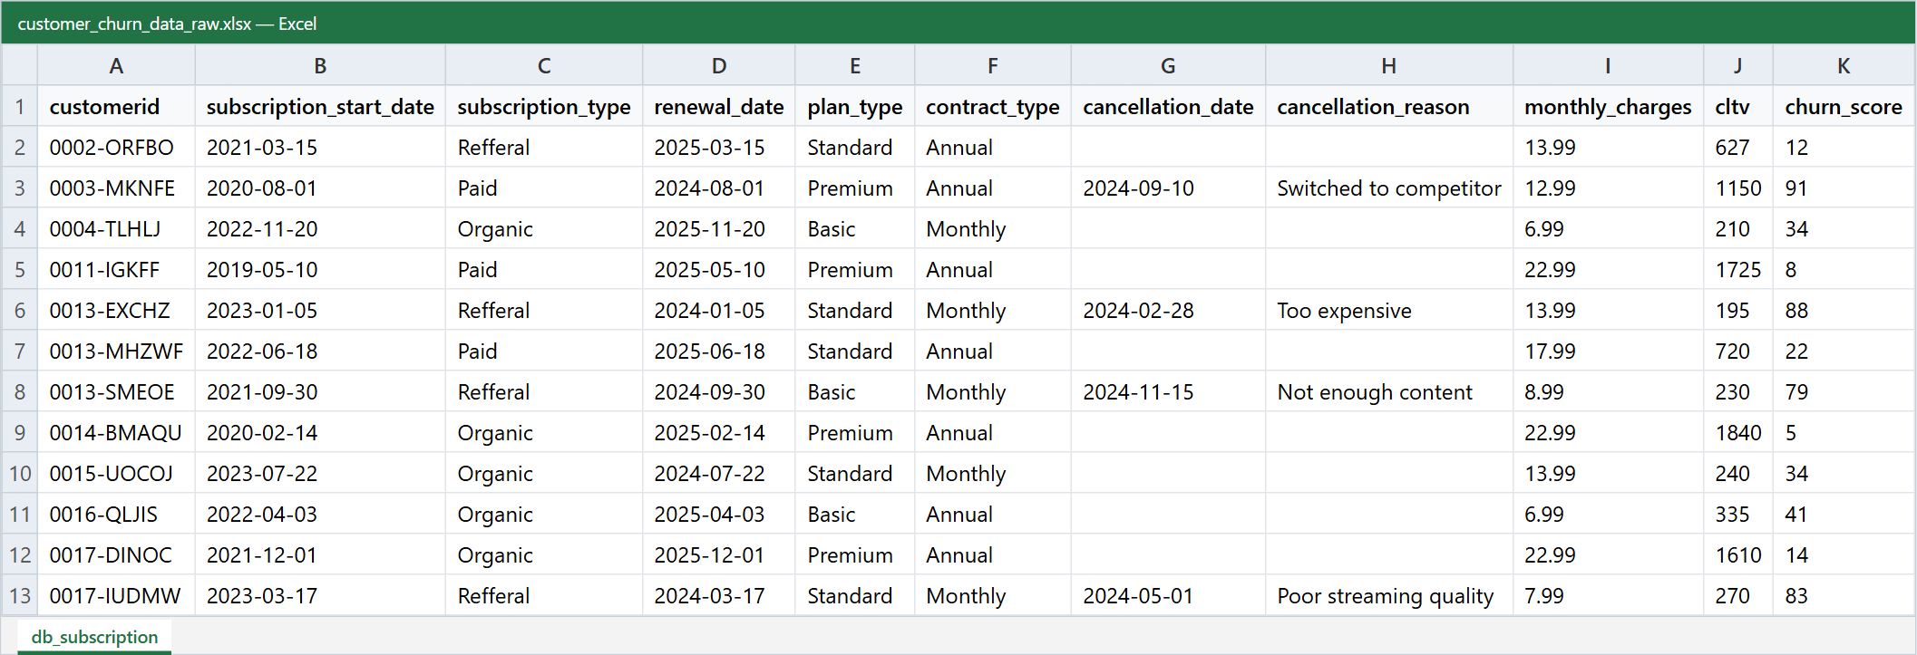
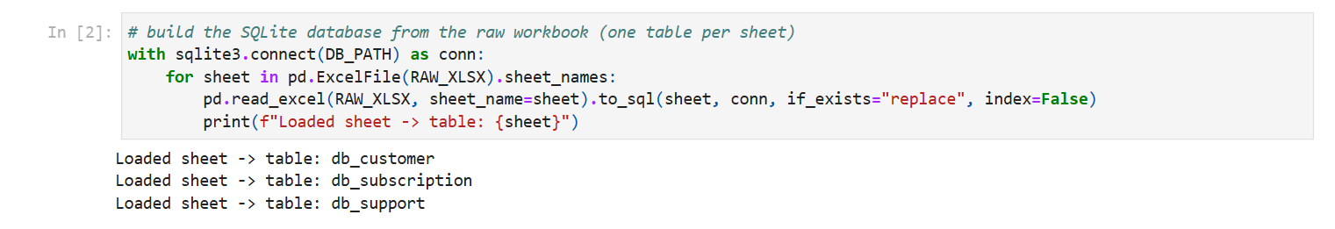
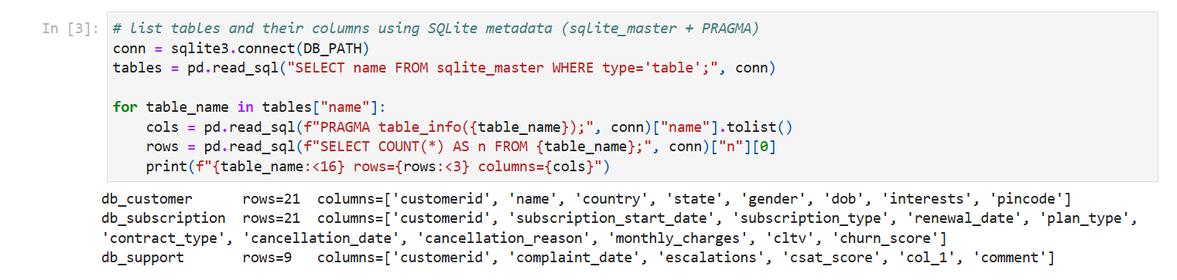
Step 1: Excel → SQLite → pandas
Each Excel sheet becomes a SQLite table. I read the schema with sqlite_master and PRAGMA table_info, then load each table into pandas with SQL, the same way I would pull from a production warehouse.
Customer Churn Analysis · Gaurav Kalamkhede
6
Notes:
Raw subscription sheet on top; below, the notebook code that builds the database and lists the tables.

Slide 7
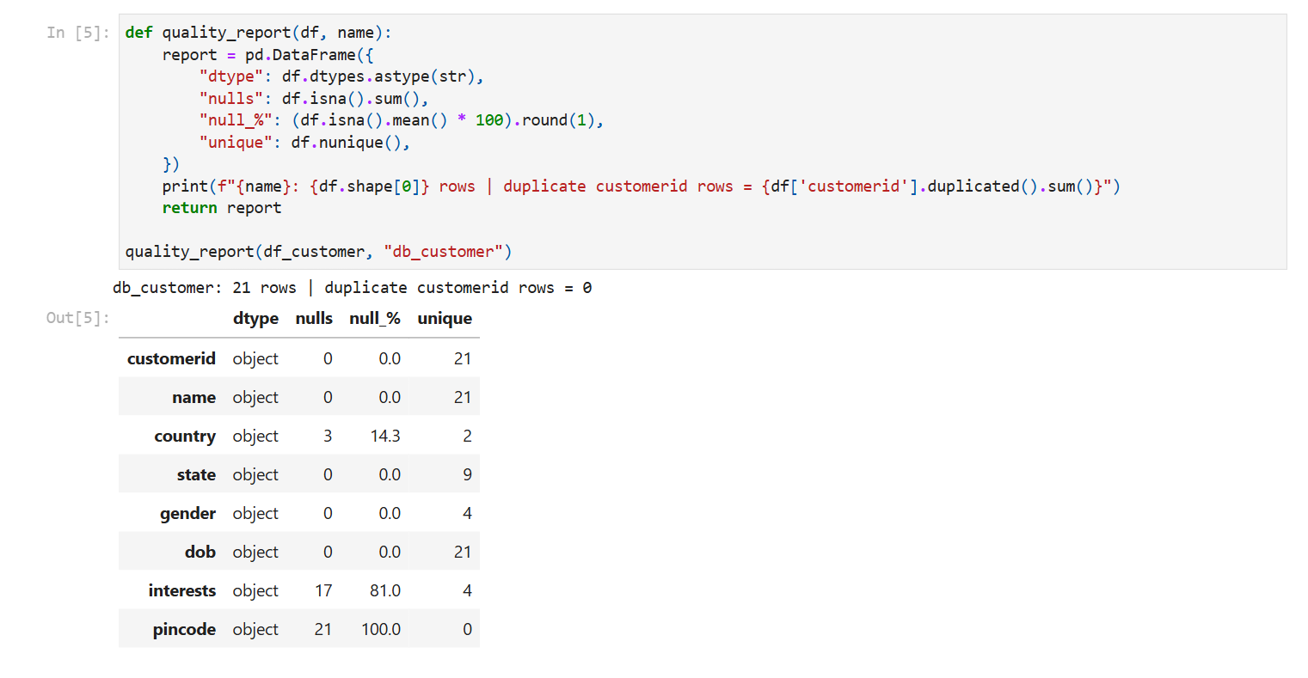
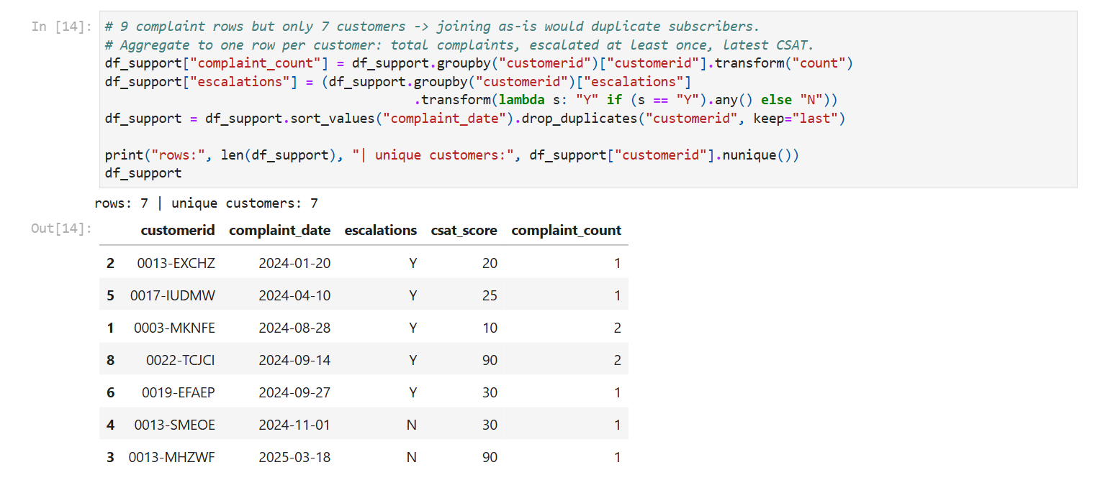
Step 2–3: Data quality checks and cleaning
Issue found → fix
Gender: Male / Female / Men / Women
Standardised
3 missing countries
Filled from state map
interests 81% null, pincode 100% null
Dropped
Dates stored as text
Converted to datetime
Typo 'Refferal'
Corrected
9 tickets for 7 customers
One row per customer
Customer Churn Analysis · Gaurav Kalamkhede
7
Notes:
The key fix: duplicate support tickets. Joining them as-is would turn 21 subscribers into 23 rows and inflate every KPI, so I aggregated them to one row per customer first.

Slide 8
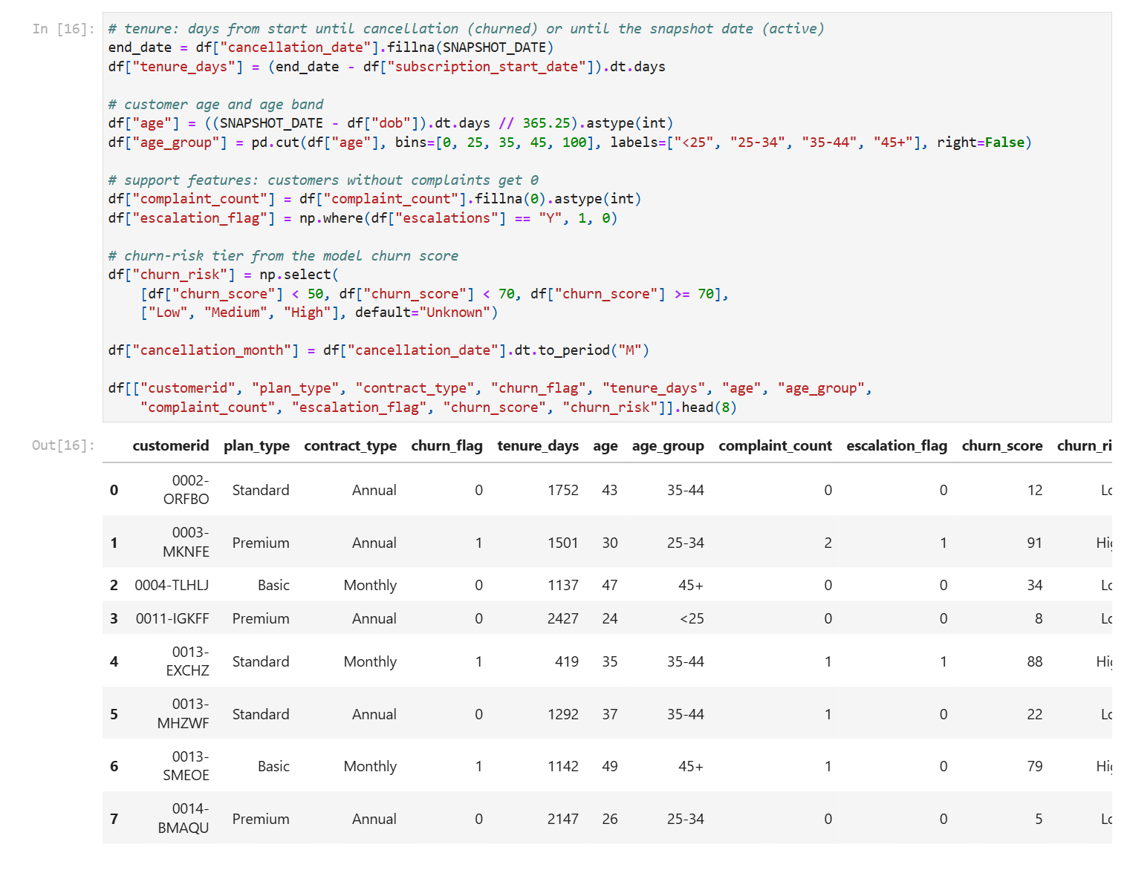
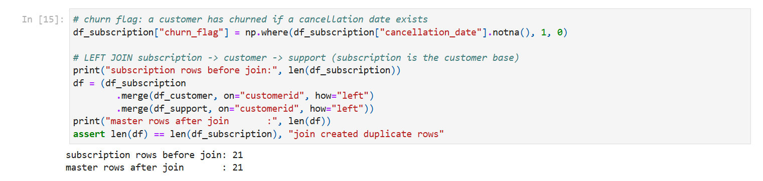
Step 4–5: Feature engineering and safe joins
1.
churn_flag
1 if cancellation_date exists
2.
tenure_days
start → cancel / snapshot date
3.
age, age_group
age bands <25 … 45+
4.
complaint_count
tickets per customer
5.
escalation_flag
ever escalated (Y)
6.
churn_risk
Low <50 · Medium 50–69 · High ≥70
Customer Churn Analysis · Gaurav Kalamkhede
8
Notes:
The join uses subscription as the base table and asserts the row count stays at 21.

Slide 9
KPI scorecard
28.6%
71.4%
Rs 18.85
1,355
Churn rate
Retention rate
ARPU
Avg tenure (days)
6 of 21
active customers
Rs 21.46 for active
≈ 3.7 years
Rs 396
Rs 74
Rs 2,047
23.8%
Monthly revenue
MRR lost
CLTV lost
Escalation rate
total MRR
18.7% of MRR
lifetime value
0.43 complaints / user
Validated in SQL: churn rate, ARPU, MRR lost and CLTV lost recomputed directly in SQLite match the pandas results exactly.
Customer Churn Analysis · Gaurav Kalamkhede
9
Notes:
Headline KPIs. ARPU is the average monthly charge across all customers; tenure is measured to 31-Dec-2025.

Slide 10
Monthly contracts churn 6.7× more than annual
Takeaway
5 of the 6 churned customers were on monthly contracts.
Basic churns most (60%), but Premium earns 55% of revenue at only 14% churn.
Converting monthly users to annual plans is the biggest lever.
Customer Churn Analysis · Gaurav Kalamkhede
10
Notes:
Contract length matters more than plan tier. Basic + Monthly is the worst cell at 75% churn.

Slide 11
Escalations and referral sign-ups predict churn
Takeaway
All 5 escalated customers churned. Correlation with churn: 0.88.
An escalation is the clearest early-warning signal in the data.
Referral users churn at 83%; the referral funnel brings in low-intent users.
Customer Churn Analysis · Gaurav Kalamkhede
11
Notes:
Support experience and acquisition channel are both strong churn signals.

Slide 12
Churn peaked in Sep-2024 and in two states
Karnataka lost 2 of 2 customers and Meghalaya 2 of 3; five states had zero churn. Check pricing changes, outages and competitor launches around Sep-2024.
Customer Churn Analysis · Gaurav Kalamkhede
12
Notes:
Six cancellations between Feb and Nov 2024, two of them in September.

Slide 13
We lose low-value customers, mostly to competitors
Takeaway
Churned CLTV is 3× lower.
Competitors and price drive half of the exits.
Price, content and streaming-quality complaints each map to a product action: pricing tiers, content bundles and QoS monitoring.
Customer Churn Analysis · Gaurav Kalamkhede
13
Notes:
Churned customers average Rs 341 CLTV against Rs 1,016 for retained customers.

Slide 14
Revenue at risk: who to call this month
2
Active customers at risk
Medium tier, still subscribed
Rs 34.98
MRR at risk
Rs 1,190 CLTV at risk
All 6 High-risk customers have already churned, so the churn score works. The 2 Medium-risk active customers are the outreach list.
Customer Churn Analysis · Gaurav Kalamkhede
14
Notes:
Risk tiers come from churn_score: Low below 50, Medium 50 to 69, High 70 and above.

Slide 15
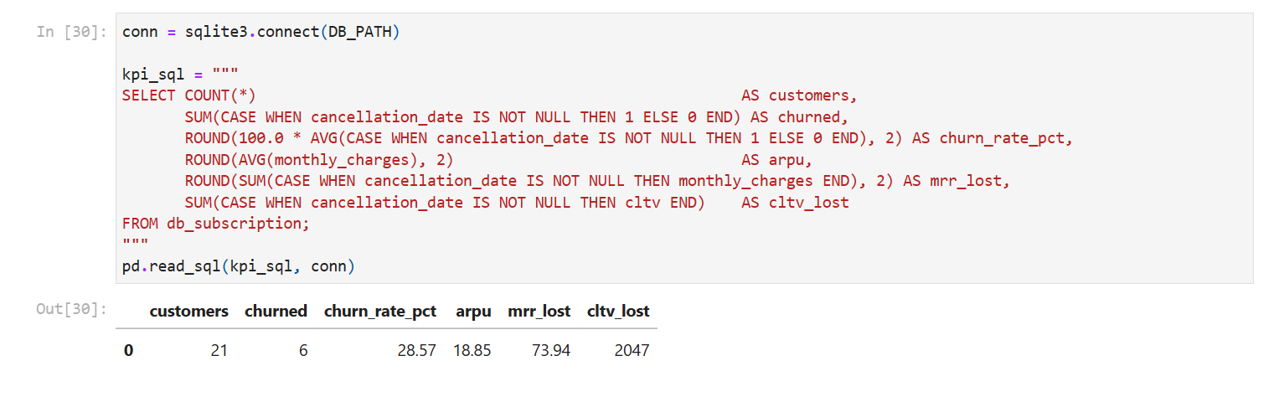
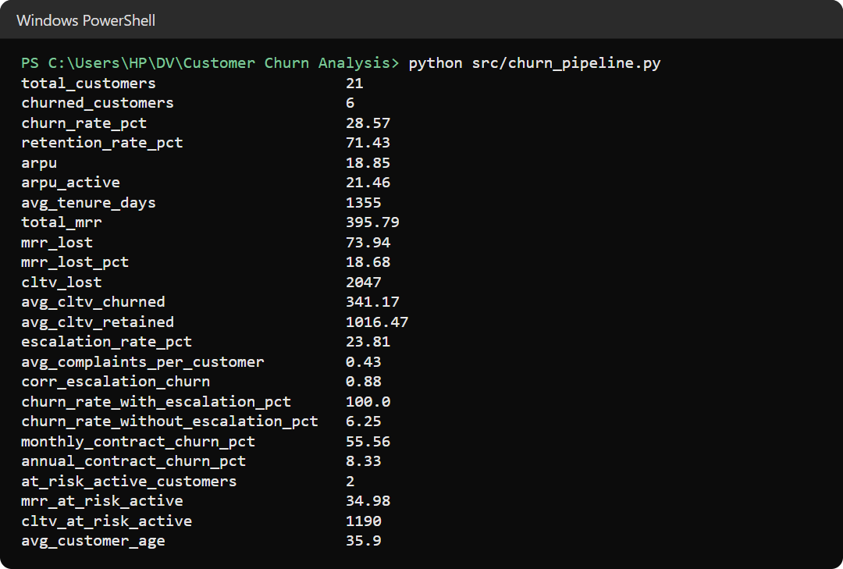
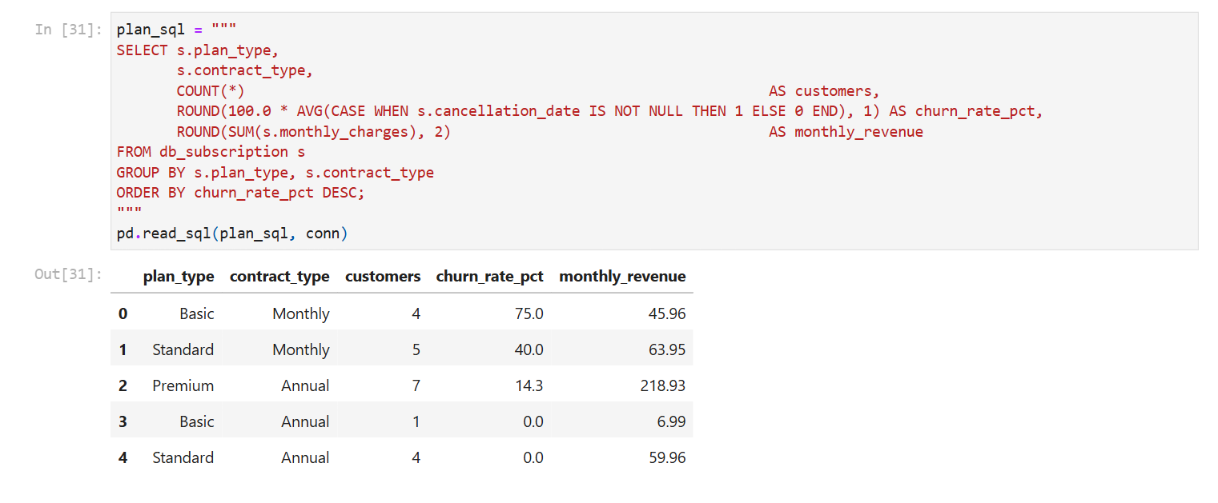
Every KPI cross-checked in SQL
Customer Churn Analysis · Gaurav Kalamkhede
15
Notes:
SQL with CASE WHEN, JOIN, GROUP BY and HAVING gives the same numbers as pandas. The pipeline script reproduces everything in one command.

Slide 16
Recommendations
1.
Monthly → annual
2.
Escalation SLA
3.
Fix referral funnel
Offer 2 months free to switch to an annual plan at renewal.
Senior agent, 48-hour fix, goodwill credit for every escalation.
Tighter eligibility, longer onboarding, annual nudge.
Annual churn is 6.7× lower
Targets a 100%-churn group
Referral churn is 83%
4.
Basic-plan value
5.
Proactive outreach
6.
Root-cause review
A/B test a content bundle or a cheap upgrade path.
Call, email and SMS Medium/High-risk users, ordered by CLTV.
Investigate Karnataka and Sep-2024: price, outages, competitors.
Basic churn is 60%
Rs 34.98 MRR at risk
2 exits to competitors
Customer Churn Analysis · Gaurav Kalamkhede
16
Notes:
Recommendations 1 and 2 have the highest impact. Track success with monthly churn rate, monthly-to-annual conversion and churn among escalated users.

Slide 17
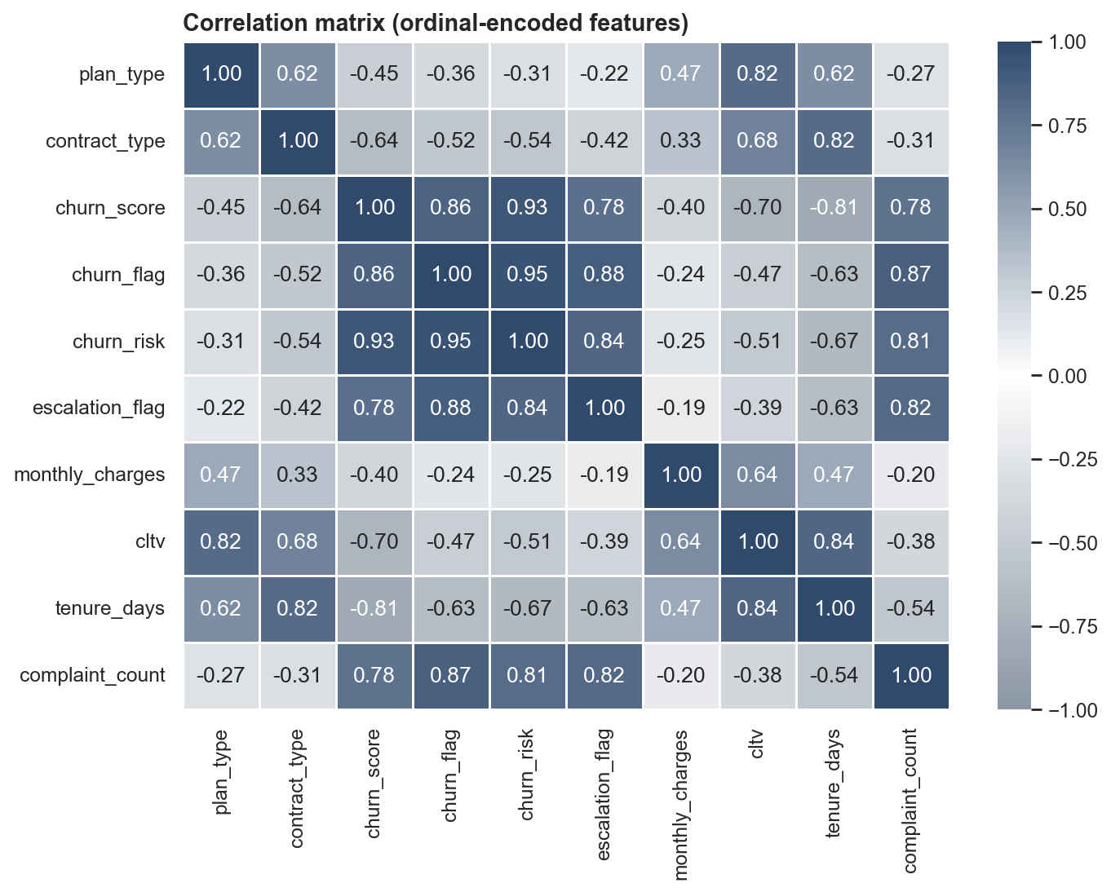
Limitations and next steps
1.
Small sample
21 customers shows the method; confirm the rates on the full customer base.
2.
Predictive model
Train my own churn model (logistic regression or XGBoost) instead of relying on the given churn score.
3.
Live dashboard
Publish the KPIs in Power BI or Tableau, refreshed from the SQL database.
4.
Cohort analysis
Retention curves by sign-up month and channel.
Customer Churn Analysis · Gaurav Kalamkhede
17
Notes:
The correlation matrix (ordinal-encoded) already shows strong signals for a predictive model: escalations, complaints and contract length.

Slide 18
Thank you
Questions and feedback welcome
Notebook
notebooks/churn_analysis.ipynb
Pipeline
src/churn_pipeline.py
Report
reports/Customer_Churn_Analysis_Report.pdf
Code
github.com/gauravkal006/Customer-Churn-Analysis
Gaurav Kalamkhede

