Slide 1
Retail Orders Analysis
End-to-end data analytics project with Python (pandas) and SQL
Gaurav Kalamkhede
9,994 orders, 2022-2023 | github.com/gauravkal006
2,215,859
205,169
9.26%
+2.25%
Total sales
Total profit
Profit margin
Sales growth 2023 vs 2022

Slide 2
Project overview
Turn a raw retail orders file into answers about products, months, regions and profit.
Data: Kaggle 'Retail Orders' - 9,994 order lines, United States, Jan 2022 to Dec 2023.
Flow from Ankit Bansal's tutorial
1
Clean
2
Load
3
Analyse
Fix missing values, rename columns, derive discount, sale price and profit in pandas
Load the clean table into a SQLite database
Answer five business questions in SQL
Added by me
■ Six more SQL queries using window functions and CTEs
■ Charts, an Excel dashboard, this deck and a PDF report
■ A one-command pipeline (src/pipeline.py) and checks that SQL and pandas agree
Retail Orders Analysis | Gaurav Kalamkhede
2

Slide 3
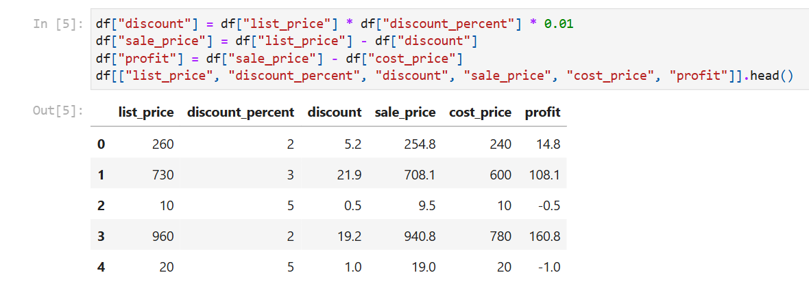
Step 1: Cleaning the data with pandas
■ Missing values: 'Not Available' and 'unknown' read as NaN (6 ship modes).
■ Column names: converted to snake_case for pandas and SQL.
■ New columns: discount, sale_price and profit.
■ Dates: order_date converted from text to a date.
■ Dropped: list_price and cost_price (already captured).
■ Result: 9,994 rows, no duplicate orders, no rows lost.
Notebook: deriving discount, sale_price and profit
Retail Orders Analysis | Gaurav Kalamkhede
3

Slide 4
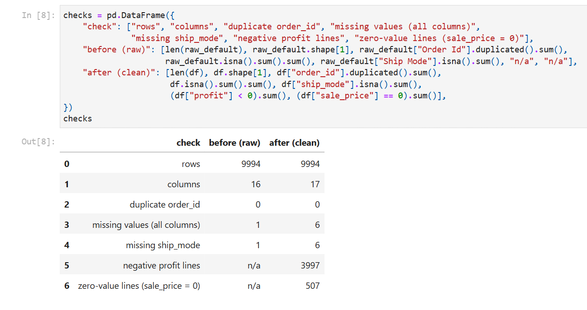
Checks after cleaning
■ No rows lost, every order_id unique.
■ 507 lines have a price and cost of 0. They add nothing, so they are kept.
■ 3,997 lines (40%) lose money.
– 3,955 have list price = cost, so any discount makes a loss
– Total loss is 3,151 (1.5% of profit)
Notebook: checks before and after cleaning
Retail Orders Analysis | Gaurav Kalamkhede
4

Slide 5
Headline numbers
2,215,859
205,169
9.26%
9,994
Total sales
Total profit
Profit margin
Orders
221.72
80,331
+2.25%
+1.90%
Average order value
Total discount given
Sales growth 2023 vs 2022
Profit growth 2023 vs 2022
■ Sales rose from 1,095,590 in 2022 to 1,120,268 in 2023.
■ Profit grew slightly slower than sales, so the margin dipped from 9.28% to 9.24%.
■ About 1 in every 11 dollars of sales is profit.
Retail Orders Analysis | Gaurav Kalamkhede
5

Slide 6
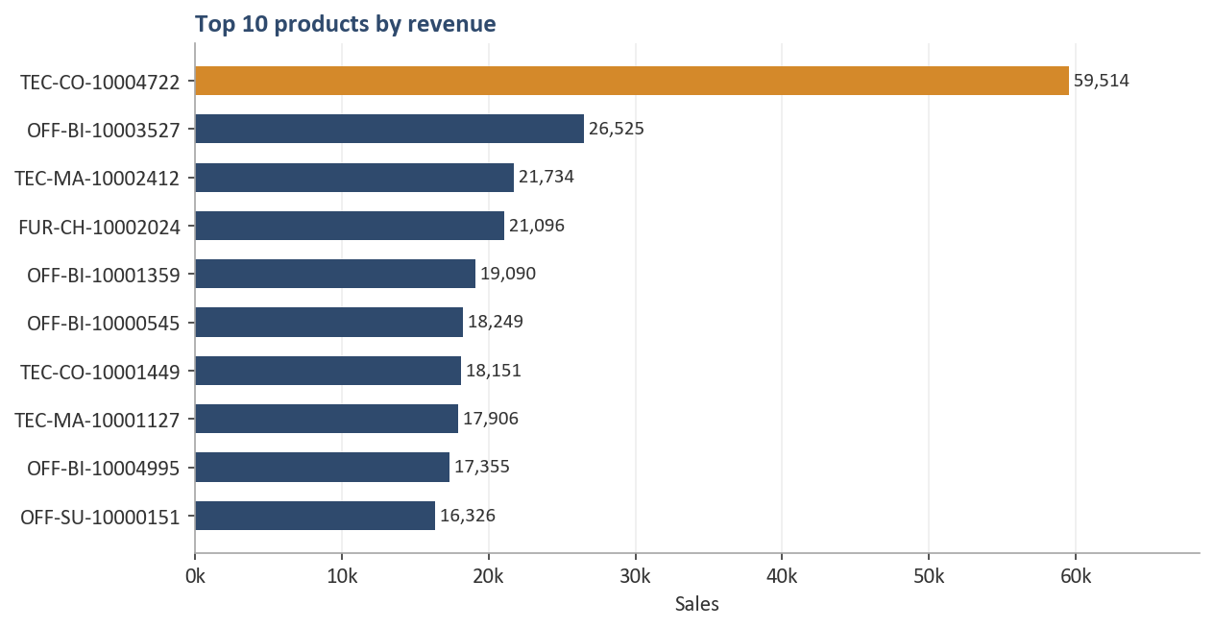
Q1. Top 10 products by revenue
■ TEC-CO-10004722 (a copier) earns 59,514, more than twice the second product.
■ It is 2.7% of all sales on its own.
■ Four of the top ten are binders; two are machines.
Retail Orders Analysis | Gaurav Kalamkhede
6

Slide 7
Q2 and Q4. Leaders by region and best month by category
Q2: No. 1 product in each region
Q4: Highest-sales month by category
Region | No. 1 product | Sales
Central | TEC-CO-10004722 | 16,975
East | TEC-CO-10004722 | 29,099
South | TEC-MA-10002412 | 21,734
West | TEC-CO-10004722 | 13,440
Category | Best month | Sales
Furniture | 2022-10 | 42,889
Office Supplies | 2023-02 | 44,118
Technology | 2023-10 | 53,000
■ The same copier leads three of the four regions. The South is led by a machine.
■ October appears twice: it is a strong month for Furniture and Technology.
■ Full top-5 lists for every region are in sql/analysis.sql (Q2).
Retail Orders Analysis | Gaurav Kalamkhede
7

Slide 8
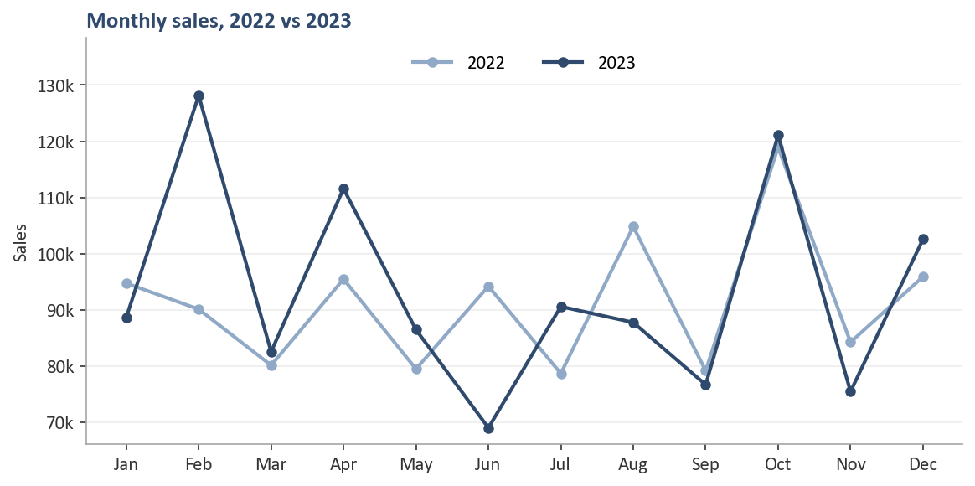
Q3. Month-over-month sales, 2022 vs 2023
■ 2023 beat 2022 in 7 of 12 months.
■ Biggest gains: February (+42%) and April (+17%).
■ Biggest falls: June (-27%) and August (-16%).
■ October was a top-two month in both years.
Retail Orders Analysis | Gaurav Kalamkhede
8

Slide 9
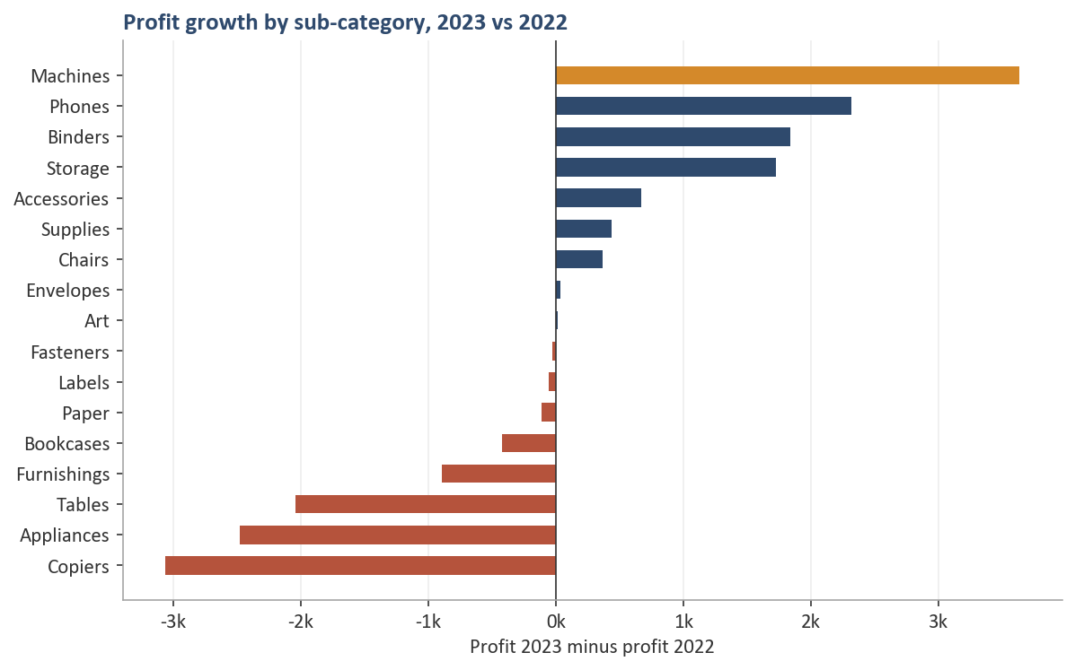
Q5. Which sub-category grew profit the most?
■ Machines: profit up from 7,243 to 10,878 (+50%).
■ Phones, Binders and Storage also grew strongly.
■ Copiers, Appliances and Tables lost the most, about 7.6k together.
■ 9 sub-categories grew, 8 declined.
Retail Orders Analysis | Gaurav Kalamkhede
9

Slide 10
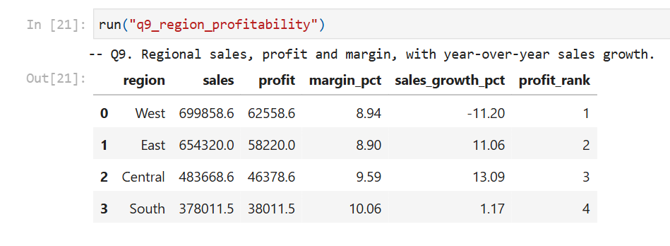
Step 2: SQL in SQLite - techniques used
■ CTEs (WITH) to break queries into steps
■ ROW_NUMBER, RANK, DENSE_RANK for top-N per group
■ SUM() OVER (PARTITION BY ... ORDER BY ...) for running totals
■ SUM(SUM(x)) OVER () for share of total
■ CASE WHEN to pivot 2022 and 2023 into columns
■ strftime() for year and month in SQLite
Notebook: Q9 regional profitability query result
Retail Orders Analysis | Gaurav Kalamkhede
10

Slide 11
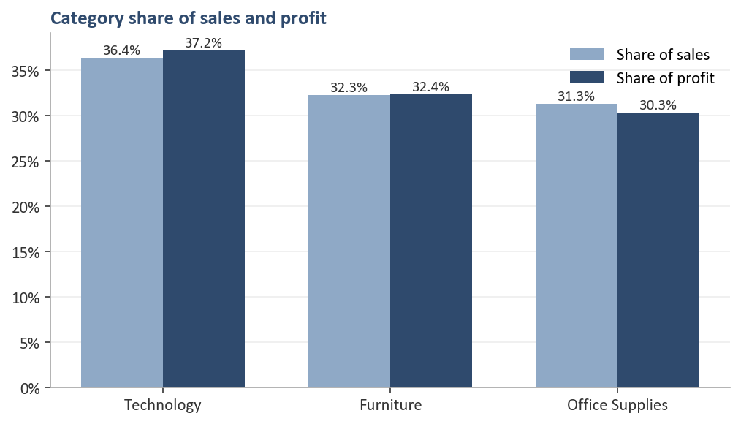
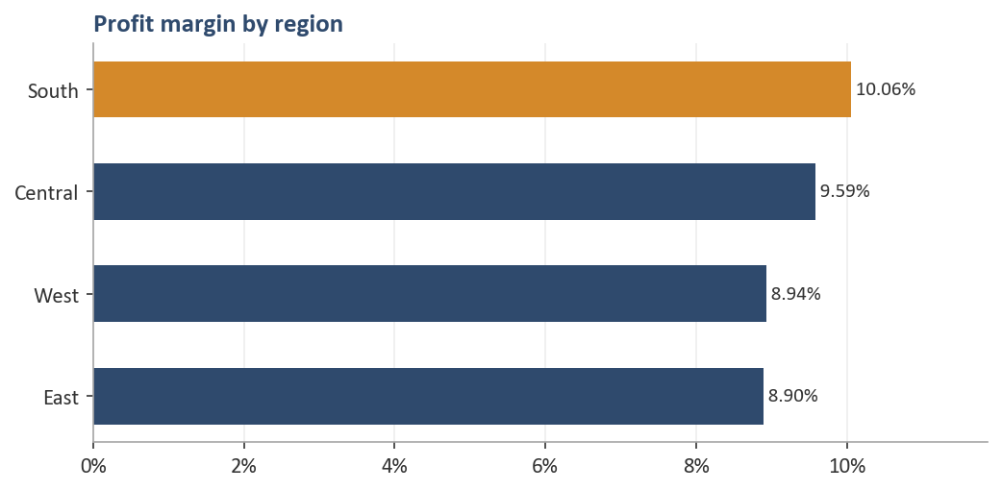
Categories and regions
■ Technology is the largest category (36% of sales, 37% of profit). Margins are similar across categories.
■ South has the best margin (10.06%) but the lowest sales.
■ West sells the most, but its sales fell 11.2% in 2023 while the other regions grew.
Retail Orders Analysis | Gaurav Kalamkhede
11

Slide 12
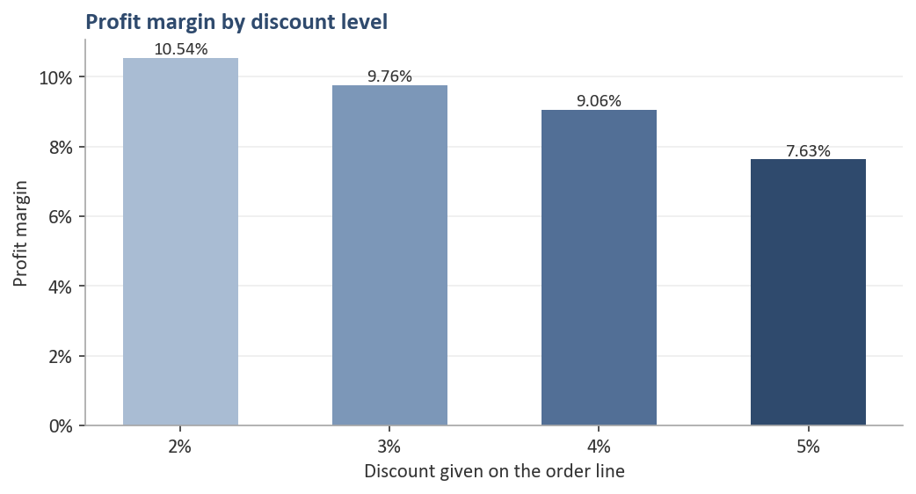
Discounts reduce margin
■ Margin falls from 10.54% at a 2% discount to 7.63% at 5%.
■ Each discount level has about 2,500 lines, so this is not a few large orders.
■ The 4% and 5% levels gave 51,404 of discount.
■ Items with no markup still get discounts and make a loss.
Retail Orders Analysis | Gaurav Kalamkhede
12

Slide 13
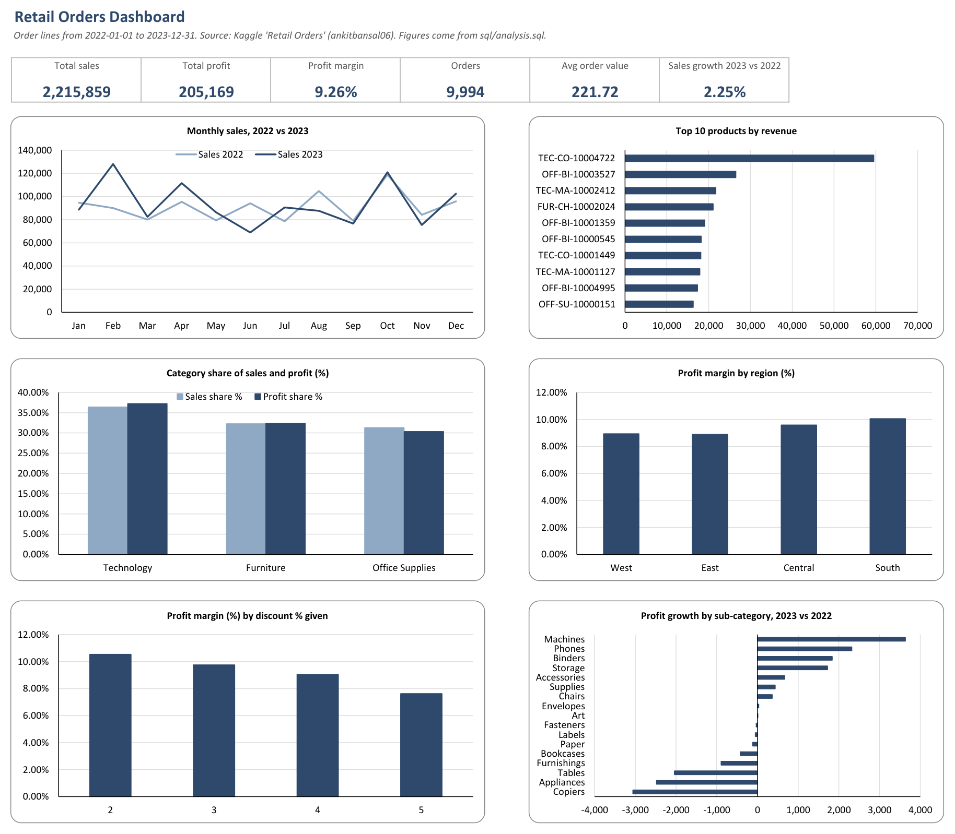
Excel dashboard
excel/Retail_Orders_Dashboard.xlsx - KPI cells, native Excel charts, and data sheets with conditional formatting
Retail Orders Analysis | Gaurav Kalamkhede
13

Slide 14
Recommendations
1
Stop discounting items sold at cost
2
Review the 4-5% discount levels
This removes almost all loss-making lines.
They cost about 51k and give the lowest margins.
3
Look into the West
4
Protect the top copier
The biggest region, but the only one that shrank in 2023.
One product brings 2.7% of all sales.
5
Check Copiers, Appliances and Tables
6
Plan for busy months
Find out why their profit fell: price, cost or mix.
October is strong every year; February and April were strong in 2023.
Retail Orders Analysis | Gaurav Kalamkhede
14

Slide 15
Tools and acknowledgement
■ Python: pandas (cleaning), matplotlib (charts), openpyxl (Excel), python-pptx (slides), Playwright (PDF)
■ SQL: SQLite - 11 queries in sql/analysis.sql
■ Notebook: notebooks/retail_orders_analysis.ipynb, executed with outputs
■ Reproducible: python src/pipeline.py rebuilds the clean data, SQL results, KPIs and charts
Acknowledgement
■ The flow and the five core questions follow Ankit Bansal's YouTube tutorial 'End to End Data Analytics Project (Python + SQL)' and his Kaggle dataset. The code was written fresh, and the extended analysis, dashboard, report and slides were added.
Retail Orders Analysis | Gaurav Kalamkhede
15

