Slide 1
Memo
By Gaurav Kant Shankhdhar

Slide 2
Pure Components and Memo
Pure components are class components that only render when there is a change in shallow comparison of props or states.
Exactly the same functionality is done in case of functional components using memo.

Slide 3
Memo cont..
Suppose there is a parent component in which the state, name = ‘Harry’ which is not changing and there is also a timer setInterval to 2 sec. So, on every 2 sec, the name must rerender. To change this for better performance, we need to render name only for the first time and the name must not rerender again and again. Her we use memo.

Slide 4
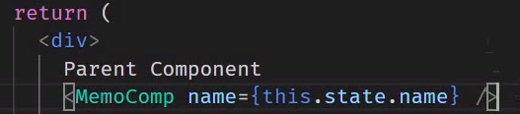
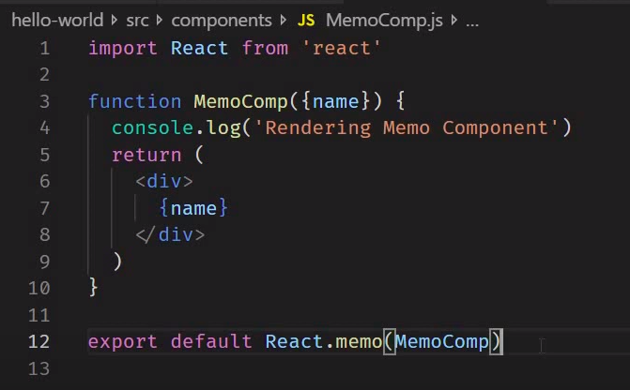
Memo cont..
In Parent component
In Child component

Slide 5
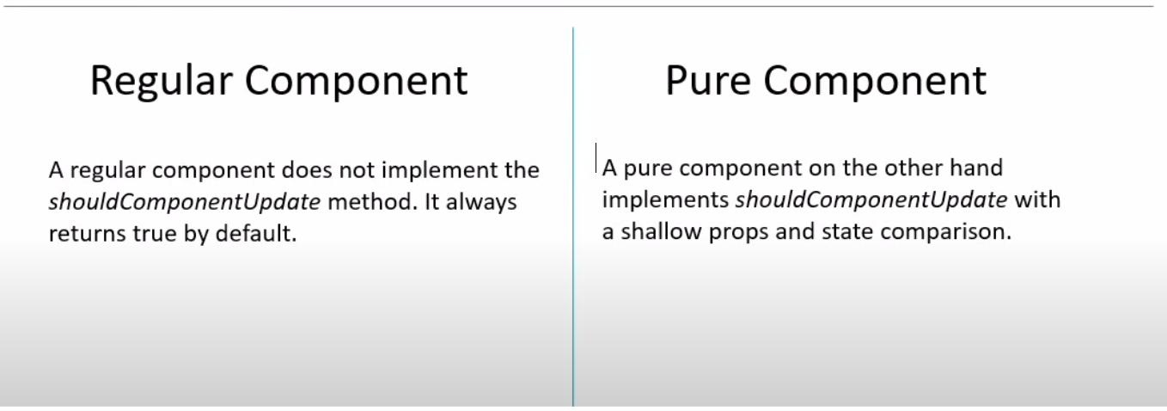
Regular Component versus Pure Component

Slide 6
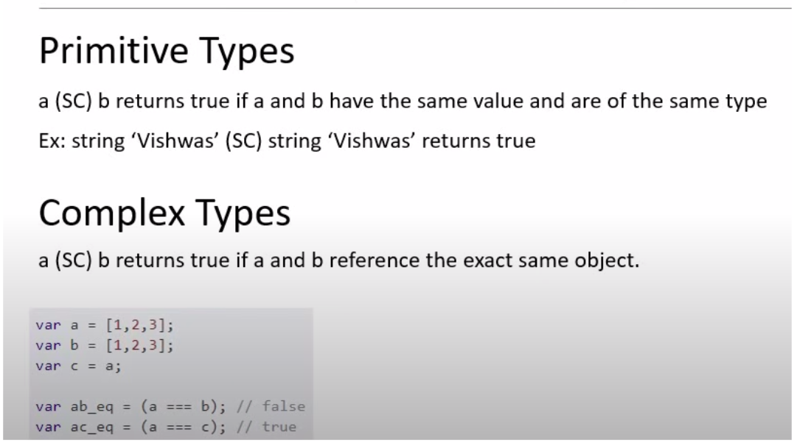
Shallow Comparison (SC)

