Slide 1
Sentiment Analysis
Shaikh Safir Mohammad Yelpale Kshitij Girdhar Shubham Raman Pranay Kapadiya Gaurav

Slide 2
Motivation and background
One of the Hot Topics of NLP
Extract Valuable information from the Text
Improve User Experience by providing better Results
Results based on the Factors identified by the Model
Factors identified by analyzing the User Sentiments
Giving Attention to each User Group
Increased Business Turnover, Satisfied Customers, More Interaction!

Slide 3
Previous Work
Sentiment Analysis based on:
a proposed approach that automatically classified the Tweets as positive, negative or neutral [1].
ontology [2].
a novel method which extracts structured data from emails by using data cleaning, data extraction, and data consolidation [3].
twitter data using different techniques such as Naive Bayes, Maximum Entropy and Support Vector Machine [4].
Naive Bayes Algorithm with a maximum of 82.1% accuracy [5].
the processing of Twitter API streaming feed in real time and to classify its polarity to provide valuable insight in industry and users [6].

Slide 4
Problem
Many a times, the important comments/reviews of Users/Customers are ignored which contain crucial information.
Cannot process each review/comment manually.
Challenges:
Irony and Sarcasm
Emojis
Defining Neutral
Comparisons etc.

Slide 5
How We Want to Solve the problem?
Build a generic Machine Learning model called "Emotion Model" for text classification of English language user sentiments.
The Model accurately extracts people's opinions from a large number of unstructured review texts and classifies them into sentiment classes, positive, neutral or negative! (Model Training).
We would like to use top Classification techniques such as Deep Neural Network using CNN, LSTM etc. and compare the results.
This Model can then be further used in multiple specific applications like Recommender Systems, Hotel/Restaurant Review Analysis etc.

Slide 6
Research Question and Hypothesis
Research Question: Is LSTM based model better than Bayes for sentiment analysis ?
Alternate Hypothesis(H1): LSTM outperforms Bayes based models
Null Hypothesis(H0): There is no difference between the performance of LSTM and Bayes based models

Slide 7
Evaluation and expectation
Platform: A simple webapp with intuitive UI. There will be a text box where the user can enter his review and press the submit button.
Process:
User enters the reviews
The reviews are processed and classification is done
A class is displayed as output for each review (eg: negative, neutral, positive)
The user is asked follow up questions whether he/she agrees with the classes assigned to the reviews
After collecting enough data points, Survey Accuracy is calculated for the user

Slide 8
Experimental Design
User | Model 1 | Model 2
U1 | 0.8 | 0.85
U2 | 0.75 | 0.88
U3
U4
U5
U6
U7
U8
U9

Slide 9
Statistical Test
Dependent variables DV: 1 (Accuracy)
Kind of DV: continuous (ratio)
Independent Variable(IV): 1 (Type of model)
Kind of IV: Discrete (1,2)
Levels of discrete IV: 2 (LSTM, Bayes)
Within subject IV: YES (users exposed to all test conditions)
Parametric data: mostly YES (as ratio data), but test of normality to be done
Statistical test: Paired T test (if parametric)
Wilcoxon signed-rank test (if non-parametric)

Slide 10
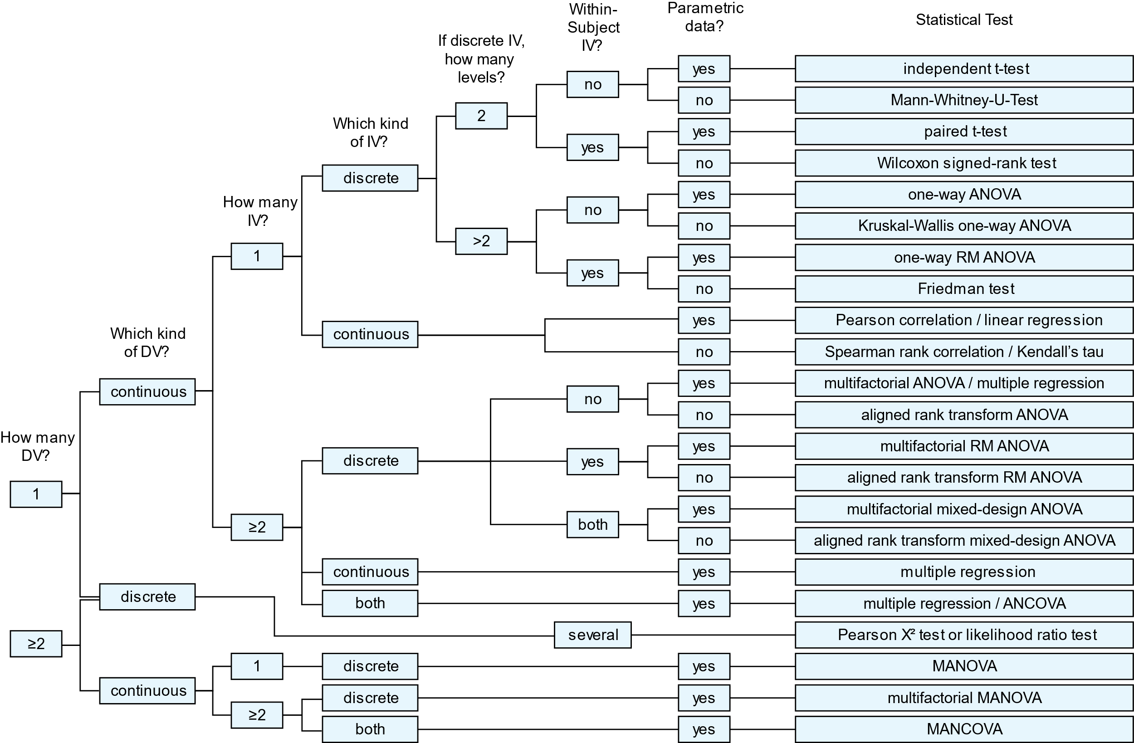

Slide 11
References
[1] V. Sahayak, V. Shete, and A. Pathan, “Sentiment analysis on twitter data,” International Journal of Innovative Research in Advanced Engineering (IJIRAE), vol. 2, no. 1, pp. 178- 183,2015.
[2] F. Ceci, A. L. Goncalves, and R. Weber, “A model for sentiment analysis based on ontology and cases,” IEEE Latin America Transactions, vol. 14, no. 11, pp. 4560–4566, 2016.
[3] S. S. A. Q. Mahlawi, “Structured data extraction from emails,” 2017 International Conference on Networks Advances in Computational Technologies (NetACT), vol. 37, pp. 323–328, 2017.
[4] V. Kharde, P. Sonawane et al., “Sentiment analysis of twitter data: a survey of techniques,” 2016.
[5] N. P. M. Vadivukarassi and P. Aruna, “Sentimental analysis of tweets using naive bayes algorithm,” World Applied Sciences Journal, vol. 35,
no. 1, pp. 54–59, 2017.
[6] Md. Rakibul Hasan, Maisha Maliha and M. Arifuzzaman, “Sentiment Analysis with NLP on Twitter Data,” International Conference on Computer, Communication, Chemical, Materials and Electronic Engineering (IC4ME2), 11-12 July, 2019.

Slide 12
Thank You

