Slide 1
Optimized Searching in RDBMS
Presented BY:
Gaurav Khurana
(01451203117)

Slide 2
OBJECTIVES
Implement
Implement a Table Scan for the relational database management System.
Implement
Implement Index Seek for Relational Database Management System .
Implement
Implement
Implement Multilevel Indexing in Relational Database Management System
Compare
Search in
Better search in less time
Implement B+ Tree for better query optimization
Compare the efficiency of Index Seek and Table Scan in the relational database.

Slide 3
Overview
This is a research-based project and the basic point motivating this project is learning and implementing algorithms that reduces time and space complexity.
In the first part of the project, we reduce the time taken to search a given record by using a B/B+ tree rather than indexing and traditional sequential access. It is concluded that disk-access times are much slower than main memory access times. Typical seek times and rotational delays are of the order of 5 to 6 milliseconds and typical data transfer rates are of the range of 5 to 10 million bytes per second and therefore, main memory access times are likely to be at least 4 or 5 orders of magnitude faster than disk access on any given system.

Slide 4
TOOLS AND TECHNOLOGY
SOFTWARE Used
FRAMEWORK Used
JAVA VIRTUAL MACHINE (JVM)
VISUAL STUDIO CODE
COMMAND PROMPT
ABSTRACT WINDOW TOOLKIT (AWT)
SWING

Slide 5
WHAT IS JAVA AWT?
Java AWT (Abstract Window Toolkit) is an API to develop GUI or window-based applications in java.
Java AWT components are platform-dependent i.e. components are displayed according to the view of operating system. AWT is heavyweight i.e. its components are using the resources of OS.
The java.awt package provides classes for AWT api such as TextField, Label, TextArea, RadioButton, CheckBox, Choice, List etc.

Slide 6
WHAT IS SWING?
Swing API is a set of extensible GUI Components to ease the developer's life to create JAVA based Front End/GUI Applications. It is built on top of AWT API and acts as a replacement of AWT API, since it has almost every control corresponding to AWT controls. Swing component follows a Model-View-Controller architecture to fulfill the following criteria:
A single API is to be enough to support multiple look and feel.
API is to be model driven so that the highest-level API is not required to have data.
API is to use the Java Bean model so that Builder Tools and IDE can provide better services to the developers for use.

Slide 7
B-TREE
B-Tree is a self-balancing search tree. In most of the other self-balancing search trees (like AVL and Red-Black Trees),
It is assumed that everything is in main memory. To understand the use of B-Trees, we must think of the huge amount of data that cannot fit in main memory.
When the number of keys is high, the data is read from disk in the form of blocks.
Disk access time is very high compared to main memory access time.
The main idea of using B-Trees is to reduce the number of disk accesses.

Slide 8
B-TREE
B Tree is a specialized m-way tree that can be widely used for disk access. A B-Tree of order m can have at most m-1 keys and m children.
A B tree of order m contains all the properties of an M way tree. In addition, it contains the following properties.
Every node in a B-Tree contains at most m children.
Every node in a B-Tree except the root node and the leaf node contain at least m/2 children.
The root nodes must have at least 2 nodes.
All leaf nodes must be at the same level.
It is not necessary that, all the nodes contain the same number of children but, each node must have m/2 number of nodes.

Slide 9
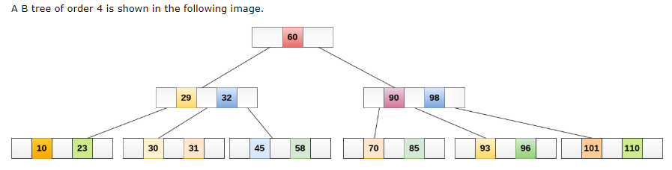
B-TREE
Image Courtesy: Javatpoint

Slide 10
WHY B+ Tree over B-TREE?
In order, to implement dynamic multilevel indexing, B-tree and B+ tree are generally employed. The drawback of B-tree used for indexing, however, is that it stores the data pointer (a pointer to the disk file block containing the key value), corresponding to a key value, along with that key value in the node of a B-tree. This technique, greatly reduces the number of entries that can be packed into a node of a B-tree, thereby contributing to the increase in the number of levels in the B-tree, hence increasing the search time of a record.

Slide 11
INFO CONTAINED BY B+ Tree Node
int *keys; // An array of keys
int t; // Minimum degree (defines the range for number of keys)
BTreeNode **C; // An array of child pointers
int n; // Current number of keys
bool leaf; // Is true when node is leaf. Otherwise false

Slide 12
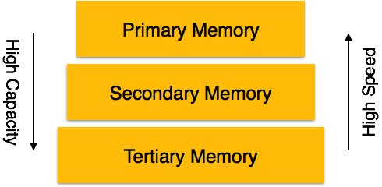
DBMS Data Storage System
Primary Storage − The memory storage that is directly accessible to the CPU comes under this category. CPU's internal memory (registers), fast memory (cache), and main memory (RAM) are directly accessible to the CPU, as they are all placed on the motherboard or CPU chipset
Secondary Storage − Secondary storage devices are used to store data for future use or as a backup. Secondary storage includes memory devices that are not a part of the CPU chipset or motherboard.
Tertiary Storage − Tertiary storage is used to store huge volumes of data. Since such storage devices are external to the computer system, they are the slowest in speed. These storage devices are mostly used to take the back up of an entire system.
Image Courtesy: JavaTpoint

Slide 13
ALGORITHM
The root of a B+ Tree represents the whole range of values in the tree, where every internal node is a subinterval.
We are looking for a value k in the B+ Tree.
Starting from the root, we are looking for the leaf which may contain the value k.
At each node, we figure out which internal pointer we should follow.
An internal B+ Tree node has at most ≤ children, where every one of them represents a different sub-interval.
We select the corresponding node by searching on the key values of the node.

Slide 14
PROJRCT DEMO

Slide 15
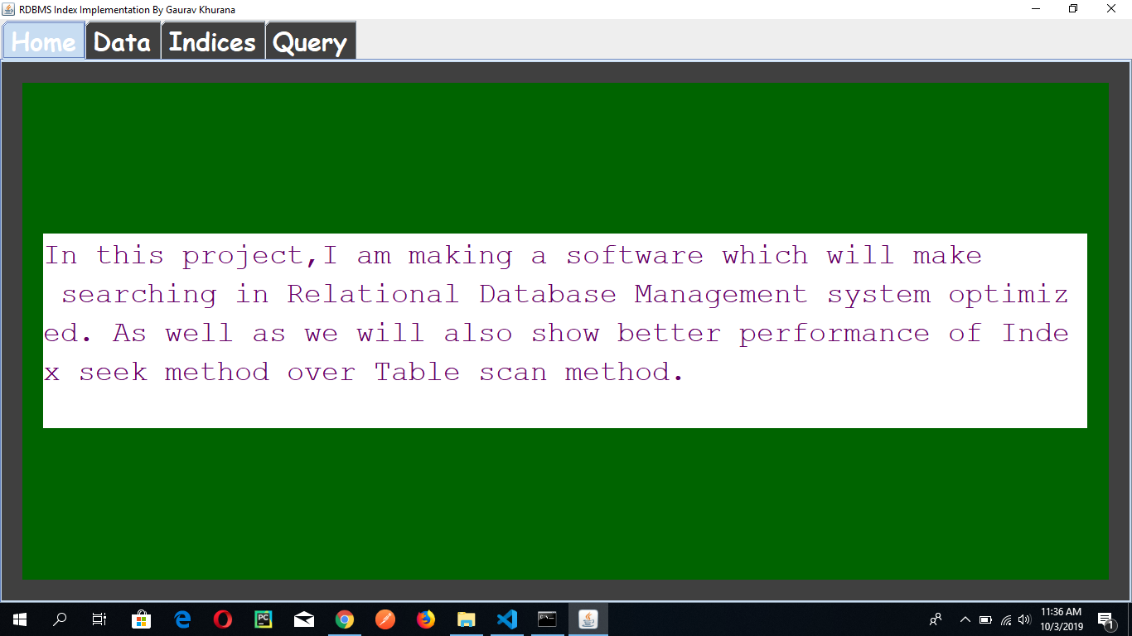

Slide 16
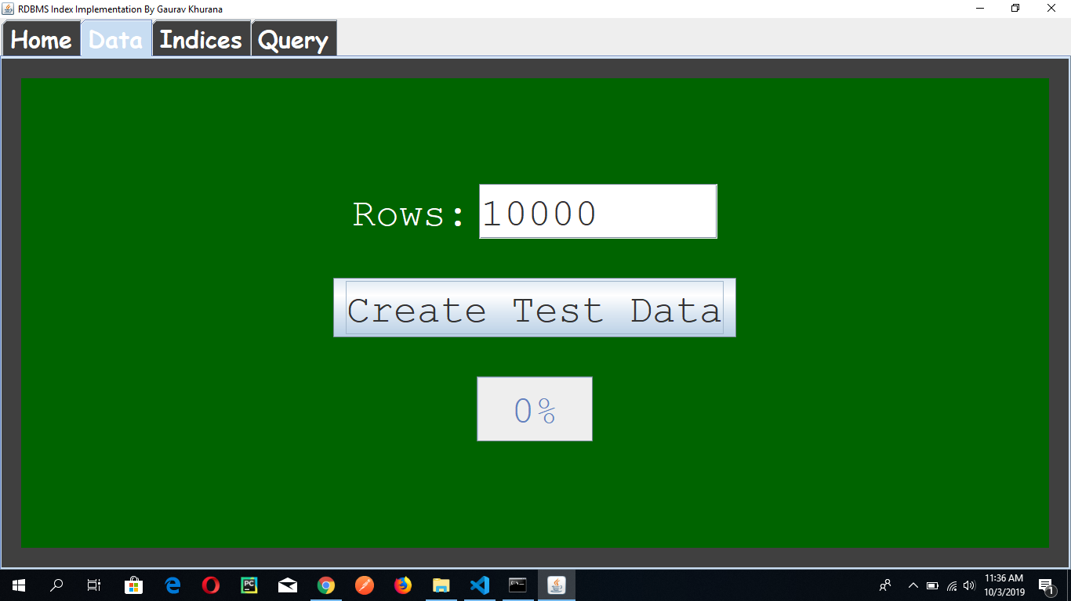

Slide 17
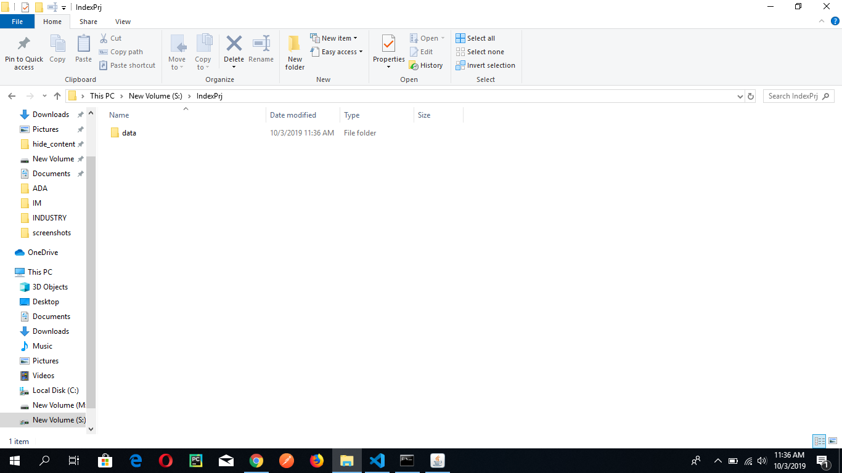

Slide 18
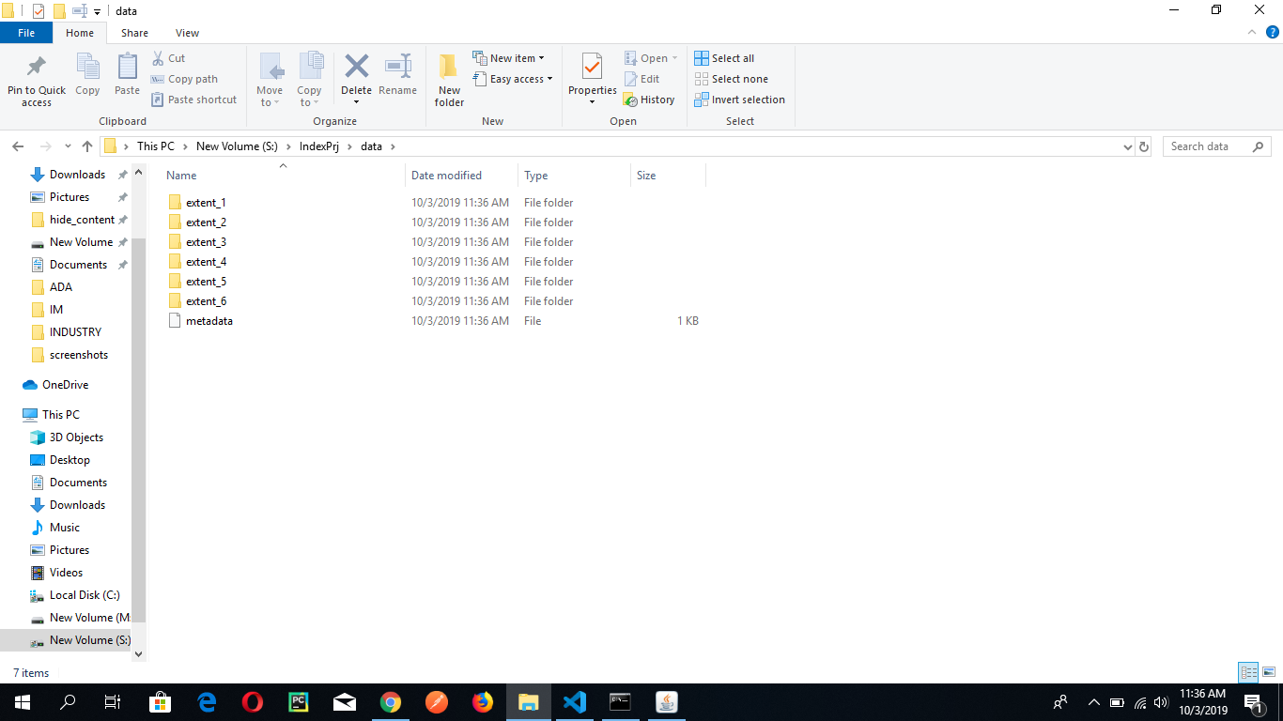

Slide 19
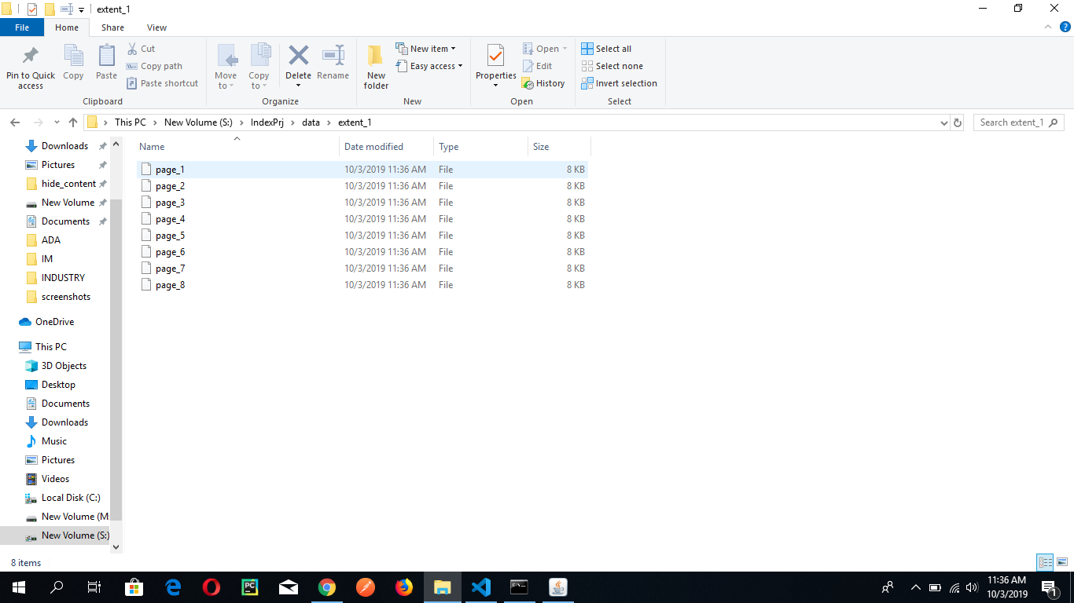

Slide 20
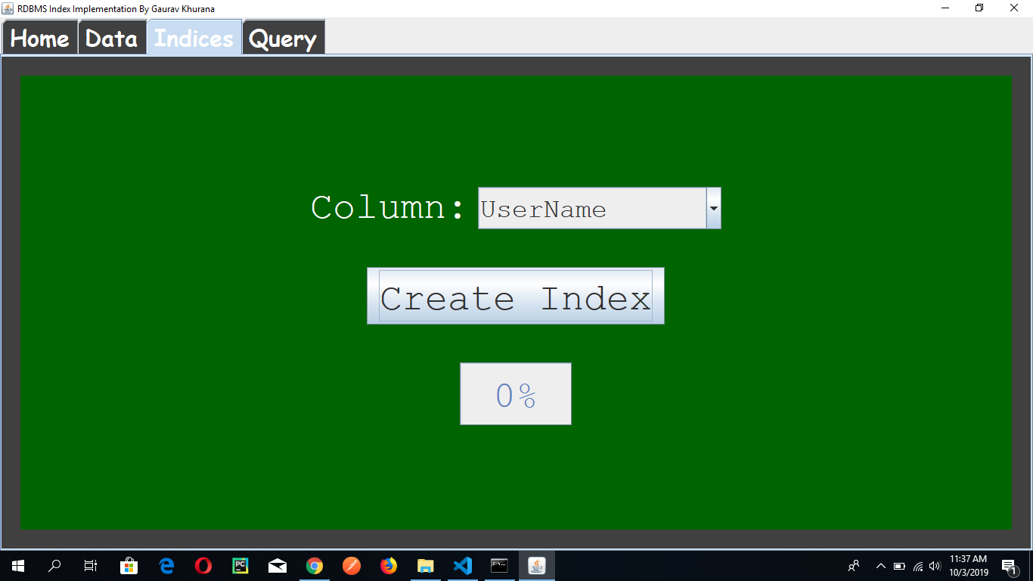

Slide 21


Slide 22
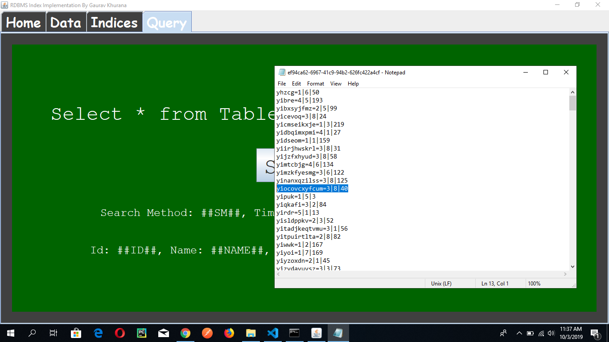

Slide 23
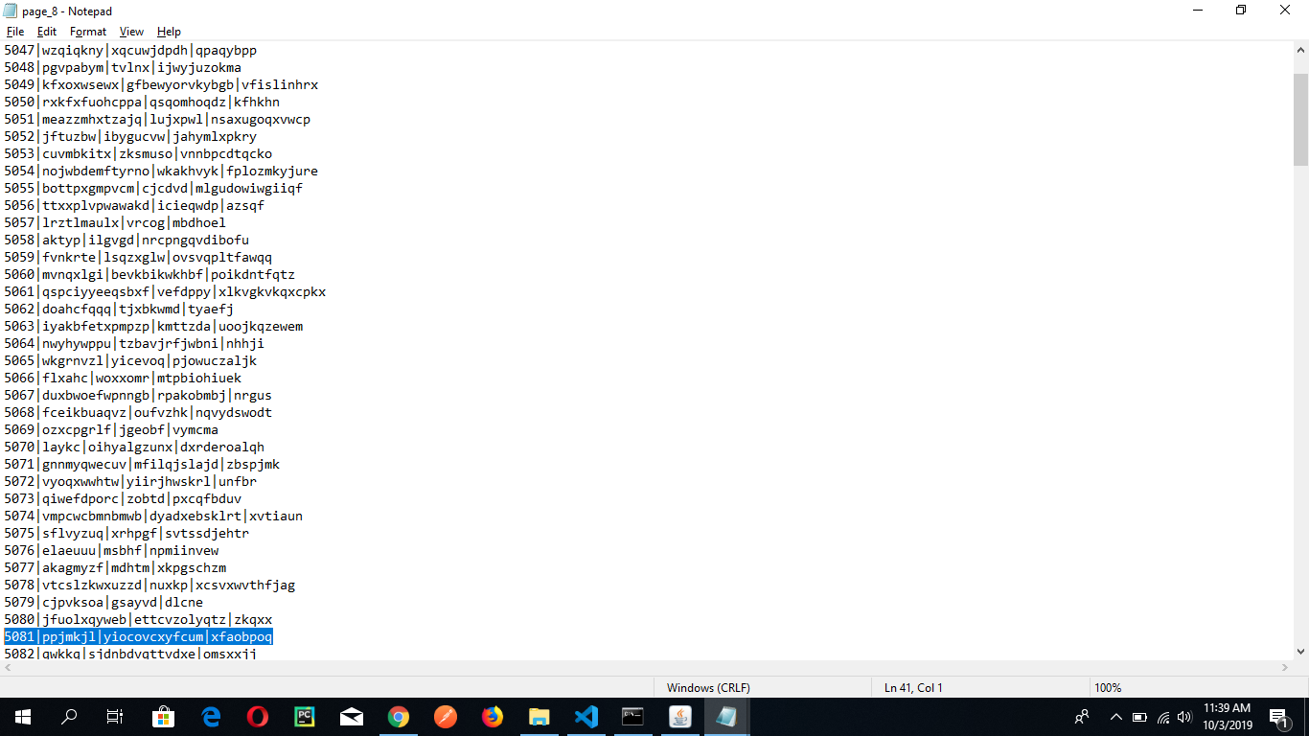

Slide 24
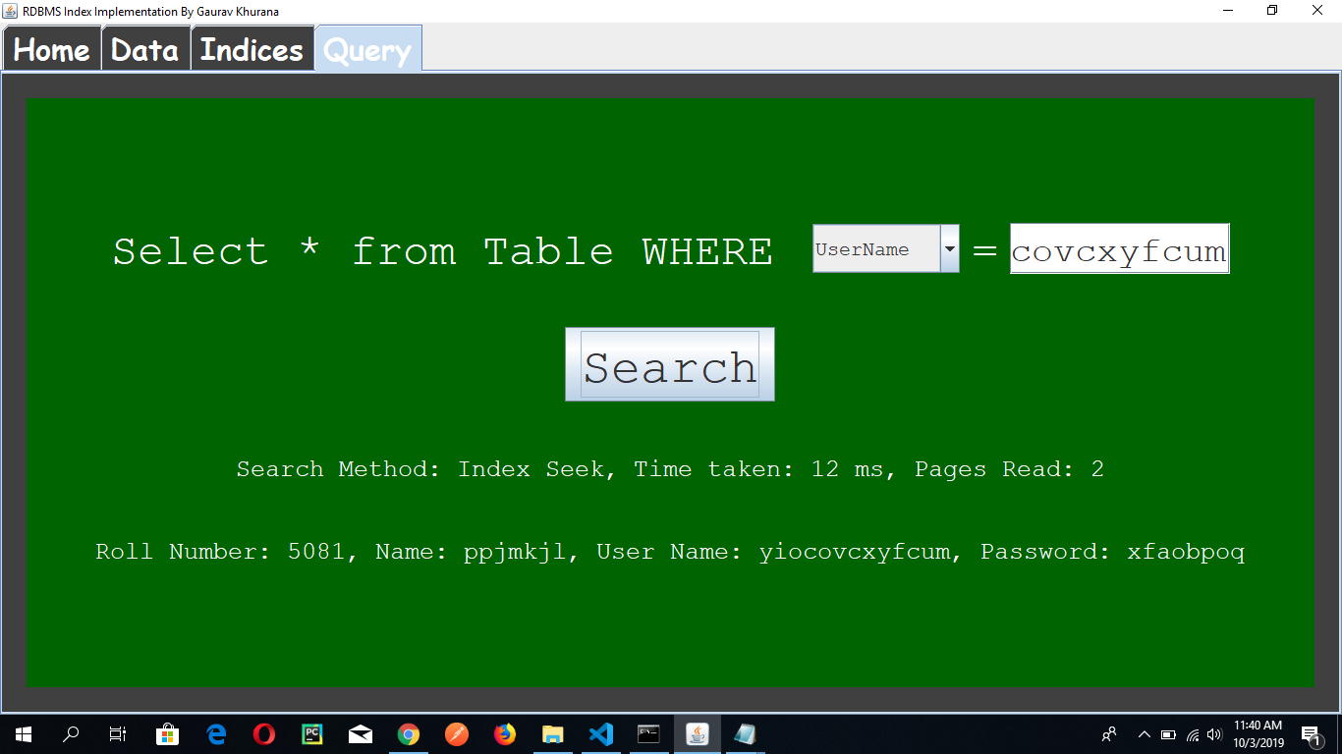

Slide 25


Slide 26


Slide 27
THANK YOU

