Slide 1

World Wide Energy Consumption Analysis

Slide 2
About me
Gaurav Sunil Kulkarni B.E. in Electronics & Telecommunication Engineering (D. Y. Patil College Of Engineering, Akurdi, Pune)
Why I Want to Learn Data Science: I’m passionate about understanding real-world data and uncovering insights that can help make informed, efficient, and impactful decisions. Learning Data Science helps me connect technology with analysis — turning data into solutions.
Work Experience / Projects:
Energy Consumption Analysis — SQL & Excel-based study of global energy usage and trends.
Student Performance Dashboard — Built in Excel for analysing academic results and improvement areas.
Weather Forecasting App — Developed using Android Studio & Java (real-time API integration).
GPS-Enhanced Safety Pouch — IoT project using ESP32, GPS, and GSM for personal safety tracking.
Profiles: 🔗 LinkedIn: linkedin.com/in/gaurav-kulkarni-6b4aa422a 💻 GitHub: https://github.com/gauravkulkarni-24

Slide 3
Objective of project
The main objective of the Energy Consumption Analysis project is to study and understand how energy is produced, consumed, and emitted across different countries.
By analyzing large datasets containing information about energy types, GDP, population, and emissions, the project aims to identify patterns, trends, and relationships that can help optimize energy use, reduce wastage, and support sustainable development.

Slide 4
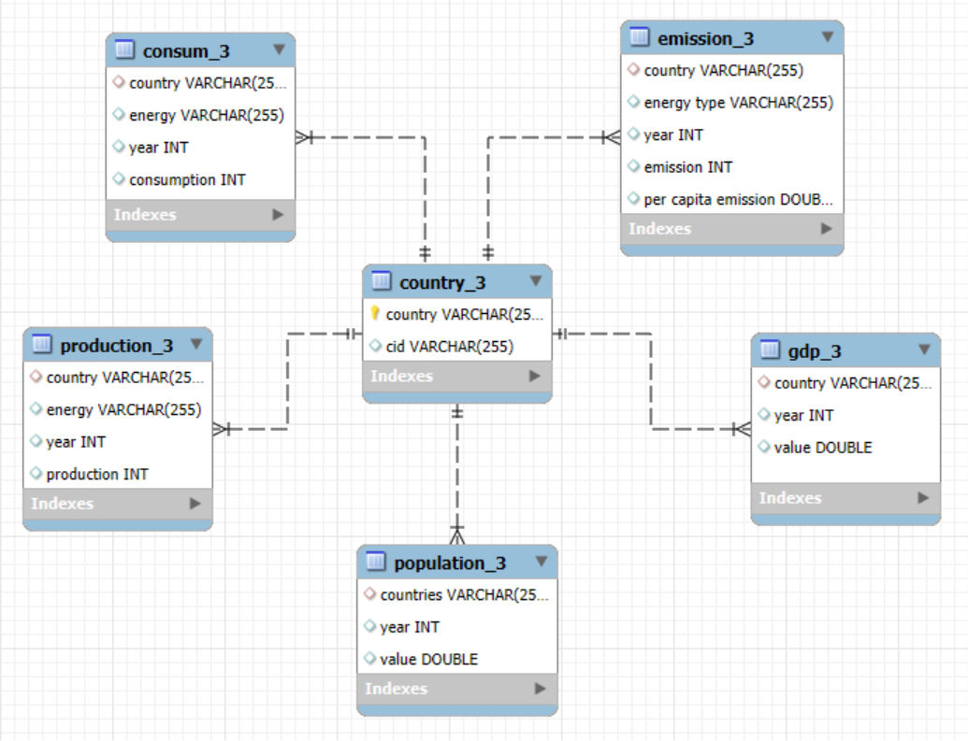
E-R Diagram

Slide 5
Key analysis questions
Total emission per country for the most recent year.
Global emissions change year over year.
Energy types contributing most to emissions across all countries.
Top 5 countries by GDP in the most recent year.
Energy production and consumption by country and year.

Slide 6
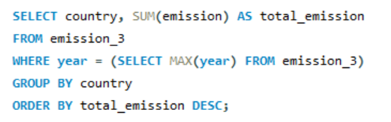
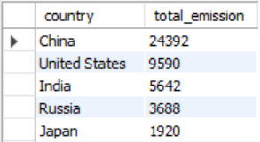
Total emission per country for the most recent year
This query helped me find which countries produce the highest emissions in the latest available year.
I used the SQL functions SUM() and GROUP BY country to calculate total emissions.
For example, if India emitted 100 units and China emitted 300, the query sums those to rank countries by emission.
From my result, I found that China and the USA have the highest emissions — which makes sense because they have large industries, high populations, and massive energy consumption.

Slide 7
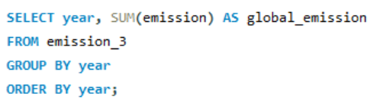
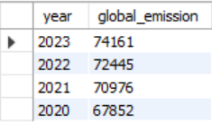
Global emissions change year over year
This query shows how total global emissions have changed over time. I grouped the data by year and summed all emissions for each year.
The result showed that global emissions are increasing almost every year, mainly due to industrialization and rising demand for energy.
Interestingly, there was a small drop around 2020, likely because of lockdowns during the COVID-19 pandemic when industries and travel were restricted.

Slide 8
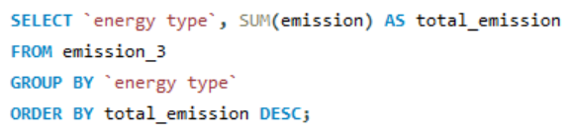
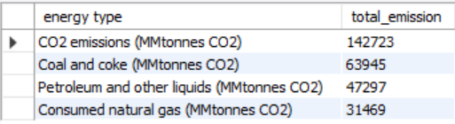
Energy types contributing most to emissions across all countries
In this query, I analyzed which energy types — like coal, oil, gas, or renewables — produce the most emissions.
I used GROUP BY energy_type and SUM(emission) to calculate totals for each source.
The output clearly showed that coal contributes the highest emissions, followed by oil and gas.
Renewable energy sources, on the other hand, have very low emissions.
This highlights why countries are moving toward solar, wind, and hydro energy to achieve sustainability goals.

Slide 9
GDP
GDP (Gross Domestic Product) is the total monetary value of all goods and services produced within a country during a specific period — usually a year.
GDP Formula:
Expenditure Method (Most Common)
GDP = C + I + G + (X − M)
Where:
C = Consumption (spending by people)
I = Investment (spending by businesses)
G = Government spending
X = Exports (goods sold to other countries)
M = Imports (goods bought from other countries)
This formula tells us how money flows through an economy.
Example:
If people spend ₹100 crore (C), businesses invest ₹50 crore (I), government spends ₹30 crore (G), exports are ₹40 crore (X), and imports are ₹20 crore (M), then:
GDP = 100 + 50 + 30 + (40 − 20) = ₹200 crore

Slide 10
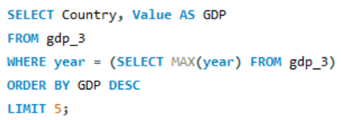
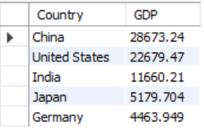
Top 5 countries by GDP in the most recent year
The result showed the United States, China, Japan, Germany, and India as the top GDP countries.
Higher GDP usually means higher industrial activity, which leads to higher energy use and emissions.
This query helped link the economic strength of a country with its energy demand — showing how energy powers growth.

Slide 11
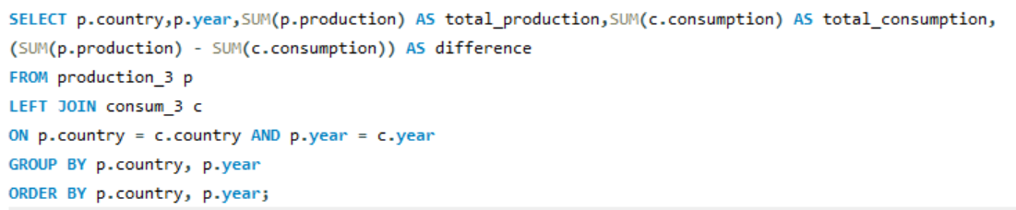
Energy production and consumption by country and year
if a country produces 100 units but consumes 150, it means it imports energy.
If it produces more than it consumes, it’s an exporter.
From my results, countries like Japan and India consume more than they produce,
while countries like the USA and Russia are closer to balance or even export energy.
This gives real insight into energy dependency and trade patterns between nations.

Slide 12
Conclusion
This project helped me understand how data can tell real-world stories.
With SQL, we can go beyond numbers — we can see how our energy usage connects with economy and environment.
It made me realize the importance of data analysis in solving global problems like energy conservation and climate change. “Energy saved is energy produced.”

Slide 13

THANK YOU

