Slide 1
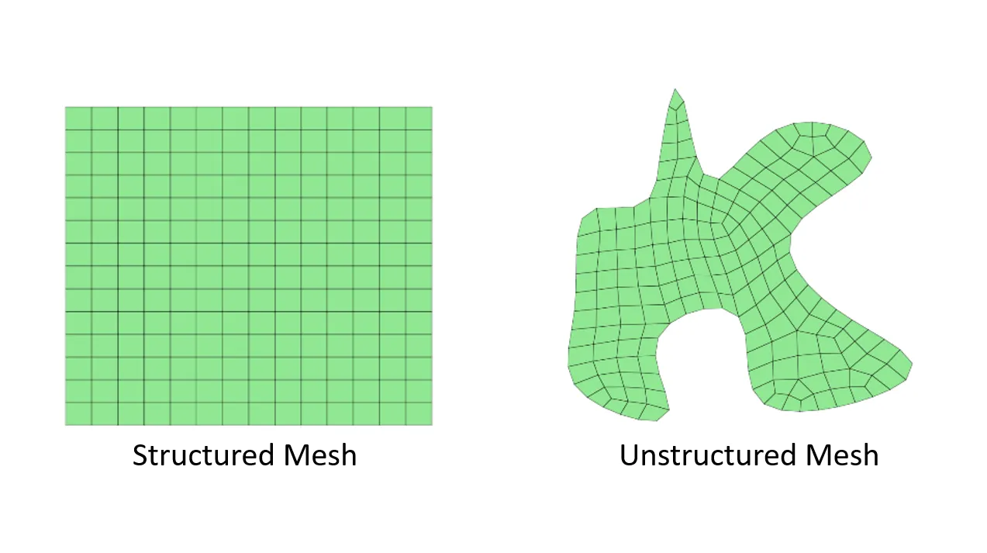
Finite Difference method
`
`
`
`
`

Slide 2
Finite Volume method
Divergence theorem:
`
x
`
x
`
x
`
x
`

Slide 3
Finite Volume method
`
x
`
x
`
x
`
x
`

Slide 4
Grid
`
`
`
`
`
nb1
`
P
nb2
nb4
`
`
`
nb3
`
Structured grid
Unstructured grid

Slide 5
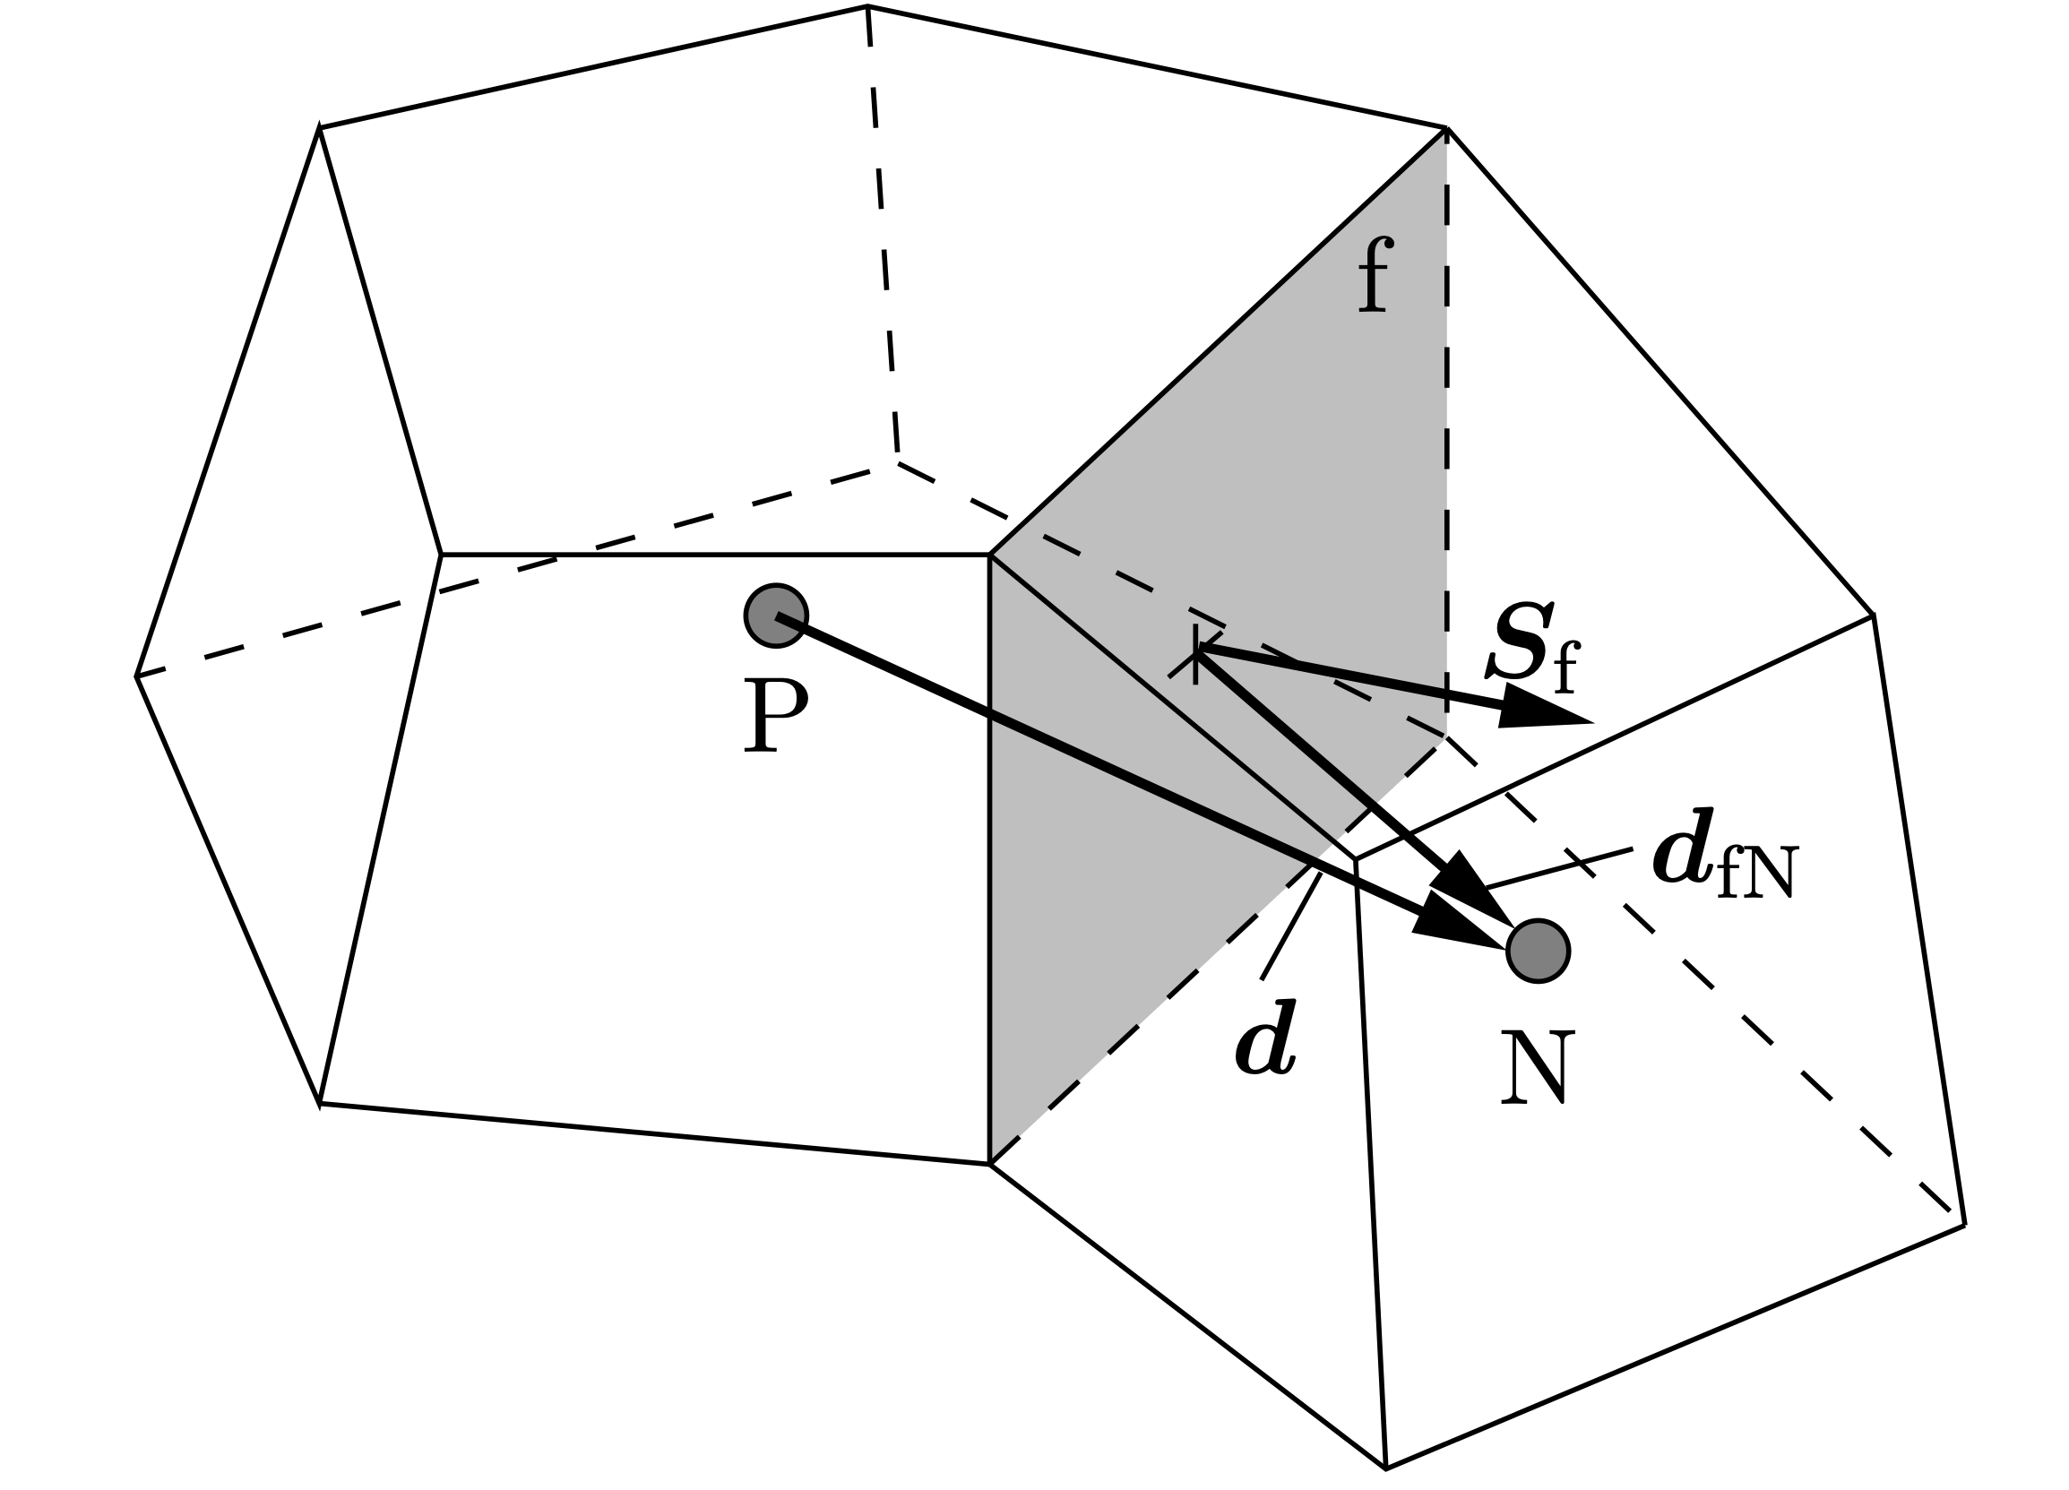
Finite Volume method
nb1
`
P
nb2
nb4
`
`
`
nb3
`
Gauss-Green theorem:
Least-squared method: ?

