Slide 1
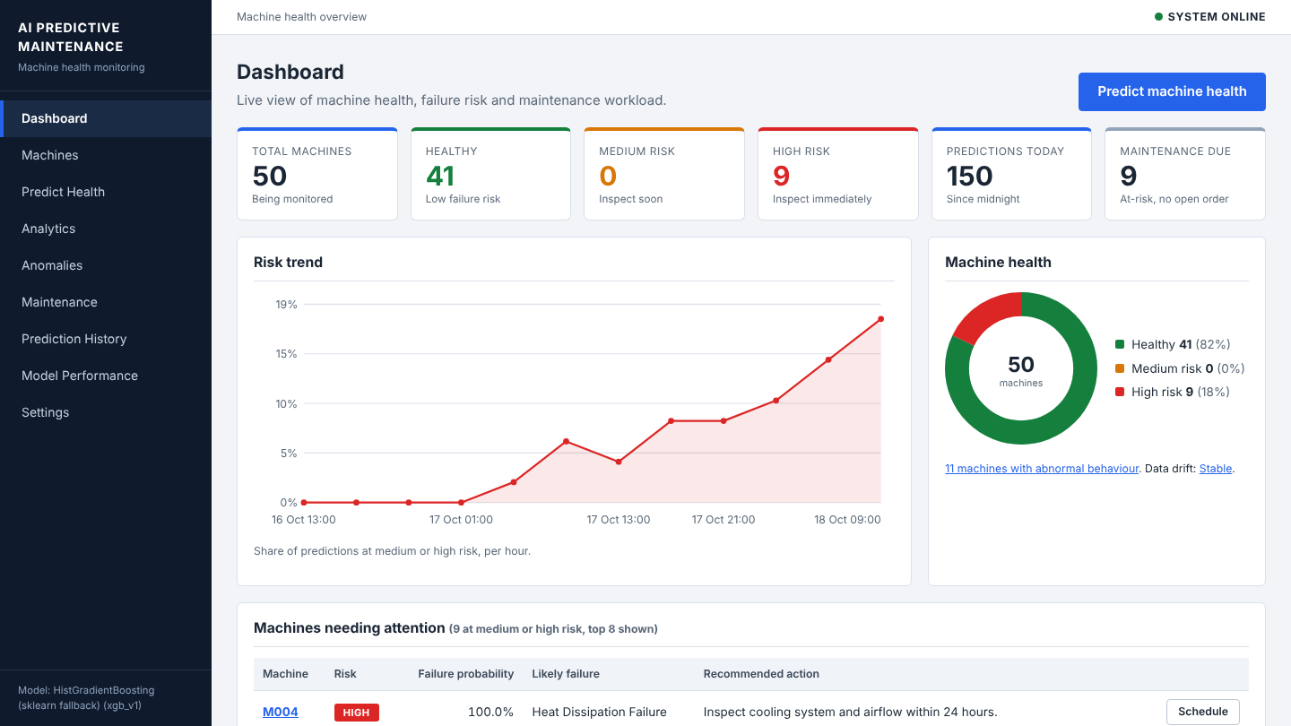
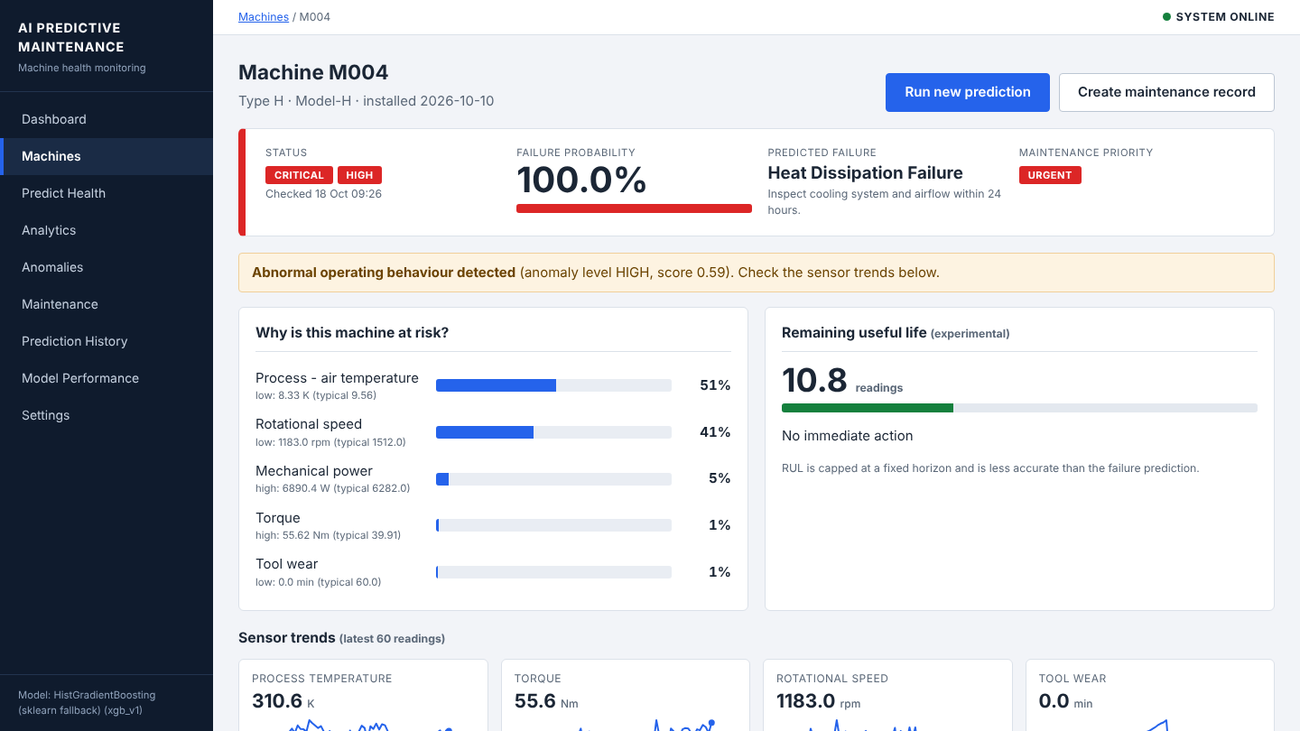
AI-Based Predictive Maintenance Platform
B.TECH MAJOR PROJECT | IT
Machine failure prediction, anomaly detection and a maintenance workflow, built with machine learning and Flask
Gaurav Kumar
ITM Group of Institutions, Aligarh
Notes:
Namaste. Mera project hai AI-Based Predictive Maintenance Platform. Isme maine sirf ek ML model nahi banaya, balki poora system banaya hai: data se prediction, prediction se risk level, aur risk level se maintenance ka action. Aage ke slides me main problem, approach, results aur demo explain karunga.

Slide 2



Why predictive maintenance
Reactive
50
Repair after the breakdown. Unplanned downtime.
machines monitored
Preventive
10,000
Fixed schedule. Some checks are not needed.
sensor readings
Predictive
2.96%
Use sensor data to act before the failure.
readings are failures
Notes:
Maintenance teen tarah ki hoti hai. Reactive me machine kharab hone ke baad repair karte hain, isse downtime hota hai. Preventive me fixed schedule par check karte hain, par kai baar zaroorat nahi hoti. Predictive me sensor data dekhkar pehle hi pata chal jata hai ki kaun si machine fail hone wali hai. Mera dataset 50 machines ki 10,000 readings ka hai, aur sirf 2.96 percent readings failure hain. Ye imbalance aage ke slides me bahut important hai.

Slide 3





Project objectives
Predict failure risk
Compare models
Detect anomalies
Probability for every machine, shown as LOW, MEDIUM or HIGH
Logistic Regression, Decision Tree, Random Forest and gradient boosting
Isolation Forest flags unusual behaviour without labels
Estimate type and RUL
Web dashboard and API
Test and be honest
Likely failure type and remaining useful life
Flask app with database, 9 pages and REST endpoints
46 automated tests and clearly stated limitations
Notes:
Mere 6 objectives the. Pehla, har machine ka failure risk predict karna. Doosra, kai models compare karna taaki sahi model choose ho. Teesra, anomaly detection. Chautha, failure type aur remaining useful life ka estimate. Paanchva, ek web dashboard aur API. Aur chhatha, testing aur limitations ko honestly batana.

Slide 4
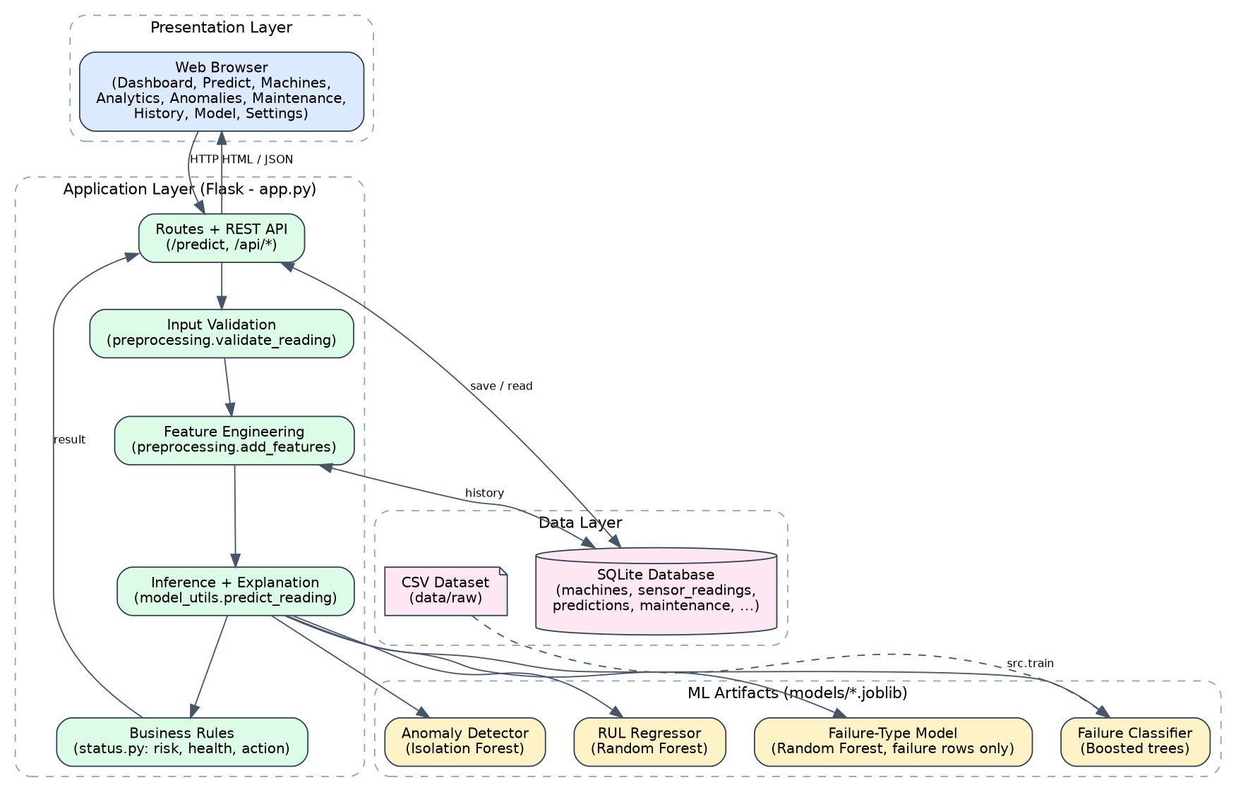
System architecture
Presentation
Flask templates, inline SVG charts, JSON API
Application
Validation, risk rules, explanation, maintenance workflow
ML
Training pipeline and saved model file
Data
SQLite with 7 tables and CSV datasets
Notes:
Architecture 4 layers me hai. Presentation layer me Flask templates aur charts hain. Application layer me validation, risk rules, explanation aur maintenance workflow hai. ML layer me training aur saved model hai. Data layer me SQLite database ke 7 tables aur CSV datasets hain. Charts maine inline SVG se banaye hain, isliye koi JavaScript library ya internet nahi chahiye.

Slide 5
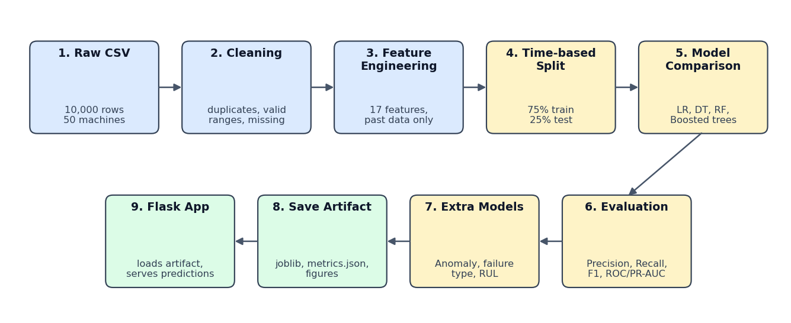
Machine learning pipeline
Notes:
Pipeline ka flow: data clean karna, features banana, time ke hisaab se train aur test split, models train karna, evaluate karna, aur best model ko save karke Flask app me use karna. Sabse important baat ye hai ki training aur prediction dono me same feature code chalta hai, isse mismatch nahi hota.

Slide 6


Dataset and feature engineering
Raw sensors
Derived features
Trend features
Air and process temperature (Kelvin)
Rotational speed (rpm)
Torque (Nm)
Tool wear (min) and machine type
Temperature difference
Power = torque x speed
Torque to speed ratio
Wear rate
Rolling mean and std
Delta (sudden change)
Slope (gradual trend)
Built from past readings only
17 features in total. Every rolling feature uses only earlier readings, so the model never sees the future (checked by a test).
Notes:
Dataset AI4I 2020 ke structure par based synthetic dataset hai, jisme maine machine id aur timestamp add kiya taaki trend features nikal sako. Kul 17 features hain: raw sensors, derived features jaise power aur temperature difference, aur trend features jaise rolling mean, delta aur slope. Rolling features sirf pichli readings se bante hain, isse data leakage nahi hota, aur iske liye ek test bhi likha hai. Temperature Kelvin me hai kyunki original dataset Kelvin me hai.

Slide 7
Doing the evaluation correctly
75 / 25
Weights
PR-AUC
Time-based split
Class weights, not SMOTE
Metrics beyond accuracy
First 75% of the timeline trains, the last 25% tests. A random split would leak the future into training.
Failures are rare. Weights change the loss, while SMOTE would create unrealistic points in time-ordered data.
Always saying no failure scores 97% accuracy. So precision, recall, F1, ROC-AUC and PR-AUC are used.
Notes:
Evaluation ke teen important decisions. Pehla, time-based split: pehle 75 percent time train, aakhri 25 percent test. Random split se future ka data train me chala jata aur score jhootha achha aata. Doosra, imbalance ke liye class weights use kiye, SMOTE nahi, kyunki time series me synthetic points banana risky hai. Teesra, accuracy use nahi ki, kyunki hamesha no failure bolne par bhi 97 percent accuracy aa jaati hai. Isliye precision, recall, F1 aur PR-AUC dekhe.

Slide 8
Model comparison on the test period
What the table says
Logistic Regression catches 97% of failures but 5 of 6 alerts are false (precision 0.17)
Random Forest is precise (0.97) but misses 23% of failures
Gradient boosting gives the best balance: precision 0.91, recall 0.89
Notes:
Chaar models compare kiye. Logistic Regression ka recall 0.97 hai, yaani lagbhag saare failures pakadta hai, par uski precision sirf 0.17 hai, matlab bahut false alarms. Random Forest ki precision 0.97 hai par wo 23 percent failures miss karta hai. Gradient boosting me balance sabse achha hai: precision 0.91, recall 0.89, F1 0.897 aur PR-AUC 0.937. Isliye isse primary model chuna. Is machine par XGBoost install nahi tha, to sklearn ka HistGradientBoosting use hua; XGBoost install karne par ye automatically use hota hai.

Slide 9
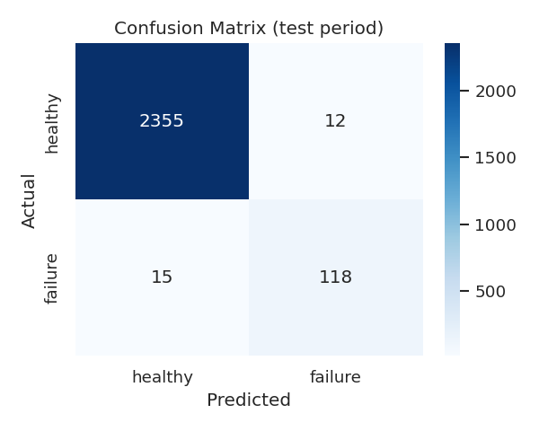
Selected model: results on 2,500 test readings
0.897
0.887
F1 score
Recall: failures caught
0.908
0.937
118 failures caught, 15 missed, 12 false alarms out of 2,367 healthy readings
Precision: real alerts
PR-AUC
Notes:
Selected model ke results. Test set me 2500 readings hain jinme 133 real failures. Model ne 118 failures pakde, 15 miss kiye, aur 12 false alarms diye. Maintenance me missed failure zyada costly hota hai, isliye threshold kam karke recall badhaya ja sakta hai, kuch zyada inspections ke badle. Notebook 03 me alag thresholds par precision aur recall ki table hai.

Slide 10
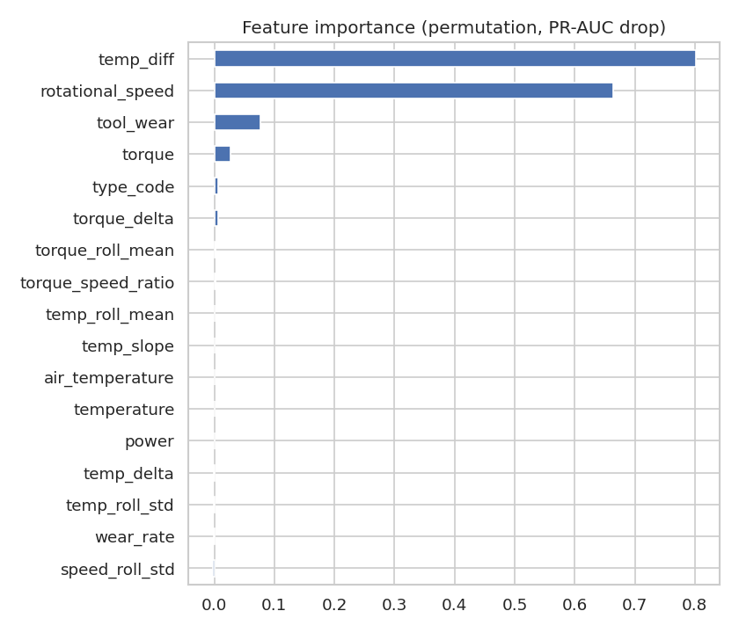
What drives the prediction
Why is this machine at risk?
The 17 features are grouped into 8 sensor groups
Each group is replaced by its training median and the drop in failure score is measured
The drops become percentages that add up to 100%
This is a what-if explanation, not SHAP. SHAP is future work
Notes:
Left side me feature importance hai: temperature difference, rotational speed, tool wear aur torque sabse important features hain. Right side me explain kiya hai ki dashboard me 'why is this machine at risk' kaise nikalta hai. 17 features ko 8 sensor groups me baanta hoon, har group ko training median se replace karke dekhta hoon ki failure score kitna girta hai. Ye SHAP nahi hai, simple what-if method hai, aur ye maine honestly likha hai. SHAP future scope me hai.

Slide 11
Supporting models
Anomaly detection
Failure type
Remaining useful life
Isolation Forest
Random Forest, failure rows only
Random Forest Regressor
131
0.95
7.75
readings flagged in the test period
weighted F1 (macro F1 0.79)
mean error in readings (baseline 10.22)
About half of the real failures also show up as anomalies (precision 0.48, recall 0.47). It supports the failure model and does not replace it.
Trained on 163 failures, tested on 133. Rare types such as Power have only 2 test examples, so their scores are less reliable.
Better than always predicting the average, but R2 is only 0.25. It is marked experimental in the app.
Notes:
Teen supporting models hain. Anomaly detection Isolation Forest se, jo sirf healthy data se normal behaviour seekhta hai. Failure type model sirf failure rows par train hua hai, kyunki No Failure rows ke saath score artificially high aata. Weighted F1 0.95 hai par macro F1 0.79, kyunki rare types ke test examples bahut kam hain. RUL model experimental hai, MAE 7.75 hai jabki average predict karne par 10.22 aata hai.

Slide 12

Fleet dashboard
Fleet at a glance
Machines, at-risk count and maintenance due
Ranked risk table
Highest risk first, with the likely failure type
Trends
Health, risk distribution and live drift check
Notes:
Ye dashboard hai. Plant me log ek machine nahi, poori fleet dekhte hain. Isliye upar KPI cards hain, neeche risk ke hisaab se sorted table, aur trends. Sabse zyada risk wali machine sabse upar aati hai, saath me likely failure type bhi.

Slide 13
Machine detail page
Risk and health
Failure probability, risk level, RUL
Why it is at risk
Sensor groups with their share of the risk
Recommended action
Based on the failure type, with a time-frame
Create maintenance record
Form is pre-filled from the prediction
Notes:
Machine page par us machine ki poori detail hai: risk, health, estimated RUL, sensor trends, aur why it is at risk wala explanation. Recommended action failure type ke hisaab se aata hai, jaise heat dissipation failure ho to cooling system inspect karo. Yahin se maintenance record bhi ban jata hai, aur form prediction se pre-fill hota hai.

Slide 14
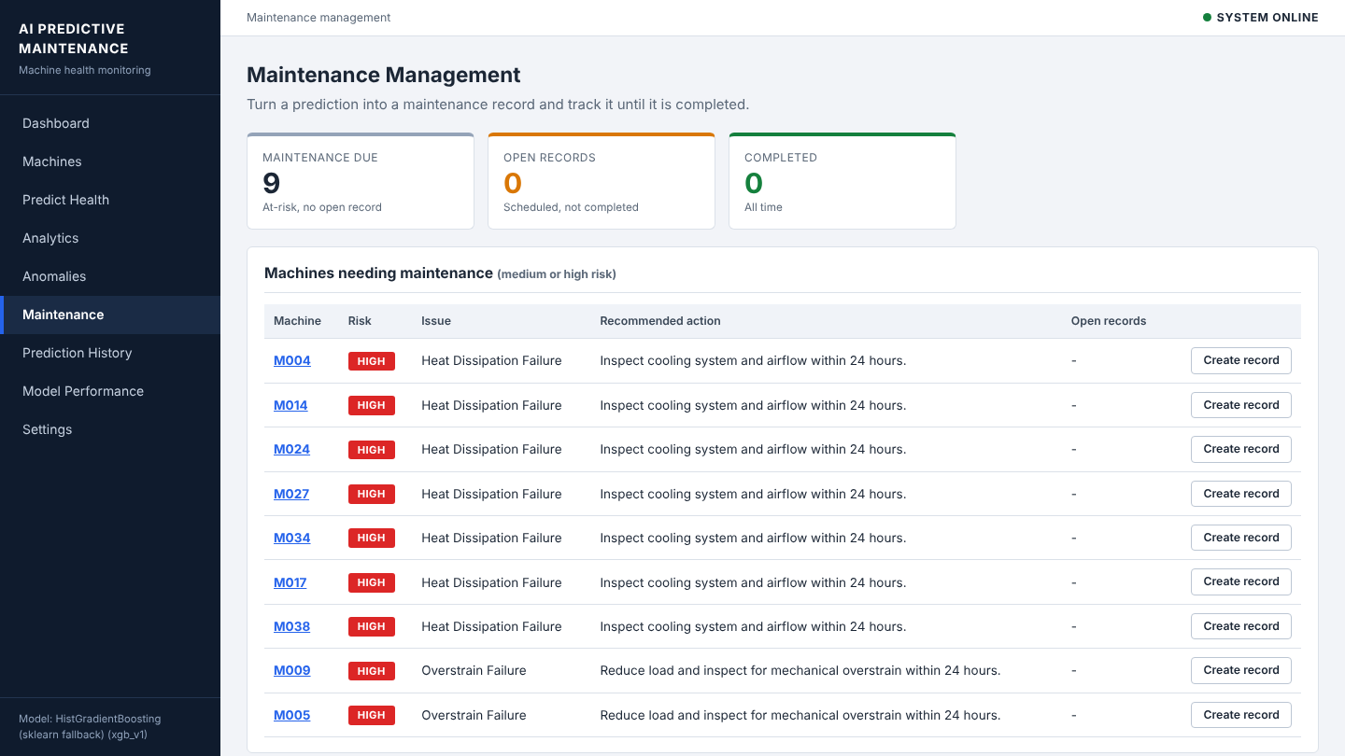
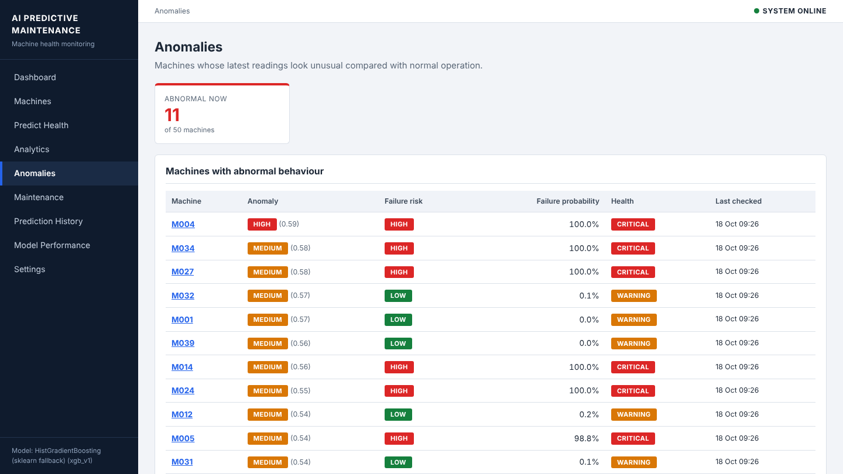
From prediction to action
1 Predict risk
2 Recommend action
3 Schedule record
4 Mark completed
Maintenance records with priority, technician and status
Anomaly page: unusual readings with a severity level
Notes:
Ye is project ki main baat hai: prediction par rukna nahi, action tak jana. Risk predict hota hai, recommended action milta hai, maintenance record Scheduled status me banta hai, aur kaam hone par Mark completed. Maintenance due card un at-risk machines ko dikhata hai jinka koi open record nahi hai. Anomaly page par unusual readings severity ke saath dikhti hain.

Slide 15
Check on the real AI4I 2020 dataset
Same pipeline, real data
Real file converted with import_ai4i.py, no code changes
Gradient boosting is still the best model (F1 0.794)
Score is lower because AI4I rows are independent: no machine history, so rolling features help less
Notes:
Maine same pipeline real AI4I 2020 dataset par bhi chalayi, bina code badle, sirf import script se convert karke. Wahan F1 0.794 aur ROC-AUC 0.984 aaya. F1 kam hai kyunki real AI4I me har row independent hai, machine ki history nahi hai, isliye rolling aur trend features kam kaam aate hain. Isse ye bhi pata chalta hai ki pipeline sirf apne synthetic data par tuned nahi hai.

Slide 16
Testing and API
46
REST endpoints
POST /api/predict
Risk, anomaly, type, RUL and explanation
automated tests, all passing
GET /api/summary
Fleet numbers for the dashboard
Input validation and risk rules
Pages, API and maintenance flow
Leakage check on rolling features
Temporary database for every run
GET /api/machines
All machines with latest risk
GET/POST /api/maintenance
List and create records
GET /api/drift
Live data vs training data
GET /health
Status and model version
Notes:
Testing ke liye unittest framework use kiya, 46 tests hain aur sab pass hote hain. Tests temporary database par chalte hain taaki asli data na bigde. REST API bhi hai: predict, summary, machines, maintenance, drift aur health endpoints. Drift check batata hai ki live sensor data training data se kitna hat gaya, taaki pata chale kab model dobara train karna hai.

Slide 17
Limitations and future scope
Honest limitations
Future scope
Default data is synthetic, real plant results will differ
Anomaly and RUL are supporting and experimental
Explanation is a what-if method, not SHAP
No login or CSRF protection (single-user demo)
Flask development server, not production
Train on real plant data with proper machine histories
Live sensors through MQTT or OPC-UA
SHAP explanations and probability calibration
Choose the threshold from the real cost of a missed failure
Login, roles and a production server
Notes:
Limitations maine honestly likhi hain. Default data synthetic hai, anomaly aur RUL experimental hain, explanation SHAP nahi hai, aur login ya CSRF protection nahi hai kyunki ye single user demo hai. Future me real plant data, live sensors MQTT ya OPC-UA se, SHAP, calibration aur proper authentication add kar sakte hain.

Slide 18

Conclusion
Correct ML practice
Time split, no leakage, class weights, the right metrics
A complete system, not only a model
Useful output
Risk, reason, failure type and a recommended action
Working system
Dashboard, database, API, maintenance flow and 46 tests
Thank you. Questions?
Notes:
Conclusion: is project me maine poora system banaya hai. ML part me sahi practice follow ki: time-based split, no leakage, class weights aur sahi metrics. Output useful hai kyunki risk ke saath reason, failure type aur recommended action milta hai. Aur system working hai: dashboard, database, API, maintenance workflow aur 46 tests. Gradient boosting model ne F1 0.897 diya aur real AI4I dataset par bhi pipeline chali. Dhanyavaad, ab aap questions pooch sakte hain.

