Slide 1

UNIFIED AND STABLE PROJECT
“USHERING IN THE FUTURE” FUTURE TECHNOLOGIES CONFERENCE (FTC) 25 OCTOBER 2019, SAN FRANCISCO, CA

Slide 2


Contact Information
Gaurav Kuppa, B.S. in Computer Engineering
San Jose State University
gaurav.kuppa@sjsu.edu
[1] Fayad, M.E., Kuppa, G, and Hamu, D. Unified and Stable Privacy Model.
International Journal of Advanced Trends in Computer Science and Engineering ( IJATCSE ), Vol. 8 No.4, July -August 2019
[2] Fayad, M.E., Kuppa, G, and Hamu, D. Unified and Stable Privacy Model. International Conference on Innovations in Computer Science and Engineering (iCiCSE2019), 26 - 28 June 2019, Miri Sarawak, MALAYSIA
[3] Fayad, M.E., Kuppa, G, and Hamu. Unified and Stable Project – “Ushering in the Future”. FTC 2019 - Future Technologies Conference 2019, San Francisco, California, USA, 24-25 October 2019.
[4] Fayad, M.E., Kuppa, G, Jindal, S., and Hamu. A Cutting-Edge Unified and Stable Rule Design Pattern. FTC 2019 - Future Technologies Conference 2019, San Francisco, California, USA, 24-25 October 2019
Notes:
Put a little information about me. Publications, at the very least.

Slide 3
Table of Contents
Introduction
AnyProject Stable Design Pattern
Scenarios
Conclusion

Slide 4
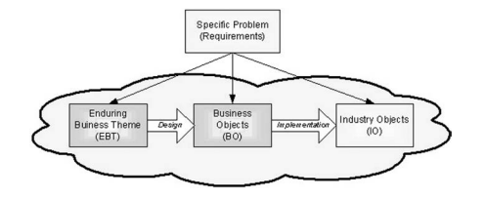
Introduction
EBT | BO | IO
ultimate goal and design enduring core knowledge of concept | maps EBTs to concrete classes describes capabilities externally stable internally adaptable | application objects adaptable and interchangeable for any application context
Notes:
Every concept in the dictionary is unique. For example, a rule is different than a policy is different than a constraint.
Every concept in the dictionary has three concepts.
These all map to their own personal properties.
This maps to EBT, BO, and IO.
EBT Example: Project
Need
BO Example: Proposal
AnyParty, AnyConstraint, AnyMechanism,
IO Examples: all tangible objects, which are what we build systems with
Using the EBT, BO and IO, we will be able to unify the requirements to create the unified and stable design of the topic. Every concept has functional requirements, nonfunctional requirements, and design.
which columns should they read? reference them.
Every concept has nonfunctional (qality factor) and functional requirements. There is no ceoncept that is bad. Violence is not a bad thing. Show the
Write two scenario and show the model. Match with corresponding model.
Show pattern in the beginning. How do you describe design patterns? Cite the Stable Design Patterns. Show the book.
We

Slide 5
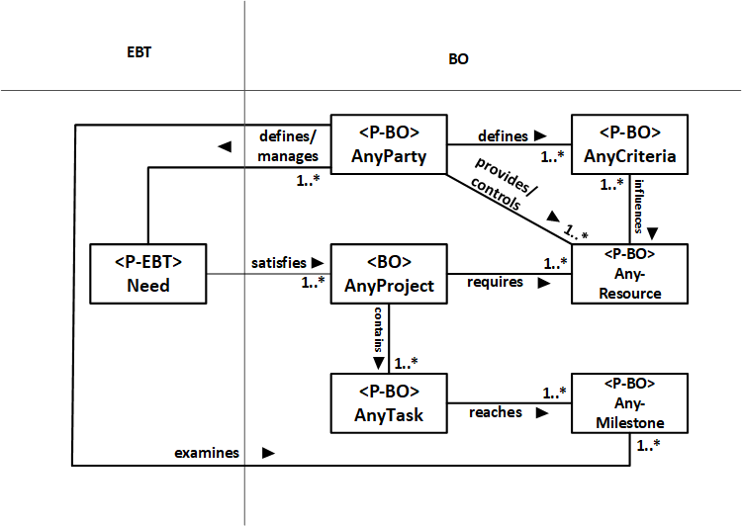
AnyProject Stable Design Pattern
Notes:
This is knowledge. This is a stable pattern. This never changes among all scenarios of AnyRule because it is the core knowledge.
EBT: Governing
AnyParty: exerts governship over a certain domain
AnyConstraint: defines the boundaries for governship
AnyRule: defines how governship will occur
AnyMedia: which media
AnyType: what type of rules
AnyEntity/AnyEvent: any misc. entities

Slide 6
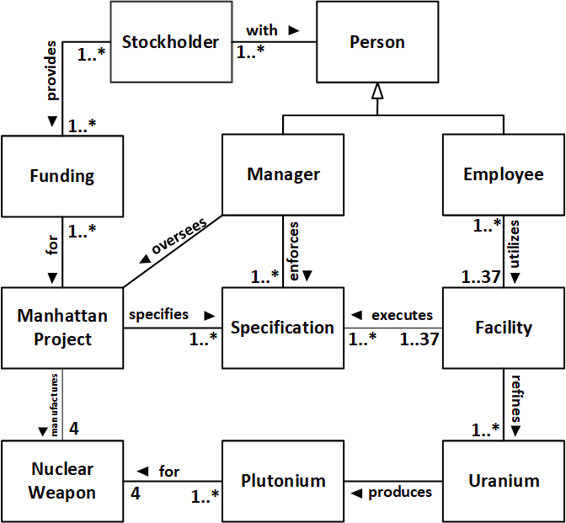
AnyProject Scenario
The Manhattan Project is a famous example. It was an effort during World War II in the United States to develop the first nuclear weapon. This top-secret project lasted from 1939 until 1945 and utilized various resources under the direction of General Leslie R. Groves, Deputy Chief of Construction of the U.S. Army Corps of Engineers. It resulted successfully the production of nuclear bombs used in WW II The Man-
hattan Project was an effort to make the nuclear bomb done by the US Government and the US Army in the middle of the 20 th century. After spending considerable time and money and by utilization of advanced laboratories and knowledgeable personnel, the project was completed successfully in 1945.
Notes:
Scenario and Stable Model
EBT represents
Violence
Change
Renewal
Growth
there is vioelnce in everything. it exists in everything in nature.
d
This is the

Slide 7
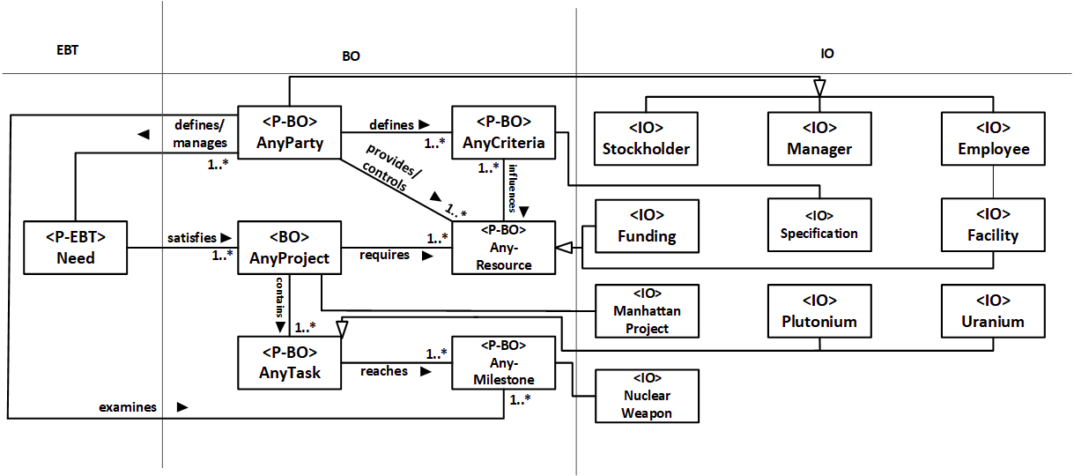
AnyProject Scenario cont.
The United States (AnyParty), United Kingdom (AnyParty), and Canada (AnyParty) worked on The Manhattan Project (AnyProject) from 1942 to 1946. This project was a $2 billion (AnyResource) undertaking during the World War II in attempts to create the world’s first nuclear weapon (AnyMilestone) before Germany’s nuclear weapon project was completed (AnyCriteria). The Military Major (AnyParty) managed this top-secret project and employed up to 130,000 people (AnyResource) at
37 facilities (AnyResource) across the nation. These employees conducted research on enriching and separating uranium (AnyTask), producing plutonium from uranium (AnyTask), and gathering intelligence on the German nuclear weapon project (AnyTask).
Notes:
We have shown two different scenarios through which rules are applied and how they can be modeled within the core knowledge we built, from AnyRule’s nonfunctional requirements.
This never changes, because this is the knowledge of AnyRule. Concentrate on the two patterns. Only the leafs change. That is why you can build on any scenarios. There is unlimited scenarios, reuse, and applicability.
The Stable Design

Slide 8
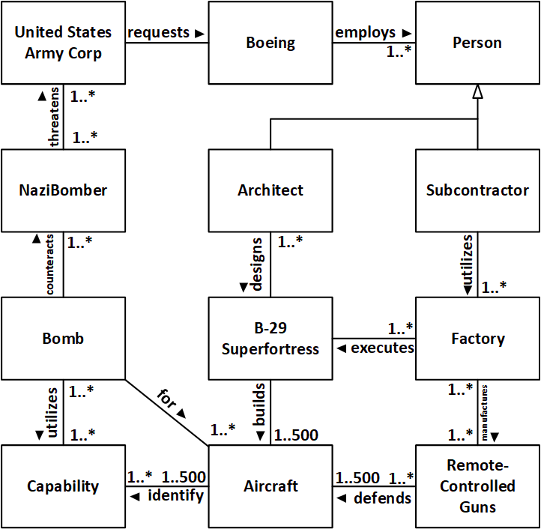
AnyProject Scenario cont.
The Boeing B-29 Super-fortress is a four-engine propeller-driven heavy bomber designed by Boeing, which was flown primarily by the United States during World War II and the Korean War. It was one of the largest aircraft operational during World War II and featured state-of-the-art technology. Including design and production – at over $3 billion – it was the most expensive weapons project in the war, exceeding the
$1.9 billion cost of the Manhattan Project—using the value of dollars in 1945. Innovations introduced included a pressurized cabin, dual-wheeled, tricycle landing gear, and an analog computer-controlled fire-control system directing four remote machine
gun turrets that could be operated by a single gunner and a fire-control officer.

Slide 9
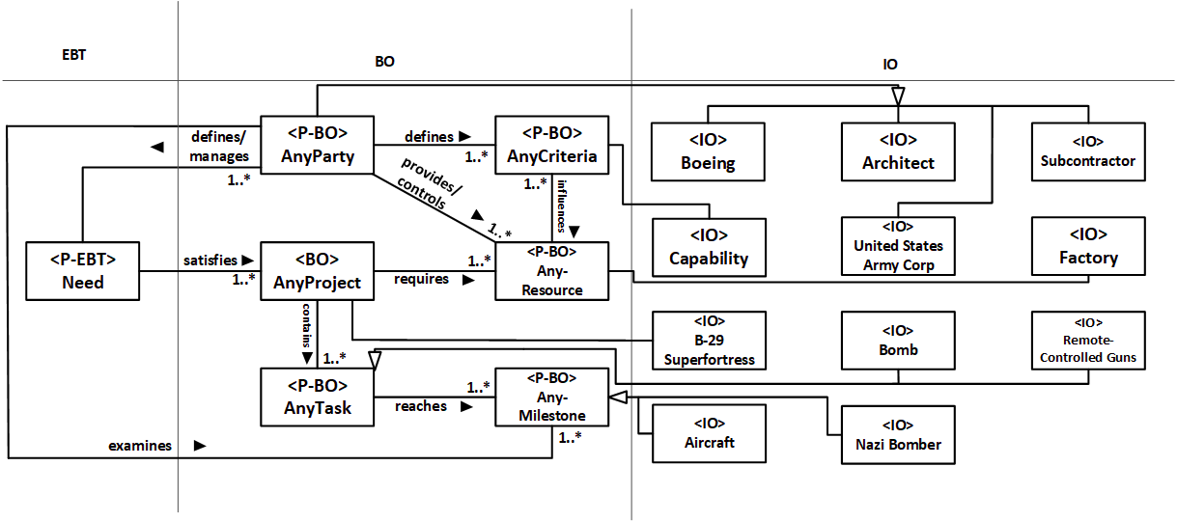
AnyProject Scenario cont.
Boeing (AnyParty) began to design the B-29 Superfortress (AnyProject) in 1938 in response to a request from the United States Army Air Corps (AnyParty). This request detailed that the aircraft should be capable of delivering 20,000 lb of bombs (AnyCriteria) from a distance of 2667 miles (AnyCriteria), and is capable of flying at a speed of 400 mph (AnyCriteria). Henry H. Arnold (AnyParty) led the production of a new bomber flight to counter the production of Nazi nuclear bombers (AnyMilestone).
After getting the proposal approved, Boeing received a production order for 500 aircraft (AnyMilestone). The manufacturing process involved operating plants at four
different locations and employing thousands of subcontractors. The B-29 Superfortress had many new features such as remote-controlled guns (AnyCriteria) and pressurized and connected crew areas (AnyCriteria).
Notes:
We have shown two different scenarios through which rules are applied and how they can be modeled within the core knowledge we built, from AnyRule’s nonfunctional requirements.
This never changes, because this is the knowledge of AnyRule. Concentrate on the two patterns. Only the leafs change. That is why you can build on any scenarios. There is unlimited scenarios, reuse, and applicability.
The Stable Design

Slide 10
Conclusion
Thus, the enduring concepts help build a solid foundation for solutions and implement a better way of software stability model. Hence, the stability model is preferred as a design model for any application.
Nonfunctional Requirements:
Practical
Manageable
Growth
Notes:
Every concept in the dictionary is unique unto itself. The uniqueness of these terms is displayed through their nonfunctional requirements/ Show the nonfunctional requirements. You can use the nonfunctional requirements to describe any concept. Start digging into certain examples. Ex: Violence,
Create a pattern for it
Nonfunctional requirements use it for description, properties, and measurements.
We have
AnyRule or any concept and we can create a pattern for it and it has the nonfunctional requirements. Nonfunctional requirements for AnyRule determine how it will work. The base of AnyRule are that the are fair, flexible and acceptable.
Violence
Change
Renewal
Growth
Revenge
Safety

Slide 11
References
[1] A. Mahdy, M.E. Fayad, H. Hamza, and P. Tugnawat “Stable and Reusable Model-Based Architectures” ECOOP 2002, Workshop on Model-based Software Reuse, June 2002, Malaga, Spain
[2] H. Hamza and M.E. Fayad. “Model-base Software Reuse Using Stable Analysis Patterns” ECOOP 2002, Workshop on Model-based Software Reuse, June 2002, Malaga, Spain
[3] Fayad, M. E., “Stable Design Patterns for Software and Systems”. Boca Raton, FL: Auerbach Publications, July 2015.

