Slide 1

A CUTTING EDGE UNIFIED
AND STABLE RULE DESIGN PATTERN FUTURE TECHNOLOGIES CONFERENCE (FTC) 24 OCTOBER 2019, SAN FRANCISCO, CA

Slide 2


Contact Information
Gaurav Kuppa, B.S. in Computer Engineering
San Jose State University
gaurav.kuppa@sjsu.edu
[1] Fayad, M.E., Kuppa, G, and Hamu, D. Unified and Stable Privacy Model.
International Journal of Advanced Trends in Computer Science and Engineering ( IJATCSE ), Vol. 8 No.4, July -August 2019
[2] Fayad, M.E., Kuppa, G, and Hamu, D. Unified and Stable Privacy Model. International Conference on Innovations in Computer Science and Engineering (iCiCSE2019), 26 - 28 June 2019, Miri Sarawak, MALAYSIA
[3] Fayad, M.E., Kuppa, G, and Hamu. Unified and Stable Project – “Ushering in the Future”. FTC 2019 - Future Technologies Conference 2019, San Francisco, California, USA, 24-25 October 2019.
[4] Fayad, M.E., Kuppa, G, Jindal, S., and Hamu. A Cutting-Edge Unified and Stable Rule Design Pattern. FTC 2019 - Future Technologies Conference 2019, San Francisco, California, USA, 24-25 October 2019
Notes:
Put a little information about me. Publications, at the very least.

Slide 3
Table of Contents
Introduction
AnyRule Stable Design Pattern
Scenarios
Conclusion

Slide 4
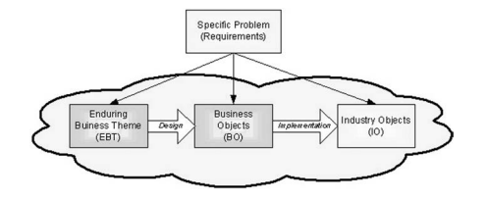
Introduction
EBT | BO | IO
ultimate goal and design enduring core knowledge of concept | maps EBTs to concrete classes describes capabilities externally stable internally adaptable | application objects adaptable and interchangeable for any application context
Notes:
Every concept in the dictionary is unique. For example, a rule is different than a policy is different than a constraint.
Every concept in the dictionary has three concepts.
These all map to their own personal properties.
This maps to EBT, BO, and IO.
EBT Example: Proposal
Acceptance
BO Example: Proposal
AnyParty, AnyConstraint, AnyMechanism,
IO Examples: all tangible objects, which are what we build systems with
Using the EBT, BO and IO, we will be able to unify the requirements to create the unified and stable design of the topic. Every concept has functional requirements, nonfunctional requirements, and design.
which columns should they read? reference them.
Every concept has nonfunctional (qality factor) and functional requirements. There is no ceoncept that is bad. Violence is not a bad thing. Show the
Write two scenario and show the model. Match with corresponding model.
Show pattern in the beginning. How do you describe design patterns? Cite the Stable Design Patterns. Show the book.
We

Slide 5
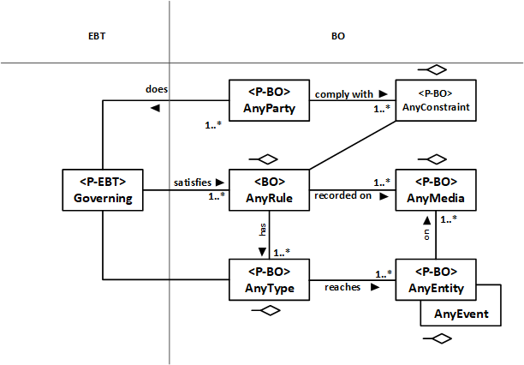
AnyRule Stable Design Pattern
Notes:
This is knowledge. This is a stable pattern. This never changes among all scenarios of AnyRule because it is the core knowledge.
EBT: Governing
AnyParty: exerts governship over a certain domain
AnyConstraint: defines the boundaries for governship
AnyRule: defines how governship will occur
AnyMedia: which media
AnyType: what type of rules
AnyEntity/AnyEvent: any misc. entities

Slide 6
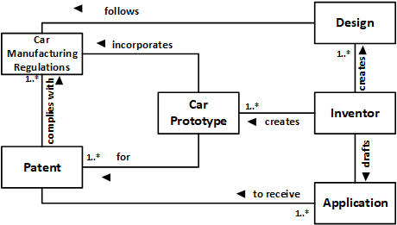
AnyRule Scenario
During the trial and selection of the prototype for a new car, the inventor creates the design of the car. The selection of the prototype has to be carried in accordance with the standard car manufacturing regulations and how it improves the car industry. The prototype performing best are listed for selection.
Notes:
Scenario and Stable Model
EBT represents
Violence
Change
Renewal
Growth
there is vioelnce in everything. it exists in everything in nature.
d
This is the

Slide 7
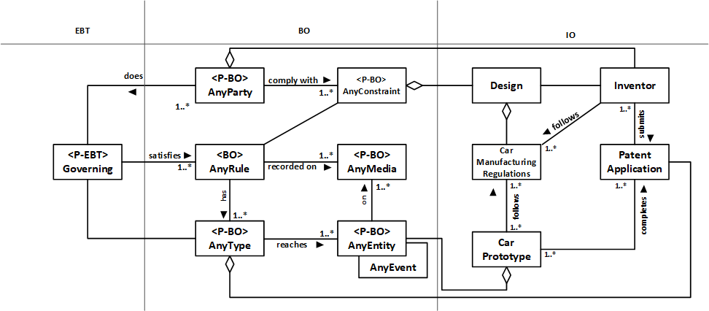
AnyRule Scenario cont.
During the trial and selection of the prototype for a new car, the inventor (AnyParty) defines the minimum capabilities (AnyConstraint) for finalization. For selecting the best prototype, the inventor (AnyParty) uses a defined set of rules (AnyRule) as determined by observational data (AnyMedia). The selection of the prototype has to be carried in accordance with standard car manufacturing regulations (AnyType) and how it improves the car industry. The prototype performing the best(AnyEvent) and meeting the minimum patent requirements (AnyConstraint) are listed for selection.

Slide 8
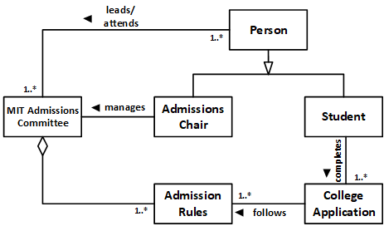
AnyRule Scenario cont.
Usually in applying to large universities like Massachusetts Institute of Technology (MIT), applying Students are subject to certain specific University Rules determined by the MIT Admissions Committee. This committee also determines which Prospective Students are accepted and enroll.

Slide 9
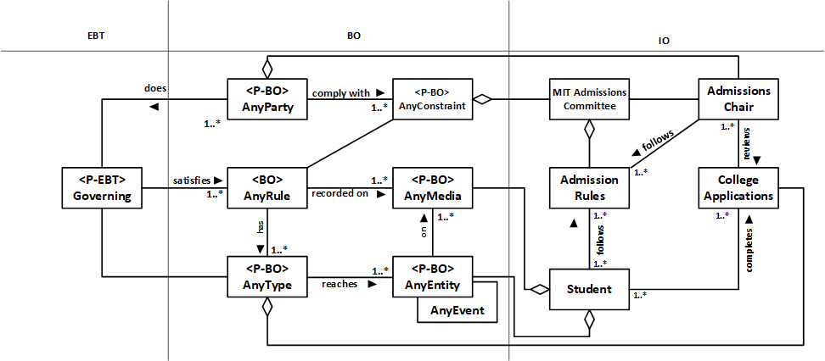
AnyRule Scenario cont.
Usually in applying to large universities like Massachusetts Institute of Technology (MIT), there are certain specific University Rules (AnyRule) that need to be followed by the Prospective Students (AnyParty) to enroll and submit their application for acceptance. These rules are often specified and approved by the University Adnmissions Committee (AnyParty) and is also responsible to manage the decisions aspect. The students can complete their Enrollment (AnyType) by completing an Electronic Form (AnyMedia) which also highlights the Submission Guidelines (AnyConstraint) that should followed.
Notes:
We have shown two different scenarios through which rules are applied and how they can be modeled within the core knowledge we built, from AnyRule’s nonfunctional requirements.
This never changes, because this is the knowledge of AnyRule. Concentrate on the two patterns. Only the leafs change. That is why you can build on any scenarios. There is unlimited scenarios, reuse, and applicability.
The Stable Design

Slide 10
Conclusion
The usefulness and varied applicability of the AnyRule Stable Design Pattern can be illustrated by the fact that it is based on the core knowledge underlying any type of rules which makes it reusable in unlimited applications.
Nonfunctional Requirements:
Fair
Flexible
Acceptable
Notes:
Every concept in the dictionary is unique unto itself. The uniqueness of these terms is displayed through their nonfunctional requirements/ Show the nonfunctional requirements. You can use the nonfunctional requirements to describe any concept. Start digging into certain examples. Ex: Violence,
Create a pattern for it
Nonfunctional requirements use it for description, properties, and measurements.
We have
AnyRule or any concept and we can create a pattern for it and it has the nonfunctional requirements. Nonfunctional requirements for AnyRule determine how it will work. The base of AnyRule are that the are fair, flexible and acceptable.
Violence
Change
Renewal
Growth
Revenge
Safety

Slide 11
References
[1] A. Mahdy, M.E. Fayad, H. Hamza, and P. Tugnawat “Stable and Reusable Model-Based Architectures” ECOOP 2002, Workshop on Model-based Software Reuse, June 2002, Malaga, Spain
[2] H. Hamza and M.E. Fayad. “Model-base Software Reuse Using Stable Analysis Patterns” ECOOP 2002, Workshop on Model-based Software Reuse, June 2002, Malaga, Spain
[3] Fayad, M. E., “Stable Design Patterns for Software and Systems”. Boca Raton, FL: Auerbach Publications, July 2015.

