Slide 1
Enterprise Logistics Data Platform
DONE BY: VEDANT BADVE
GAURAV KHAVANEWADKAR
CHANDRA MANIKANTA

Slide 2
Enterprise Logistics Data Platform (ELDP)
Building a Unified Logistics & Supply Chain Analytics Platform Covered Sprints: Sprint 0 — Project Initiation & Architecture Sprint 1 — Data Discovery & Ingestion This project focuses on building an enterprise-level logistics data platform. The objective is to integrate data from transportation, warehouse, fleet, order, inventory and delivery systems into a unified foundation for operational analytics and reporting. In this presentation, we are focusing specifically on Sprint 0 and Sprint 1.

Slide 3
Problem Statement
ABC Logistics Ltd. generates large volumes of data from multiple systems such as TMS, WMS, fleet management, GPS, OMS, inventory, and delivery platforms. Since these systems operate independently, the data is fragmented and difficult to combine, making it challenging to track shipments, monitor warehouse and fleet operations, optimize deliveries, and generate reliable enterprise-wide insights. The absence of a unified data platform limits visibility and makes logistics data-driven decision-making more difficult.

Slide 4
Project Scope
The project focuses on developing an Enterprise Logistics Data Platform (ELDP) that integrates data from multiple logistics source systems and prepares it for analytics and reporting. The scope includes data discovery and ingestion using Pentaho, storage in PostgreSQL, data profiling and cleaning using Python/Pandas, version control through Git/GitHub, and reporting through Power BI. The platform covers the movement of data from source systems through ingestion and storage to analytics, while also supporting metadata, audit logs, data lineage, and enterprise documentation.

Slide 5
Proposed Solution
The proposed Enterprise Logistics Data Platform (ELDP) provides a centralized workflow to integrate, process, store, and analyze logistics data from multiple independent systems. Pentaho is used to ingest and transform data from different formats, while PostgreSQL stores the raw data in staging and provides the enterprise data storage layer. Python/Pandas is used for data profiling, cleaning, and standardization. The processed data is then made available for Power BI dashboards and operational reporting. Git/GitHub supports version control and collaborative development throughout the process.
Solution Flow
Logistics Data Sources TMS • WMS • Fleet • GPS • OMS • Inventory • Vendor • IoT ↓ Pentaho ETL Extract → Transform → Load ↓ PostgreSQL – Staging Layer Raw Logistics Data ↓ Python / Pandas Profiling → Cleaning → Standardization ↓ PostgreSQL – Enterprise Data Warehouse Curated & Structured Data ↓ Power BI Dashboards → Logistics Analytics → Executive Reporting
Git / GitHub → Version Control & Collaboration

Slide 6
Project Objective
Collect data from multiple heterogeneous enterprise systems Clean, validate and standardise logistics data Store curated data in PostgreSQL Maintain metadata, audit logs and data lineage Support shipment, warehouse, fleet and inventory analytics Enable executive and operational reporting Use Git/GitHub for collaborative development Produce enterprise-standard documentation The main objective is not simply to collect data. The platform should take data through different stages — from collection and validation to storage and analytics. For example, shipment data from the TMS and GPS systems should be collected, processed and eventually made available for delivery and fleet analytics. The platform also needs governance features such as metadata, audit logs and data lineage so that the organization can understand and track its data.

Slide 7
Technology Stack
Component | Technology | Purpose
ETL | Pentaho Data Integration | Data ingestion and ETL transformations
Database | PostgreSQL | Staging and enterprise data storage
Programming | Python / Pandas | Data processing and profiling
Version Control | Git / GitHub | Collaboration and version control
Reporting | Power BI | Business dashboards and reporting
Documentation | Markdown / MS Word | Technical documentation
Methodology | Agile Scrum | Sprint-based project development

Slide 8
Sprint Roadmap
Sprint 0 — Project Initiation & Architecture
Sprint 0 focuses on establishing the business and technical foundation of the Enterprise Logistics Data Platform. The sprint begins by understanding the logistics business problem and identifying the key stakeholders involved, such as logistics managers, warehouse operations, fleet management, procurement, customer service, and executive management. It also involves identifying the major data sources, defining the project scope, preparing the Business Requirement Document (BRD), designing the high-level solution architecture, and setting up the Git repository and project structure.
Sprint 1 — Data Discovery & Ingestion
Sprint 1 focuses on discovering logistics data and building the initial data ingestion layer. The team analyzes different source systems and prepares a Data Dictionary to understand the available data and its fields. Pentaho transformations are then developed to ingest data from formats such as CSV, Excel, JSON, XML, and SQL. The raw data is loaded into PostgreSQL staging tables, while logging and exception handling are implemented to monitor and manage ingestion issues. Successful ingestion work is also committed to Git for version control.

Slide 9
Sprint 0: Project Setup & Deliverables
Sprint 0 focuses on establishing the technical, organizational, and planning foundation for the Enterprise Logistics Data Platform before development begins. The team sets up the Git repository and enterprise project structure to organize and manage project artifacts. A Product Backlog and Sprint Backlog are prepared to define and prioritize the work. The team also develops the Solution Architecture to provide a high-level technical blueprint and prepares the Project Charter to formally establish the project direction.
Key Deliverables:
Business Requirement Document (BRD) — Defines the business requirements and project needs.
Solution Architecture — Provides the high-level technical design of the platform.
Git Repository — Enables version control and collaborative development.
Sprint Backlog — Lists and prioritizes the work planned for the sprint.
Project Charter — Establishes the project's scope, direction, and overall foundation.

Slide 10
Sprint 1: Data Discovery & Ingestion
Sprint 1 is where the actual data engineering process begins. The first step is data discovery — understanding the different source systems and their data. Then Pentaho is used to build ETL transformations. The incoming raw data is loaded into PostgreSQL staging tables. At this stage, the focus is primarily on successfully bringing raw logistics data into the platform. Later stages will perform deeper profiling, cleansing and transformation.

Slide 11

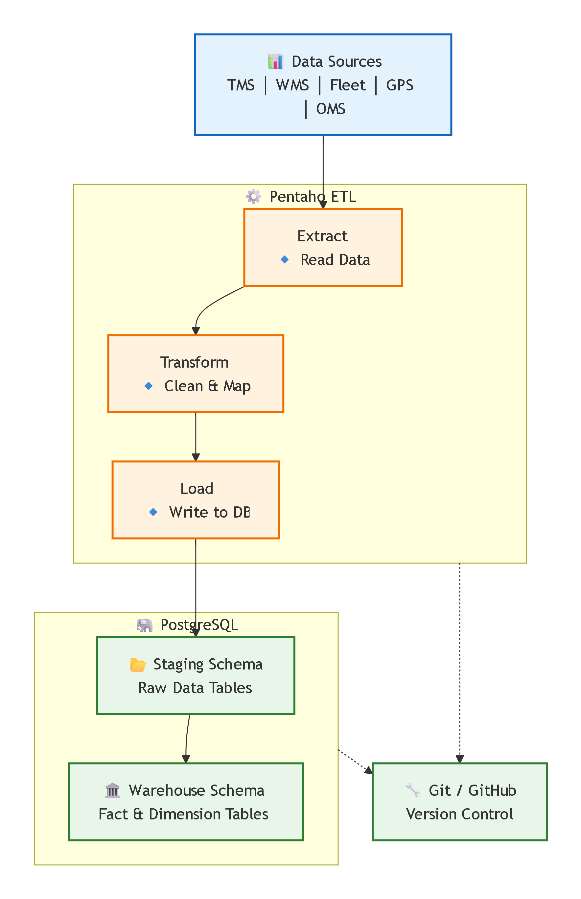
Architecture

Slide 12
Sprint 1: Data Formats & ETL
Data Pipeline Controls Logging Exception Handling Successful Git Commit The source systems may provide data in different formats. For example, one source may provide CSV files while another may provide JSON or XML. Pentaho Data Integration, also called Spoon, is used to create transformations that handle these different formats. The basic ETL flow is: Extract → Transform → Load The extracted information is processed through Pentaho and loaded into PostgreSQL staging tables. Logging helps track pipeline execution, while exception handling helps identify and manage ingestion problems.

Slide 13
Sprint 1: Deliverables & Outcome
Sprint 1 Deliverables 1. Source Inventory A documented list of the logistics data sources identified during data discovery. 2. Data Dictionary A structured description of the available logistics data and its fields. 3. Pentaho ETL Pipelines Pentaho transformations developed to ingest data from different source systems and formats. 4. Staging Database PostgreSQL staging tables containing the ingested raw logistics data. 5. Git Commit History Version-controlled history of the ingestion code and project changes. Expected Outcome A functioning Logistics Raw Data Landing Zone containing data from multiple heterogeneous enterprise systems. At the end of Sprint 1, the initial data ingestion layer should be operational and ready for the next stage: data profiling, quality assessment, standardization and warehouse development.

Slide 14
THANK YOU

