Slide 1

PES’s Modern College of Engineering
Shivajinagar, Pune -5
Department of Electrical Engineering
Year: 2022-2023
Topic: Economic Management of Alternate Energy Sources For Electric Power Generation
Name of Student:
1) Gaurav Lokhande (46046)
2) Varad Chavare (46010)
3) Akshay Malangner (46048)
4) Nandkishor Chavarekar (46011)
Name of Guide: Prof. Dr. Mrs. V.S. Jape

Slide 2
Index
Title
Aim & Objectives
Literature survey and Literature review
Methodology
Block diagram
Results
Reference

Slide 3
Title
Economic Management of Alternate Energy Sources For Electric Power Generation

Slide 4
Objectives of Project
Economic analysis of the proposed system using HOMER software.
To check the feasibility (Technical and economical) of the proposed hybrid system before its installation.
Perform simulation studies of different combinations.
To analyze the proposed system's Net Present Cost (NPC), Cost of Energy (COE), and Operating Cost.

Slide 5
Literature Survey And Review
1) “Economical Analysis Of Hybrid Energy Systems For Rural Electrification Using HOMER”
[2017]
The paper proposes a methodology using HOMER to design a stand-alone hybrid PV/wind/diesel/battery system, focusing on minimizing the Cost of Energy (COE) and CO₂ emissions for the village of Perumal Kovilpathy, Tamil Nadu.
Hybrid combination of renewable energy sources at an off-grid location can be a cost-effective alternative to grid extension and it is sustainable, economically, and environmentally friendly.
Three combinations of hybrid system is proposed among which the most economical is pv-diesel generator- battery.
2) “Technical Performance Evaluation And Economic Viable Solutions Using Hybrid
Renewable Energy Systems”[2015]
The design of a hybrid renewable energy system with battery backup has been proposed in this paper. For this hybrid system, the meteorological data of Solar Radiation, and hourly wind speed are taken to meet the primary load of 100KWh/day, and 28Kw peak load.
The local solar radiation, wind data, and load were analyzed and simulated in HOMER to assess the technical and economic viability of the integrated system.
Simulation of this hybrid power system was done using HOMER.

Slide 6
3) “A Review of Hybrid Renewable/Alternative Energy Systems for Electric Power
Generation: Configurations, Control, and Applications”[2017]
Different coupling methods for integration of different RE/AE systems such as DC coupling and AC coupling are discussed in this paper.
In DC coupling, the dc sources may be connected to the dc bus directly if appropriate. If there are any dc loads they can also be connected to the dc bus directly or through dc/dc converters.
4) “Design of hybrid power systems using Homer simulator for different renewable energy
sources”[2017]
The HOMER is a software tool developed by the National Renewable Energy Laboratory to design hybrid systems such as renewable microgrids, standalone, or grid-connected hybrid power system.
Three cases are studied including 1)PV- Battery, 2) Wind turbine- Battery, and 3) PV-Wind turbine-Battery and their economic and technical parameters were analyzed in homer.
The 3rd case (PV-Wind turbine-Battery) is more economical in terms of power generation than other cases.

Slide 7
5) “Optimization and operation of a renewable energy based PV-FC-Micro grid using
HOMER”[2017]
This paper optimizes the operation of PV/FC system with storage device under DC grid-connected mode and provides simulation results.
HOMER’s optimization and sensitivity analysis algorithms make it easier to evaluate possible design configurations.
“Design And Economic Analysis Of Hybrid Renewable Energy System ”[2019]
The focal point of this paper is to design and perform analysis along with cost analysis of a wind-solar on grid hybrid power generation system for a selected location.
For modeling of the proposed hybrid system MATLAB-SIMULINK is used and the Hybrid optimization model of renewable energy(HOMER) is used for cost analysis.

Slide 8
Methodology
Collection of electric load data and plotting daily Load Curve.
Collection of solar data and wind data such as Average Daily Solar Irradiance( kwh/m^2/ day), and Average Daily Wind (m/sec) of a given location.
Market survey for determining components’ cost and yearly maintenance cost.
Simulation performed on HOMER software.
Comparative analysis of different combination results.

Slide 9
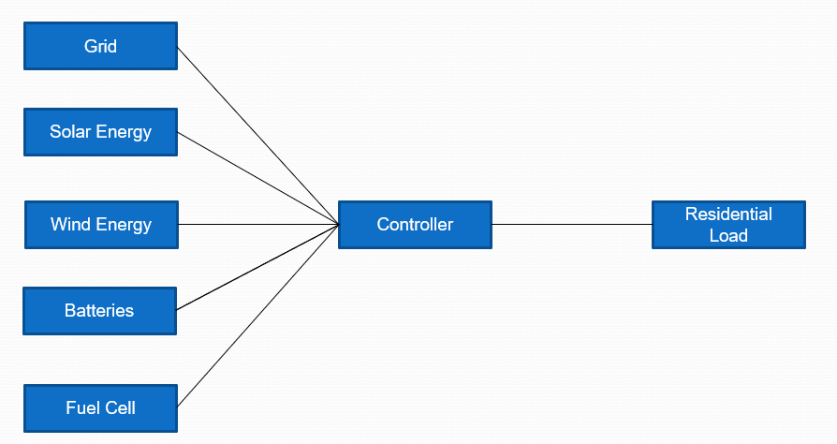
Block Diagram
Basic Block Diagram of The System

Slide 10
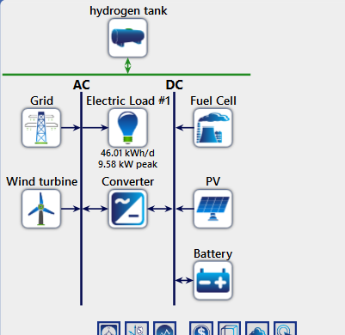
Schematic Diagram
Block Diagram of Actual System

Slide 11
Work done
Study of HOMER software (study of different parameters in it).
Considered a residential electrical load of 9.58kw peak. Annual average Daily consumption of 46.01 kWh.
Find the solar and wind for a given location
1) Solar Irradiance (kw/m^2/day)
2) Wind Speed(m/sec)
Find the yearly operating cost when our load is connected to the Grid only.
Initial cost and maintenance cost of the components.
Simulation studies are done
Final results and conclusion done
Work on a research paper done.
Work on the Final Report done
.

Slide 12
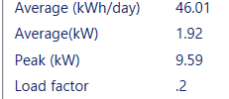
Important Data
Component | Rating and costing
Solar PV system | 1 kw (Rs. 32000)
Wind Turbine system | 1.5 kw (Rs. 260000)
Single phase inverter | 7.5 kw (Rs. 125000)
Battery (Lead Acid) | 12v,200amph (quantity-10) (Rs. 110000)
Rating of Used Components
Electrical Load Parameters

Slide 13
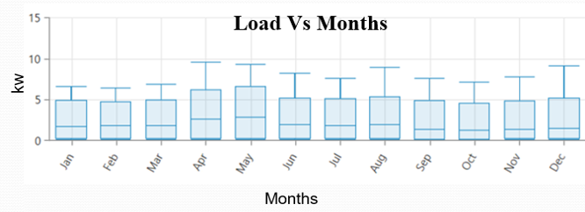
Daily load curve
Annual load curve

Slide 14
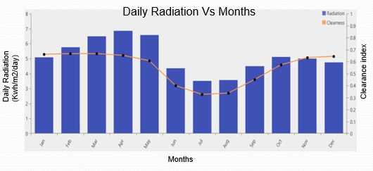
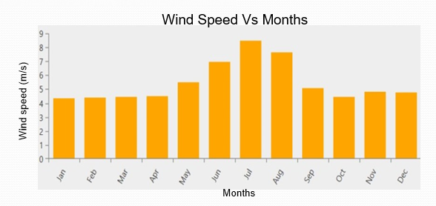
Solar and wind data
Solar Radiation
Average solar Radiation
(annual) = 5.12 kWh/m2/day
Clearance Index = 0.549
Average wind speed
Wind Speed
Average wind speed (annual) = 5.44 m/s

Slide 15
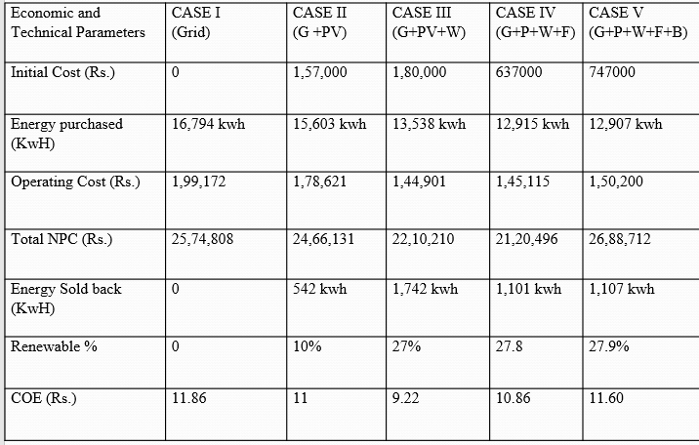
Results without Homer Optimisation
G = Grid ( 220V, 50Hz, Single phase, Residencial )
W = Wind (1.5 Kw ).
PV = Solar (1 Kw ).
F = Fuel Cell ( 500 watts )
B = Battery ( 10 battery , 12V , 200 Amp-hr.)

Slide 16
Result Graphs

Slide 17
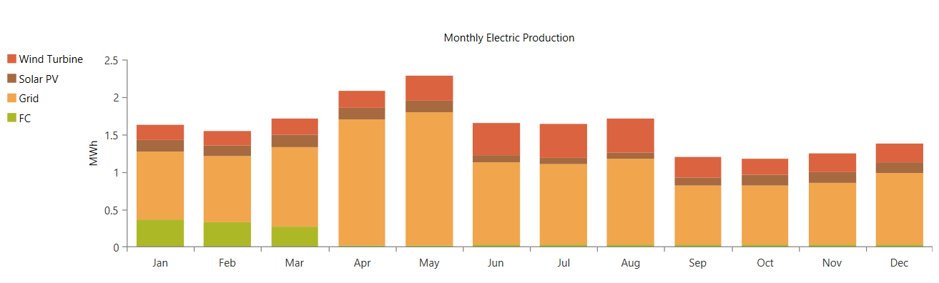
Monthly Electric Production Data
Component-wise annual Electrical energy production by each component (Case V, G+PV+W+FC+B, unoptimized)

Slide 18
Results with Homer Optimisation
Case No. | System Configuration | NPC (Rs.) | Operating Cost (Rs./year) | Initial Capital (Rs.) | Renewable Sources Percentage (%) | Energy Purchased (kWh) | Energy Sold (kWH)
VI | G+ PV ( 3Kw)+ W (1 Kw)+I(2.46 kW) | 17,28,936 | 6.43 | 3,16,991 | 38.5317 | 12771.86 | 3984.332
VII | G + PV (3kW) + W (1 kW) + I(2.46kW)+ B (1) | 17,46,601 | 6.50 | 3,28,538 | 38.5488 | 12769.68 | 3986.567
VIII | G+ PV (3kW) + I (2.46 kW) | 20,19,016 | 8.11 | 1,36,887 | 23.4872 | 14717.51 | 2441.718
IX | G + PV (kW) + I (2.46 kW) + B(1) | 20,36,571 | 8.18 | 1,48,069 | 23.5008 | 14715.34 | 2442.301
X | G + W (1 KW) | 22,84,719 | 10.01 | 1,80,000 | 19.7653 | 14157.56 | 851.5541
The above all cases are GRID connected

Slide 19
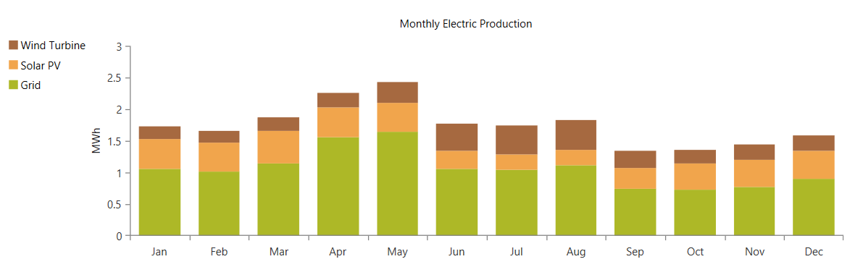
Component-wise annual Electrical energy production by each component (Case VI , G+PV(3kw)+W(1kw), Optimized)

Slide 20
Comparing Parameters | Actual System (CASE V) without optimization | HOMER optimized System (Case VI)
Energy purchased (KwH) | 12,907 kwh | 12,770 kwh
Operating Cost (Rs.) | 1,50,200 Rs. | 1,09,220 Rs.
Total NPC (Rs.) | 26,88,712 Rs. | 17,28,936 Rs.
Energy Sold back (KwH) | 1,107 kwh | 3,984 kwh
Renewable % | 27.9% | 38.5%
COE (Rs.) | 11.60 Rs. | 6.44 Rs.
Pay Back Period | 15 years | 3.5
Annual Saving | 48,972 Rs. | 89,952 Rs.

Slide 21
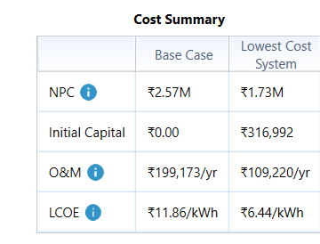
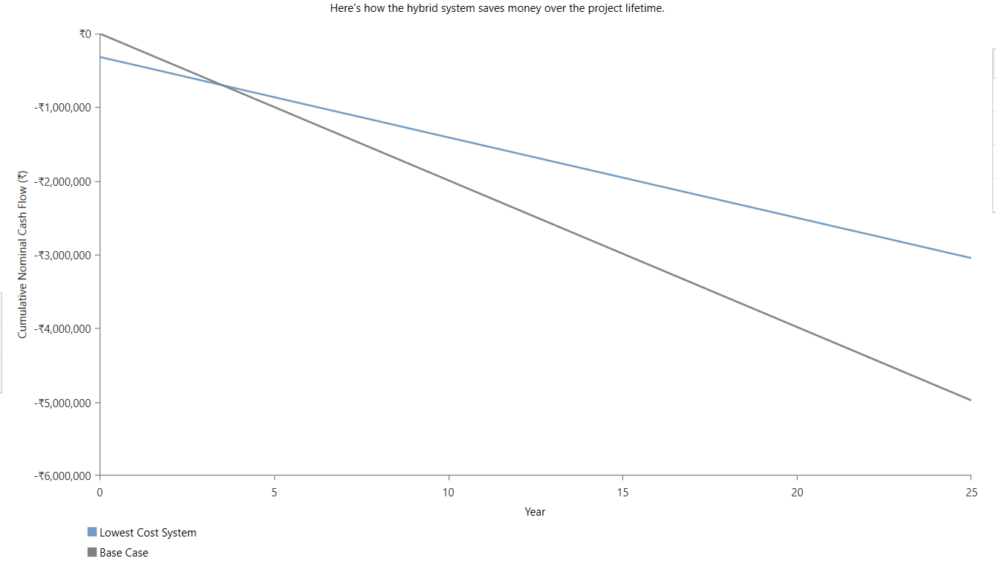
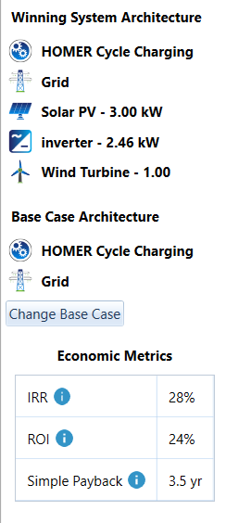
Optimized Result from HOMER
Optimised system
Base Case (grid)

Slide 22
Conclusion
Case III, which is a simulation without HOMER optimization, has the lowest operating cost (Rs. 1,44,901) and a COE (Cost of Energy) of Rs. 9.22. This indicates that the system configuration in Case III is cost-effective and efficient.
Case V represents an actual system that is planned for installation. While it has an initial cost of Rs. 7,47,000 and an operating cost of Rs. 1,50,200, the annual savings are Rs. 48,972. However, the payback period for this system is 15 years, suggesting that it may not be economically favourable in the long run.
The HOMER optimization simulation (Case VI) aims to find an optimized system configuration. Out of 19,444 feasible cases, the optimized system includes a 3kW solar PV, 1kW wind source, and a 2.46kW inverter. It has an initial capital requirement of Rs. 3,16,992, an annual operating cost of Rs. 1,09,220, and annual energy bill savings of Rs. 89,995. The payback period for this system is only 3.5 years, making it economically attractive.
Comparing the results of the simulation study, it is evident that the HOMER-optimized system (Case VI) outperforms the actual system (Case V) in terms of COE and NPC (Net Present Cost). The HOMER simulation is recommended as a means to evaluate the economic and technical feasibility of hybrid system projects before investing, as it can lead to more cost-effective and efficient solutions.

Slide 23
References
Jagriti kumari, P.Subathra, J. Edwin Moses, Shruthi D., “Economic Analysis Of Hybrid Energy System For Rural Electrification using HOMER”, IEEE international conference on Innovations in electrical, electronics, instrumentation and media technology [2017].
K. Nagasujatha, V.B. Shalini, “Technical Performance Evaluation And Economic Viable Solutions Using Hybrid Renewable Energy Systems”, IEEE Power, Communication and information technology conference (Bhubaneswar, India) [2015].
N.H. Nehrir, C. Wang, K. Strunz, H. Aki, R. Ramakumar, J. Bing, Z. Miao, Z.Salameh “A Review Of Hybrid Renewable/Alternative Energy Systems For Electric Power Generation: Configuration, Control, An Applications”, IEEE Transactions on sustainable energy [2011]
Hoarca Cristian, Nicu Bizon, Badita Alexandru, “Design Of Hybrid Power System Using Homer Simulator For Different Renewable Energy Sources”, International Conference on Electronic, computers and artificial intelligence, Targoviste, Romania [2017]

Slide 24


