Slide 1
Solar Irradiance Prediction Using Satellite data and Machine Learning
Internship Project | February – June 2025
Gaurav Lute

Slide 2
Outline
Introduction
Project Overview
Problem Statement
Dataset Description
Project Workflow
Exploratory Data Analysis
Feature Engineering
Models and Results
Evaluation Table

Slide 3
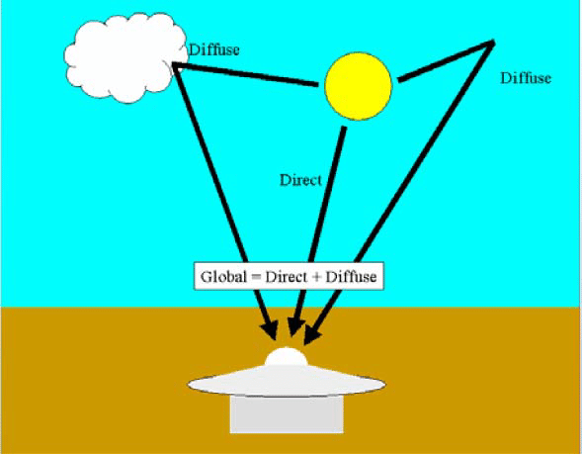
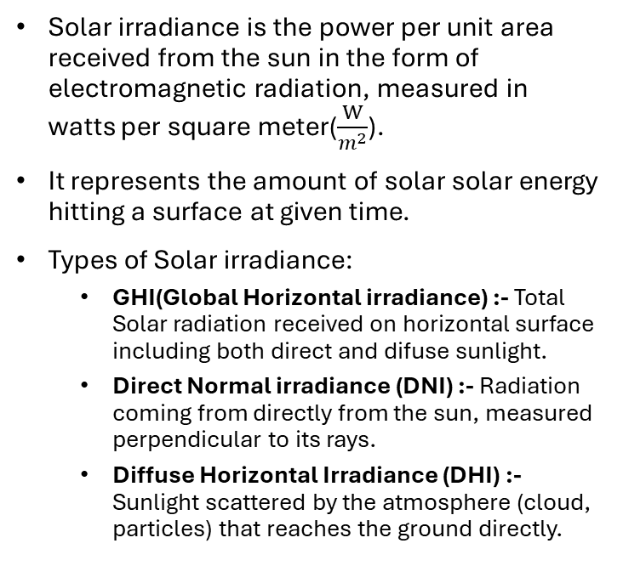
Introduction
Solar irradiance is the power per unit area received from the sun in the form of electromagnetic radiation, measured in watts per square meter($\frac{W}{m^{2}}$).
It represents the amount of solar solar energy hitting a surface at given time.
Types of Solar irradiance:
GHI(Global Horizontal irradiance) :- Total Solar radiation received on horizontal surface including both direct and difuse sunlight.
Direct Normal irradiance (DNI) :- Radiation coming from directly from the sun, measured perpendicular to its rays.
Diffuse Horizontal Irradiance (DHI) :- Sunlight scattered by the atmosphere (cloud, particles) that reaches the ground directly.

Slide 4
Project Overview
📌 Objective
Forecast Global Horizontal Irradiance (GHI) using satellite data and machine learning.
🛰️ Dataset
NASA POWER (Feb 2016 – Feb 2025),
🛠️ Techniques Used
Classical ML
📈 Goal
Predict GHI for March 2025 to support short-term solar energy planning.
🌞 Application
Useful for solar panel optimization,
Grid integration.
Renewable energy forecasting.
Time Series Models.
Pune, India.

Slide 5


Problem Statement
Problem 1: Parametric Estimation
🎯 Objective: Estimate GHI using a simple parametric model based on known physical and atmospheric relationships.
📊 Approach: Use meteorological features (temperature, humidity, wind, etc.) to Random forest, Gradient Boosting etc.
🧩 Purpose: Understand feature influence and provide quick estimates using ML.
Problem 2: ML-Based Forecasting
🔮 Objective: Forecast solar irradiance values for March 2025 using historical satellite data.
📈 Approach: Use ML and time series techniques like XGBoost, LightGBM, ARIMA, Prophet.
🧠 Purpose: Build a data-driven model that learns temporal and atmospheric patterns to give accurate short-term GHI forecasts.

Slide 6
Dataset Description
📌 Source:
NASA POWER (Prediction Of Worldwide Energy Resources)
🌍 Location:
Pune, India
Latitude: 18.52°N, Longitude: 73.86°E
🕒 Time Period:
February 28, 2016 – February 28, 2025
📅 Frequency:
Daily resolution (365 observations per year)
🎯 Target Variable:
ALLSKY SFC SW DWN Global Horizontal Irradiance (GHI)
🔍 Input Features (Examples):
☀️ Solar: DNI, DHI radiation
🌡️ Temperature: T2M, Dew Point
💧Humidity: RH2M, QV2M
🌬️ Wind: Speed and Direction at 2m/10m
📆 Time: Day of Year (DOY), Lag Features

Slide 7
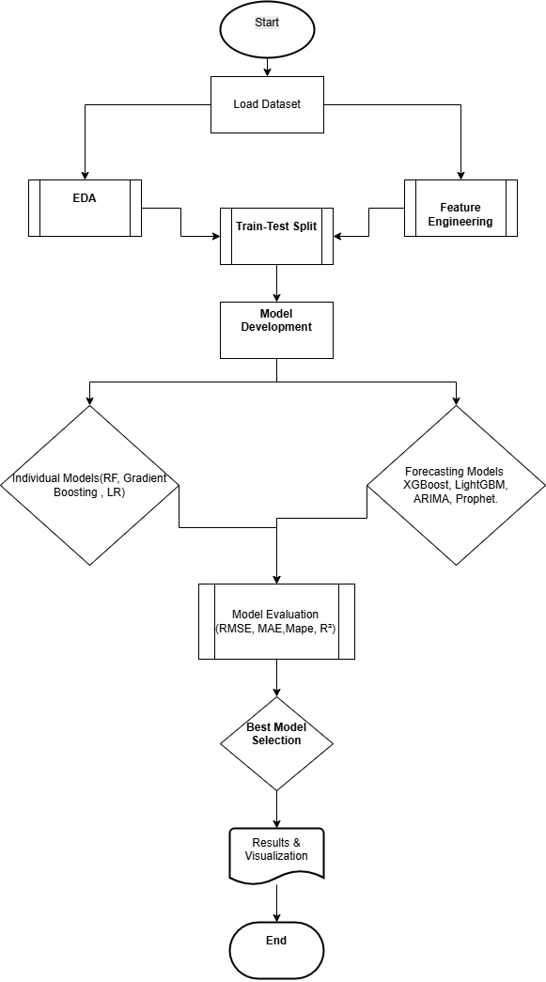
Project Workflow
🔹 Objective
Predict solar irradiance using satellite data.
Build reliable models for energy planning and forecasting.
🔹 Data Source
NASA POWER (2016–2025) and others like NSRDB, GHI, temperature, humidity, cloud cover, wind speed, etc.
🔹 Methodology Highlights
Applied Exploratory Data Analysis (EDA) to understand patterns.
Used feature engineering for time-based and domain-specific variables.
Applied ML models (RF, XGBoost, LR) and forecasting models (ARIMA, Prophet).
🔹 Model Evaluation Metrics
RMSE, MAE, MAPE, R² to assess model accuracy.
Cross-validation or walk-forward validation (if time series).
🔹 Outcome
Best-performing model identified.
Visualized predictions vs actual values.
Insights generated for solar energy planning.

Slide 8
Exploratory Data Analysis
✅ Seasonal Patterns: GHI shows a clear annual cycle with peak values during summer and dips during monsoon/winter.
✅ Feature Relationships: Temperature and solar radiation show non-linear patterns; humidity and precipitation show negative correlation with GHI.
✅ Outliers & Distribution: Few extreme values found in precipitation, wind speed, and solar radiation handled using log transformation and boxplot analysis.
✅ Wind Direction Encoding: Circular features (wind direction) were transformed using sine and cosine encoding.
✅ Correlation Analysis: Features like T2M, RH2M, and cloud-related variables showed moderate to strong correlation with GHI.

Slide 9
✅ Seasonal Patterns: GHI shows a clear annual cycle with peak values during summer and dips during monsoon/winter.
✅ Feature Relationships: Temperature and solar radiation show non-linear patterns; humidity and precipitation show negative correlation with GHI.
✅ Outliers & Distribution: Few extreme values found in precipitation, wind speed, and solar radiation handled using log transformation and boxplot analysis.
✅ Wind Direction Encoding: Circular features (wind direction) were transformed using sine and cosine encoding.
✅ Correlation Analysis: Features like T2M, RH2M, and cloud-related variables showed moderate to strong correlation with GHI.

Slide 10
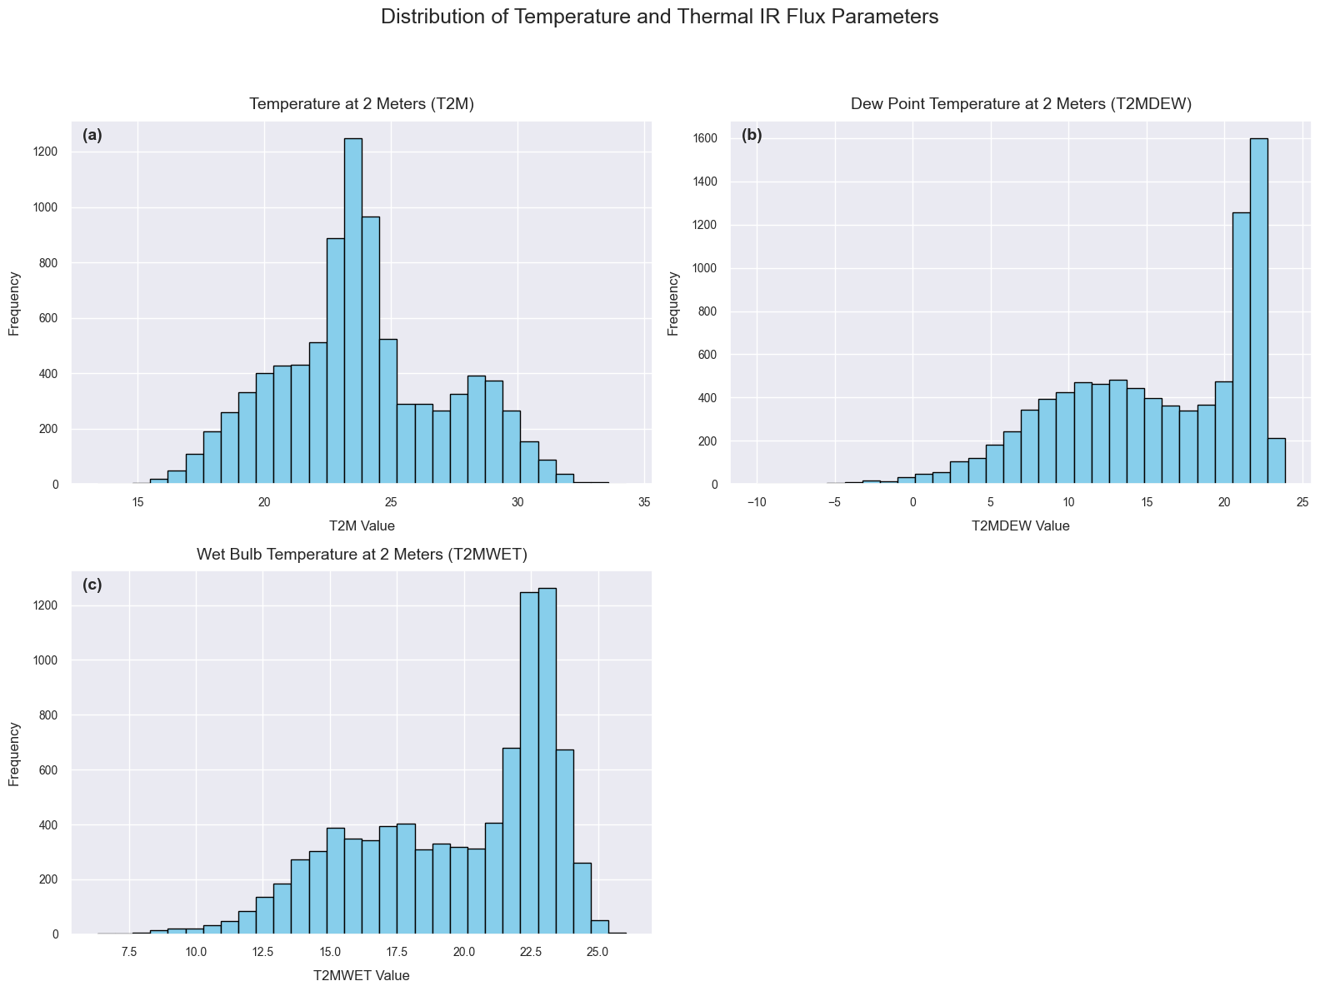
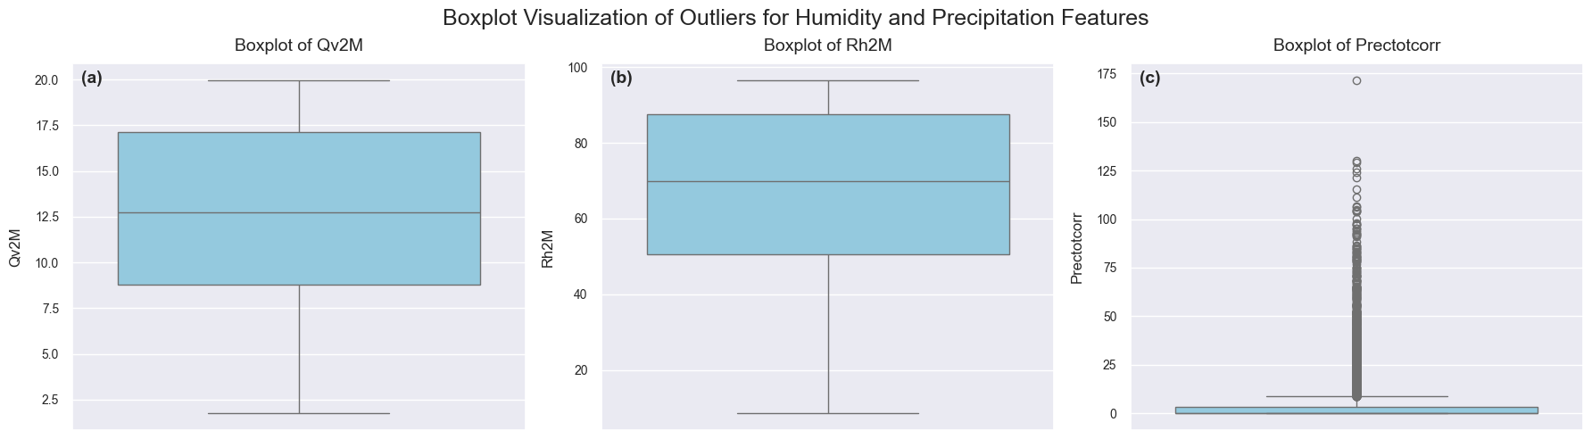
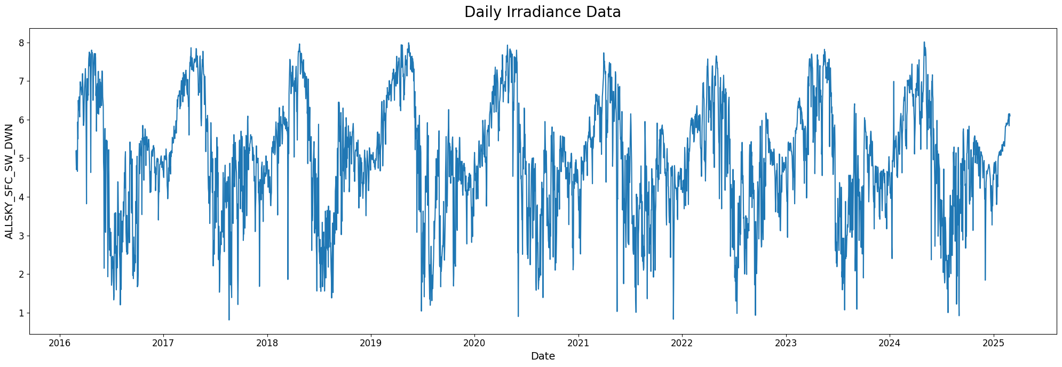
EDA for ML Model

Slide 11
Feature Engineering
Classical ML Model
Time Series Prediction Mode
Logarithmic transformation in PRECTCORR columns(Highly Right skew).
Transform Wind direction Feature.
Remove Highly Uncorrelated Feature.
Developed New Lags Features.
Lag_1 : GHI value from the previous day.
Lag_2 : GHI value from two days prior.
Lag_7 : GHI value from the same day one week earlier.
Lag_365 : GHI value from the same day one year earlier.

Slide 12
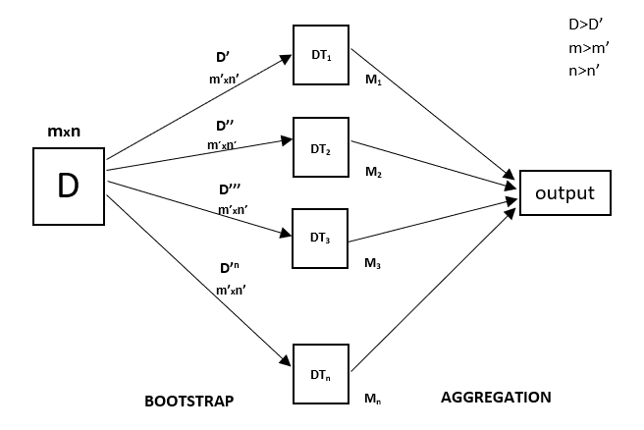
Classical Machine Learning Models
Random Forest Model
A tree-based ensemble learning model.
Handles non-linear relationships very well.
Result
Average MSE: 0.39
Average R2 Score: 0.98

Slide 13
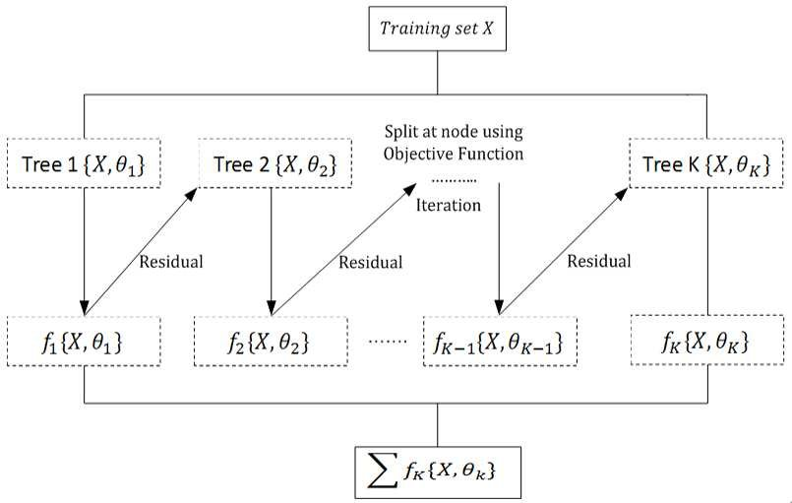
XGBoost Model with Lag variables.
XGBoost stands for Extreme Gradient Boosting.
Builds trees sequentially, each one trying to correct the errors of the previous model.
Feature Engineering - Developed some lag features.
Results
RMSE :- 0.192
R2 Score :- 0.891

Slide 14
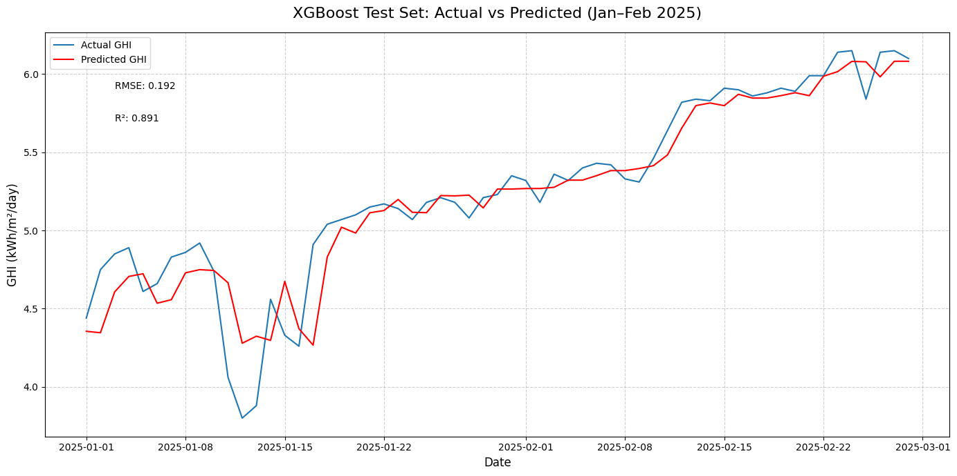
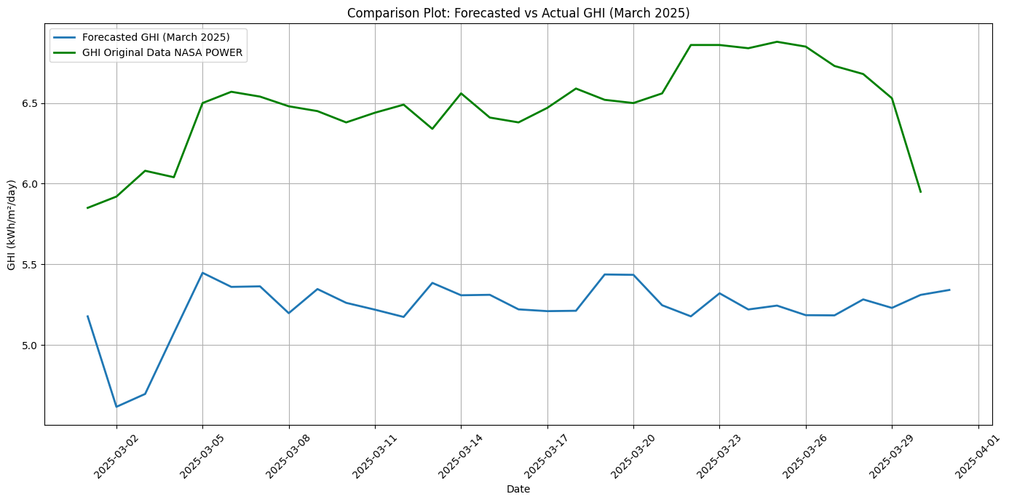
XGBoost Models with Lag variables.

Slide 15
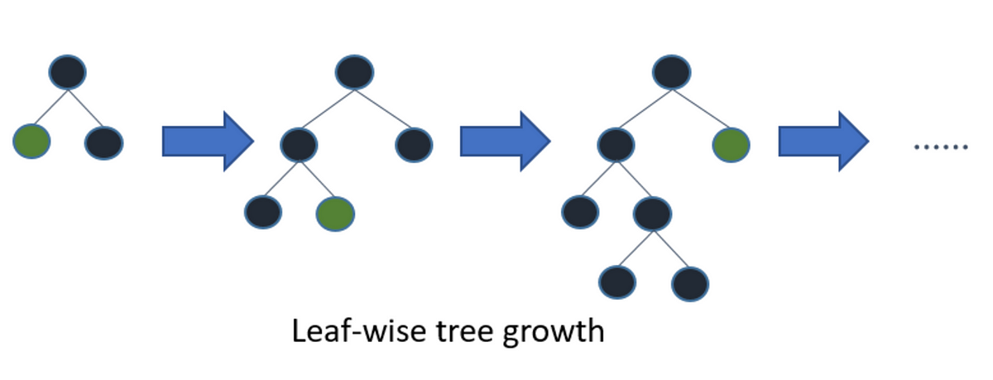
Light-GBM (Light Gradient Boosting Machine) model
LightGBM (Light Gradient Boosting Machine) is fast.
Like XG-Boost, it builds decision trees sequentially to minimize errors.
But unlike traditional boosting:
It grows tree leaf-wise (best leaf first), not level-wise.
Uses histogram-based binning for faster split finding.
Works best when data is large and sparse.
Result
• RMSE:- 0.05
• R 2 Score :- 0.856

Slide 16
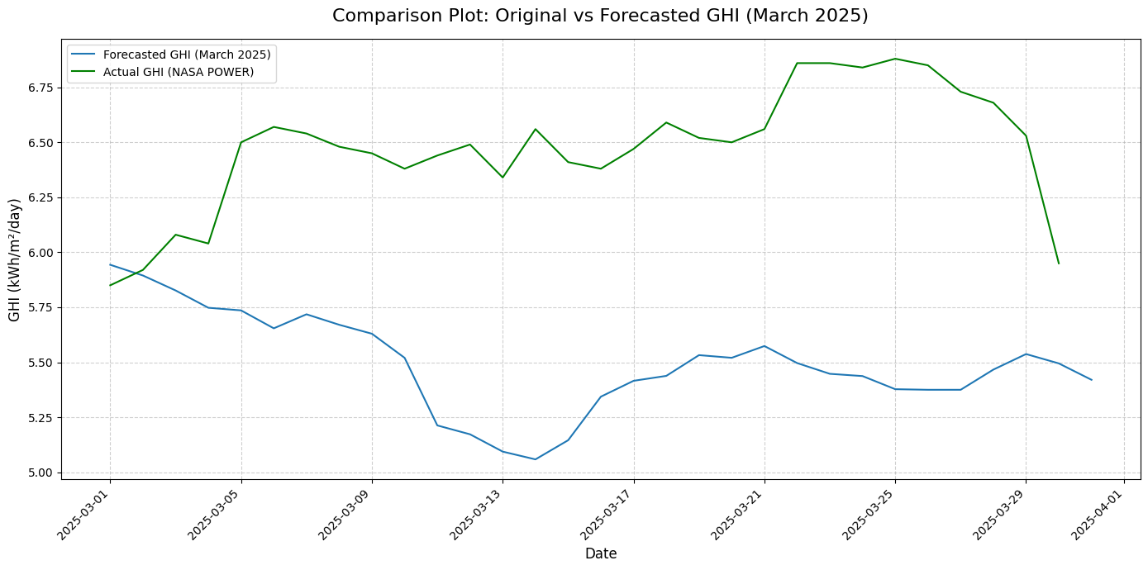
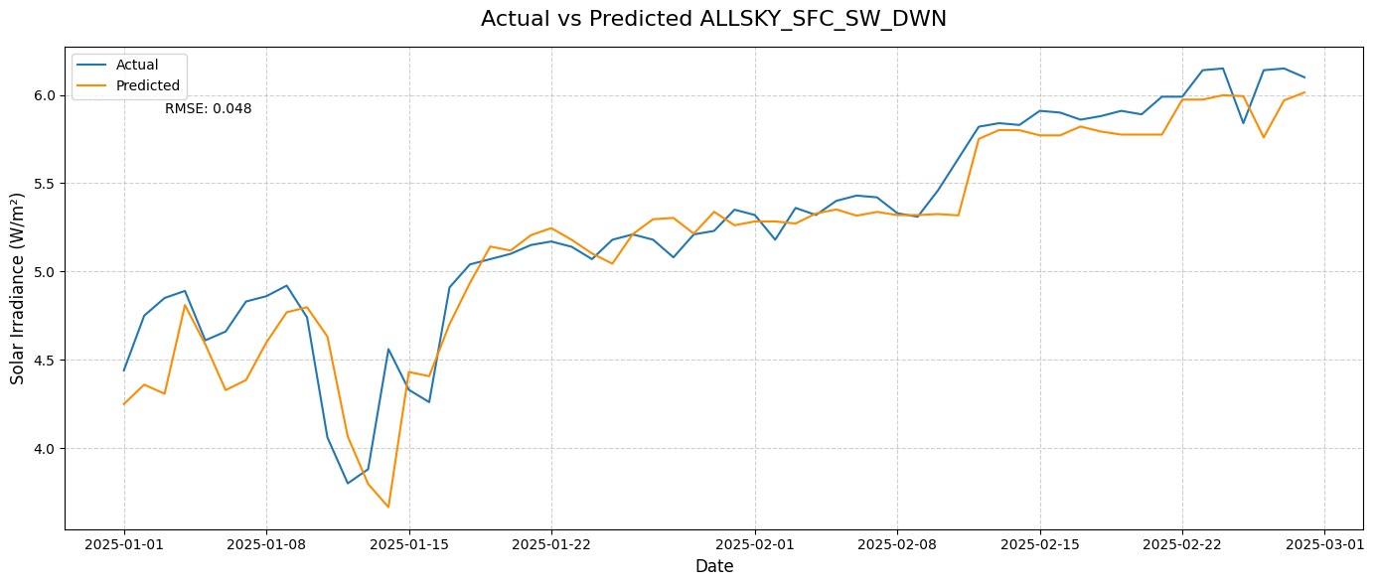
Light-GBM (Light Gradient Boosting Machine) model

Slide 17
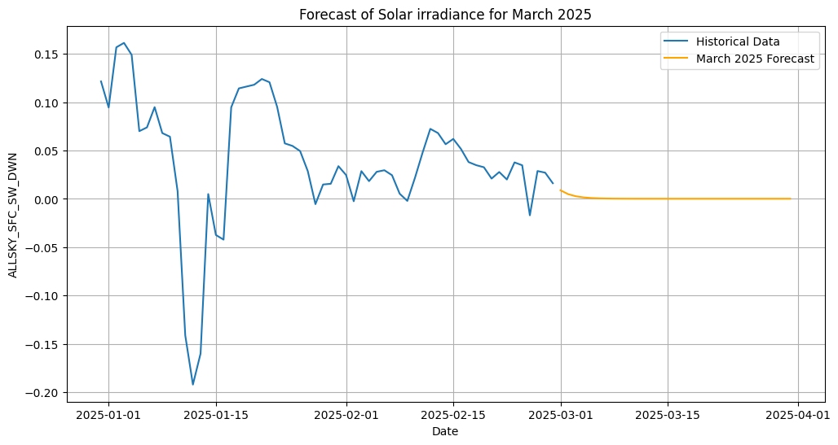
ARIMA (Autoregressive Integrated Moving Average)
ARIMA is a classical time series forecasting model.
It combines Auto-Regression (AR), Integration (I), and Moving Average (MA) to model temporal data.
Component Explanation:
AR (Auto-Regression): Predicts using past values (lags of the target)
I (Integration): Applies differencing to make the time series stationary
MA (Moving Average): Uses past forecast errors to improve prediction.
Results
RMSE :- 0.035
MAE :- 0.035

Slide 18
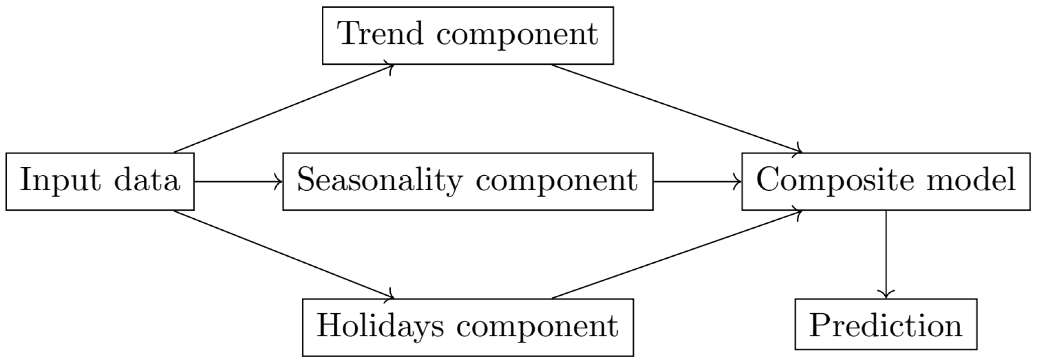
Facebook Prophet Model
Prophet is an open-source time series forecasting tool developed by Facebook.
Ideal for daily, weekly, and monthly time series with seasonality and trends.
Automatically detects and models:
Trend (piecewise linear or saturating)
Seasonality
Holidays/events (Optional)
Results
MAPE(Mean absolute percentage error) :- 0.03
Mean absolute error :- 0.17

Slide 19
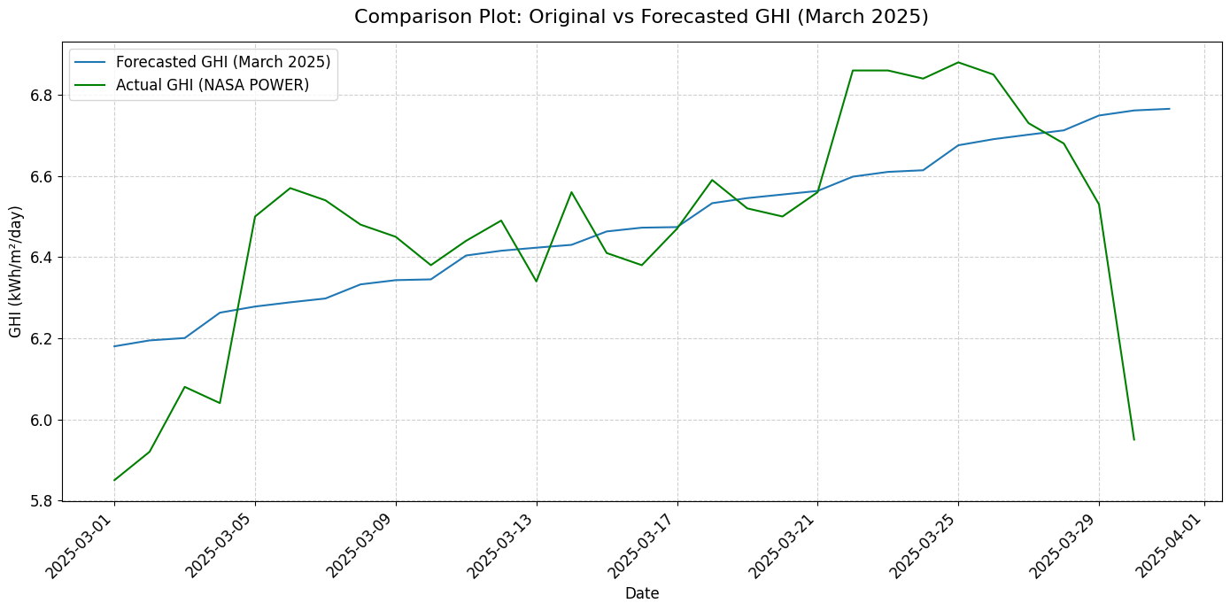
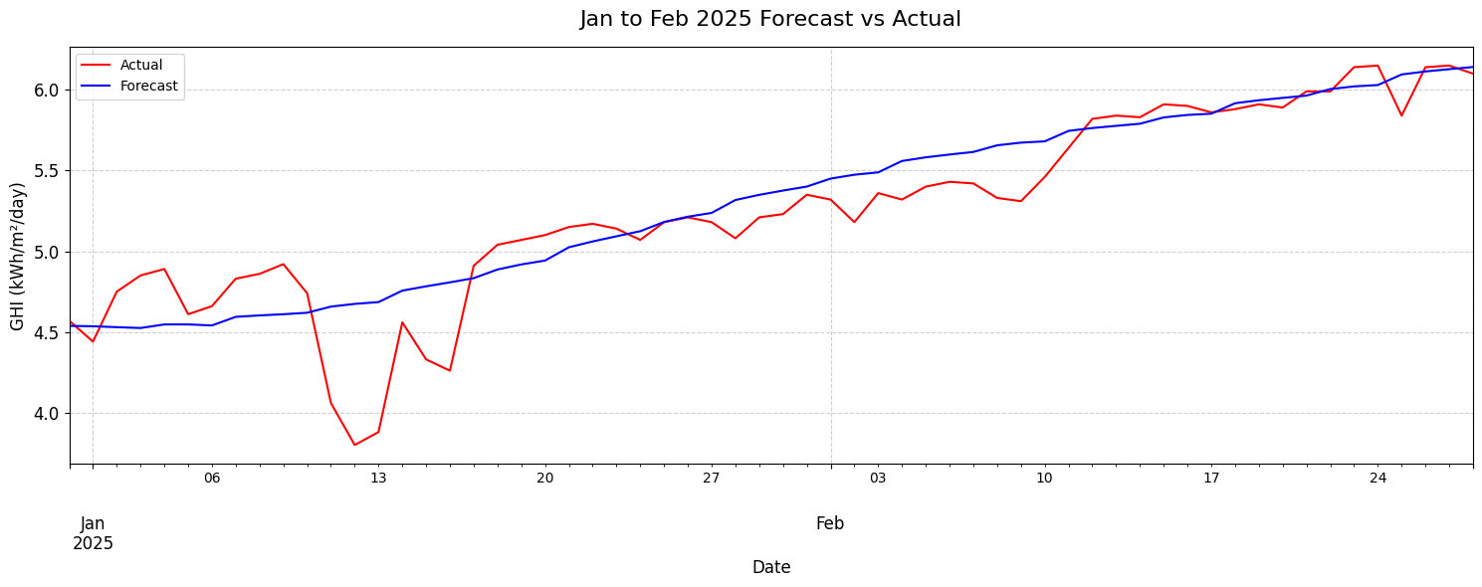
Facebook Prophet Model

Slide 20
Evaluation Table
Model | RMSE ↓ | R² Score ↑ | Key Strength
XGBoost | 0.05 | 0.89 | Best overall accuracy & robust with lag features
Random Forest | 0.39 | 0.98 | Strong on non-linear patterns
Gradient Boosting | 0.43 | 0.98 | Good balance, slightly slower
LightGBM | 0.05 | 0.856 | Fastest training, low memory usage
ARIMA | RMSE :- 0.035 | MAE :- 0.035 | Simple, interpretable, but univariate
Facebook Prophet | MAPE = 0.03 | 0.81 | Trend-aware & easy, but less flexible

Slide 21
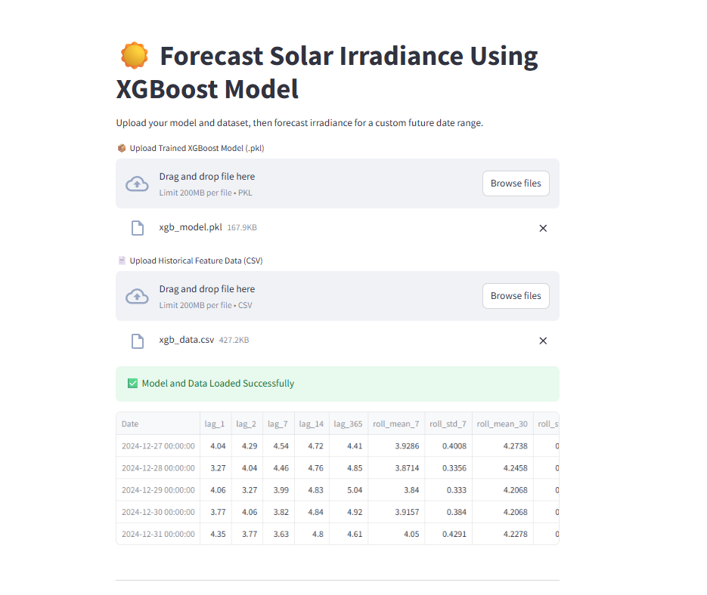
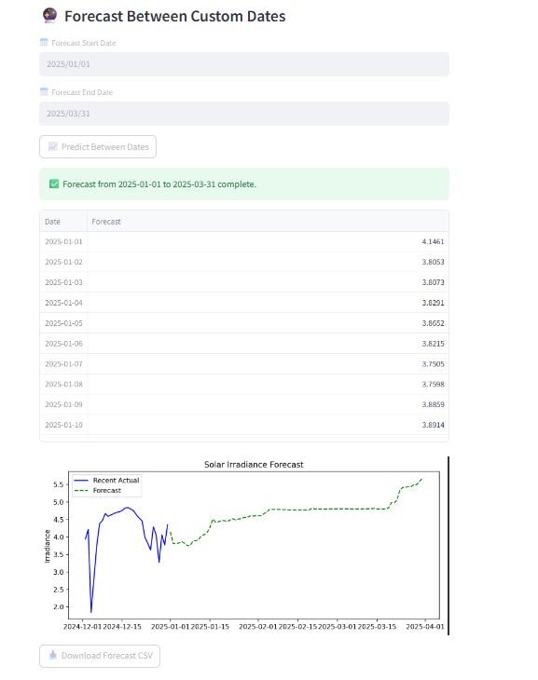
Simple Streamlit UI interface

Slide 22
Thank you

