Slide 1
Data Analysis and Visualization using Power BI
Gaurav Saini

Slide 2
CONTENT SLIDE
Overview/Dashboard
Explanation of Dashboard
Profit Analysis
Animated Analysis
Forecast Analysis

Slide 3
OBJECTIVE
Received practical training on data analysis and visualization using Power BI. Learned how to configure visualizations, create date grouping matrix visualizations, view reports in the Power BI service, drill through report pages, configure animated charts, and explore building forecast charts.
After completing this project, I able to:
Configure visualizations.
Create date grouping matrix visualizations.
View reports in the Power BI service.
Create drill through report pages.
Configure animated charts.
Create a forecast chart.

Slide 4
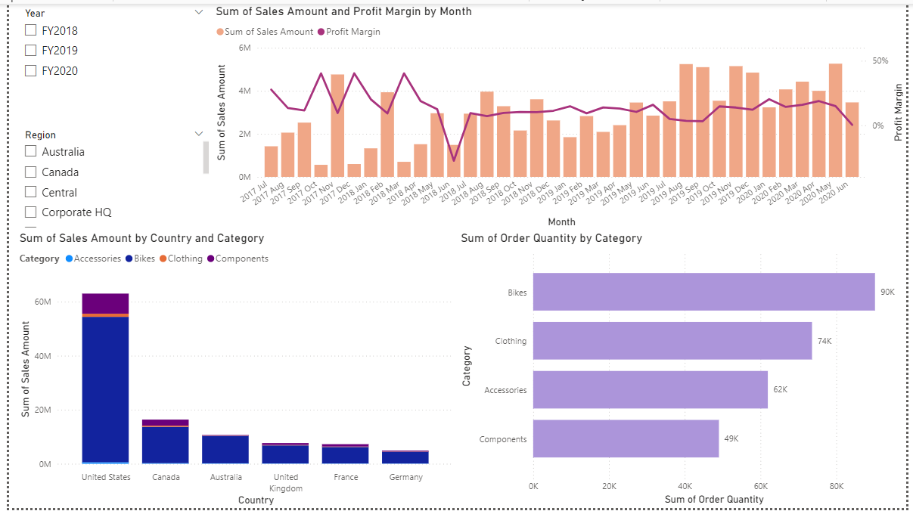
Overview/Dashboard
20XX
Section Subtitle

Slide 5
Explanation of Dashboard
Sales by Month: The line chart titled "Sum of Sales Amount by Month" shows a trend in sales over a two-year period. It appears sales increased throughout 2018 and the first half of 2019.
Profit Margin: The table titled "Sum of Sales Amount and Profit Margin by Month" shows profit margin alongside sales amount. It reveals that profit margin may be higher in FY2020 than FY2019 based on the data displayed.
Sales by Region: The table titled "Sum of Sales Amount by Country and Category" shows sales figures for different countries. It indicating that the United States has the highest overall sales amount in all three categories.
Sales by Category: The bar chart titled "Sum of Order Quantity by Category" shows the quantity of orders placed for different product categories. Bikes seem to be the most popular category, followed by Clothing and Accessories.
Overall, this dashboard suggests a positive sales trend with Bikes being the top-selling category. The United States appears to be the leading sales region.

Slide 6
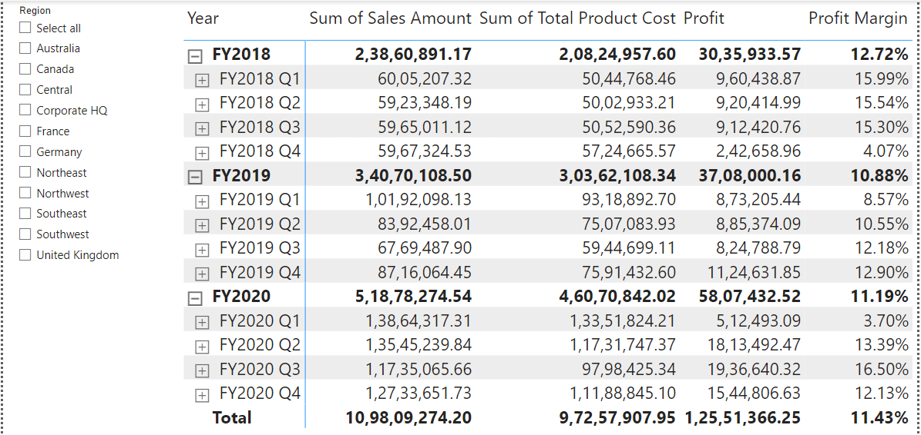
Profit Analysis
Overall Sales Growth: There has been a significant increase in total sales amount from FY 2018 to FY 2020. Sales nearly doubled from ₹2,38,60,891.17 in FY 2018 to ₹5,18,78,274.54 in FY 2020.
Profit Margin Fluctuation: Profit margins have fluctuated over the years. FY 2018 had a higher average profit margin (12.72%) than FY 2019 (10.88%) and FY 2020 (11.19%). However, there is a significant increase in profit amount from ₹30,35,933.57 in FY 2018 to ₹58,07,432.52 in FY 2020, likely due to the substantial growth in sales.

Slide 7
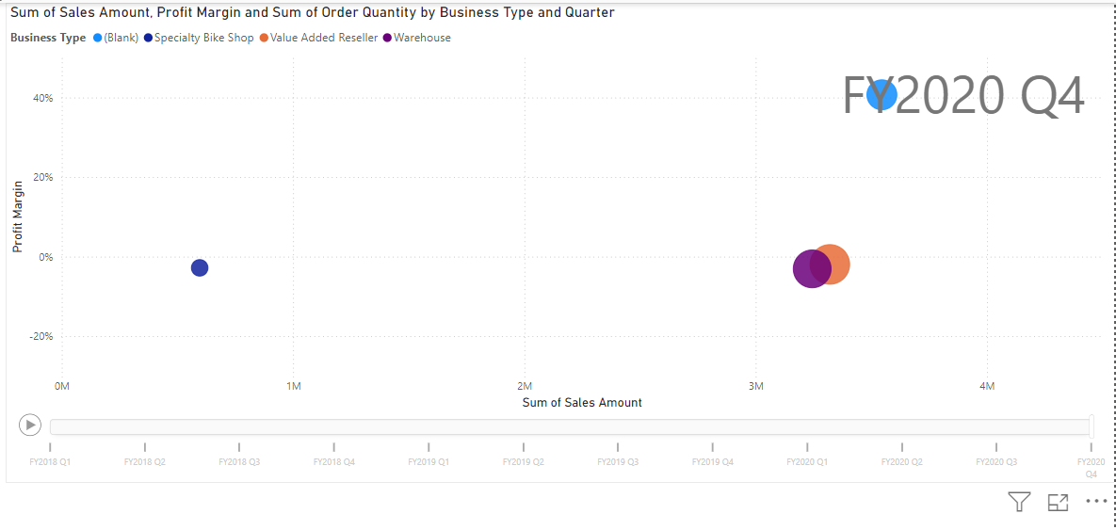
Animated Sales Amount Analysis
Animation Type: This is a time-series animation, likely using a custom visual like "Play Axis" in Power BI. This type of animation is useful for showing trends over time.
Animation Speed and Controls: Slower speeds allow for better comprehension, while faster speeds might highlight trends. Look for controls to pause, rewind, or fast-forward the animation for closer inspection in Power BI.
Focus on the Underlying Data: The animation appears to show the sum of sales amount, profit margin, and cost of goods sold by quarter.
Identify Key Changes: There seems to be a significant increase in the sum of sales amount over time. Profit margin appears to fluctuate.

Slide 8
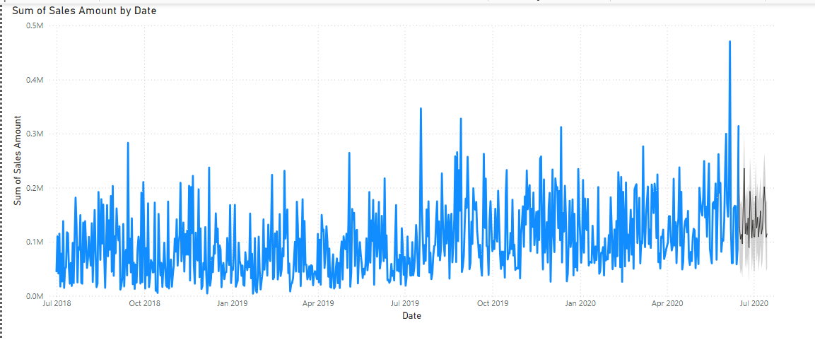
Forecast Analysis
Forecast visual that shows the predicted future sales amount along with the historical sales amount. The forecast predicts that the sum of sales amount will increase in the next few months. The forecast is a line extending from the last known data point (May, June 2020) and is shaded in a light blue color. There are two additional lines above and below the forecast line, which represent the upper and lower bounds of the confidence interval. The confidence interval is a measure of how certain the forecast is. In this case, the confidence interval is set at 80%, which means that there is a 80% chance that the actual sales amount will fall within the shaded area.
There is a label at the end of the forecast line that says which is the predicted sales amount for July 2020.
There are also labels for the upper and lower bounds of the confidence interval.

Slide 9
Conclusion
I am familiar with some of the tools and concepts in this project, and this will serve as an excellent opportunity to deepen my understanding and refine my skills.
This project also prepared me for some of the topics covered in the Microsoft Certified Exam PL-300: Power BI Analyst. This globally recognized certification is industry-backed proof of my technical skills and knowledge.

Slide 10
THANK YOU!

