Slide 1
Introduction to TensorFlow
DL 2.0. Workshop
Gaurav Manek

Slide 2
TensorFlow?
It is
graph-driven computation library
support for arrays of arbitrary dimensions
filled with common (and uncommon!) neural network primitives
  convolutions
  optimizers (automatic differentiation!)
It is NOT
a programming language
just a neural network library
  it can do a lot more!
Caffe/MatConvNet
a substitute for NumPy/SciPy

Slide 3
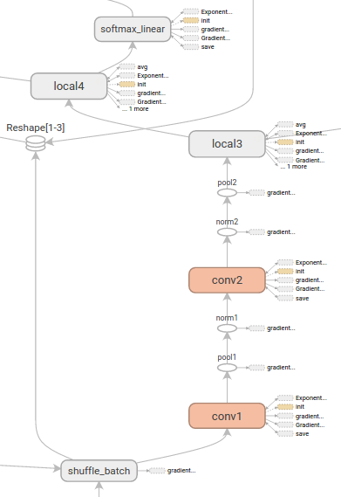
“graph-driven computation”?
1. Design your model as a graph, including the training and evaluation.
2. Write it in Python
3. TensorFlow will build the model on the CPU/GPU and run it there.

Slide 4
Some Caveats
Once the model is initialized (i.e. memory is allocated), the graph is immutable.
Moving data between native Python/C++ and TensorFlow is inefficient.
  Perform all the computation you can using TensorFlow primitives, including loading data from disk.
Adding new TensorFlow primitives is difficult.

Slide 5
Tensor and Variable
Tensor
The output of any computation.
A matrix of arbitrary size.
Can be converted to Numpy array.
Variable
Stored matrix of arbitrary shape.
Can be trainable – Optimizers are allowed to change.

Slide 6
Op and Placeholder
Op
Any computation – takes variables and ops as input, and (at runtime) produces a Tensor as output.
Any op can be used as a sink/output node. All dependencies are automatically computed.
Ops and variables can be grouped into a single Op.
Placeholder
Reserved space for arbitrary input.
An actual value must be provided during execution.
Unfilled placeholders cause exceptions.
Typically a numpy array is expected.

Slide 7
Let’s write a computational graph! (1/5)
Images
Prediction
Labels

Slide 8
Let’s write a computational graph! (2/5)
Images
Softmax Loss Function
Optimizer
Labels

Slide 9
Let’s write a computational graph! (3/5)
Initializer
Images
Softmax Loss Function
Optimizer
Labels

Slide 10
Let’s write a computational graph! (4/5)
Initializer
Logging
Images
Softmax Loss Function
Optimizer
Labels

Slide 11
Let’s write a computational graph! (5/5)
(Sink)
Target nodes
(Source)
Placeholder Nodes
Initializer
Logging
Images
Softmax Loss Function
Optimizer
Labels

Slide 12
cnn/train.py
Download the example with:
git clone https://github.com/gauravmm/DL2W.git
Go to the directory and run the example with:
python3 workshop.py cnn train
You can download pretrained weights using:
python3 workshop.py --pretrained cnn
The first time you run any example, it will download the dataset.
You need a wired connection or VPN to access the datasets.

Slide 13
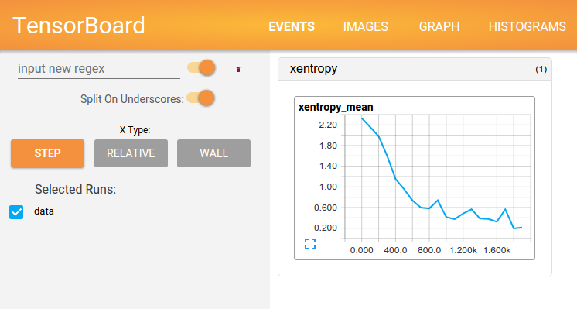
Tensorboard Output
tensorboard --logdir cnn/train_logs

Slide 14
Data Precision
Supports:
  tf.int(8|16|32|64)
  tf.float(16|32|64)
  ...
tf.float16 offers 10-bit precision, and is a good compromise.
Caveat:
  Half-precision on GPU requires hardware support.
    TITAN X / Tesla cards offer this.

Slide 15
Data Precision +
Automatic Differentiation
Almost all operations support automatic differentiation.
  Optimizers use this automatically.
Caveats: Precision Issues!
  Vanishing Gradients – Avoid tf.softmax(tf.softmax(x))
    The cross-entropy loss functions have this by default!
  Order of Operations
    tf.reduce_sum(tf.log(x)) is better than tf.log(tf.reduce_prod(x))

Slide 16
Supervisor
Automates loading, initialization, summary writing.
Refer to cnn.py:46-51 for example.
If any variables are saved, they are transparently loaded when the managed session is created.
  with sv.managed_session() as sess:

Slide 17
Logging Training Progress
Insert summary ops in the graph.
  tf.summary.*
Run the summary op
  You can run it with some computation (e.g. training) or by itself.
  Merge all summaries using tf.summary.merge(_all)?
  Output of this is a tf.Summaries object.
Save the summary object
  Use a tf.summary.FileWriter object.

Slide 18
Logging Training Progress
Insert summary ops in the graph.
  tf.summary.*
Run the summary op
  You can run it with some computation (e.g. training) or by itself.
  Merge all summaries using tf.summary.merge(_all)?
  Output of this is a tf.Summaries object.
Save the summary object
  Use a tf.summary.FileWriter object.
Use a
Supervisor!

Slide 19
What Ops can I Use?
tf.nn
  Ops that perform computation.
  An interface to the underlying implementation.
tf.layers
  Neural network layers!
tf.contrib
  A huge variety of ops that handle distributions, audio, kernel methods, linear algebra, linear optimization, sparse matrices, sequence-to-sequence, etc.

Slide 20
Some Op Caveats
Batch Normalization
  Additional UPDATE_OPS are created, and must be run with the optimizer.
<tensor>.get_shape() vs tf.shape(<tensor>)
  <tensor>.get_shape()
    Shape at construction time
    Unknown dimensions are ?
  tf.shape(<tensor>)
    Is an op.
    Shape at runtime, when all dimensions are known.

Slide 21
tf.layers
Examine cnn/vgg.py

Slide 22
Scopes
with tf.variable_scope('conv1'):
  Used to group variables and ops into logical groups.
with tf.name_scope('opname'):
  Used to define a new op.

Slide 23
Variable Reuse
You can share structure without sharing weights:
with tf.variable_scope(‘scope_1’) as scope:
y1 = make_model(x1)
with tf.variable_scope(‘scope_2’) as scope:
y2 = make_model(x2)
You can share model structure and weights:
with tf.variable_scope(‘scope_1’) as scope:
y1 = make_model(x1)
scope.reuse_variables()
y2 = make_model(x2)

Slide 24
In Summary
TensorFlow’s computation model
Comptuational Graph cannot be changed after it is initialized
Automatic dependency calculations
  You tell it what sinks you want,
  If you’re missing any sources, it barfs
Training supervisors automate a lot of the overhead.
Some Ops are special – read the documentation!

