Slide 1
Introduction to TensorFlow
DL 2.0. Workshop
Gaurav Manek

Slide 2
TensorFlow?
It is
graph-driven computation library
support for arrays of arbitrary dimensions
filled with common (and uncommon!) neural network primitives
  convolutions
  optimizers (automatic differentiation!)
It is NOT
a programming language
just a neural network library
  it can do a lot more!
Caffe/MatConvNet
a substitute for NumPy/SciPy

Slide 3
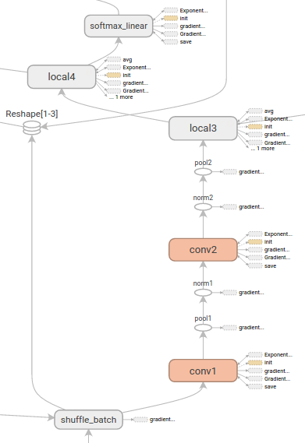
“graph-driven computation”?
1. Design your model as a graph, including the training and evaluation.
2. Write it in Python
3. TensorFlow will build the model on the CPU/GPU and run it there.

Slide 4
Some Caveats
Once the model is initialized (i.e. memory is allocated), the graph is immutable.
Moving data between native Python/C++ and TensorFlow is inefficient.
  Perform all the computation you can using TensorFlow primitives, including loading data from disk.
Adding new TensorFlow primitives is difficult.

Slide 5
Let’s write a computational graph! (1/5)
Images
Prediction
Labels

Slide 6
Let’s write a computational graph! (2/5)
Images
Softmax Loss Function
Optimizer
Labels

Slide 7
Let’s write a computational graph! (3/5)
Initializer
Images
Softmax Loss Function
Optimizer
Labels

Slide 8
Let’s write a computational graph! (3/5)
Initializer
Logging
Images
Softmax Loss Function
Optimizer
Labels

