Slide 1
Generative Adversarial Networks
DL 2.0. Workshop
Gaurav Manek

Slide 2
What is a Generative Model?
Generative
Produces samples from a distribution.
Input:
  source of randomness,
  class label,
  latent variable, etc.
Output: a sample from the target distribution.
Discriminative
Given a sample, determines if it comes from a distribution
Input: a sample
Output:
  True/False,
  a class label, etc.

Slide 3
Training a Generative Model
Generative
Data
  (Image, Label)
  (Image, Label)
  ...
Label -> Image
  Not a function!
  It is a distribution.
  One-to-many relationship.
Discriminative
Data
  (Image, Label)
  (Image, Label)
  ...
Image -> Label
  Non-bijective function.
  SGD to learn function.

Slide 4
Make the Generator a Function
Generator
Network
z
Source of Randomness
Needed to produce different samples from the distribution.
Generator Network
Function from random vector z to an image x. We are learning weights so that x appears to be from target distribution Y.

Slide 5
Score the output
Generator
Network
Score the output.
z
Source of Randomness
Needed to produce different samples from the distribution.
Generator Network
Function from random vector z to an image x. We are learning weights so that x appears to be from target distribution Y.
Score the Output
Given a sample x from X, we need a differentiable function that can determine how likely x is to be from target distribution Y.
How can we construct such a function?

Slide 6
The Discriminator Network
Generator
Network
z
Discriminator
Network
0
Real
Images
Real Images
Samples from distribution Y
Discriminator Network
Returns 1 if the input image is from X (generator output distribution), and 0 if it is from Y (real image distribution).

Slide 7
Training the Network (1/3)
Discriminator
Network
0
Real
Images
Update Weights

Slide 8
Training the Network (2/3)
Generator
Network
z
Discriminator
Network
1
Fix Weights
Update Weights

Slide 9
Training the Network (3/3)
Generator
Network
z
Discriminator
Network
0
Update Weights
Fix Weights

Slide 10
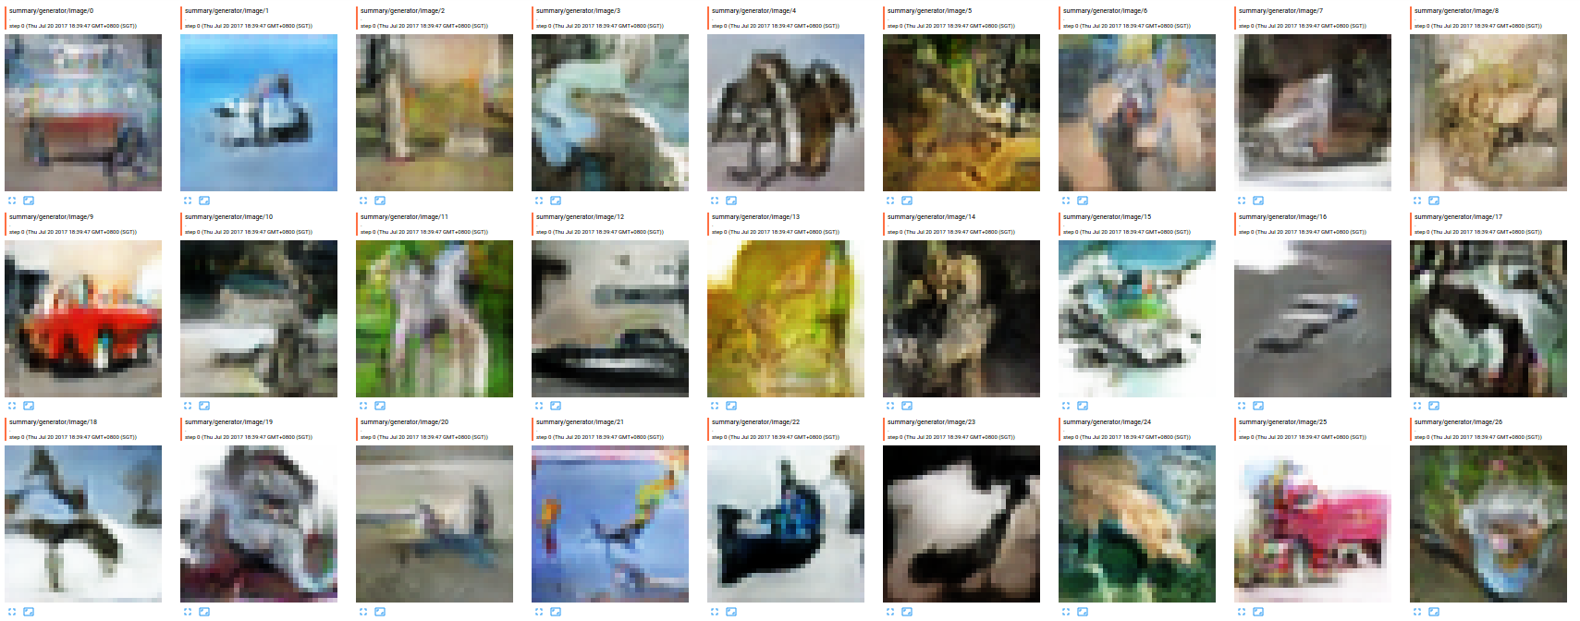
Output!

Slide 11
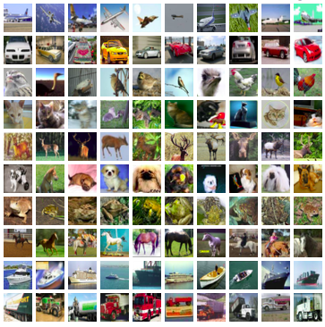
Comparing Output

