Slide 1
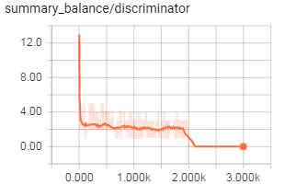
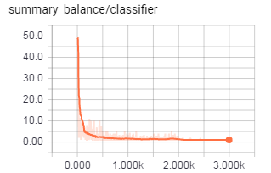
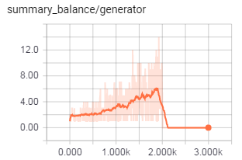
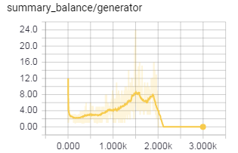
Balancing training:
Converging to 2:
Converging to 1:
D
C
G
Steady augmentation:
or
Bounded augmentation:
Higher goals for the generator

