Slide 1
Unit -1
Java Database Connectivity

Slide 2
JDBC
JDBC stands for Java Database Connectivity.
JDBC is Java API to connect and execute the query with the database.
It is used to write programs required to access databases.
The classes and interfaces of JDBC allow the application to send requests made by users to the specified database.

Slide 3
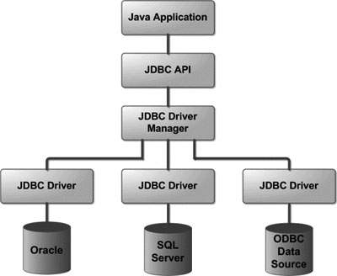
JDBC Architecture

Slide 4
Common JDBC Components
JDBC provides an API for connecting and executing queries with databases.
The main components are :
DriverManager
Driver
Connection
Statement
ResultSet
SQLException

Slide 5
Driver Manager
It Manages a list of database drivers.
It establishes a connection between the Java application and the database.
It selects the appropriate driver based on the connection URL
Example:
Connection con = DriverManager.getConnection("jdbc:mysql://localhost:3306/mydb", "user", "password");

Slide 6
Driver
It Acts as an interface between the JDBC API and the database.
It loads the specific database driver.
It translates Java calls into database-specific calls.
Example:
Class.forName("com.mysql.cj.jdbc.Driver");

Slide 7
Connection
It represents a session with the database.
It sends SQL statements to the database.
It manages transactions.
Example:
Connection con = DriverManager.getConnection("jdbc:mysql://localhost:3306/mydb", "user", "password");

Slide 8
Statement
It executes SQL queries.
Statement: For simple SQL queries.
PreparedStatement: For parameterized queries to prevent SQL injection.
CallableStatement: For stored procedures.
Example:
Statement stmt = conn.createStatement();

Slide 9
ResultSet
It represents the results of a query.
It allows reading data row by row.
Example:
ResultSet rs = stmt.executeQuery("SELECT * FROM students");
while (rs.next()) {
System.out.println("Name: " + rs.getString("name"));
}

Slide 10
SQL Exception
It handles database access errors or other errors in JDBC.
Example:
try {
// Code that might throw SQLException
} catch (SQLException e) {
System.out.println("Error: " + e.getMessage());
}

Slide 11
Establishing Connection with Database
Below are the steps that explains how to connect to Database in Java:
Step 1 – Import the Packages
Import java.sql.*;
Import java.io.*;
Step 2 - Loading the drivers
Class.forName()
Here we load the driver’s class file into memory at the runtime. No need of using new or create objects. The following example uses Class.forName() to load the Oracle driver as shown below as follows:
Class.forName(“jdbc:mysql://localhost:3306/dbname”);

Slide 12
Establishing Connection with Database
Step 3: Establish a connection using the Connection class object
After loading the driver, establish connections as shown below as follows:

Slide 13
Establishing Connection with Database
Connection con= DriverManager.getConnection(url,user,password);
user: Username from which your SQL command prompt can be accessed.
password: password from which the SQL command prompt can be accessed.
con: It is a reference to the Connection interface.
Url: Uniform Resource Locator which is created as shown below:

Slide 14
Establishing Connection with Database
Step 4: Create a statement
Once a connection is established you can interact with the database. The JDBCStatement, CallableStatement, and PreparedStatement interfaces define the methods that enable you to send SQL commands and receive data from your database.
Statement stmt = con.createStatement();
Step 5: Execute the query
The executeQuery() method of the Statement interface is used to execute queries of retrieving values from the database. The executeQuery() method of the Statement interface is used to execute queries of retrieving values from the database.

Slide 15
Establishing Connection with Database
The executeUpdate(sql query) method of the Statement interface is used to execute queries of updating/inserting.
Examples:-
ResultSet rs=stmt.executeQuery("select * from emp");
while(rs.next()){
System.out.println(rs.getInt(1)+" "+rs.getString(2));
}
Step 6: Closing the connections
It is used to close the connection.
Con.close();

Slide 16
ResultSet Metadata
The metadata means data about data i.e. we can get further information from the data.
If you have to get metadata of a table like total number of column, column name, column type etc. , ResultSetMetaData interface is useful because it provides methods to get metadata from the ResultSet object.

Slide 17
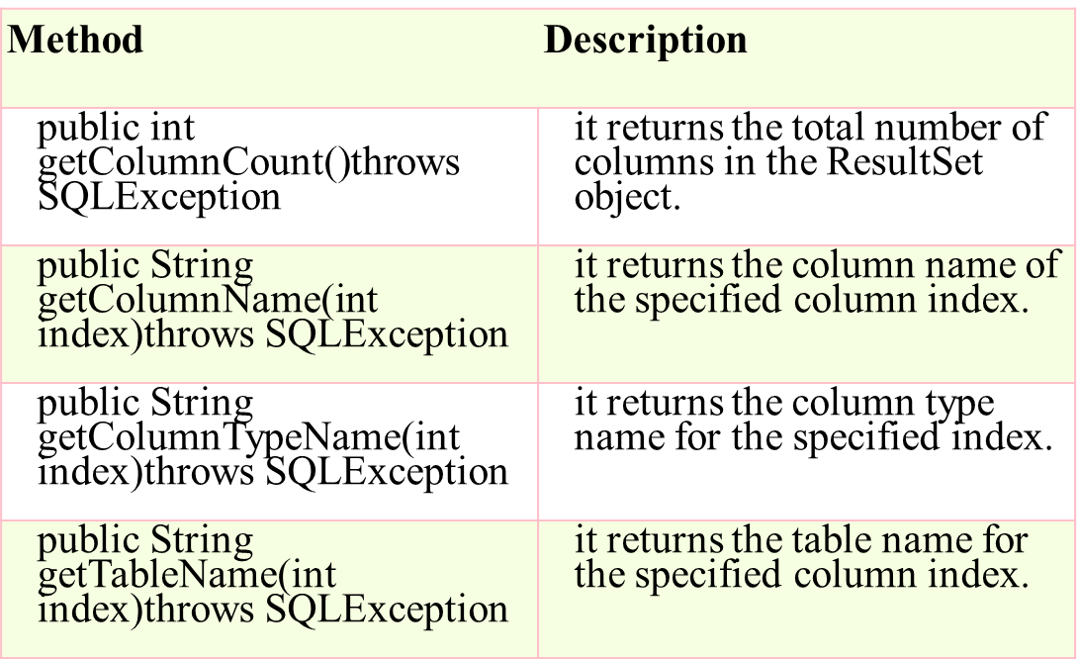
ResultSet Metadata

Slide 18
Precompiled Statements
A PreparedStatement represents a precompiled SQL statement that can be executed multiple times. It accepts parameterized SQL queries, with ? as placeholders for parameters, which can be set dynamically.
String query = "INSERT INTO people(name, age)VALUES(?, ?)";
PreparedStatement pstmt = con.prepareStatement(query);
pstmt.setString(1,"Ayan");
ptstmt.setInt(2,25);

Slide 19
Precompiled Statements
Once the PreparedStatement object is created, there are three ways to execute it:
execute(): This returns a boolean value and executes a static SQL statement that is present in the prepared statement object.
executeQuery(): Returns a ResultSet from the current prepared statement.
executeUpdate(): Returns the number of rows affected by the DML statements such as INSERT, DELETE, and more that is present in the current Prepared Statement.

Slide 20
Callable Statements
A CallableStatement is used to execute stored procedures in the database. Stored procedures are precompiled SQL statements that can be called with parameters. They are useful for executing complex operations that involve multiple SQL statements.
Syntax:-
CallableStatement cstmt = con.prepareCall("{call ProcedureName(?, ?)}");

