Slide 1

EDS LAB MATERIAL PORTAL
PHASE 1 WALKTHROUGH · ENGINEER TO LAB ADMIN
JCB
Gaurav Shelke · EDS Lab, Pune
October 2026
Notes:
Today I will show every page of the new portal and exactly what happens on each click, using real lab data.

Slide 2
WHY WE BUILT IT
THE PROBLEM AND THE ANSWER
TODAY
WITH THE PORTAL
Stock checked by hand in the Excel sheet.
One place for live stock, calculated from every movement.
Harness BOMs compared with stock line by line.
Paste a BOM and see the gaps in seconds.
Requests by mail or word of mouth; no status for the engineer.
Every request tracked from submission to release.
Nobody sees at a glance what is short and what is on order.
Each role sees only its own pages: Engineer, Lab Admin, Lab Lead, Manager.
Runs in Power Apps on the lab's existing workbook. No new licence, no server; opens in the browser or Teams.
EDS Lab Material Portal · Phase 1
JCB
Notes:
Nothing new to install; it opens in the browser or Teams with the company login.

Slide 3
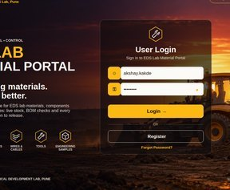
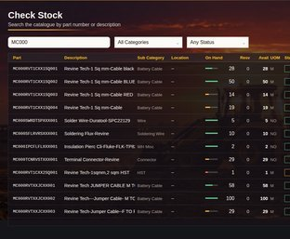
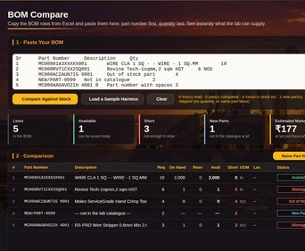
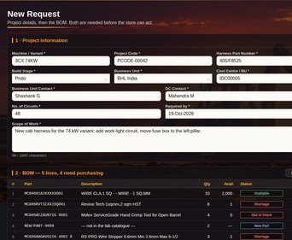
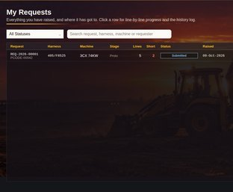
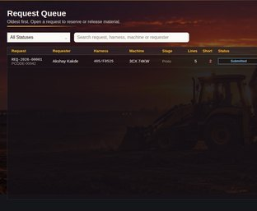
PHASE 1 AT A GLANCE
PHASE 1 · THE FLOW
Engineer to Lab Admin in about 2 minutes, on live lab stock.
STEP 1
STEP 2
STEP 3
STEP 4
STEP 5
STEP 6
LOG IN
CHECK STOCK
BOM COMPARE
RAISE REQUEST
MY REQUESTS
LAB ADMIN
Username and password
Live on hand for every part
Paste the Excel BOM, see the gaps
Project details and BOM lines
Track status any time
Store sees it instantly
Tested end to end on the lab's real data before every release: login, stock search, BOM paste, request saved, Lab Admin sees it.
EDS Lab Material Portal · Phase 1
JCB
Notes:
This is the flow management asked for. The next slides walk through each step.

Slide 4
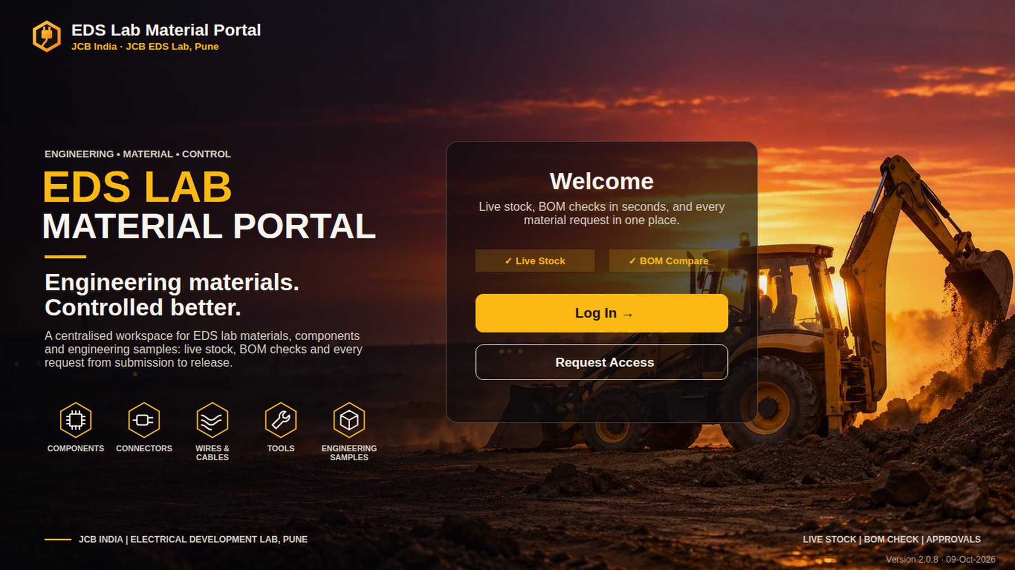
WELCOME PAGE
START · EVERYONE
CLICK → WHAT HAPPENS
1
Log In
Opens the login page.
2
Request Access
A new person asks for an account; the Lab Admin gives the role.
3
What the portal does
Live stock, BOM compare and request tracking, in one line.
3
RESULT
Nobody sees lab data before logging in.
1
2
Start · everyone
JCB
Notes:
First screen for everyone. The version number bottom right tells us which build is installed.

Slide 5
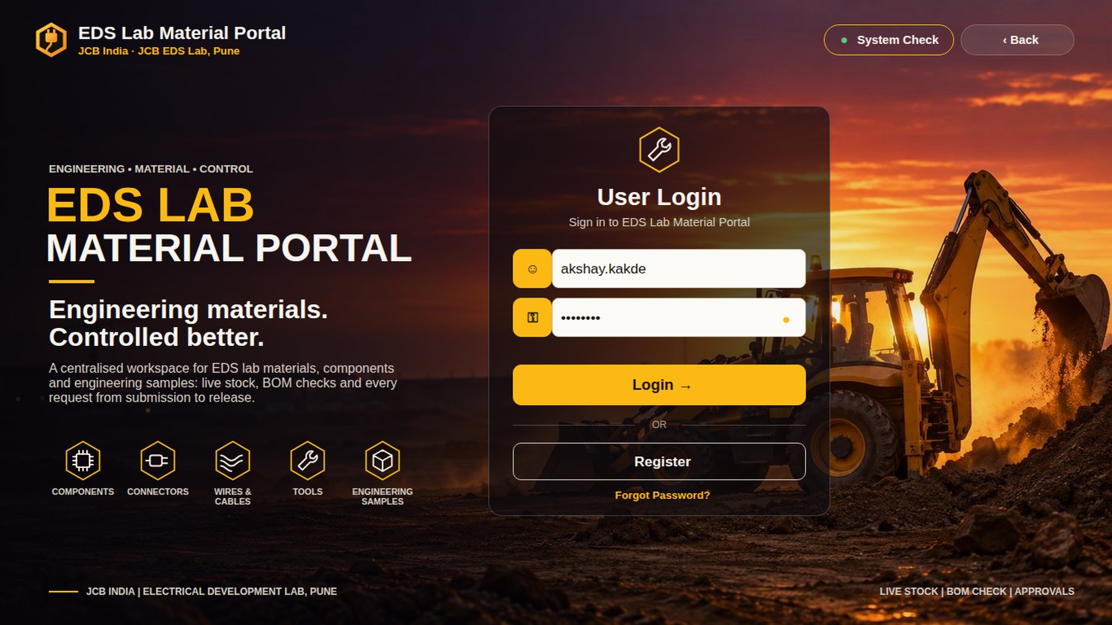
LOGIN PAGE
STEP 1 OF 6 · ENGINEER
CLICK → WHAT HAPPENS
6
1
Username
The name the Lab Admin set up, e.g. akshay.kakde.
2
Password
Eye icon shows or hides it. Empty password? You choose one on first login.
3
Login
Opens the dashboard for your role.
1
4
Forgot Password?
Type your username and set a new password. No waiting for anyone.
2
3
5
Register
New user fills name, username and password; role starts as Pending.
5
6
System Check
18 health checks of the data links, for support.
4
RESULT
The engineer lands on the Engineer dashboard.
Step 1 of 6 · Engineer
JCB
Notes:
Kept simple on purpose: username and password, self-service password reset.

Slide 6
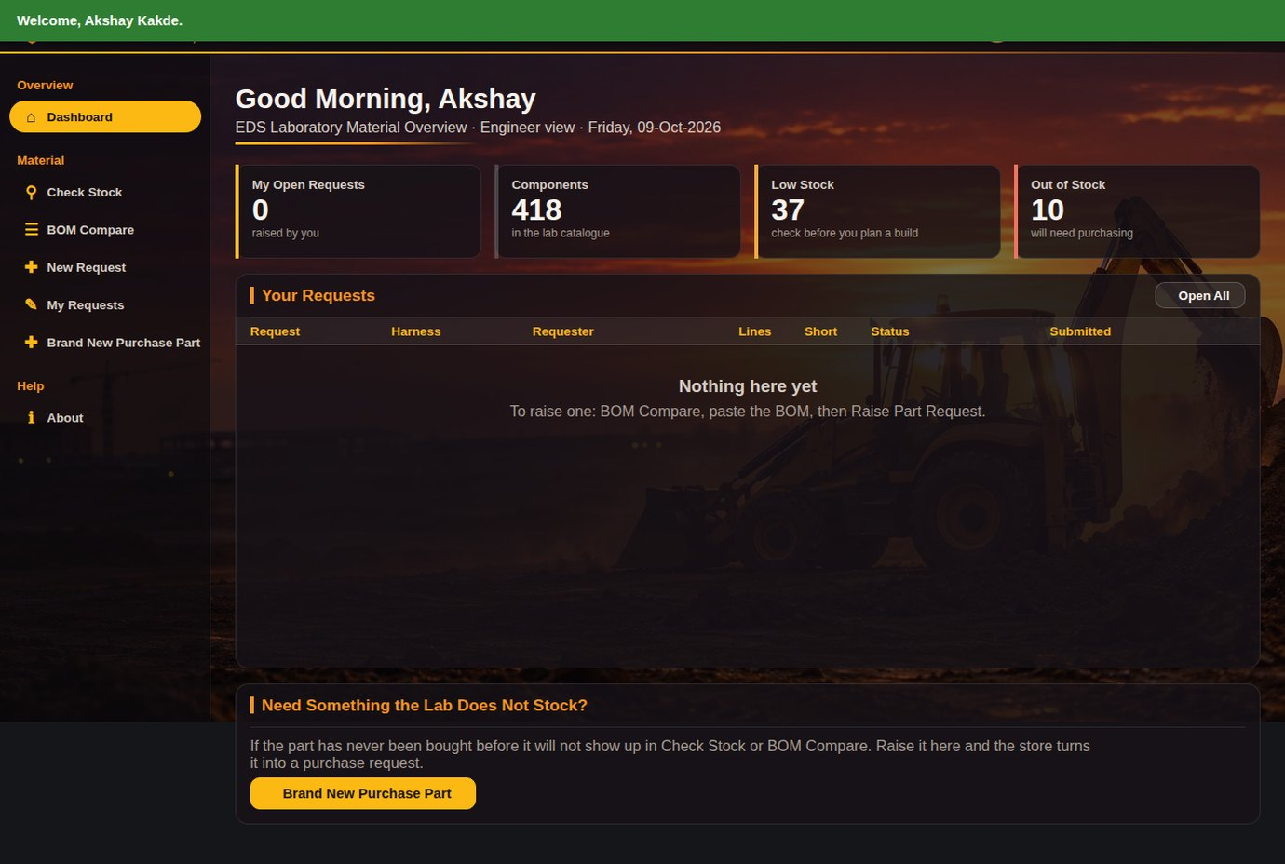
ENGINEER DASHBOARD
STEP 1 OF 6 · ENGINEER
5
6
CLICK → WHAT HAPPENS
4
1
1
Greeting
Good morning plus the person's name and role.
2
2
Tiles
My open requests, parts in catalogue, low stock, out of stock.
3
3
Your Requests
Each row opens the request detail. Open All lists everything.
4
Menu
Only the pages an engineer needs.
5
Live · Synced
Data refreshes itself; click to refresh now.
6
Log Out
Back to the login page.
RESULT
An engineer sees their status at a glance.
Step 1 of 6 · Engineer
JCB
Notes:
Data refreshes itself every 2 minutes; the green pill shows the last sync.

Slide 7
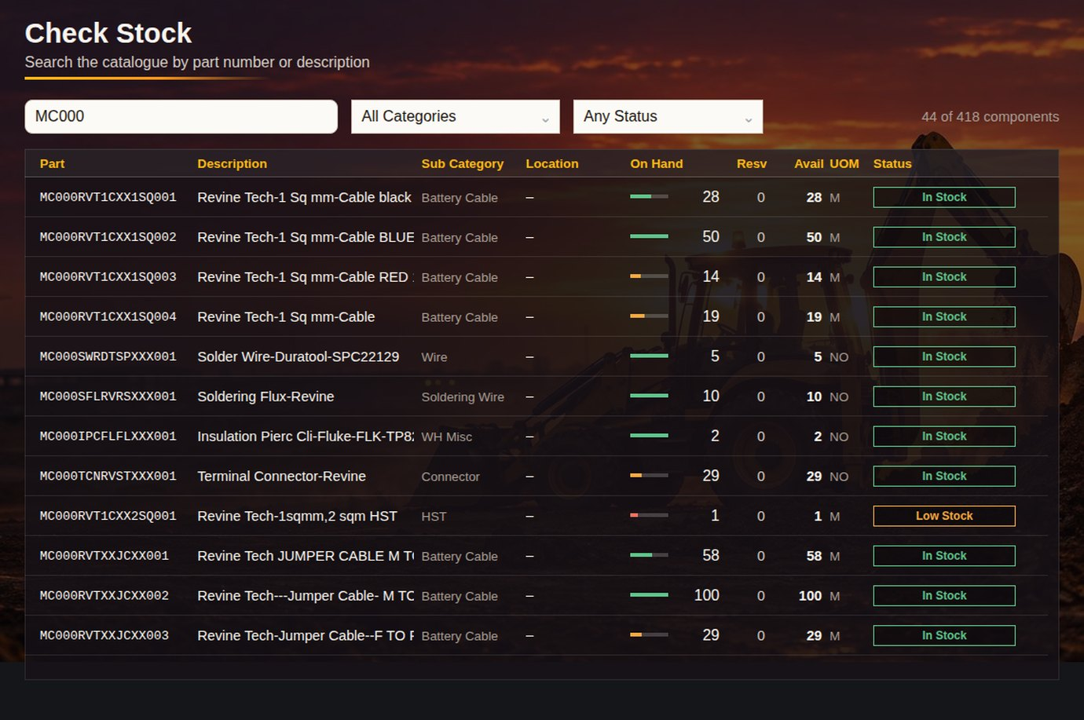
CHECK STOCK
STEP 2 OF 6 · ENGINEER
CLICK → WHAT HAPPENS
1
Search
Part number, description or store location; results as you type.
1
2
3
4
5
2
Category filter
Wires, connectors, relays and so on.
3
Status filter
In stock, low, out of stock.
4
On hand · Reserved · Available
Available = on hand minus what is reserved for requests.
5
Status pill
Green in stock, amber low, red out of stock.
RESULT
Live stock for any of the 418 parts in seconds.
Step 2 of 6 · Engineer
JCB
Notes:
On hand is calculated from every stock movement, so it cannot drift from the store records.

Slide 8
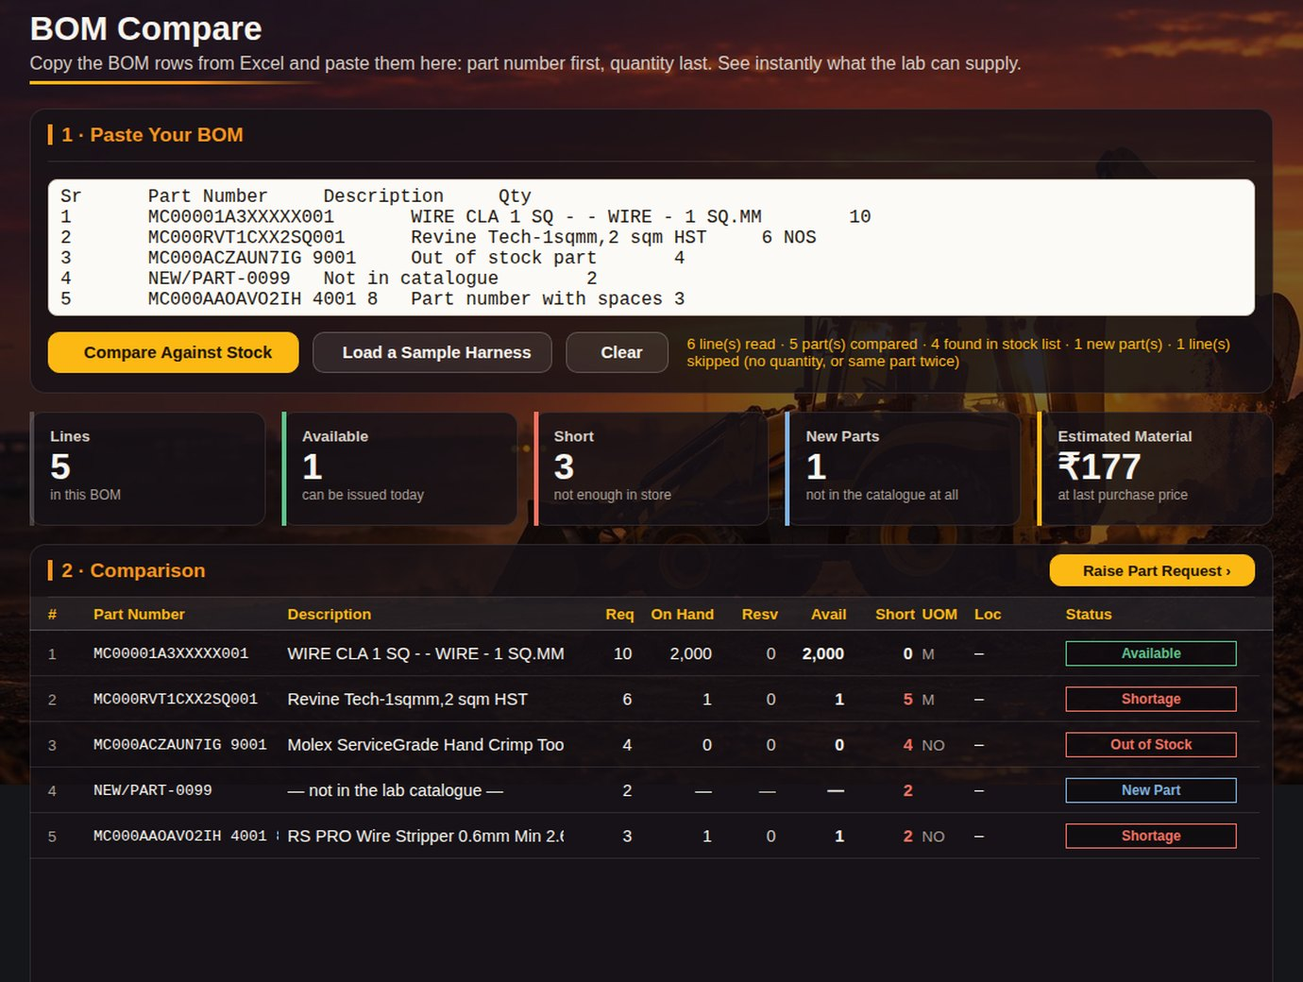
BOM COMPARE
STEP 3 OF 6 · ENGINEER
CLICK → WHAT HAPPENS
1
Paste the BOM
Copy the rows straight from the Excel BOM: Sr, part number, description, qty. Units like NOS are fine.
1
2
Compare Against Stock
The app re-reads the latest stock and checks every line of the BOM.
2
3
3
Summary line
How many lines were read, parts compared, found in stock and new parts.
4
4
Result tiles
Available today, short, new parts and the estimated material value.
6
5
Status per line
Available · Shortage · Out of Stock · New Part, with on hand, reserved and short.
5
6
Raise Part Request ›
Opens New Request with these lines already filled in.
RESULT
In seconds the engineer knows what the store can supply and what must be bought.
Step 3 of 6 · Engineer
JCB
Notes:
Copy straight from the harness BOM in Excel. New Part means the lab has never stocked it; that is different from out of stock.

Slide 9
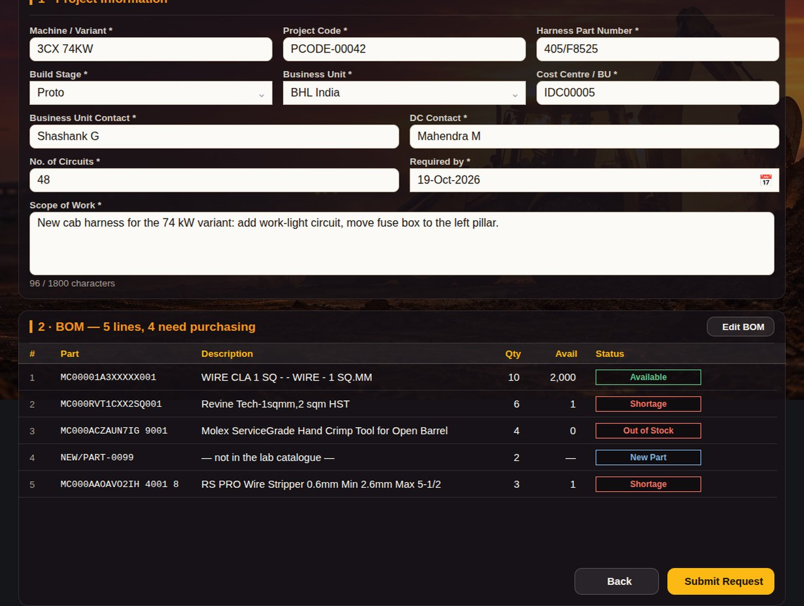
NEW REQUEST
STEP 4 OF 6 · ENGINEER
1
CLICK → WHAT HAPPENS
1
Project information
Machine, project code, harness, stage, BU, cost centre, contacts, circuits, scope.
2
2
Drop-downs
Stage and business unit are picked, not typed, so reports stay clean.
3
BOM lines
Carried over from BOM Compare; the title says how many need purchasing.
3
4
Edit BOM
Back to BOM Compare to change lines.
4
5
Submit Request
Mandatory fields checked, request number REQ-YYYY-NNNNN created, lines saved.
RESULT
Request saved with all lines; green confirmation and the engineer lands on My Requests.
5
Step 4 of 6 · Engineer
JCB
Notes:
Mandatory fields are checked before saving; nothing is half-saved.

Slide 10
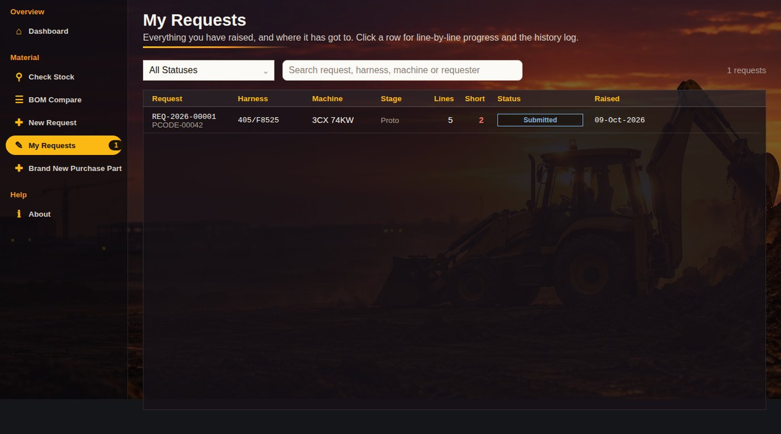
MY REQUESTS
STEP 5 OF 6 · ENGINEER
CLICK → WHAT HAPPENS
1
2
1
Status filter
Submitted, approved, ready, released, completed.
3
2
Search
Request, harness, machine or requester.
4
3
The new request
At the top, status Submitted, with lines and short count. Click → full detail.
4
Badge
How many of my requests are still open.
RESULT
The engineer can track every request without asking the store.
Step 5 of 6 · Engineer
JCB
Notes:
A green banner confirms REQ-... is with the store as soon as it is saved.

Slide 11
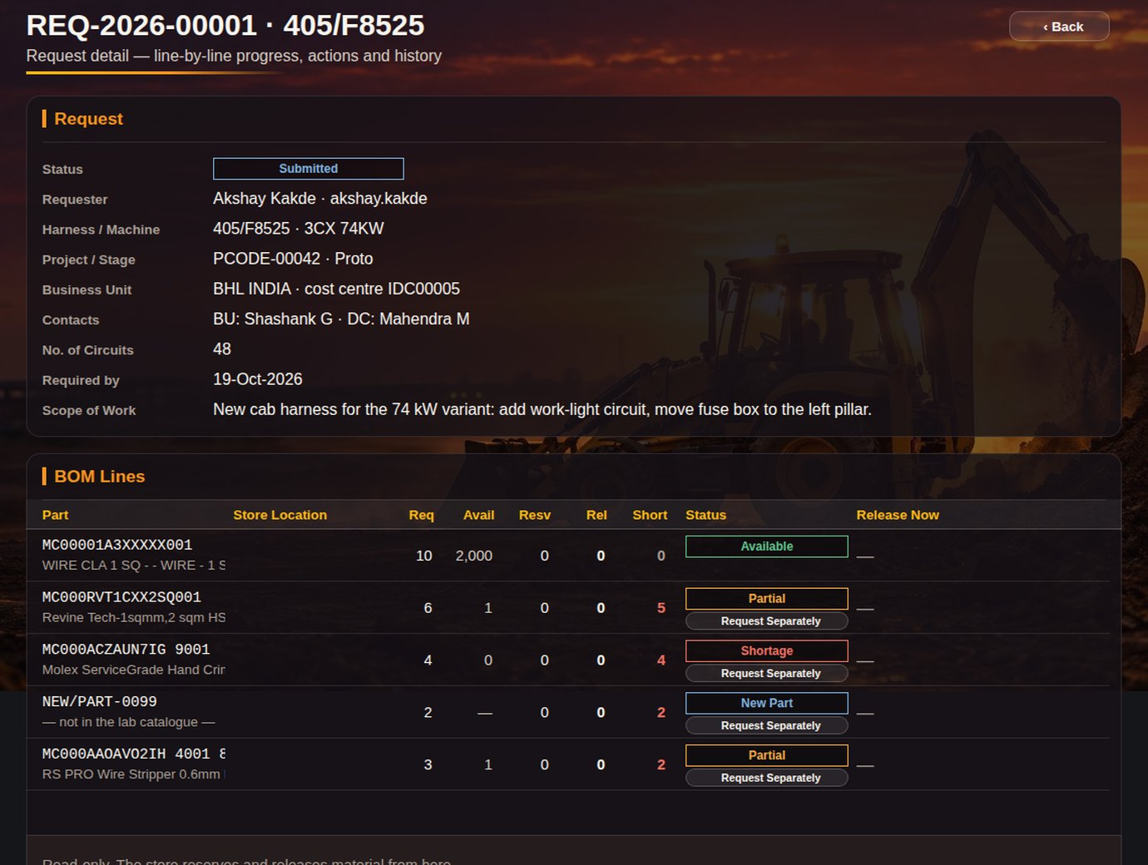
REQUEST DETAIL · ENGINEER VIEW
STEP 5 OF 6 · ENGINEER
5
CLICK → WHAT HAPPENS
1
Status
Where the request is now: Submitted, Approved, Ready, Released.
2
1
2
Header facts
Requester, harness, project, BU, contacts, required-by date, scope.
3
Line by line
Requested, available, reserved, released and short per part.
4
Line status
Available, Partial, Shortage or New Part.
5
Back
Returns to My Requests.
3
4
RESULT
Full transparency for the requester: no calls to the store needed.
Step 5 of 6 · Engineer
JCB
Notes:
The engineer sees exactly the same numbers the store sees, read-only.

Slide 12
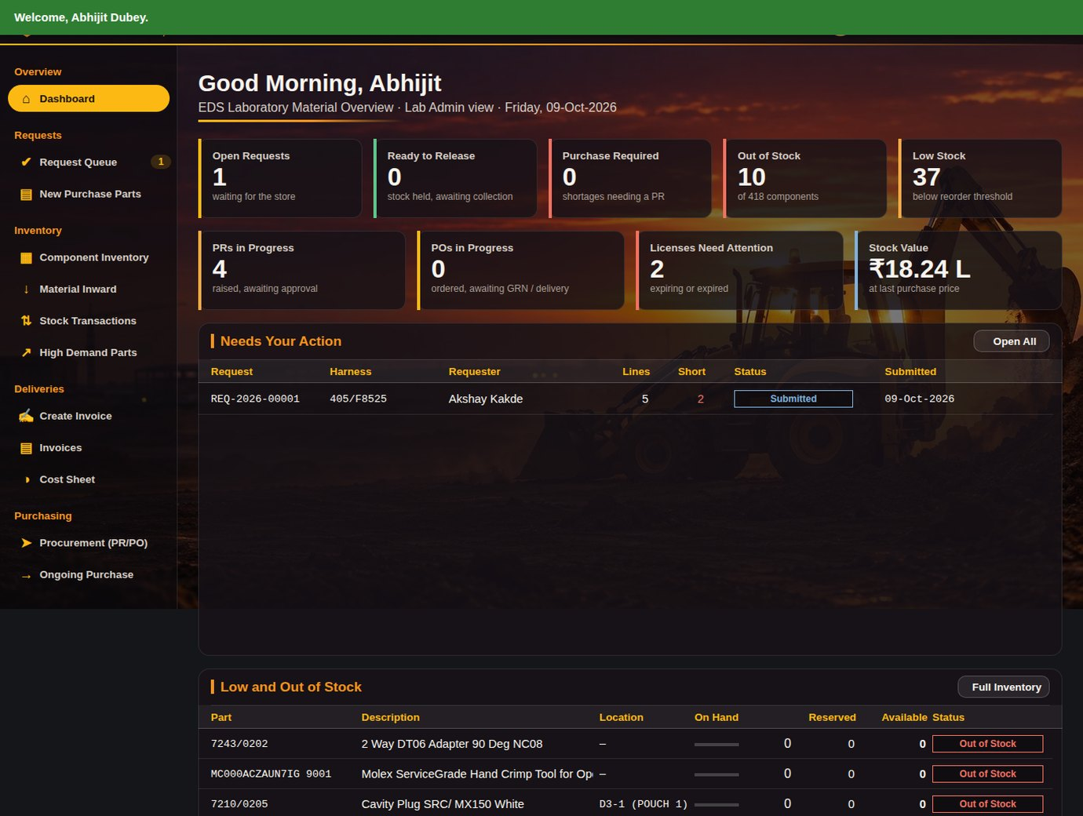
LAB ADMIN DASHBOARD
STEP 6 OF 6 · LAB ADMIN
5
CLICK → WHAT HAPPENS
1
Store tiles
Open requests, ready to release, purchase required, out of stock, low stock.
4
1
2
Purchase and money
PRs and POs in progress, licenses needing attention, stock value.
2
3
Needs Your Action
The engineer's new request is here the moment it is saved.
3
4
Request Queue badge
Shows 1: one request waiting.
5
View as
People with two roles switch view here.
RESULT
The store sees new work the moment it is submitted.
Step 6 of 6 · Lab Admin
JCB
Notes:
Same login page; the role decides which dashboard and menu appear.

Slide 13
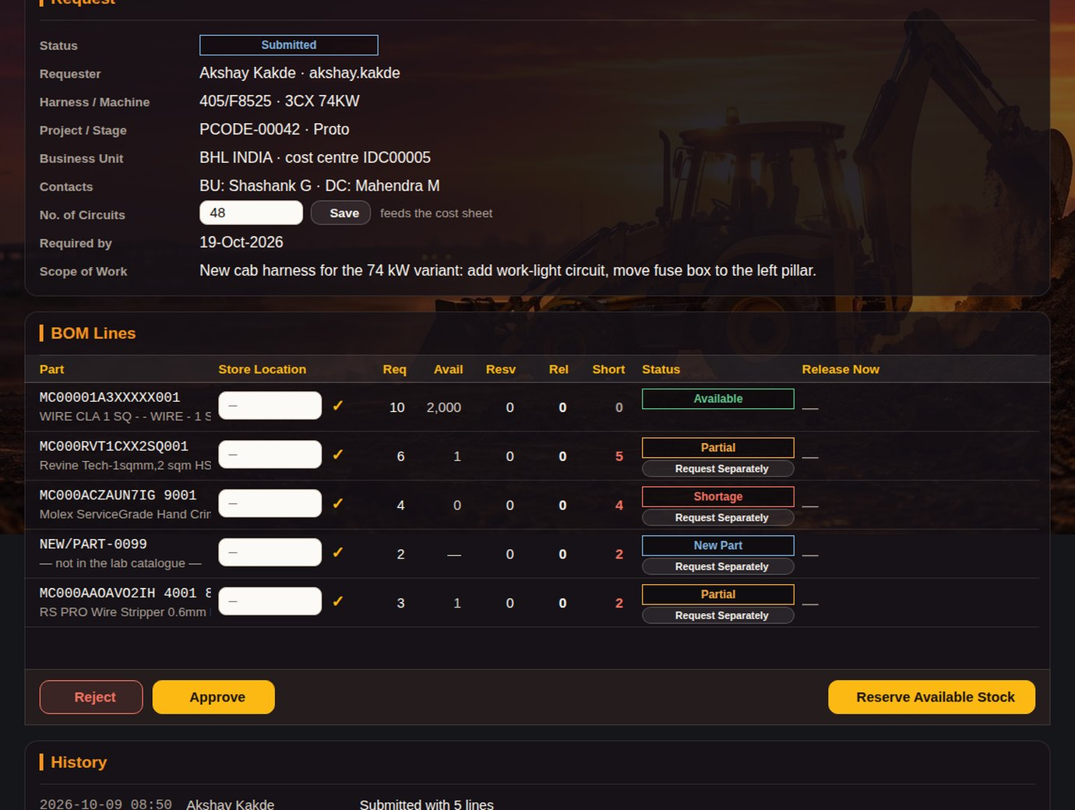
REQUEST DETAIL · LAB ADMIN
STEP 6 OF 6 · LAB ADMIN
CLICK → WHAT HAPPENS
1
Reject
Closes it with a reason in the history; the engineer still sees the record.
6
2
Approve
Moves to Approved; the store can now reserve and release.
3
Reserve Available Stock
Holds what is free for this request; what is short goes to Ongoing Purchase.
4
4
Short column
What the store cannot supply today.
5
5
Request Separately
Splits a shortfall into its own request so the rest can be released.
6
Save circuits
Lab Admin corrects the circuit count used for the cost.
RESULT
The Lab Admin can act immediately; shortfalls go to the purchase list automatically.
1
2
3
Step 6 of 6 · Lab Admin
JCB
Notes:
Phase 1 ends here. Release, invoice and procurement are already built: see the next slides and the appendix.

Slide 14
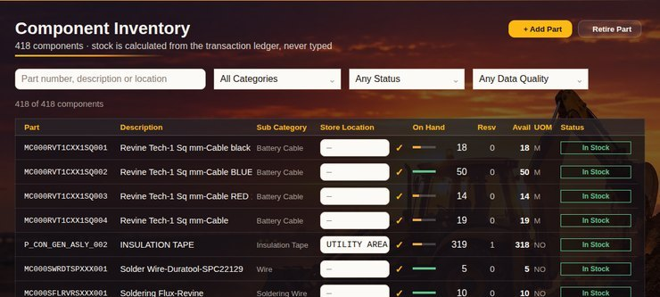
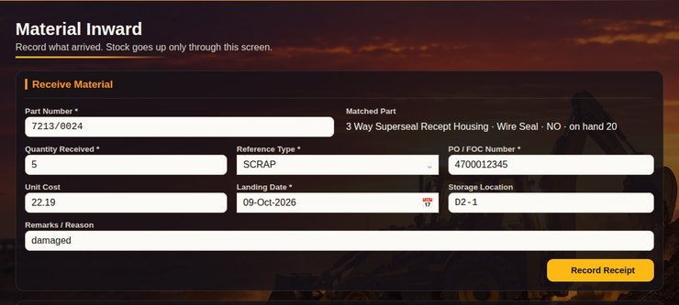
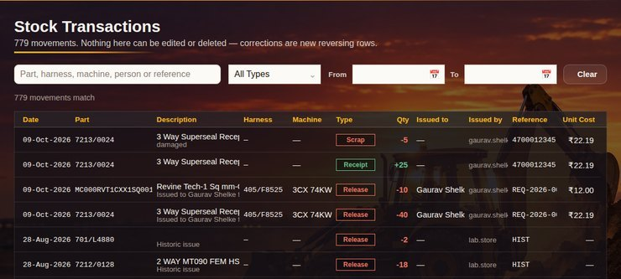
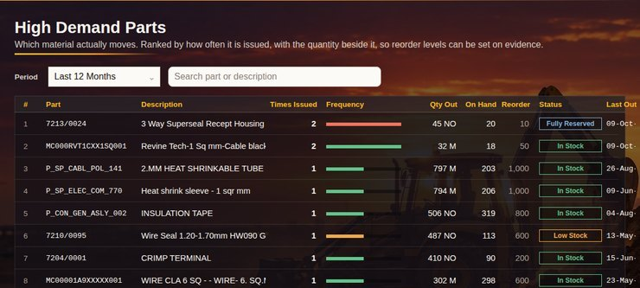
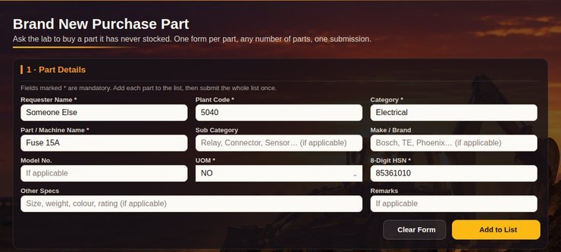
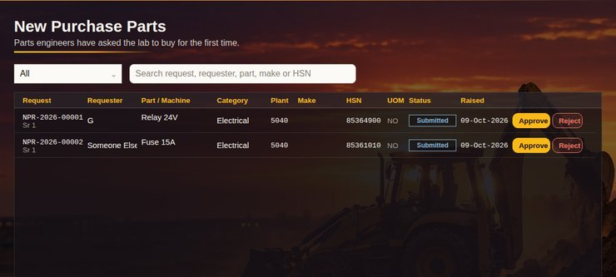
OTHER PAGES (1 OF 2)
ALREADY BUILT · STORE
COMPONENT INVENTORY
MATERIAL INWARD
STOCK TRANSACTIONS
Full catalogue with store locations; Lab Admin edits locations.
Book goods received (PO, FOC, return, scrap); stock updates at once.
Every movement with date, reference and who issued it.
HIGH DEMAND PARTS
BRAND NEW PURCHASE PART
NEW PURCHASE PARTS
Most-issued parts for the chosen period, to plan buying.
Engineer asks the lab to buy a part it has never stocked.
Lab Admin and Manager approve or reject those requests.
Store pages · already built
JCB
Notes:
These pages are built and tested; they roll out after Phase 1. Each one is in the appendix in detail.

Slide 15
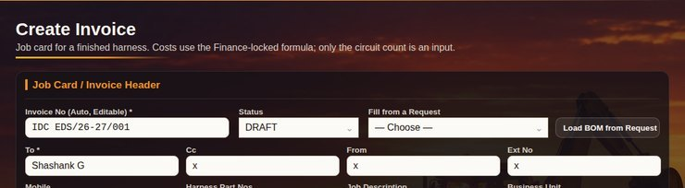
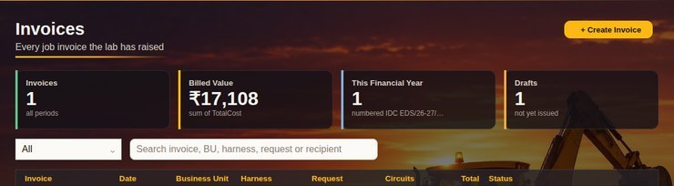
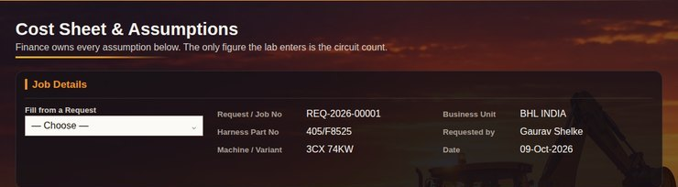
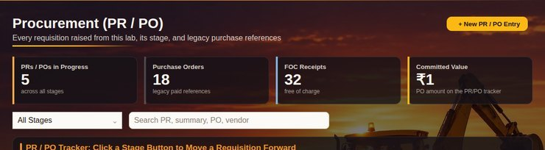
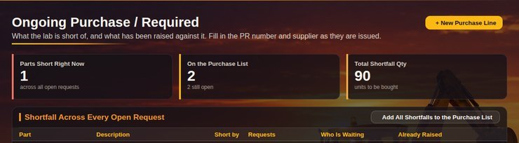
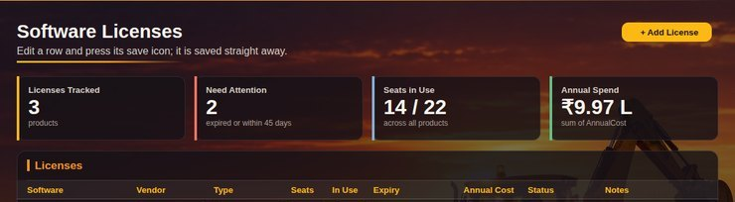
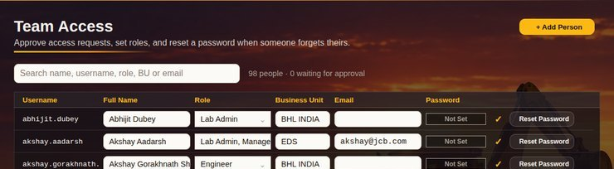
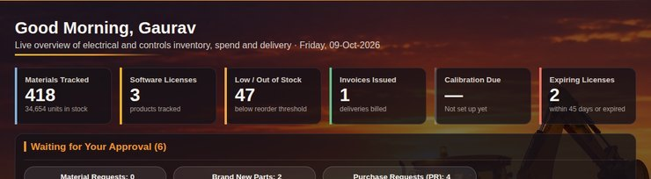
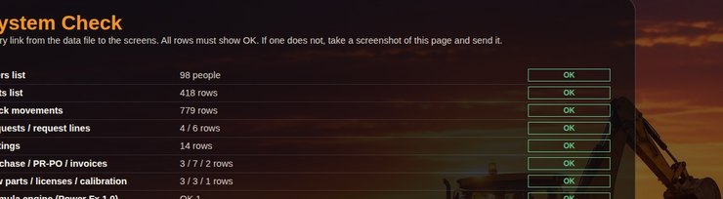
OTHER PAGES (2 OF 2)
ALREADY BUILT · MONEY AND ADMIN
CREATE INVOICE
INVOICES
COST SHEET
Job card for a released request; finance-locked cost formula.
Every invoice raised; open, edit or issue.
Quote a harness job: paste part, qty, cost.
PROCUREMENT (PR/PO)
ONGOING PURCHASE
SOFTWARE LICENSES
PR to PO to delivery, one click per stage.
All shortfalls in one list; what is on order.
Seats, renewal dates and yearly cost.
TEAM ACCESS
MANAGER DASHBOARD
SYSTEM CHECK
Roles, new people, password reset.
Approvals, revenue, purchases, projects.
18 health checks of the data links.
Money, purchasing and admin · already built
JCB
Notes:
Second half of the app. Ask me to open any one; the appendix has a slide per page.

Slide 16
NEXT STEPS
WHAT WE ASK TODAY
PLAN
ASK
Phase 1 pilot: 3 engineers + Lab Admin, 2 weeks.
Approval to start the Phase 1 pilot.
Phase 2: reserve → release → invoice live; manager dashboard.
Names of the 3 pilot engineers.
Later: move the data from Excel to a SharePoint list for more users and rows.
Review meeting at the end of the 2 weeks.
Appendix: one slide for every page of the app, for questions.
EDS Lab Material Portal · Phase 1
JCB
Notes:
Close here. Use the appendix only when someone asks about a page.

Slide 17
EVERY PAGE IN DETAIL
APPENDIX
One slide per page, for questions. Click a page name to jump to it.
18 Register
Login
19 Set or reset password
Login
20 System Check
Support
21 Request Queue
Lab Admin
22 Component Inventory
Lab Admin
23 Material Inward
Lab Admin
24 Stock Transactions
Lab Admin
25 High Demand Parts
Lab Admin
26 Brand New Purchase Part
Engineer
27 New Purchase Parts
Lab Admin / Manager
28 Create Invoice
Lab Admin
29 Invoices
Lab Admin
30 Cost Sheet
Lab Admin
31 Procurement (PR / PO)
Lab Admin
32 Ongoing Purchase
Lab Admin
33 Software Licenses
Lab Admin
34 Team Access
Lab Admin / Lab Lead
35 Manager Dashboard
Manager
36 About · Data Health
Lab Admin
37 Print / PDF
Lab Admin
Appendix
JCB
Notes:
Backup only. Jump to the page someone asks about.

Slide 18
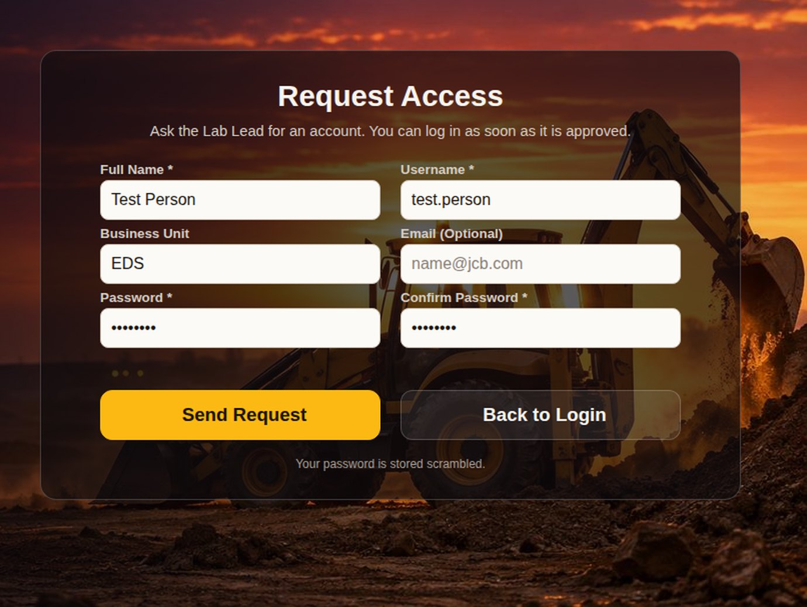
REGISTER
APPENDIX · LOGIN
CLICK → WHAT HAPPENS
1
Full Name
Shown on requests and the dashboard greeting.
2
Username
What the person logs in with.
1
2
3
Business Unit · Email
Optional; used on reports.
4
Password + confirm
At least 4 characters.
3
5
Send Request
Adds the person with role Pending; the Lab Admin sets the role in Team Access.
4
6
Back to Login
Cancels.
5
6
RESULT
New people get in without a form or a mail chain.
Appendix · Login
JCB
Notes:
Pending people cannot log in until the Lab Admin gives them a role in Team Access.

Slide 19
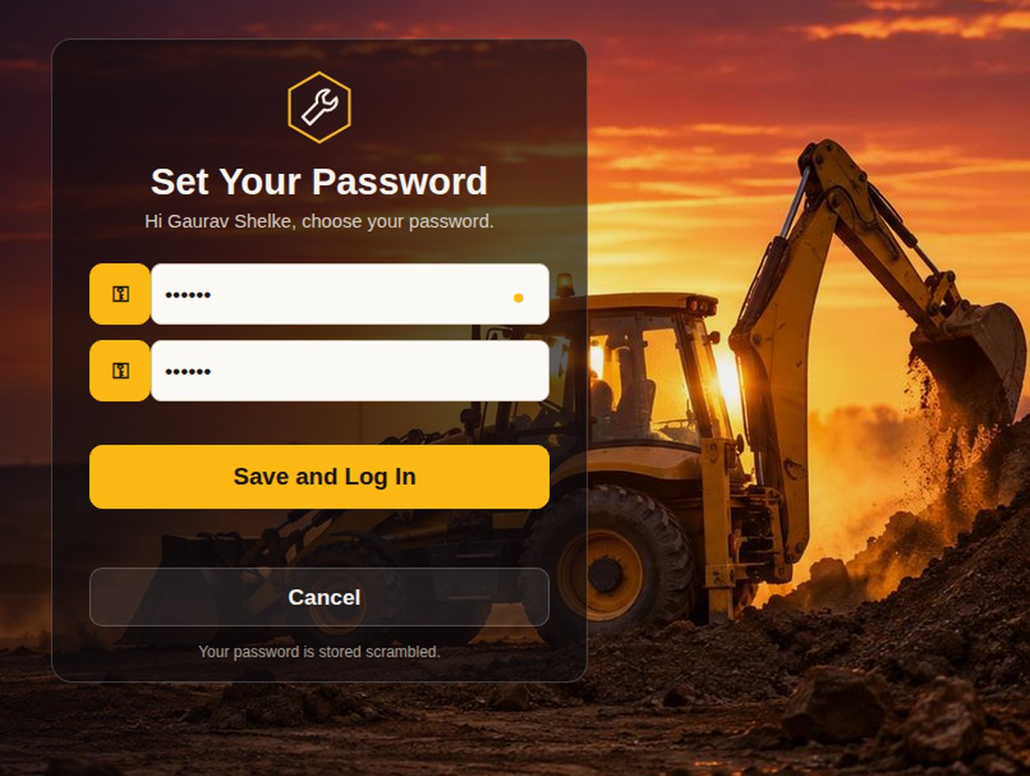
SET OR RESET PASSWORD
APPENDIX · LOGIN
CLICK → WHAT HAPPENS
1
New password
At least 4 characters.
2
Confirm
Must match.
3
Save and Log In
Password saved scrambled; the person goes straight in.
1
4
Cancel
Back to the login box.
2
RESULT
Forgot Password and first login both end here. No waiting for an admin.
3
4
Appendix · Login
JCB
Notes:
Shown after Forgot Password? or when the Password cell is empty.

Slide 20
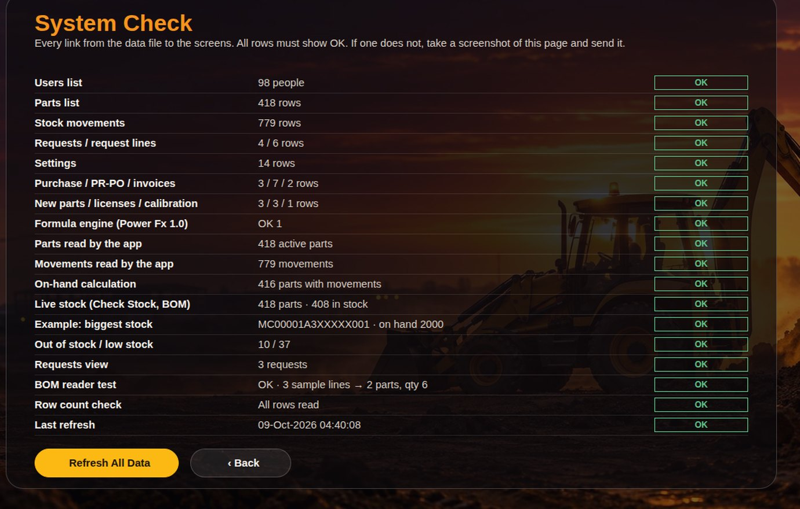
SYSTEM CHECK
APPENDIX · SUPPORT
CLICK → WHAT HAPPENS
1
2
1
18 checks
Every table connected and read, stock calculation, BOM reader test, last refresh.
2
OK per row
Any row not OK points to the exact problem.
3
Refresh All Data
Re-reads every table now.
4
Back
Returns to the login page.
RESULT
One screenshot tells support what is wrong.
3
4
Appendix · Support
JCB
Notes:
Reachable from the login page, before logging in.

Slide 21
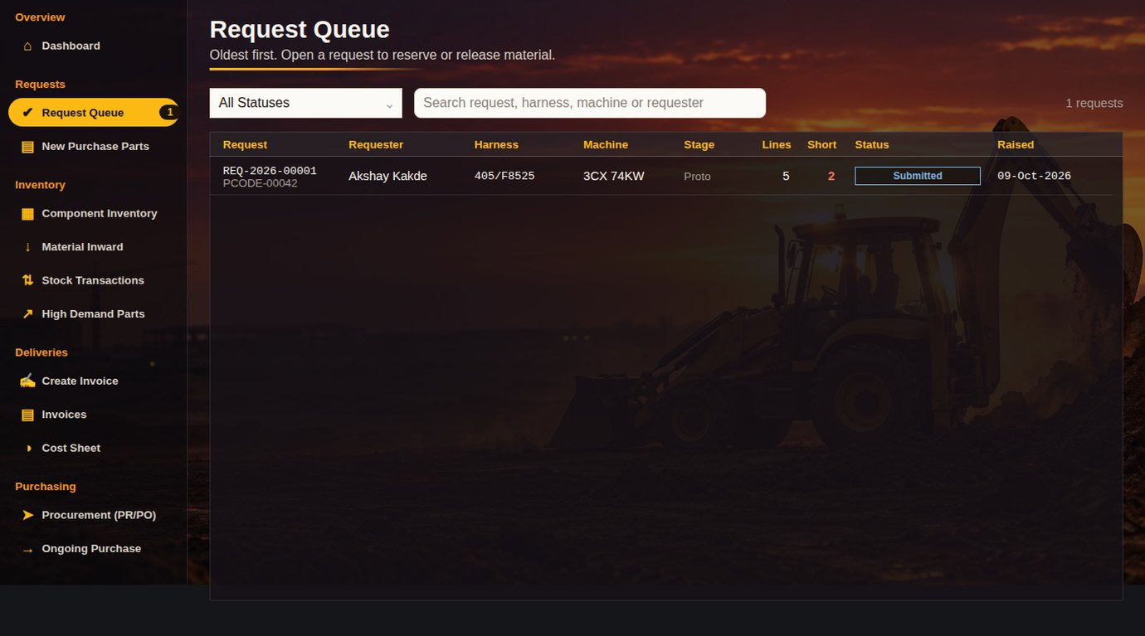
REQUEST QUEUE
APPENDIX · LAB ADMIN
CLICK → WHAT HAPPENS
4
1
2
1
Status filter
Submitted, approved, ready for release, purchase required…
3
2
Search
Request, harness, machine or requester.
3
Request row
Lines, short count, status, date. Click → request detail.
4
Badge
Requests waiting for action.
RESULT
The store's to-do list, oldest first.
Appendix · Lab Admin
JCB
Notes:
Every request from every engineer, in one list.

Slide 22
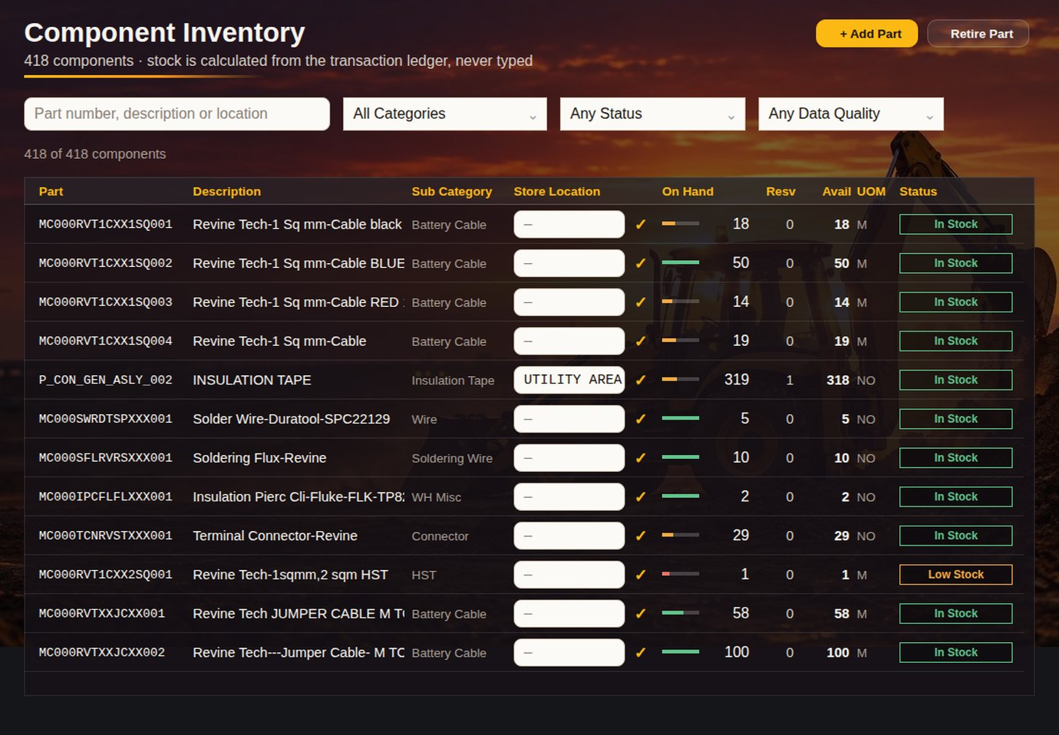
COMPONENT INVENTORY
APPENDIX · LAB ADMIN
4
5
CLICK → WHAT HAPPENS
1
Search
Part, description or location.
1
2
2
Data quality filter
Finds parts with missing or odd data in the sheet.
3
3
Location
Lab Admin types the shelf location in the row; saved at once.
4
+ Add Part
Part number, description, category, UOM, location, supplier, cost.
5
Retire Part
Takes an obsolete part out of the active list.
RESULT
The catalogue stays correct without opening Excel.
Appendix · Lab Admin
JCB
Notes:
418 active parts in the current data.

Slide 23
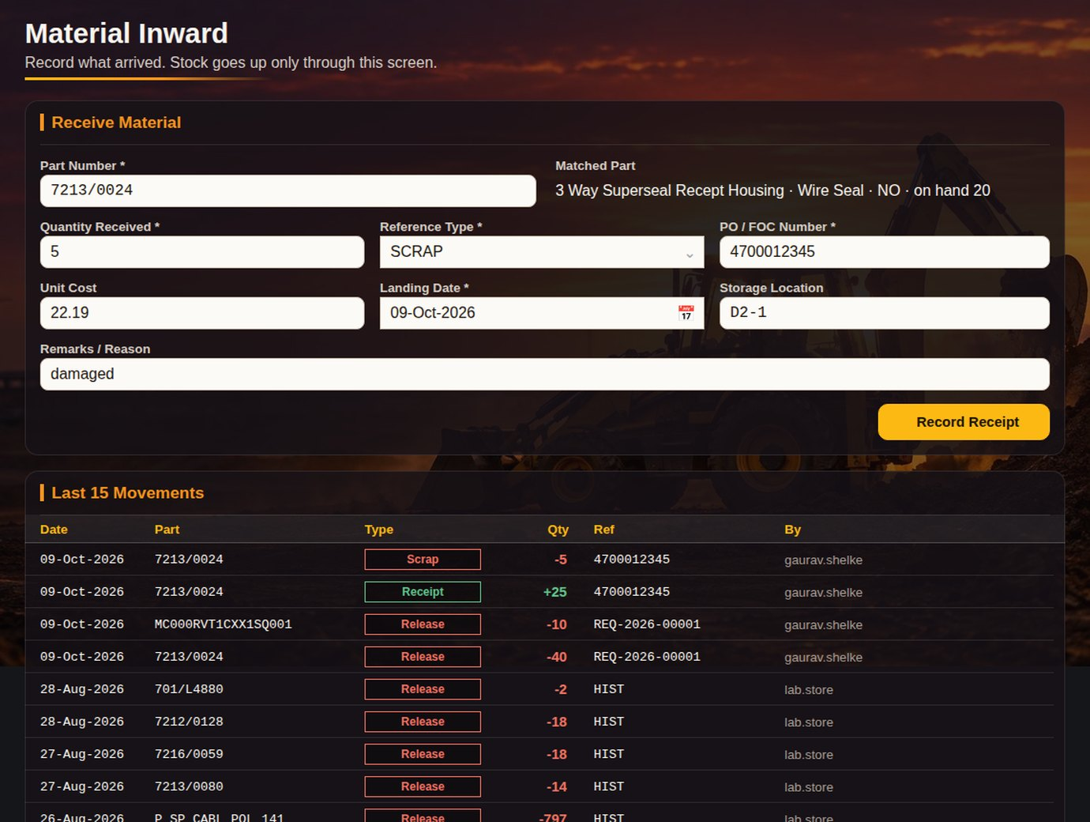
MATERIAL INWARD
APPENDIX · LAB ADMIN
CLICK → WHAT HAPPENS
1
Part number
Checked against the catalogue as you type.
1
2
Quantity
Must be more than zero.
2
3
4
3
Type
PO, FOC, Return, Adjust+, Adjust−, Scrap.
4
Reference
PO number or note.
5
6
5
Reason
Required for adjustments and scrap.
6
Record Receipt
Adds a stock movement; on hand updates at once.
RESULT
Stock goes up only through this page, so every unit is traceable.
Appendix · Lab Admin
JCB
Notes:
Removing more than is physically in store is refused.

Slide 24
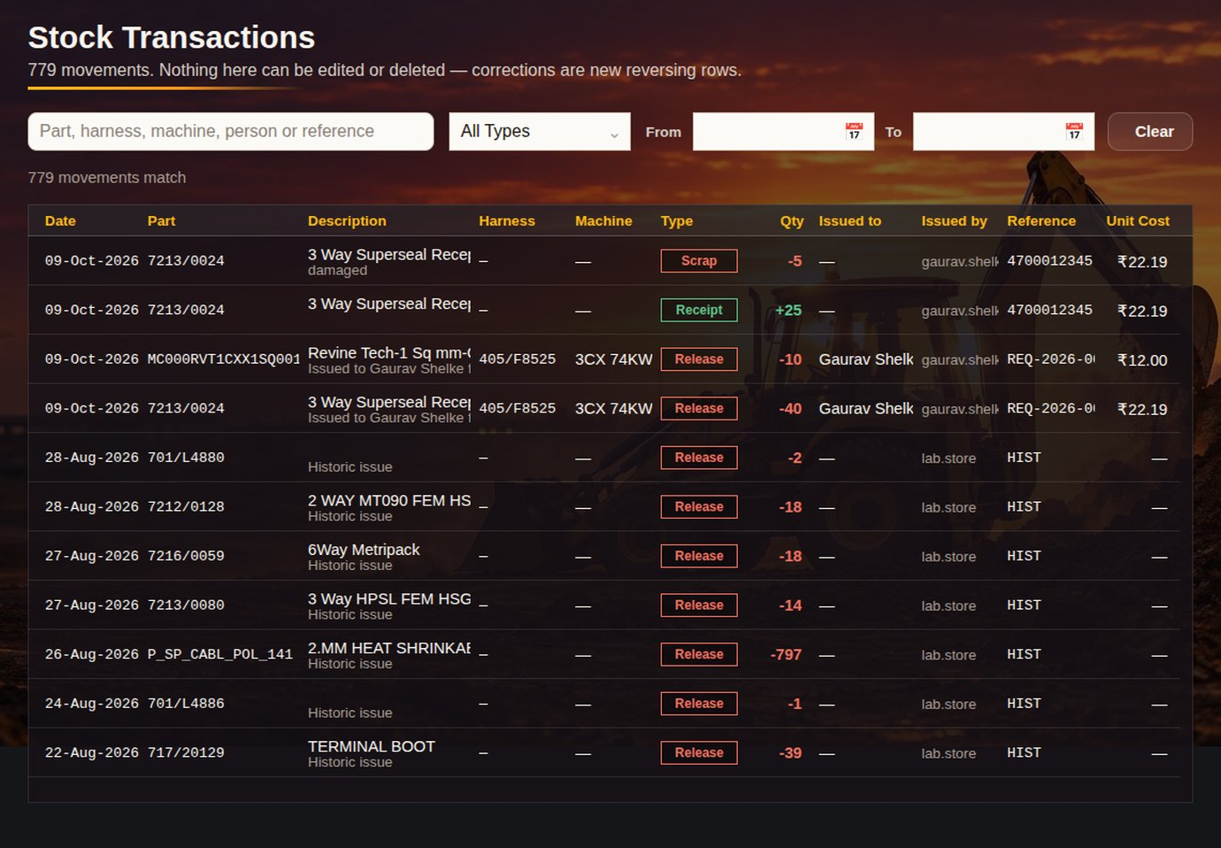
STOCK TRANSACTIONS
APPENDIX · LAB ADMIN
CLICK → WHAT HAPPENS
1
Search
Part, harness, machine, person or reference.
1
2
3
2
Type filter
Receipt, release, return, adjustments, scrap.
4
3
Clear
Resets the filters.
4
Ledger
Date, part, quantity, reference, unit cost and who did it.
RESULT
Full audit trail of every unit in and out.
Appendix · Lab Admin
JCB
Notes:
This is what on hand is calculated from.

Slide 25
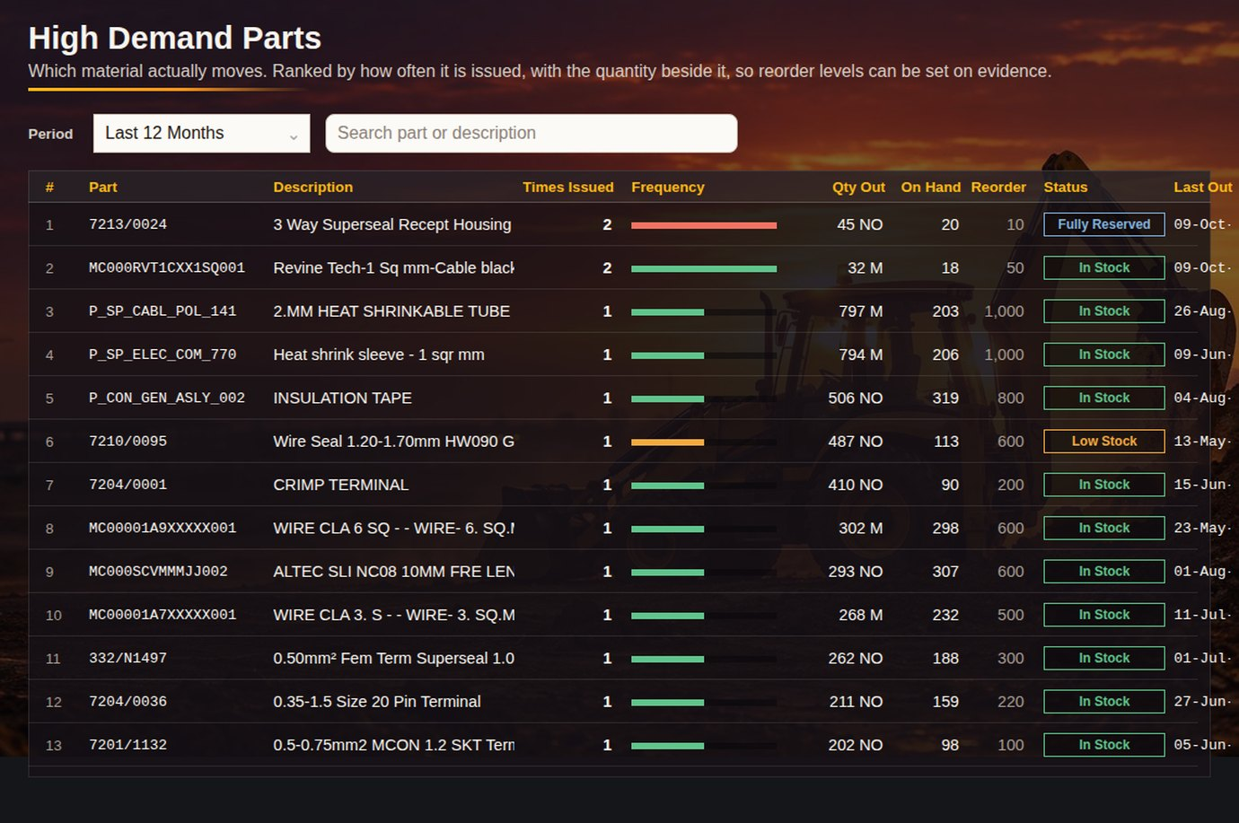
HIGH DEMAND PARTS
APPENDIX · LAB ADMIN
CLICK → WHAT HAPPENS
1
Period
Last 90 days, 180 days, 12 months or everything.
1
2
3
2
Search
Part or description.
3
Ranking
Most-issued parts first, with stock status and last issue date.
RESULT
Buy ahead for the parts every build uses.
Appendix · Lab Admin
JCB
Notes:
Opens on the last 12 months.

Slide 26
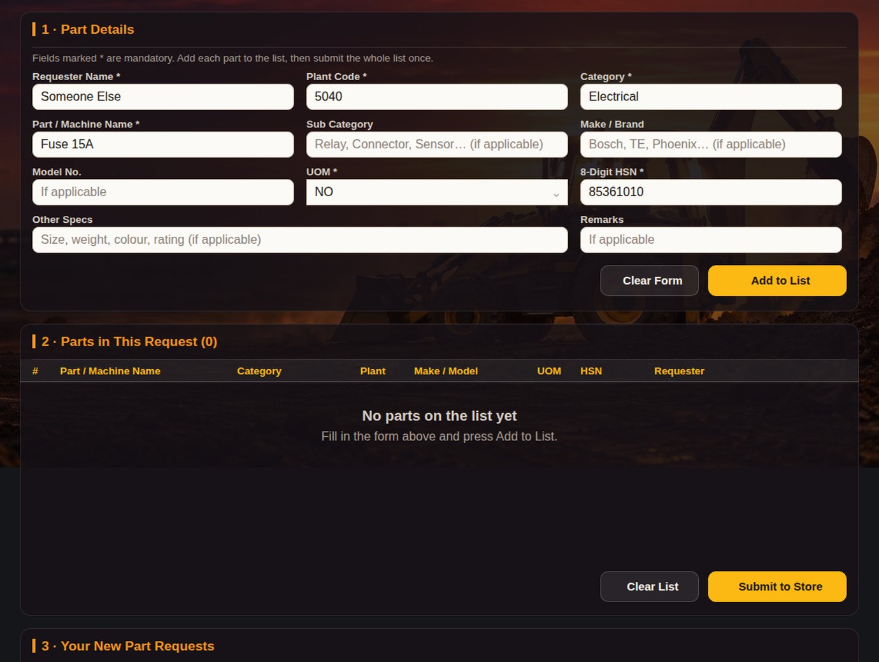
BRAND NEW PURCHASE PART
APPENDIX · ENGINEER
1
CLICK → WHAT HAPPENS
1
Part details
Name, category, make, model, UOM, HSN, specs.
2
Add to List
Several new parts in one request.
3
Parts in this request
Edit or remove before sending.
2
4
Submit to Store
Numbered request goes to the New Purchase Parts queue.
5
Your New Part Requests
Status of everything you asked for.
3
RESULT
Engineers ask for parts the lab has never stocked, in a fixed format.
4
5
Appendix · Engineer
JCB
Notes:
Replaces the separate Excel form.

Slide 27
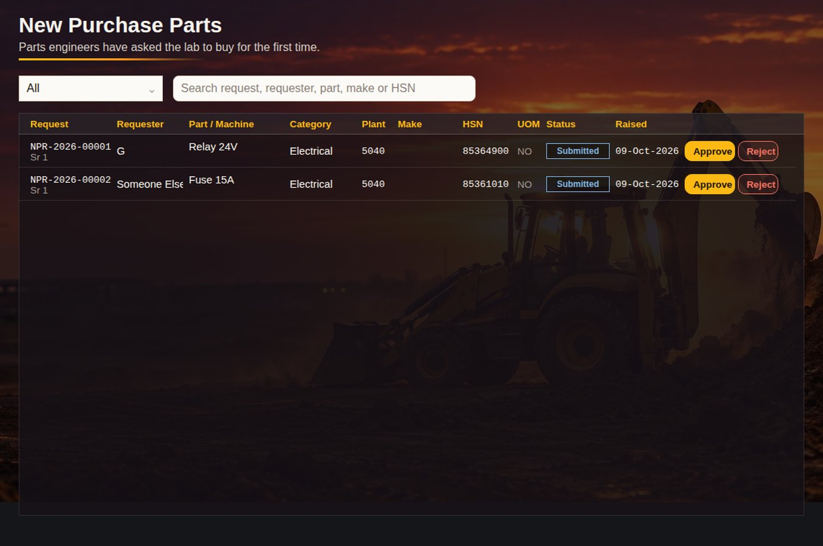
NEW PURCHASE PARTS
APPENDIX · LAB ADMIN / MANAGER
CLICK → WHAT HAPPENS
1
Status filter
Submitted, approved, rejected, draft.
1
2
2
Search
Request, requester, part, make or HSN.
3
4
3
Approve
Marked approved; add it to the catalogue once it has a part number.
4
Reject
Marked rejected; the engineer sees it.
RESULT
Every new-part request is decided in one place.
Appendix · Lab Admin / Manager
JCB
Notes:
Manager approval also shows on the Manager dashboard.

Slide 28
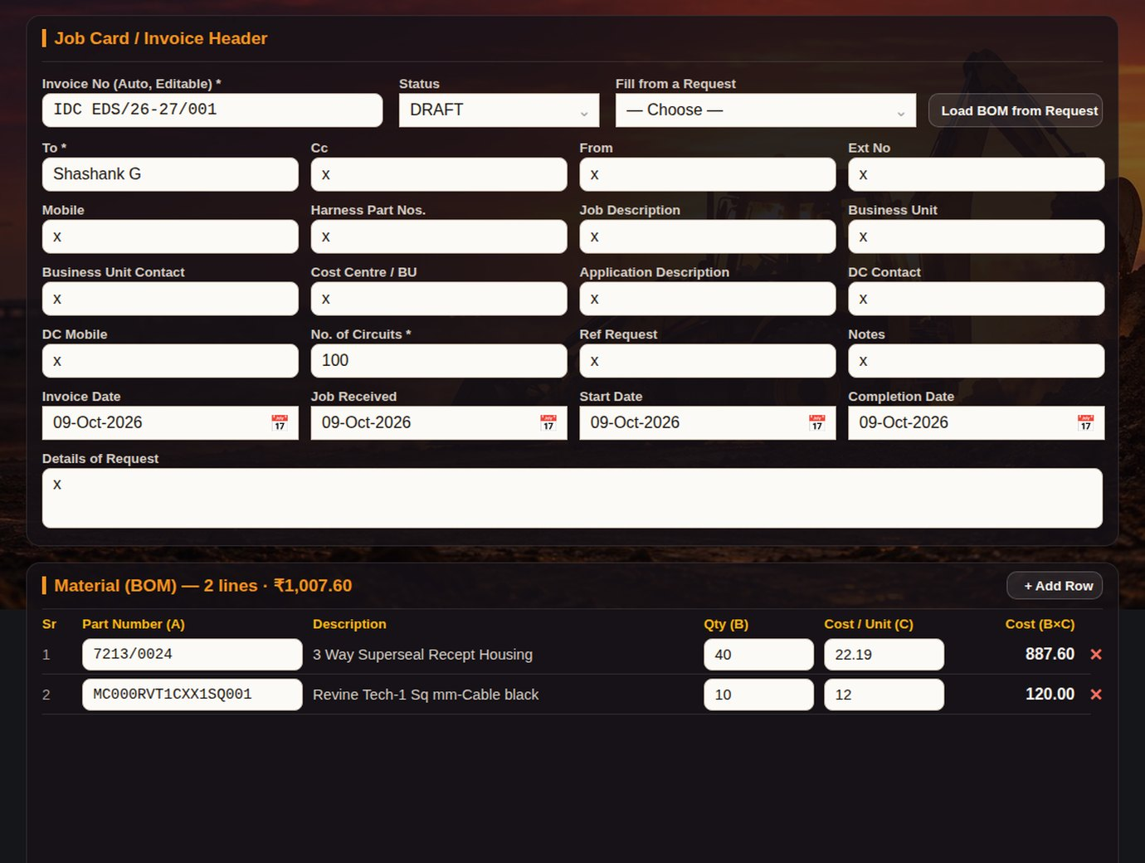
CREATE INVOICE
APPENDIX · LAB ADMIN
CLICK → WHAT HAPPENS
1
2
3
1
Status
Draft until it is issued.
2
Pick the request
Fills job details from a released request.
3
Load BOM from Request
Material lines with qty and unit cost.
4
+ Add Row
Extra material by hand.
5
Material lines
Qty × cost per line, total in the title.
6
Save Invoice · Print / PDF
At the bottom: saves with a unique number and prints the job card.
4
RESULT
Job invoice built from what was really released.
5
Appendix · Lab Admin
JCB
Notes:
The cost formula is finance-locked; only the inputs change.

Slide 29
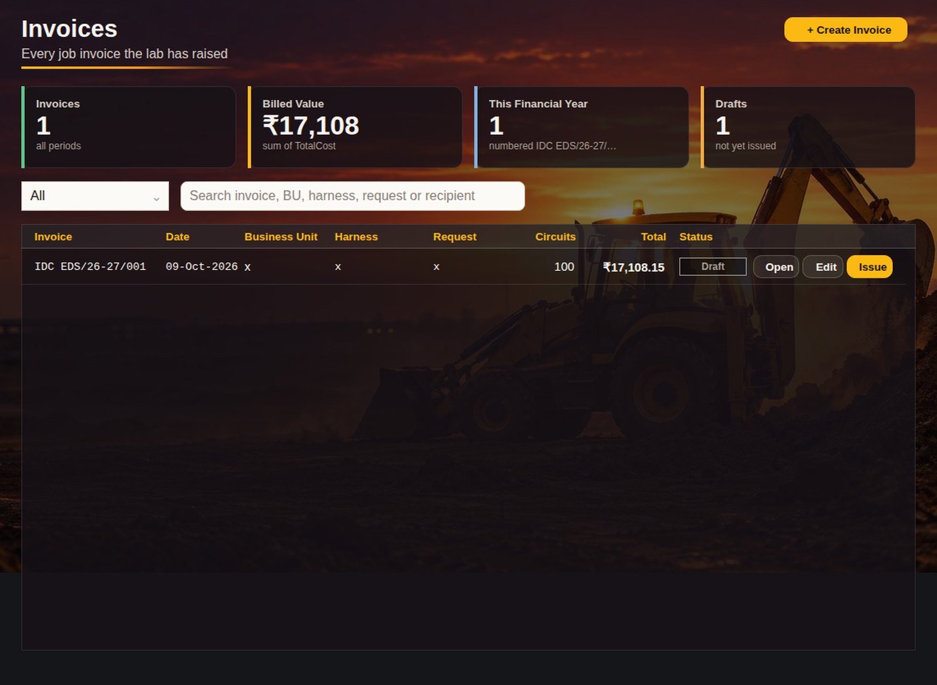
INVOICES
APPENDIX · LAB ADMIN
CLICK → WHAT HAPPENS
1
1
Tiles
Invoices, billed value, this financial year, drafts.
2
Status filter
Draft or issued.
2
3
3
Search
Invoice, BU, harness, request or recipient.
4
5
6
4
Open
Read view and print.
5
Edit
Back to Create Invoice with its lines.
6
Issue
Marks it issued.
RESULT
All lab invoices in one list.
Appendix · Lab Admin
JCB
Notes:
A new invoice can never reuse an existing number.

Slide 30
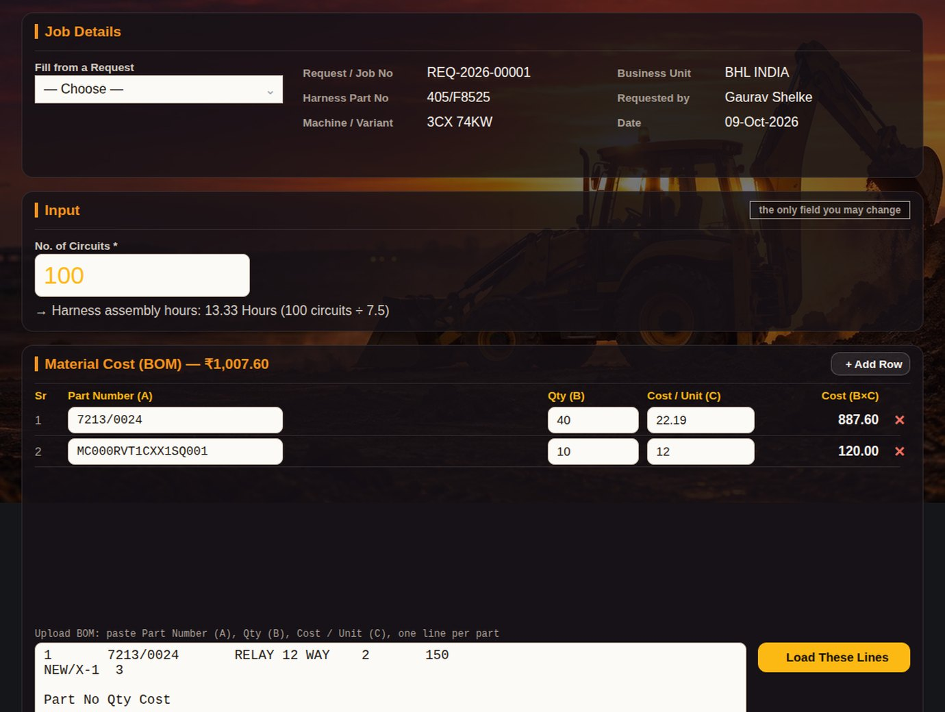
COST SHEET
APPENDIX · LAB ADMIN
CLICK → WHAT HAPPENS
1
1
Pick a job
Request or invoice to cost.
2
Input
Number of circuits is the only field you change.
2
3
Material cost
Part, qty, cost per unit, line cost.
4
+ Add Row
Extra lines.
4
5
Paste lines
Part, qty, cost straight from Excel; Load These Lines.
3
6
Calculated · Print
Below: labour and overheads from the finance-locked assumptions; print both.
RESULT
A quote for a harness job in minutes.
5
Appendix · Lab Admin
JCB
Notes:
Assumptions are read-only; finance owns them.

Slide 31
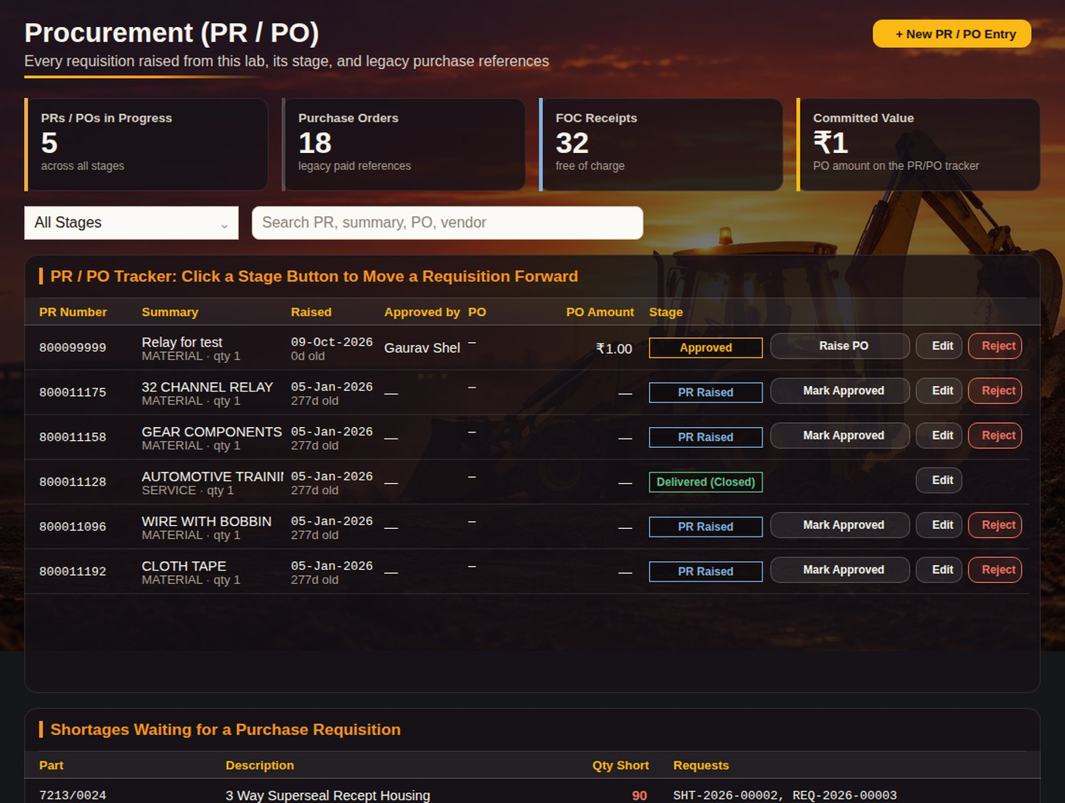
PROCUREMENT (PR / PO)
APPENDIX · LAB ADMIN
2
CLICK → WHAT HAPPENS
1
1
Tiles
PRs/POs in progress, purchase orders, FOC receipts, committed value.
2
+ New PR / PO Entry
PR number, summary, vendor, amount.
3
3
Stage filter
PR raised, approved, PO raised, GRN, delivered, rejected.
4
5
4
Stage button
One click moves it to the next stage.
5
Reject
Closes the PR.
6
Shortages waiting for a PR
From open requests, so nothing is forgotten.
RESULT
Every purchase tracked from PR to delivery.
6
Appendix · Lab Admin
JCB
Notes:
Manager sees the same stages on the Manager dashboard.

Slide 32
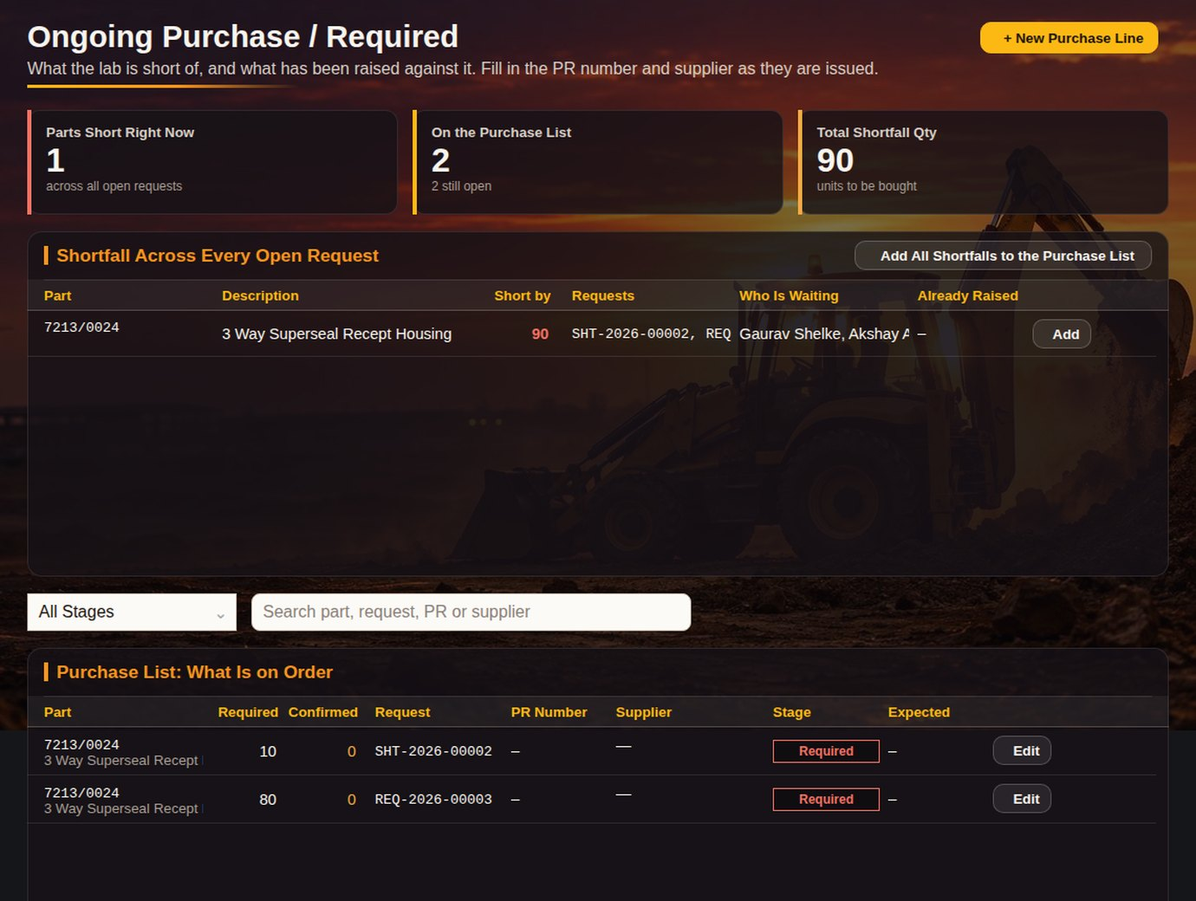
ONGOING PURCHASE
APPENDIX · LAB ADMIN
6
CLICK → WHAT HAPPENS
1
1
Tiles
Parts short now, on the purchase list, total shortfall qty.
2
Add All Shortfalls
Puts every open shortfall on the purchase list.
2
3
Add
One part for one request.
3
4
Stage filter
Required, PR raised, PO raised, in transit, received.
5
Edit
Supplier, PR number, stage.
6
+ New Purchase Line
Buy something not tied to a request.
4
RESULT
What is short across all requests, and what is already on order.
5
Appendix · Lab Admin
JCB
Notes:
One purchase row per part and request, so receipts go to the right job.

Slide 33
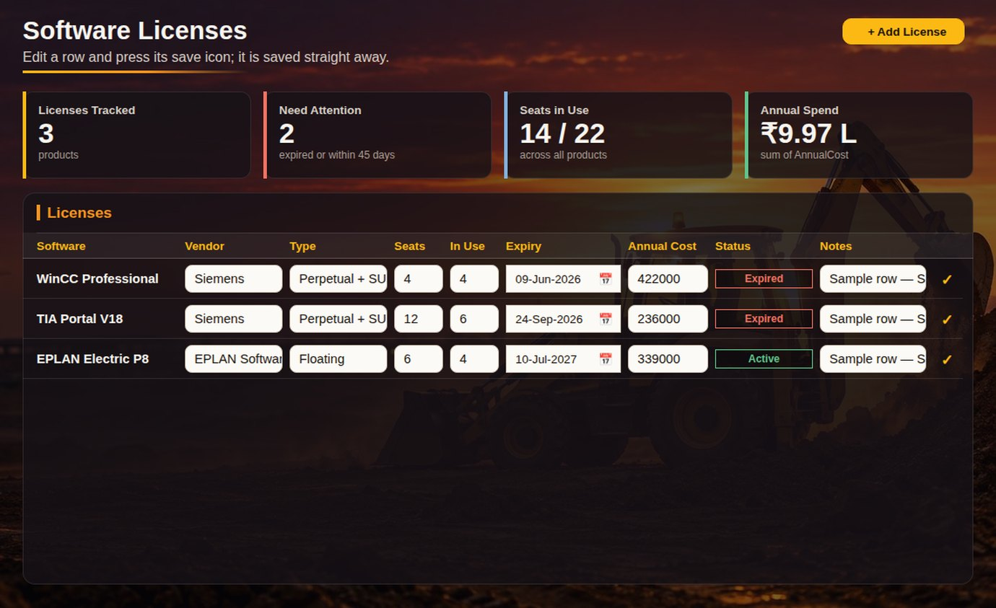
SOFTWARE LICENSES
APPENDIX · LAB ADMIN
2
CLICK → WHAT HAPPENS
1
1
Tiles
Licenses tracked, need attention, seats in use, annual spend.
2
+ Add License
Name, vendor, seats, expiry, cost.
3
List
Edit seats or dates in the row.
3
RESULT
No renewal is missed.
Appendix · Lab Admin
JCB
Notes:
Seats used against seats bought.

Slide 34
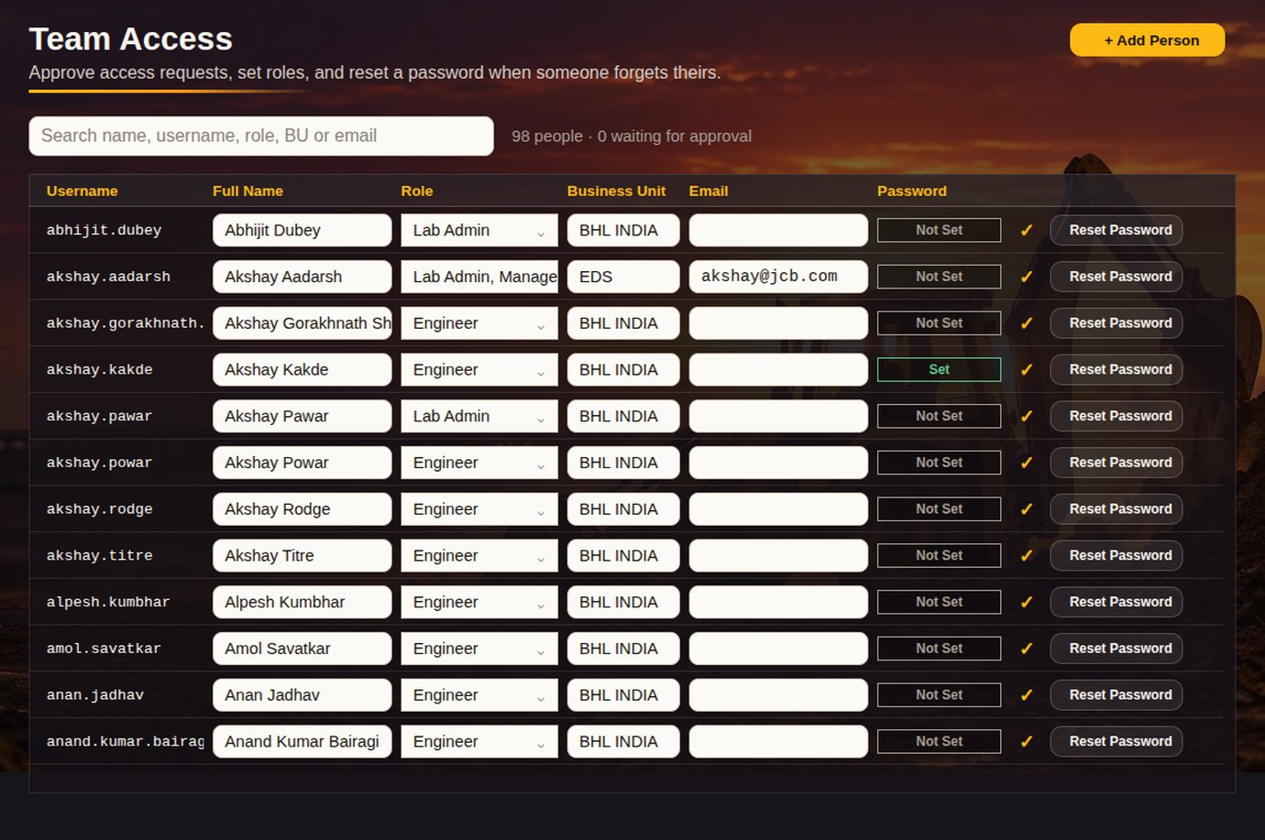
TEAM ACCESS
APPENDIX · LAB ADMIN / LAB LEAD
6
CLICK → WHAT HAPPENS
1
Search
Name, username, role, BU or email.
1
2
Role
Drop-down incl. combined roles like Engineer, Manager.
3
2
4
5
3
Name · BU · Email
Edit in the row.
4
Password
Set or Not Set; the password itself is never shown.
5
Reset Password
Clears it; the person chooses a new one at next login.
6
+ Add Person
Creates the user directly.
RESULT
Who can see what, managed without opening Excel.
Appendix · Lab Admin / Lab Lead
JCB
Notes:
Pending registrations show here for a role.

Slide 35
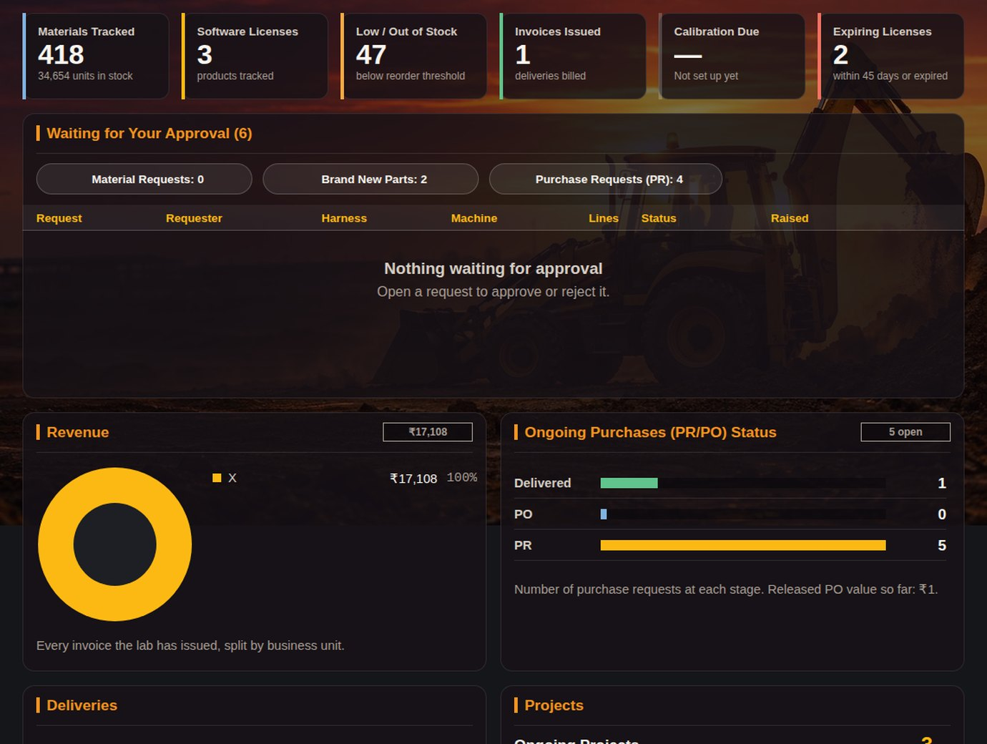
MANAGER DASHBOARD
APPENDIX · MANAGER
1
CLICK → WHAT HAPPENS
1
Tiles
Materials, licenses, low / out of stock, invoices, calibration due.
2
Approval tabs
Material requests, brand new parts, PRs.
2
3
3
Waiting for your approval
Approve or reject in the row.
4
Revenue
Invoice value by business unit.
5
Purchases
PR / PO / delivered bars.
4
5
6
Projects
Ongoing and upcoming.
RESULT
The manager's whole picture on one page.
6
Appendix · Manager
JCB
Notes:
Read-only picture of the whole lab, plus the approvals that need a manager.

Slide 36
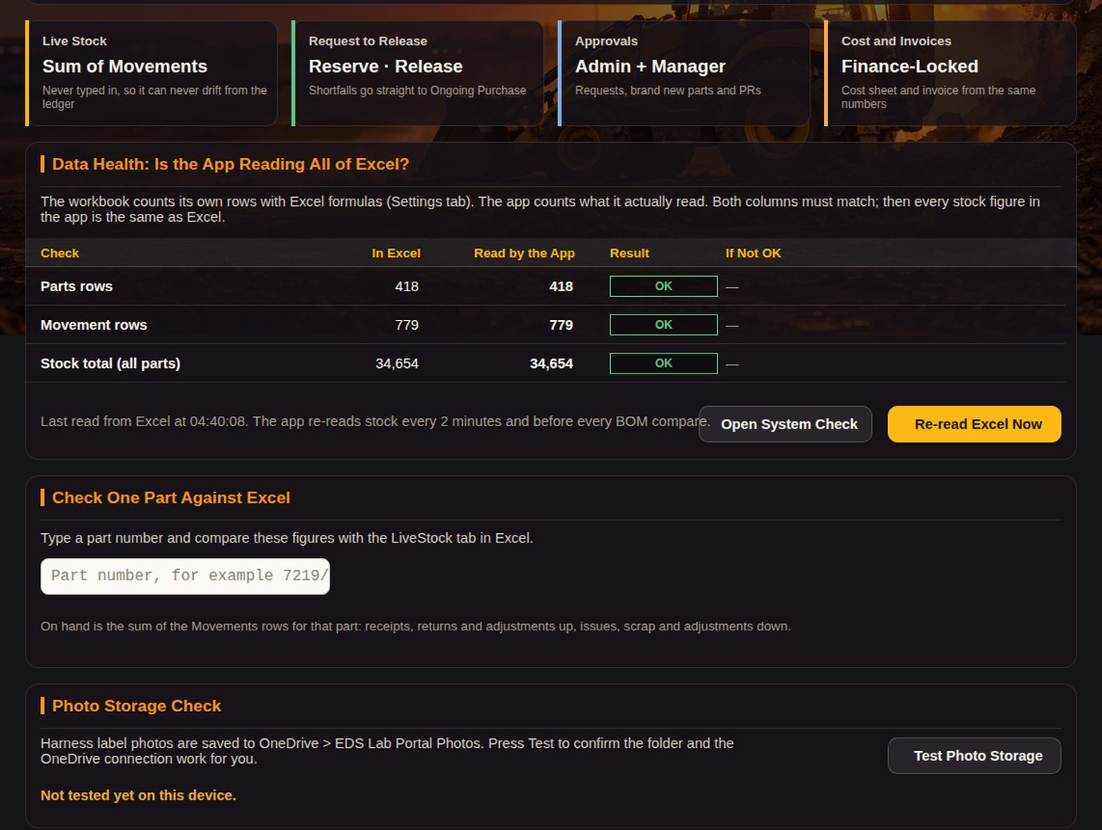
ABOUT · DATA HEALTH
APPENDIX · LAB ADMIN
1
CLICK → WHAT HAPPENS
1
How it works
Live stock, request to release, approvals, cost and invoices in four lines.
2
2
Data Health
Rows in the sheet vs rows the app reads.
3
Open System Check
The 18-row check.
4
Re-read Now
Refresh every table.
3
4
5
Check one part
Shows how one part number is read, to catch typing errors.
6
Test Photo Storage
Confirms harness photos can be saved.
5
RESULT
Admins can prove the data is complete without opening the workbook.
6
Appendix · Lab Admin
JCB
Notes:
Admin-only; ordinary users never see this page.

Slide 37

PRINT / PDF
APPENDIX · LAB ADMIN
1
2
CLICK → WHAT HAPPENS
1
Back
Returns to the invoice or cost sheet.
2
Print / Save as PDF
Browser print: paper or PDF.
3
Printable page
White page with the job card or cost sheet tables.
3
RESULT
Signed paper copy for the job file.
Appendix · Lab Admin
JCB
Notes:
Same layout as the Excel job card.

