Slide 1
Advanced Object Oriented Analysis
CECS 575

Slide 2
Agenda
Michael Williams – Infrastructure and Schema
James Le – Seed Data Collection and Population
Robert Groarke – Sorting, Searching, and Filtering
Gaurav Palande - Monetization through Product Advertising API and Image Upload Feature

Slide 3
Infrastructure and Schema Portion
Internet Game Database
Asp.NET
Code First Entity Framework
Lambda Expressions
Demonstration

Slide 4
Internet Game Database
Collect ALL games
Create a web application that can modify itself
Central hub for user and critic reviews
Help with locating and purchasing new games

Slide 5
Asp.NET
Code runs on a server to generate web page outputs
Compatible with .NET Common Language Runtime

Slide 6
Other Benefits of Asp.NET
Separation of client and server functionality with .aspx and .cs partial classes
Built in server controls for data access
Object-oriented web controls with data binding api

Slide 7
Code First Entity Framework
“Plain old C# objects” create the schema and allow CRUD operations through dot syntax
Reduces dependencies on complicated queries contained in literal strings

Slide 8
Code First Entity Framework
Example
Create annotated model classes
One-to-One, One-to-Many, and Many-to-Many relationships “baked in” through member fields
DBSet<T> generate Tables of models

Slide 9
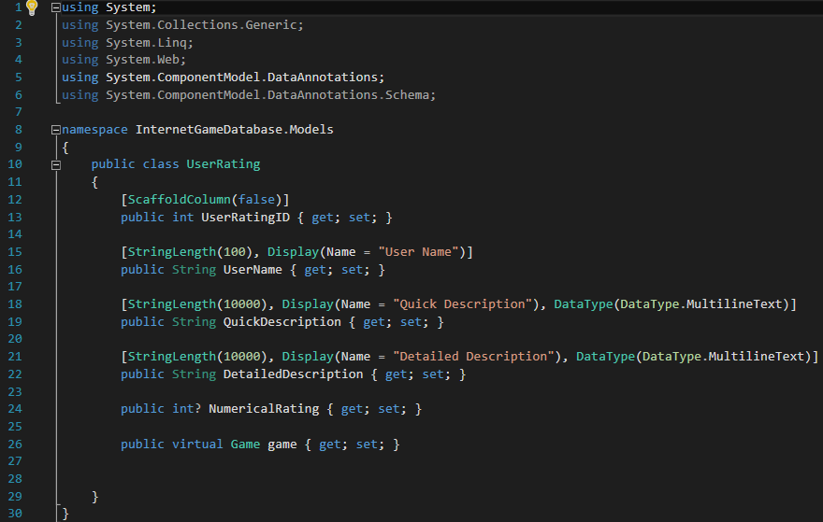
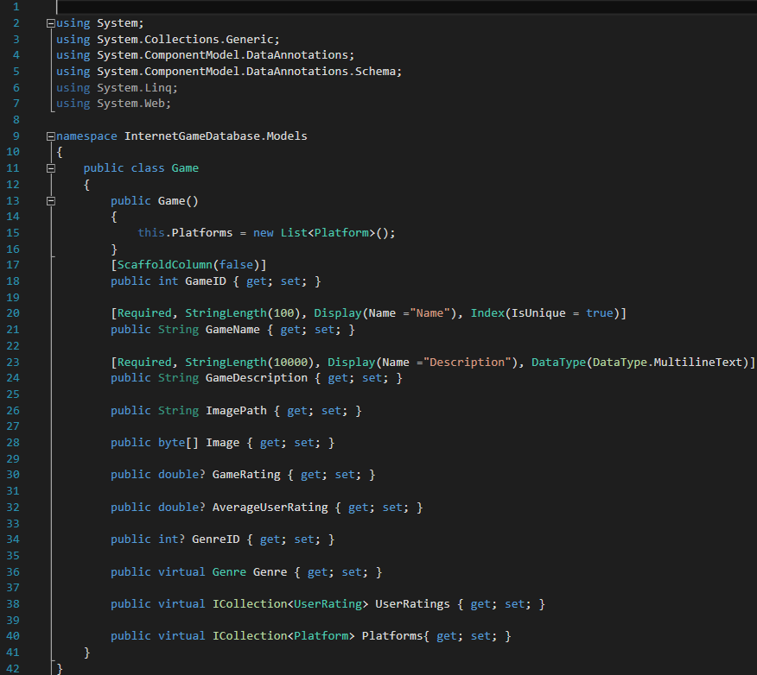
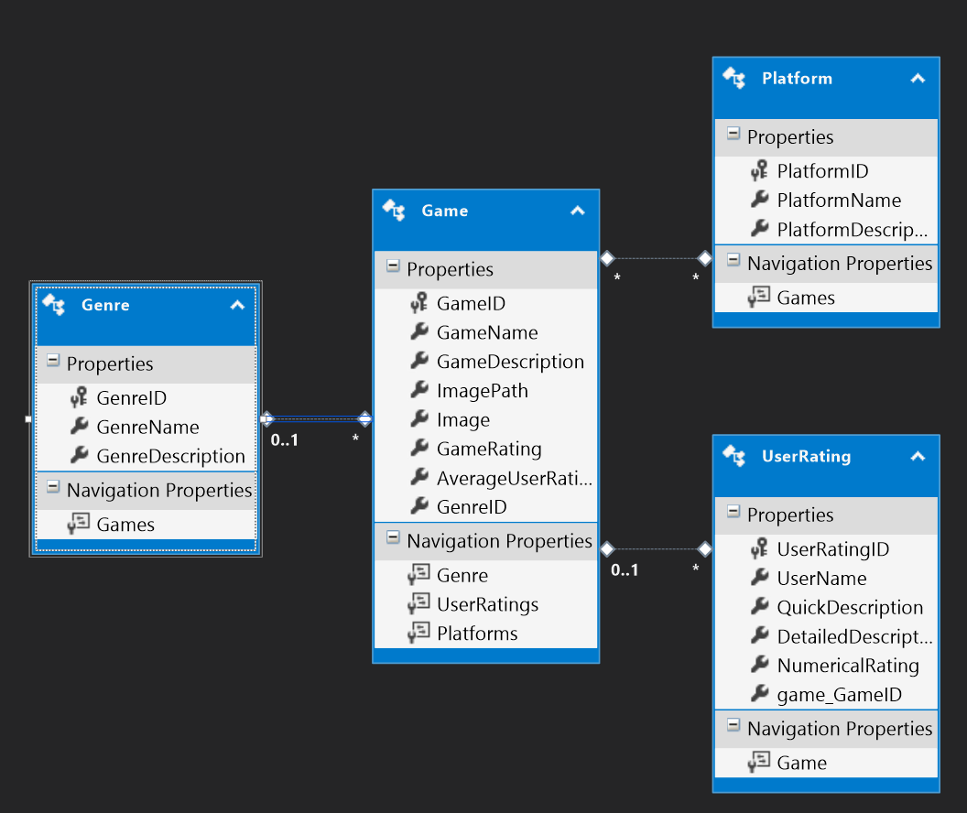
Code First Entity Framework
Illustrated
POCO translated into fully functional database

Slide 10
Delegates and Lambda Expressions
C# allows for pointers to functions
These can be a delegate type or a lambda expression
Both depend on the signature of function
Most commonly used with standard query operators
(x) => x * x; (x,y) => {x == y};

Slide 11
Demonstration
Create, Read, Update, & Delete!

Slide 12
Seed Data Collection and Population

Slide 13
A Site Needs Content
Need actual content for our site in order to attract users.
Needed a way to gather information quickly without doing it manually.
  Can take a hours to days.
  Internet is a big place.

Slide 14
WebCrawler
Its name is igdb.
This bot was used to gather the content and store it into the database.
Can tailor the bot to scrape information about games from many websites at once.
Information collected: Name, Rating, Description, Genre, Platform, and Picture of the game.
Notes:
Was used to seed the database with content. Can tailor the bot to scrape most information on the web.
In our case it was to collect information about Games.
Information collected: Name, Rating, Description, Genre, Platform, Image URL and Image

Slide 15
Scrapy
Scrapy 1.0.3 lib. for python 2.7.1
Allows you to build web crawlers based on a framework created by Scrapy.
This allows you to extract information from websites for use in many things.
Retrieval of individual information from websites is by elements.
Used xpath to define which elements to extract from.
  Ex. Where asdf is my html source to extract info from
Used to extract url links from a table.

Slide 16
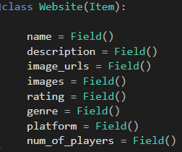
Information is stored structurally
Information is stored inside an item object.
Each item has metadata stored in a field object
Can specify a type of pipeline on the item object.
The Pipelines class is called to do a specific action on an item object.
  One example used:
  Images pipeline is used to extract and download images into our file system.

Slide 17
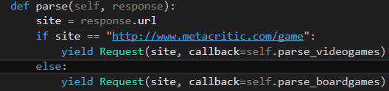
Check correct url to parse
Scrapy uses the parse() function to start scraping a page which than you can request a new page to parse by doing a Request and Response than specifying the information to extract.

Slide 18
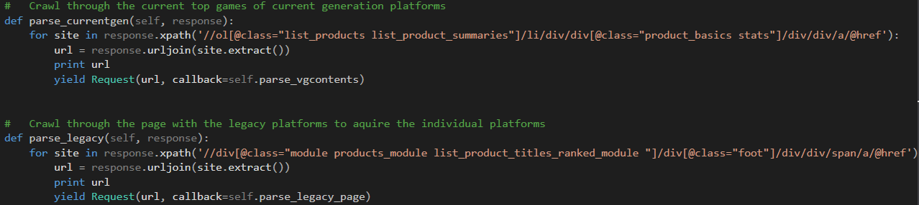
Parsing additional pages

Slide 19
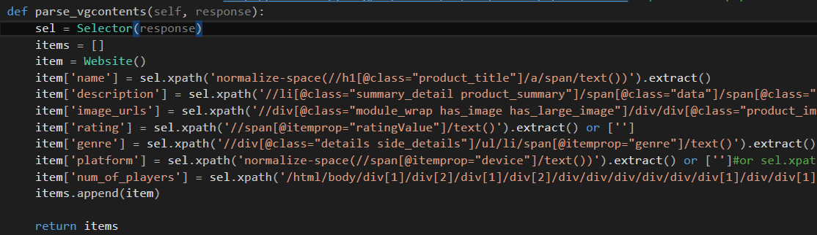
Finally scraping the information

Slide 20
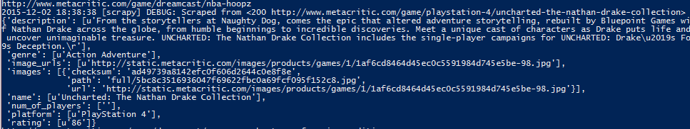
Simple Cmd
scrapy crawl igdb -o myxml.xml
This commands allows you to store information from each individual item object into an xml file.
Supports JSON, CSV and other file formats too.
Example Output:

Slide 21
Creating the game objects
Read game information from the xml file.
Reader grabs information from each game item element
  Checks if game already exists.
  Checks for different platforms that the game is on.
  While also creating new Genre and Platform Objects if it doesn’t already exist in our system.
  Creates a new game object based on extracted information.
Objects are then inserted into the database.

Slide 22
Filters & Sorting
Robert Groarke

Slide 23
Sorting – Games.aspx
Sorting is another key feature of our product, as it allows for a user to be able to reorder the search results so that they can find the game that they are looking for.
Sort arrows flip direction when clicked, results are reordered on click.
Clicking a sort button calls a method which modifies the orderby clause of the SQL query which defines the items displayed by the listview.

Slide 24
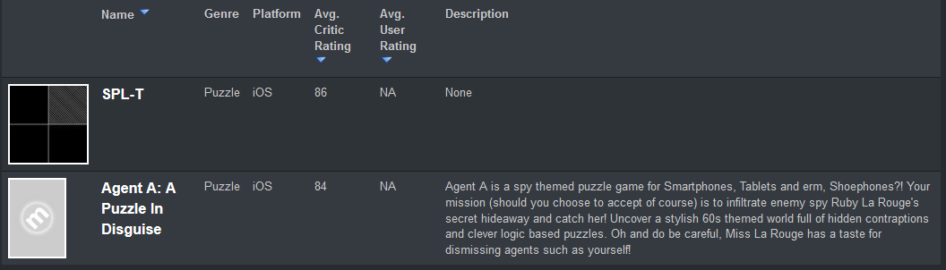
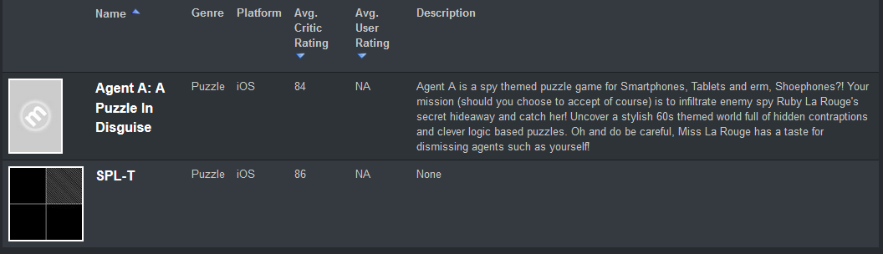
Sorting Example – Games.aspx

Slide 25
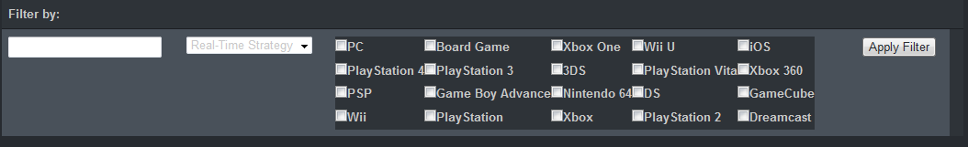
Filters – Games.aspx
Filters are a key feature of our product, as they allow for a user to be able to refine the results which are returned by the IGDB when they are searching for a Game
Search filter filters results by GameName of Game objects within the database
Genre dropdown filters results by Genre
The genre dropdown is dynamically populated by all of the unique Genre objects which are within the database
Platform checkbox list filters results by platform(s)
The platform checkbox list is dynamically populated by all of the unique Platform objects within the database

Slide 26
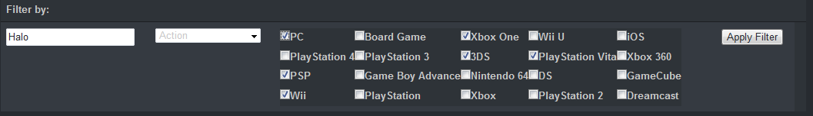

Filters: Building a Param String – Games.aspx
When the ‘Apply Filter’ button is clicked, the click event triggers a method which creates a Param String from the selections within the filter bar.
The Param String is assembled by properties and the corresponding specified IDs, separated by ampersands.
The syntax for a Param String is ?property=value,
The Param String is appended to the Games.aspx url and the page is refreshed.

Slide 27
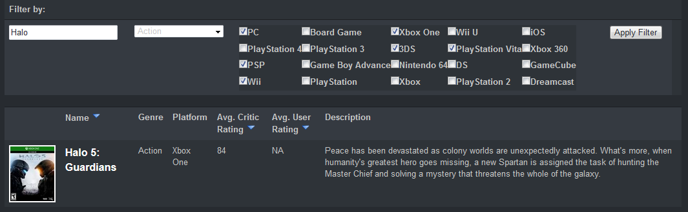
After the page is reloaded – Games.aspx
A list of games is returned which meets the requirements specified by the filter.
In this example, Halo 5: Guardians is returned, as it contains the word ‘Halo’ in its title, its Genre is Action, and its Platform is Xbox One, which is one of the platforms specified by the filter.

Slide 28
Asynchronous Load: Filling Filter Fields – Games.aspx
After the page has been reloaded, the fields defining the filters must be re-assigned.
The method which re-assigns the values of the fields must fire after the page has loaded because the checkboxes and dropdown menu are not populated until that point.
Therefore this method must be executed asynchronously, it is called by the GetGames() method, but must wait until the page_load has finished execution before it is invoked.

Slide 29
How is the list of Games results populated? – Games.aspx
The listview for the list of Games which are displayed on the Games.aspx is populated by a select method – GetGames()
GetGames calls GetGamesWithParams(GetParameters())
GetParameters() is the method which retrieves the Param String from the URL and assembles the parameters into a generic list of objects.

Slide 30
OOP – Polymorphism
GetGamesWithParams(List<object> filters) is an object oriented method which utilizes polymorphism .
The List<object> filters can be of any length, and can contain many different types of objects.
The method generates a LINQ query based on all of the parameters passed in via the list of filter objects passed into it.
The method executes the LINQ query and then returns the resulting list of games.
The list of games returned by this method is then used to populate the listview on the Games.aspx web page.

Slide 31
How is the LINQ query generated? - LINQKIT
GetGamesWithParams(List<object> filters) utilizes LINQKIT to generate the LINQ query for the filters to be applied to the list of games.
Comprised of extensions for LINQ to SQL and Entity Framework
AsExpandable() method
Predicate Builder Functions – PredicateBuilder.cs class
Allows you to Dynamically build predicates by providing methods which invoke changes to your LINQ query after it has already been defined.
Allows you to combine LINQ expressions together using ANDs, ORs, XORs, NANDs & NORs.

Slide 32
Dynamic Queries in GetGamesWithParams()
For each filter object passed into the method, the method determines which type of filter it is, generates a LINQ query corresponding to it
That LINQ query is then ANDed with the combined LINQ query generated by each filter object being processed by the foreach loop.
This is all possible as a result of the utilization of the LINQKit package.

Slide 33

Product Advertising API
Game Search on Amazon.com

Slide 34
AWS Itemsearch
Used Itemsearch functionality in Amazon’s Product Advertising API.
The ItemSearch operation returns items that satisfy the search criteria, including one or more search indices.
Search indices used:
1. Video Games
2. Toys
3. Mobile Apps and Games
Access to a lot of the data used by Amazon including the items for sale.
Used Request object to define which elements to extract from.
Retrieval of individual information from websites is by Response object.
Financial prospects are realized by creating a Product Advertising API-driven web stores which acts as an e-commerce storefront.

Slide 35
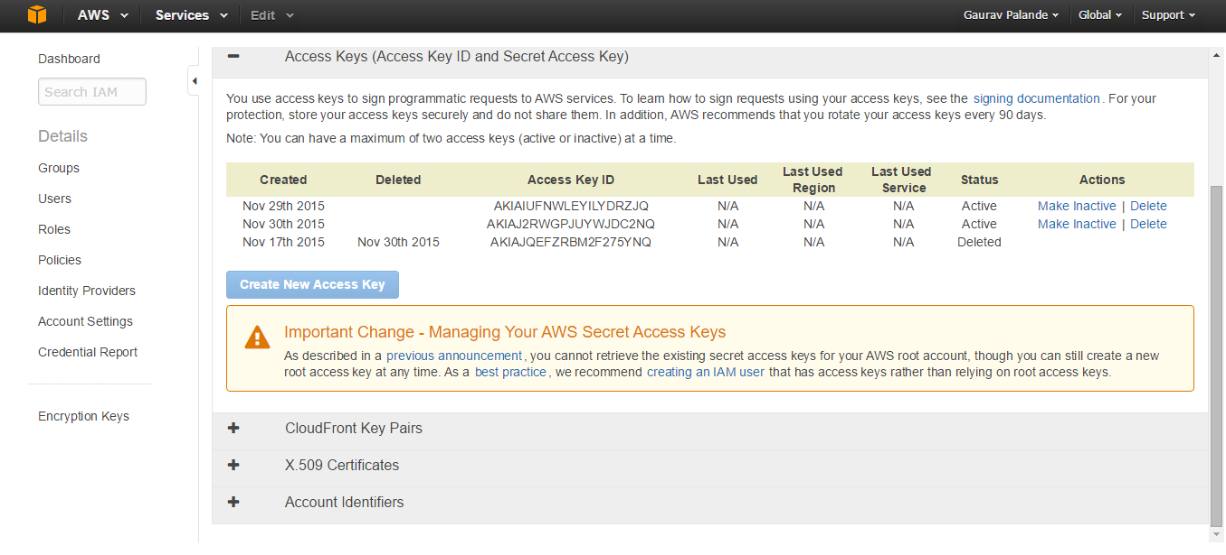
Becoming an Associate
Product Advertising API to advertise Amazon products and Amazon Associates earn referral fees when customers buy qualifying products.
Commission given on the basis of Associate ID, also known as an Associate tag.
Associate ID: An automatically generated unique identifier that is needed to make requests through the Product Advertising API

Slide 36
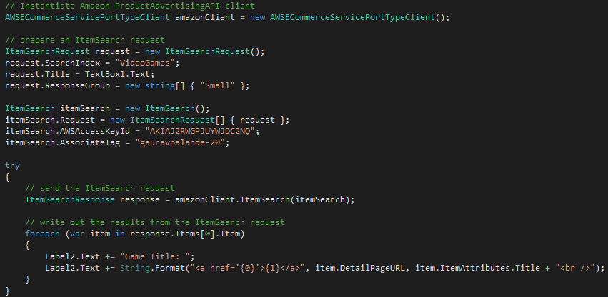
Information Exchange & OOP - Encapsulation
Client – Server interaction achieved through SOAP.
Used Request object to define which elements to extract from.
Retrieval of individual information from websites is by Response object.
OOP concept Encapsulation is achieved as “ItemSearchRequest” object encapsulates information to be sent to web service.

Slide 37
WSDL & OOP - Namespaces
Client and server agreement on the grammar and syntax used in the requests and responses based on WSDL specification.
SOAP namespace used is xmlns:soap="http://schemas.xmlsoap.org/wsdl/soap/"
Schema used is xmlns:xs="http://www.w3.org/2001/XMLSchema"
Product Advertising API WSDL namespace is "http://webservices.amazon.com/AWSECommerceService/2013-08-01"

Slide 38
WSDL Request Object Schema & OOP - Encapsulation
<xs:element name="ItemSearch">
<xs:complexType>
<xs:sequence>
<xs:element minOccurs="0" name="MarketplaceDomain" type="xs:string" />
<xs:element minOccurs="0" name="AWSAccessKeyId" type="xs:string" />
<xs:element minOccurs="0" name="AssociateTag" type="xs:string" />
<xs:element minOccurs="0" maxOccurs="unbounded" name="Request“ type="tns:ItemSearchRequest" />
</xs:sequence>
</xs:complexType>
</xs:element>
<xs:complexType name="ItemSearchRequest">
<xs:sequence>
<xs:element minOccurs="0" maxOccurs="unbounded" name="ResponseGroup" type="xs:string" />
<xs:element minOccurs="0" name="SearchIndex" type="xs:string" />
<xs:element minOccurs="0" name="Title" type="xs:string" />
</xs:sequence>
</xs:complexType>
<xs:element name="ItemSearchResponse">
<xs:complexType>
<xs:sequence>
<xs:element minOccurs="0" ref="tns:OperationRequest" />
<xs:element minOccurs="0" maxOccurs="unbounded" ref="tns:Items" />
</xs:sequence>
</xs:complexType>
</xs:element>

Slide 39
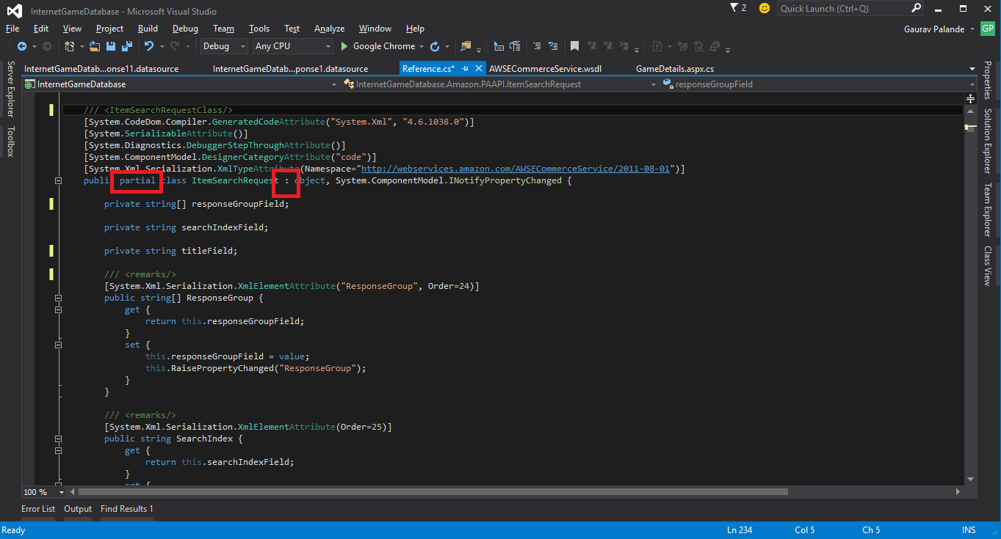
OOP - Partial class & Inheritance
Partial class is used to create possibility of splitting the definition of the class over two or more source files.
ItemSearch class inherits “INotifyPropertyChanged”
to use “RaisePropertyChanged” function for detecting changes in Object properties.
Similar for “ItemSearchResponse” class

Slide 40
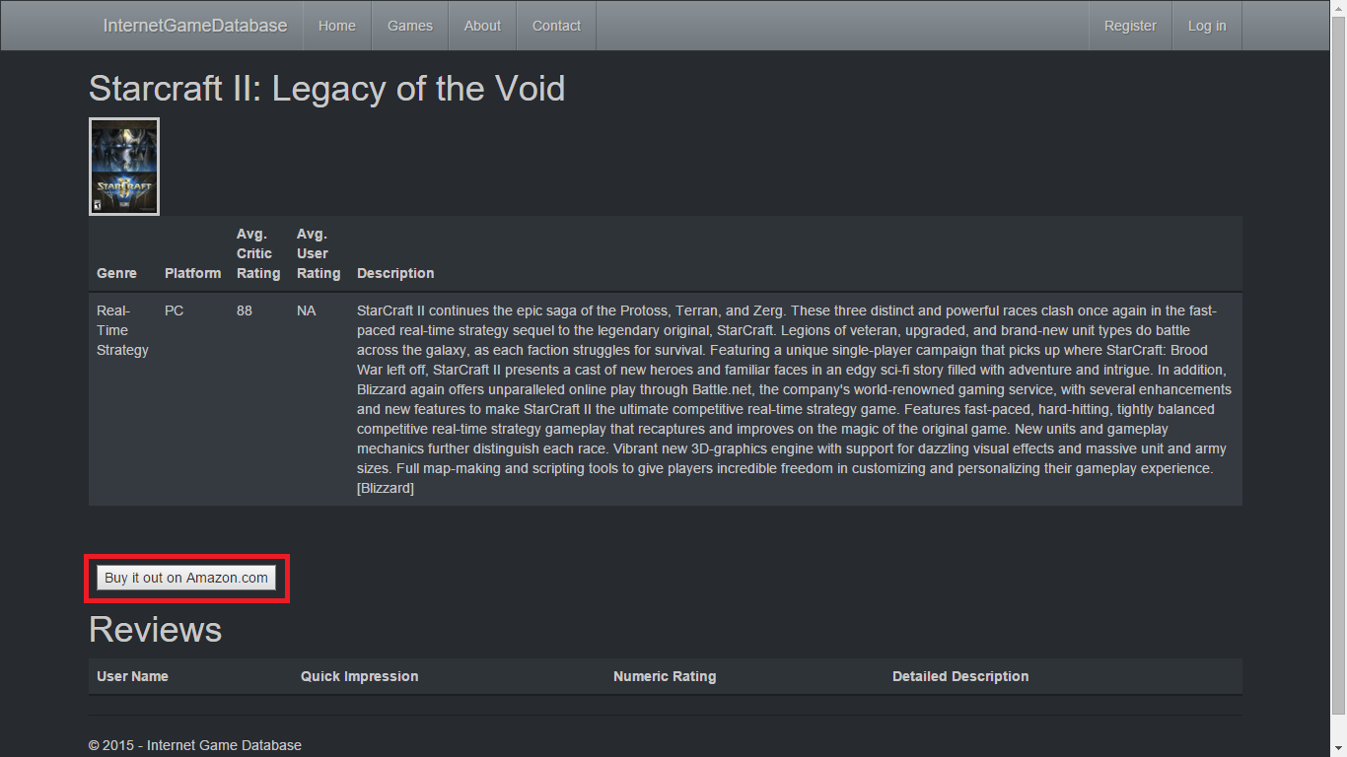
Walkthrough
Clicking the “Buy it out on Amazon.com” button retrieves link to selected game’s webpages available on Amazon.com.

Slide 41
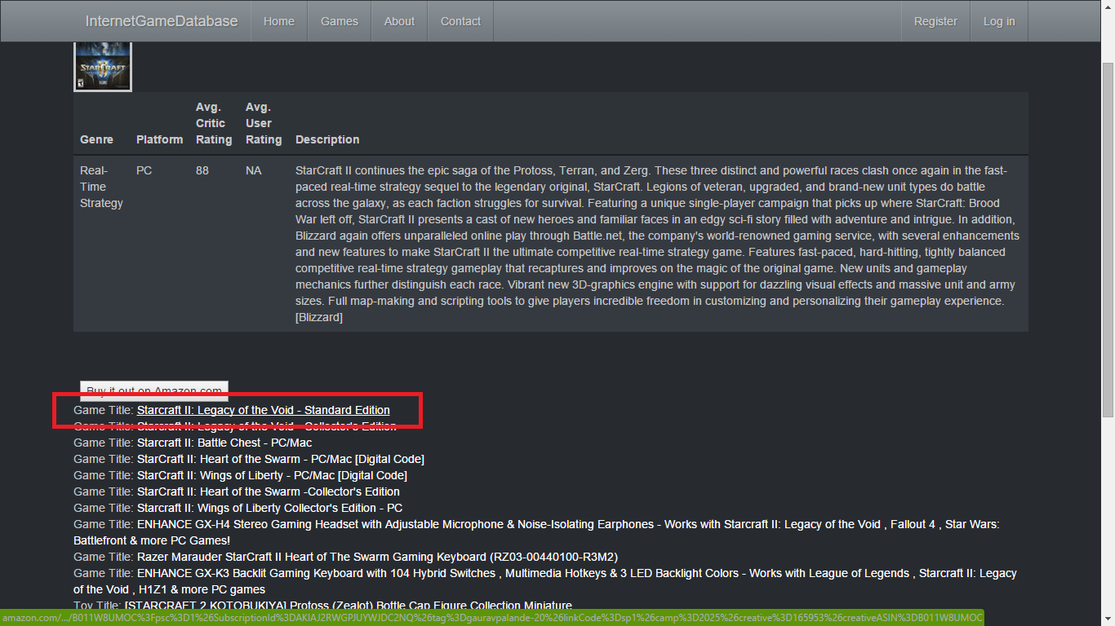
Walkthrough
Available webpage links are displayed with game titles.
User can select the link that they want to navigate to.

Slide 42
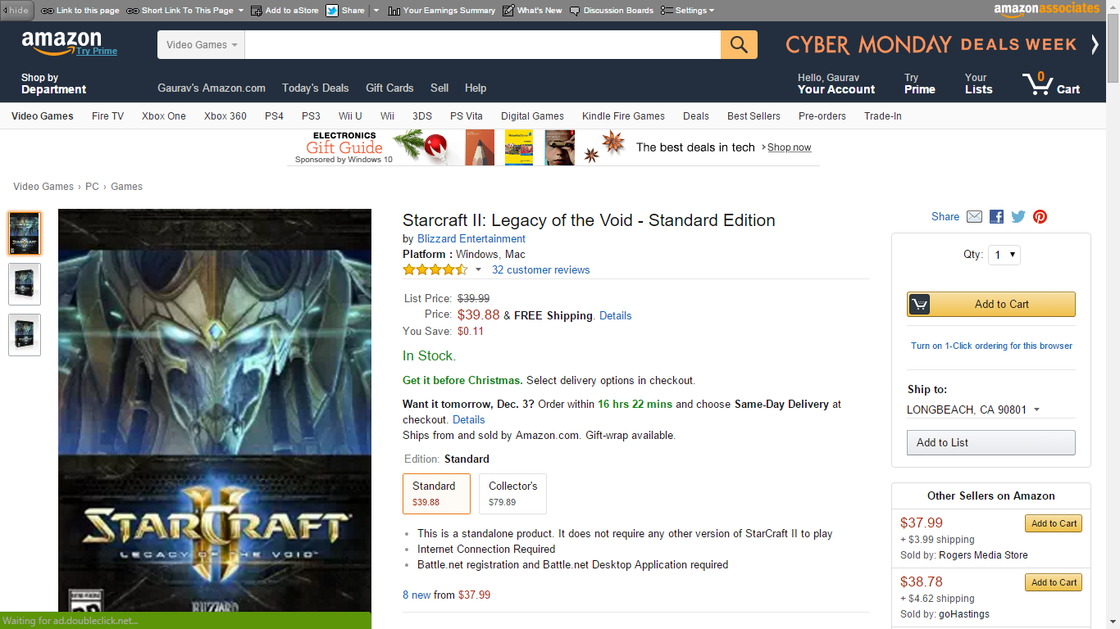
Walkthrough
User is redirected from IGDB to Amazon.com’s game website.
User can buy the game
After purchase IGDB gets commision for referral.

Slide 43
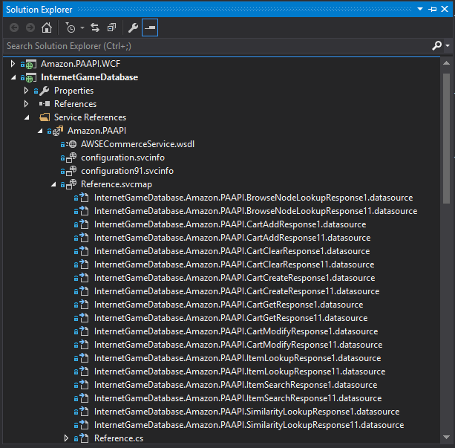
Future Expansion
Possible expansion includes:
Add selected game directly to users Amazon shopping cart.
Clear users Amazon shopping cart directly from IGDB.
Create Shopping cart on IGDB and sending bulk order to Amazon.
Include additional game information such as Price, Availability, Deals, Offers, etc from Amazon database
Find games similar to selected games from Amazon database.

Slide 44
Image Upload
Image Uploading and Preview while adding game

Slide 45
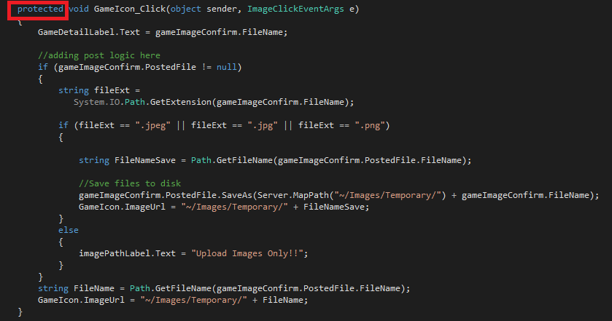
Implementation & OOP - Access Contol
“GameImageConfirm” helps upload game icon into IGDB.
Functionality filters out icons based on extension.
Filtered image is saved in Temporary folder and saved in database on click of “Add Game” button.
On “ImageIcon” click saved image is displayed for preview.

Slide 46
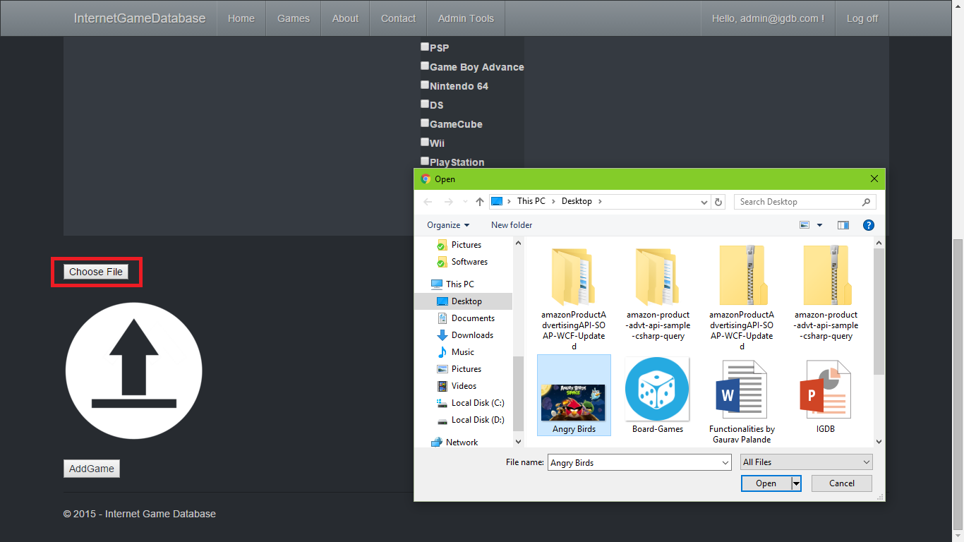
Walkthrough
Clicking on “Choose File” button on Add Game page opens Open file dialog box.
The user can choose the game icon of his choice.

Slide 47
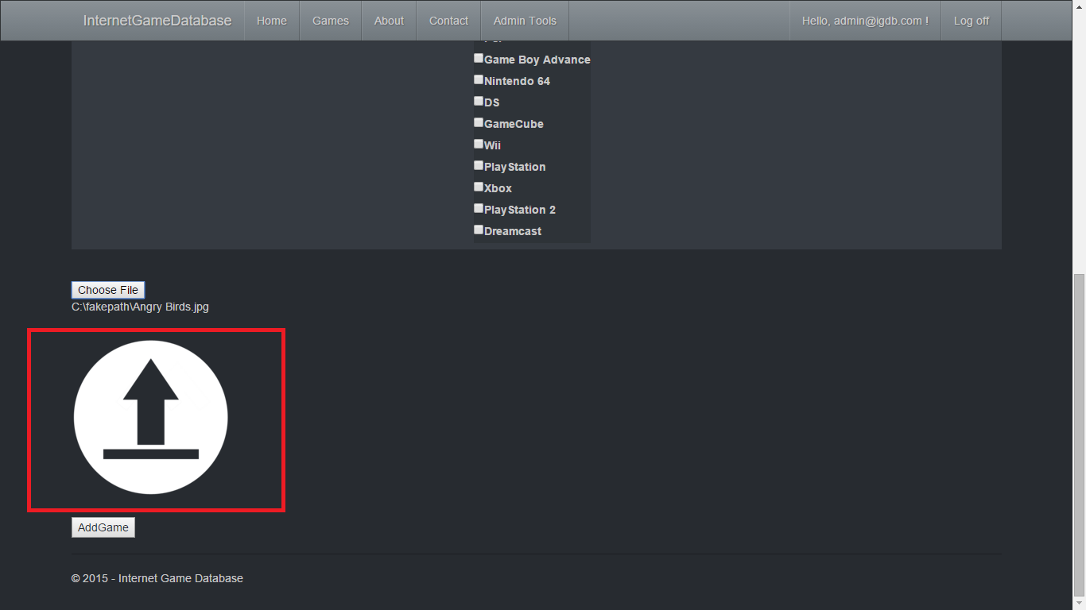
Walkthrough
Clicking on game icon image provides the preview of the uploaded image on IGDB

Slide 48
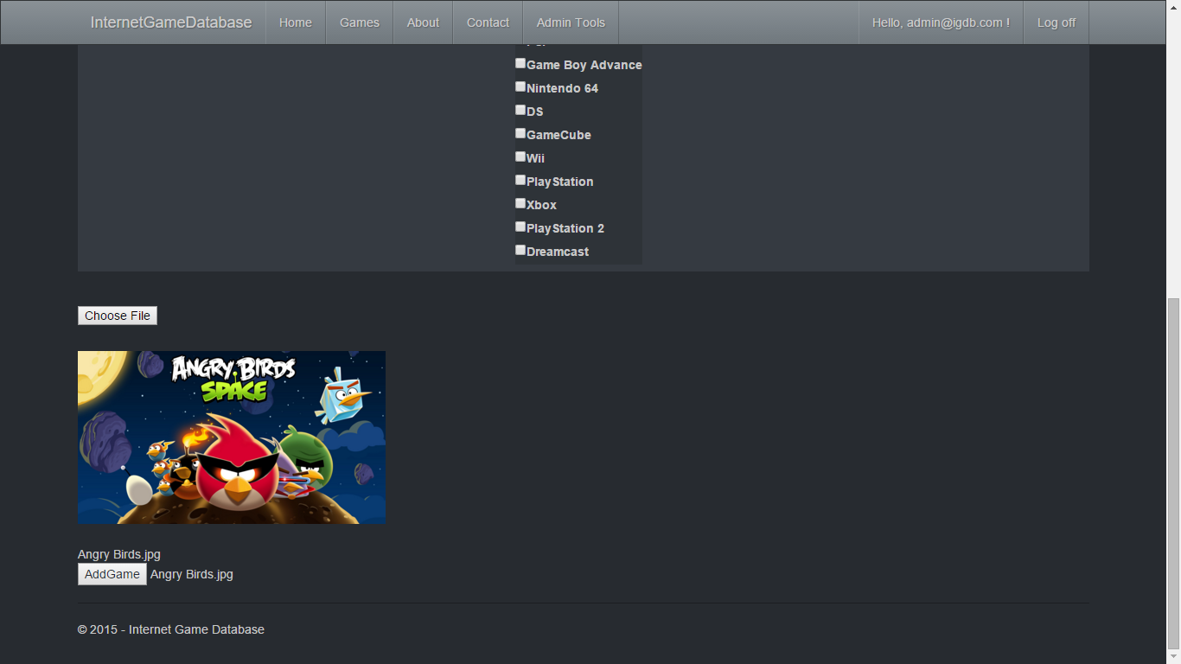
Walkthrough

