Slide 1


Real World RAG Systems
by Group 6
Gaurav Palekar,
Veera Valluri,
Kunal Singh,
Leela
Mentors:
Gopi
Lokesh

Slide 2

GAURAV PALEKAR
Meet the Team Members

Slide 3
Highlights of the project

Slide 4
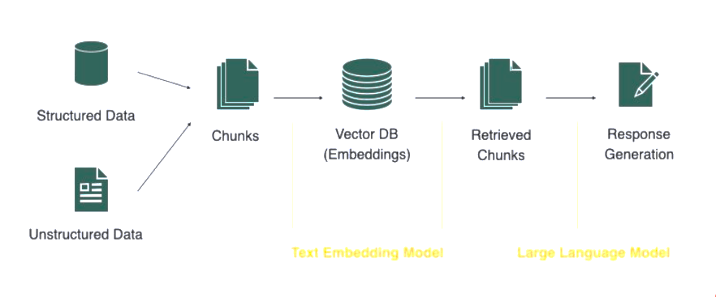
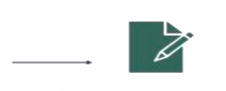
Approaches to System Architecture
DEPLOY
CHUNKING
GRADIO
Sliding Window
Paragraph splitter.
Sentence Splitter
Heuristic Re-Ranking
Chroma DB
LLM
VECTOR DB
Llama 3.3-70B-Instruct
Mistral-7B-Instruct-v0.2
GPT 3.5 Turbo 1106
GPT-4o
Maximal Marginal Relevance
Hybrid Search
TEXT EMBEDDING
sentence-transformers/msmarco-bert-base-dot-v5
sentence-transformers/all-mpnet-base-v2
Alibaba-NLP/gte-Qwen2-1.5B-instruct
dunzhang/stella_en_1.5B_v5
pritamdeka/BioBERT
OpenAi Embeddings

Slide 5
Evaluation of the RAG system
Evaluation done manually by comparing the retrieved content and LLM responses with grounded truth
Chunks Strategy
Embedding
Retrieval
LLM
CHUNKING | Evaluation
Sentence Splitter with overlap | Good but some responses from LLM were incomplete
Paragraph Splitter with overlap | Best as all the context was pulled up
Text Embedding | Evaluation
/msmarco-bert-base-dot-v5 | Very Good.
all-mpnet-base-v2 | Good.
/gte-Qwen2-1.5B-instruct | Flawed Response
BioBERT | Good response only for CovidQA dataset
OpenAi Embeddings | Best Response
Retrieval | Evaluation
MMR | Very Good.
Hybrid | Did not try.
LLM | Evaluation
Llama 3.3-70B-Instruct | Very Good.
Mistral-7B-Instruct-v0.2 | Good but not as polished as Llama/GPT
GPT 3.5 Turbo 1106 | Best Response
GPT-4o | Same as 3.5 Turbo
googleT5 | Worst

Slide 6
Evaluation of the RAG system(contd)

Slide 7
Final System Architecture
Prompt Engineering
DEPLOY
CHUNKING
GRADIO
Paragraph splitter.
Chunk size =800
Chunk Overlap = 100
VECTOR DB
Heuristic Re-Ranking
Chroma DB
LLM
Llama 3.3-70B-Instruct
Maximal Marginal Relevance
TEXT EMBEDDING
sentence-transformers/msmarco-bert-base-dot-v5

Slide 8
Minimizing Hallucinations
Since RAG systems are prone to hallucinations, we have employed the below methods to minimize it
1
2
3
4
Re-Ranking and MMR
Identify the most relevant content
Prompt Engineering
Instruct LLM to only generate response from the retrieved content and set the temperature between 0-0.2 to encourage accurate response
Validated the LLM
response against ground truth
Evaluate the system
Instruct the LLM to reason the response and calculate metrics, RMSE and AUCROC and pick up the most appropriate system

Slide 9



Challenges Faced
Team Availability
Getting the team together to work on the project
GPU access and Paid subscriptions
Running out of GPU access.
Free Tier was running out so had to buy paid subscription
TBD

Slide 10
Demo. (embedded gradio URL)

