Slide 1
UI / Navigation/ HTML / CSS / JS
By :
Akhil Singh (525691)
Ritu Jain (525700)
Rishabh Anand (525701)
Guneet Kaur (525713)
Gaurav Paliwal (525705)
Ratika Malik (525695)

Slide 2
User Interface
Types :
1. GUI
2. WUI
3. CUI
4. VUI
5. TUI
Properties :
1. Simple and Helpful
2. User Friendly
3. Consistency
4. WYSIWYG (Eg. Gmail Compose Mail / TinyMCE)
5. See and Prompt

Slide 3
User Interface
Elements :
1. TextBox
2. Option Box
3. Check Box
4. Drop Down
5. Combo Box
6. List Box
Etc.
Actions :
1. OnClick
2. OnLoad
3. OnSubmit
4. OnKeyPress
5. OnMouseOver (Hover)
6. OnFocus & LostFocus
Etc.

Slide 4
Navigation
Its like having a road sign in IT world.
Properties :
1. Systematic display.
2. Easy traversal (back and forth).
3. Easy functionality invocation.
4. Faster acquaintance with the system.
5. Easy access.

Slide 5
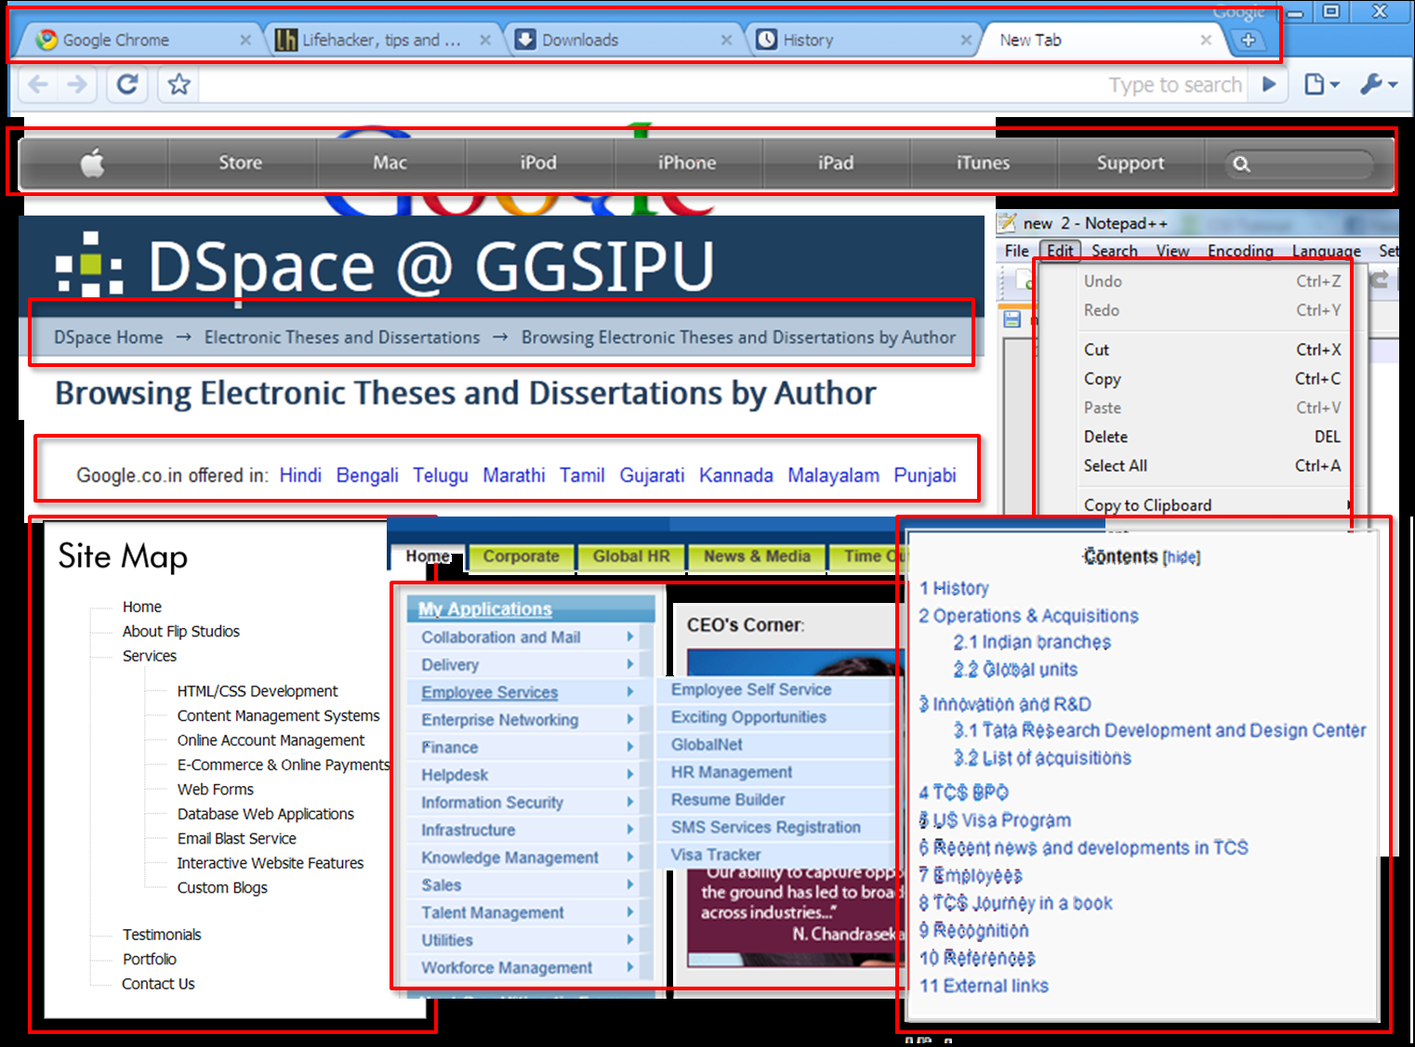

Slide 6
HTML
Hyper Text Markup Language.
Concept by Tim Berners-Lee in 1990.
Tag Language.
Used in web designing.
Predefined tags.
Browser independent.
Supported by W3C.

Slide 7
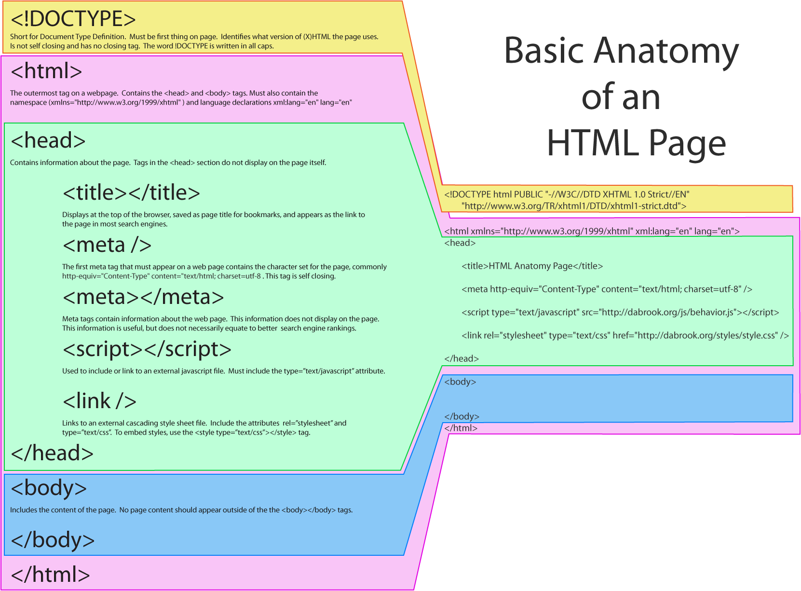

Slide 8


Slide 9
CSS
Cascading Style Sheets.
Layout of web pages.
Improves presentation.
Reusable.
Easier Maintenance.
Inheritance.
Inline, Internal and External.

Slide 10
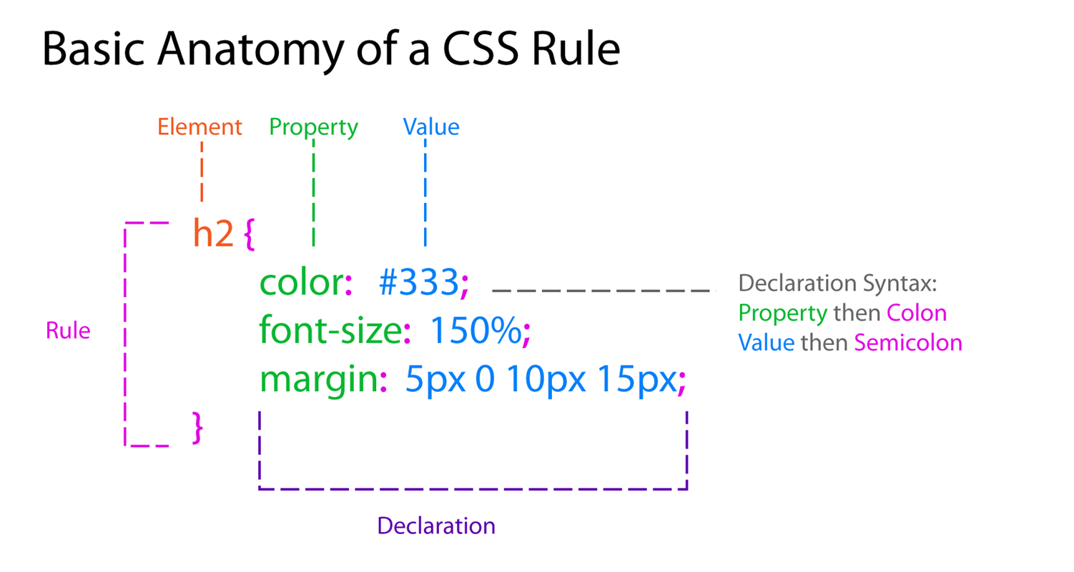

Slide 11
Javascript
Client-side processing.
Increase user engagement.
Patent free.
Used for Validation.
Make Web pages interactive.
Browser Independent
Event Driven
Case Sensitive

Slide 12
Hands On Javascript
NaN demo ( Not a Number Check ).
Whitespace check validation demo.
Date Validation.

Slide 13
Cool things with Javascript
Write less do more.
Extends Libraries.
**Sometime** used for server side scripting Ex. Node.js.
Jquery.
Jquery UI (User Interface Stuff).
Easy to use.
No Licensing Issue
Released in GPL

Slide 14
Cool Demos
Calender picker
Real Time table manipulation

Slide 15
Questions

Slide 16
Surprise !!

Slide 17
Thanks

