Slide 1

SLIM Server Implementation on Fedora Core 2
A Solution to Large Size Networked Linux System Administration, Management and Deployment
Gaurav Paliwal
B.Tech ( Information Technology )
2nd Year University School of Information Technology

Slide 2

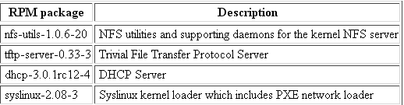
Pre-Requisite of RPM Software Packages
Since the setup of the SLIM server will need to provide NFS, TFTP and DHCP services, the following RPM software packages must be included with the Fedora Core 2 installation.
The following command queries if the package tftp-server-0.33-3 is installed. If positive, it will produce the package information; otherwise it will report that <package tftp-server-0.33-3 is not installed>. So you can check if all the above packages are installed or not.
root@localhost]# rpm -q -i tftp-server-0.33-3
In case that a package is missing, you can manually install it. You can find them on the Fedora Core 2 CDROM (under the directory Fedora/RPMS)
[root@localhost]# rpm -ih tftp-server-0.33-3.i386.rpm

Slide 3
Preparing the SLIM Server
Install the SLIM package
Building the Linux System Image
Building SLIM initrd
Setting Up the NFS Service
Setting Up the TFTP Service
Setting Up the PXE Boot Loader - pxelinux
Setting Up the DHCP Service

Slide 4
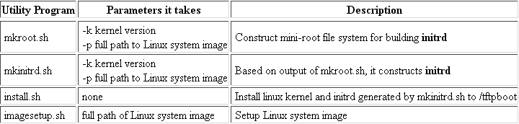
Install the SLIM package
Installation of the SLIM package is easy. Copy it from given floppy diskette or download it from the website https://intranet.cs.hku.hk/slim/, Then, unpack the gzip-tar ball to any directory you like. Usually, it is put under the root's home directory.
[root@localhost]# tar xvfz slim-v1.0e1.tar.gz
SLIM package contains the utility programs given on right side for the administrator.

Slide 5
Building the Linux System Image
Building the system image for exporting to SLIM client PCs is simply a task to duplicate the SLIM server's root file system in another partition or directory. In the example here, we put the OS image under the directory /linux/images/fc2.
Firstly, we find out what disk partitions Fedora Core 2 uses for the system.
[root@localhost]# df -F ext3
The output may look like the following.
Filesystem 1K-blocks Used Available Use% Mounted on
/dev/hda1 99292 42352 15623516 27% /boot
/dev/hda2 14745472 2404620 11591824 18% /
We see that the system uses "/" and "/boot".
The following command can replicate the system. It will take a short while to copy the system.
[root@localhost]# mkdir -p /linux/images/fc2 #make the directory
[root@localhost]# cp -x -a / /linux/images/fc2 #copy / And
[root@localhost]# cp -x -a /boot /linux/images/fc2 #copy /boot
Finally, under the SLIM installation directory we run
[root@localhost]]# cd slim-v1.0e1
[root@localhost slim-v1.0e1]# ./imagesetup.sh /linux/images/fc2

Slide 6
Building SLIM initrd
The kernel version of Fedore Core 2 is 2.6.5-1.358. The path to the OS image we have just setup is /linux/images/fc2. Then, we do
[root@localhost slim-v1.0e1]# ./mkroot.sh -k 2.6.5-1.358 -p /linux/images/fc2
[root@localhost slim-v1.0e1]# ./mkinitrd.sh -k 2.6.5-1.358 -p /linux/images/fc2
Install kernel and initrd to /tftpboot
[root@localhost slim-v1.0e1]# ./install.sh

Slide 7
Setting Up the NFS Service
To provide NFS service for exporting the shared OS image at /linux/images/fc2, copy the "exports" file in the SLIM installation directory to /etc
[root@localhost slim-v1.0e1]# cp -a samples/nfs/exports /etc
The contents of exports file look like the following.
/linux/images/fc2 10.0.1.0/255.255.255.0(ro,async,no_root_squash,no_subtree_check)
Then, restart the NFS services
[root@localhost slim-v1.0e1]# /etc/init.d/nfs restart
And make it auto-start after rebooting.
[root@localhost slim-v1.0e1]# chkconfig nfs on

Slide 8
Setting Up the TFTP Service
To enable the TFTP service, edit /etc/xinetd.d/tftp and set the "disable" property to "no"; then restart xinetd.
[root@localhost slim-v1.0e1]# /etc/init.d/xinetd restart

Slide 9
Setting Up the PXE Boot Loader - pxelinux
SLIM clients use the PXE protocol to boot the Linux kernel and the associated initrd. The boot loader must be setup properly. We use pxelinux.
Copy the config file and the PXE boot loader in the SLIM installation directory to /tftpboot
[root@localhost slim-v1.0e1]# cp -a samples/tftpboot/* /tftpboot
At this point, the /tftpboot has
/tftpboot/vmlinuz-2.6.5-1.358
/tftpboot/initrd-2.6.5-1.358
/tftpboot/pxelinux.0
/tftpboot/pxelinux.cfg
/tftpboot/pxelinux.cfg/0A0001
The name of the boot loader is "pxelinux.0".
A subdirectory named "pxelinux.cfg" under the tftpboot directory holds the config file for each network boot client PC.
The name of a config file is the hex number of the IP Address. It can be a subnet address or host address. For example, for all PCs in the private network of 10.0.1.0/255.255.255.0, the config file name will be 0A0001. For host address 10.0.1.1, the name will be 0A000101.
The contents of the config. file look like the following.
PROMPT 0
DEFAULT linux
LABEL linux
KERNEL vmlinuz-2.6.5-1.358
APPEND root=/dev/ram0 imageroot=10.0.1.254:/linux/images/fc2 initrd=initrd-2.6.5-1.358

Slide 10
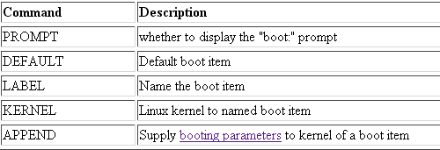
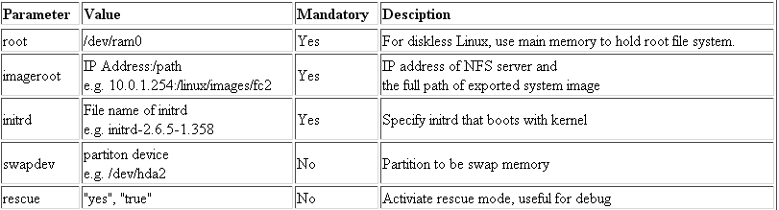
Setting Up the PXE Boot Loader - pxelinux
pxelinux has the following basic commands.
Booting Parameters
A booting parameter takes the form of parameter-name=parameter-value (no space between any parts). They are passed to the APPEND command of the pxelinux boot loader. They are summarized in the following table.

Slide 11
Setting Up the DHCP Service
To provide DHCP service, copy the dhcpd.conf from the SLIM installation directory to the /etc directory.
[root@localhost slim-v1.0e1]# cp -a samples/dhcpd/dhcpd.conf /etc
The contents of the dhcp config file look like the following.
Contd…..
allow booting;
allow bootp;
option domain-name "your.domain.com";
option domain-name-servers 10.0.1.254;
ddns-update-style none;
subnet 10.0.1.0 netmask 255.255.255.0 {
option routers 10.0.1.254;
option subnet-mask 255.255.255.0;
option broadcast-address 10.0.1.255;
default-lease-time 21600;
max-lease-time 43200;
get-lease-hostnames on; # if you want hostname from DNS
range dynamic-bootp 10.0.1.1 10.0.1.100;
next-server 10.0.1.254; # tftp server
filename "pxelinux.0";
}

Slide 12
Setting Up the DHCP Service
For examples,
10.0.1.251 node251
10.0.1.252 node252
10.0.1.253 node253
10.0.1.254 node254
Then, restart the DHCP service.
[root@localhost slim-v1.0e1]# /etc/init.d/dhcpd restart
And make it auto-start after rebooting.
[root@localhost slim-v1.0e1]# chkconfig dhcpd on

Slide 13
Preparing the Cluster Nodes
Usually this is done in BIOS setup by selecting the network interface as the boot device. For those network cards that do not have the built-in PXE feature, a PXE floppy boot disk can be constructed by using a Remote Boot Floppy Generator program named "rbfg.exe", which can be found in Windows 2003 or Windows 2000 Server version in the directory \windows\system32\dllcache or \winnt\ServicePackFiles\i386 respectively. Another alternative you may try can be found in the website http://registration.argontechnology.com/rbfg/.

Slide 14
Other Modules of Slim Server
Software Management and Applications Installation
User Accounts Management

Slide 15
The End
Any Question

