Slide 1

SLIM Server
( Single Linux Image Management Server )
A Solution to Large Size Networked Linux System Administration, Management and Deployment
Gaurav Paliwal
B.Tech ( Information Technology )
2nd Year University School of Information Technology

Slide 2
Introduction
Administering and managing large-size networked PC systems running Linux is very costly, difficult and time consuming.
Tasks such as software installation and upgrading, user account creation and post-system configuration, system backup, etc. are often a heavy burden.
From time to time, a new version of the kernel or patches to the kernel would call for many hours of hard work.
Unless there is a careful planning beforehand a machine cannot serve more than one operating system. An educational institution often needs a machine to be able to have more than one operating system installed in order to serve different kinds of students or projects.
To address these issues, the environment for networked Linux system called SLIM was introduced .

Slide 3
About Slim Server
SLIM stands for Single Linux Image Management.
The key concept of SLIM is to maintain a central server known as the SLIM Server. It holds a single Linux OS image to be shared by all the PCs via network booting or other light weight booting media (e.g. USB thumb drive, bootable floppy) to run Linux locally.
System administration and management is done on the SLIM Server. Since all client PCs shares the same Linux OS image, installation, administration and management follow the approach of "do-one- used-by-all".
SLIM follows the well-known client/server paradigm and combines distributed computing concept to form a powerful Linux platform. The major component is the SLIM server. The SLIM server holds one or more pre-installed Linux system images for sharing across the network. A system image is exported to all client PCs to build their local system during booting. One SLIM server may serve as many OS images as can be offered by different Linux distributions. Once the SLIM server is set up, any client PC can join the SLIM network without any complex preparation and can boot itself up as a full functional Linux System.
To allow client PCs to join the SLIM environment, a simple configuration procedure is needed in the SLIM server. A SLIM network may be formed by one or more TCP/IP subnets.
At the client side and while using network booting, the preparation may be just as simple as to activate the PXE network boot, to plug the network cable of the client PC to the SLIM network and to turn the power on. If client PCs do not support the PXE network interface, a PXE bootable floppy diskette can be used instead.
SLIM uses a stateless approach. On the server side, there is only one "single" OS file system, which is in contrast with other typical diskless solutions (also known as terminal service) where each client usually has its own OS file system on the server side to store client state information. In SLIM, OS software and applications run locally on the client sides rather than in the central server. Therefore the SLIM server does not need to run on a very powerful machine. With the stateless approach, it is much easier and cost effective to do centralized system administration and management

Slide 4
Application of SLIM Server
Since Linux is widely adopted and it has been used for different purposes. So SLIM is designed and implemented to address the need to following applications.
Build cluster system for parallel computing
  Blade cluster with thin nodes (Main board + NIC +Power Supply)
  Beowulf kind cluster with thick nodes (typical PC)
Typical Linux Desktop on local computer
  With local hard disk for caching system file, and storing data
Diskless Linux Workstation on local computer
  Make use of large main memory and use network storage.
  Without touching local hard disk, it allow PC installed other OS to run Linux.
Terminal Services
  X Terminal for inter-operation with other UNIX system
  Require very small of system resource (no hard disk and small among of memory).
Single Application Oriented Appliance
  Good for computers installed at public area likes mall, lobby, reception, information centre, pantry.
  e.g.. Web browsing terminal, remote desktop viewers such as VNC Client, map/directory service programs in mall.

Slide 5
Technical Background
Before to understand SLIM implementation, booting process of Linux system must be explained. And network-booting technology is needed to discuss since SLIM leverages the merit of network boot technology :
Booting Process
Network Boot Technology

Slide 6
Booting Process
Normally when a PC is turned on. The BIOS code is first part to be executed. It does the POST to initialize system hardware. Then the boot strap program of the BIOS loads the first sector of the booting device. While the booting device is hard disk, the first sector is the MBR (Master Boot Record). If it is a floppy diskette, it is the boot sector. The sector contains a tiny program, which is not more than 512 bytes. This tiny program either a boot manager, a boot loader and may be simply a boot up program part of the OS Kernel itself. Examples of these programs are LILO, grub, and syslinux. They are commonly termed as boot loader. After the execution of BIOS codes, the boot loader will take over the next step of booting. It may have one or more stages of execution in order to provide a selection menu, display message, getting kernel parameter from user, and etc.
The final step of boot loader is to load kernel image. The components required to boot up Linux includes the kernel image and initial ramdisk known as initrd. The initrd is optional. The usage of initrd is to load additional device drivers before the whole system can start up. For example, initrd in Red Hat Linux is to load device driver for SCSI and RAID controller. And it is needed when device driver is too big to compile into kernel image. After the loader load kernel image, it jumps to start point of kernel At this stage, it is kernel to start the initialization of different subsystems such as memory management, networking, buffering, I/O management and etc. Then kernel will mount the root file system on media like hard disk. The device holding root file system can be passed as parameter by the boot loader to the kernel.
Follows that kernel executes the "init" program on the root file system. But there is en exception when initrd is used. A program known as "linuxrc" on initrd will be executed before it mounts root file system and run the init program. The "linuxrc" can be any kind program. It may be shell script or a binary program for a particular purpose.
The task of init program is to initialize system components. It makes activate of network interfaces. It starts the running of the daemon processes. Examples of daemon processes are sendmail , NFS server, NIS and etc. Then it starts the terminal login prompt or graphical login dialog box. Now the whole Linux system is ready. This ends the booting process.

Slide 7
Network Boot Technology
Common booting devices are hard disk, CDROM and floppy diskette. All PC BIOS support them. Latest BIOS will allow USB device and network interface card as the primary booting device. Using the network interface card for booting is known as network boot. Different technologies are proposed on this area. EtherBoot creates boot strap program image, which is burned into ROM/EPROM to plug on socket of Ethernet network interface. A customized boot image is needed to prepare by the supplied utilities program in order for EtherBoot to load and execute. This boot image may be the combination of kernel and initrd or simply the Linux kernel itself. Netboot is another approach. Differently it uses standard DOS drivers (either Packet or NDIS-2) rather need to develop the network interface driver in the case likes EtherBoot. For similarity, the "netbootable" image is needed to prepare with the utility program with the NetBoot package. Another approach is PXE (Preboot Execution Environment). It is new standard proposed by Intel for Intel Wired for Management. As PXE is widely accepted and supported, it is network technology used in SLIM.
PXE provides varies of network connection to servers prior to loading an OS. A number of standard IP protocols such as DHCP and TFTP are support in PXE network connection. Almost latest PC system integrated with NIC in market supports PXE. For Linux, the common boot loader use with PXE is pxelinux, which is a variant of syslinux. Differently to Netboot, EtherBoot, pxelinux does not have initial boot strap code that is supposed to be part of PXE network code. The pxelinux simply communicates with PXE boot code.
Typical network boot sequence is simple. Firstly codes (PXE, Netboot, EtherBoot) in ROM of network interface contacts BOOTP/DHCP server to allocate an IP address. Then it obtains the location of the boot image. Next it uses TFTP to download the boot image, and finally jump to execution point of the boot image.

Slide 8
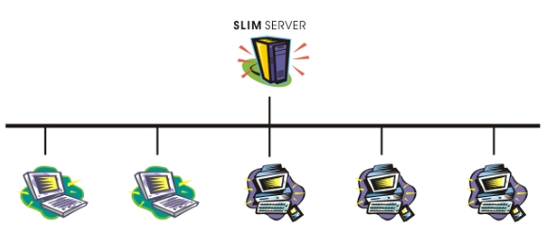
SLIM Server Component
The major component is the SLIM server. The SLIM server holds pre-installed Linux system image for sharing across the network. The system image is exported as read only by the NFS to all client PC to build the their local root file system during booting up. One SLIM server may serve as many as OS images made by different Linux distributions. It also provides TFTP service to allow client PC to download network boot loader. It also holds OS boot images which are Linux kernel and initrd for network boot loader to download.
A DHCP server is also required for network boot configuration. It assigns IP addresses to client PCs. It also provides the IP address of the SLIM server, thus client PC can download all boot up files, and use the shared system image. However, it is not restricted that DHCP server needed to be a different machine. A common deployment case may use singe server grade machine to serve as SLIM server and also provide DHCP service

Slide 9
How it works
Each client PC is configured to enable PXE network boot. It send out DHCP requests. DHCP server responds with assigned IP addresses and the IP address of SLIM server to the client PC. Client PC download the network boot loader for SLIM server, and initiate the boot loader. The boot loader retrieves the kernel and initrd for boot up a Linux system.

Slide 10
Implementation
Implementation of SLIM basically involves development of customized program. It also involves the integration of legacy software's such as NFS, TFTP and DHCP. This software are available free and can be found on any Linux distribution in market. We employ PXE network boot technology and pxelinux network boot loader for booting up client PC. We develop programs which are formed the customized initrd (known as SLIM loader). We also write utility program to make the setup and configuration of SLIM environment easily.
As the target in mind is to use single sharable Linux system image among PC clients with good performance. Mechanism for exporting the system image and importing the image is the key to the success. We use NFS with the best optimization to export the image, customize the initrd to perform the importing and building root file system by exploring local disk as the cache for part of system image from NFS server.
Set up of NFS service is easy, but some performance options for NFS is important. They are worth to mention. In this section we also describe the functionality of customized initrd. It plays a crucial role for client PC to boot up as full function Linux system.
Contd….

Slide 11
Implementation (Contd..)
The SLIM loader basically is the image of a mini root file system with associated programs. It is the implementation of initrd used in booting process. And the programs do following tasks.
Loads driver modules
Activates the network interface, starts the dhcp request to allocate an IP address.
Mounts the Linux system image from SLIM server.
Builds the local file system from mounted Linux system image.
Performs pre-init configuration
Switches to the file system on local storage media as root file system.
Starts the init program to carry out normal system initialization.
Contd….

Slide 12
Implementation (Contd..)
Building the file system on local storage media is very crucial because it directly affect the start up of each client PC in SLIM. To speed up this stage, the files duplicated from the OS image to local hard disk is cached. That's after the first boot up, the subsequence boot up will not need to do the file duplication unless the copy in SLIM server is update than the one found in local hard. This strategy is greatly reduce the client system boot time .
Mounting system image from the SLIM server is another critical point. The NFS options for client PC to mount system image are as following. As the exported system image is read only. The buffer caching at file system level can further increase the over system performance while client PC booted up. Next Slide shows the options.
Contd..

Slide 13
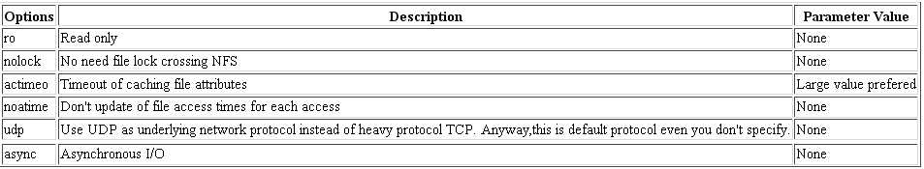
Implementation (Contd..)

Slide 14
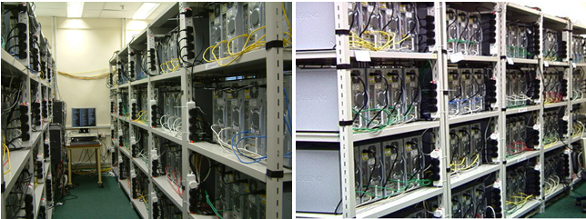
Parallel Computing
The Gideon 300 Cluster consists of 300 dedicated Pentium 4 2.0 GHz PCs running Linux Operating System. It is a high-performance cluster computer built by the Systems Research Group (SRG) of the Department of Computer Science and Information Systems. The construction of the cluster started in early-October 2003 and became fully operational in mid-October 2003. The Gideon 300 Cluster is used to conduct research at HKU on new classes problems that are only solvable using a high degree of parallelism and supercomputing power. It is ranked #175 on the latest TOP500 Supercomputers. It explores SLIM environment to administrate and manage 300 hundred cluster nodes. There is no need to manually install Linux on 300 machines. The SLIM environment applied here includes 3 SLIM servers across two physical Ethernet network.

Slide 15
Try out the Practical Implementation
Any questions ……………..

