Slide 1
flappyBird

Slide 2


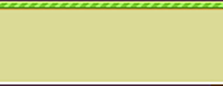
Flappy Bird project by Team Undefined
Gaurav Pandey
Bibek Thapa
Suman Kunwar
Kumar Dotel
Ramesh Rawat
Aryan Pokhrel

Slide 3
Demo

Slide 4
C++
SFML ( Simple and Fast Multimedia Library)
https://www.sfml-dev.org/

Slide 5
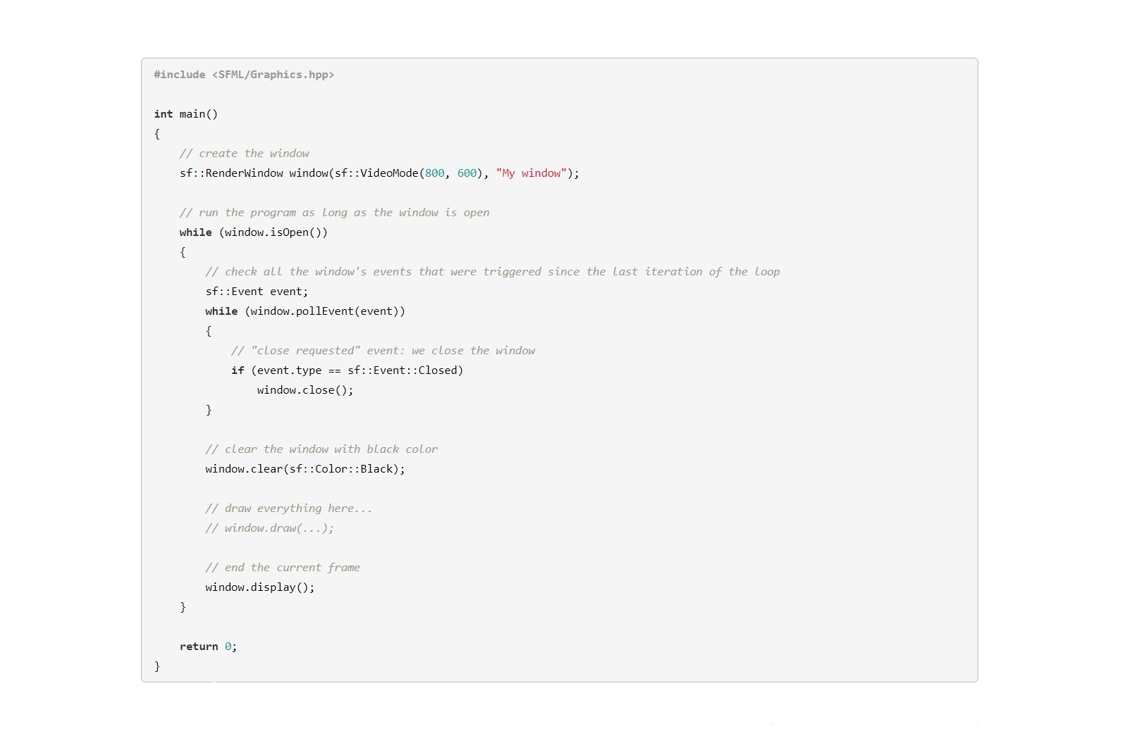

Slide 6
2D-Game Logic
Define Sprites - Bird & Pipes
while(1){
Clear Screen
Draw Sprites on Screen // based on coordinates
Update Sprites // May be Based on Events, Collision
}

Slide 7
Let’s UnderStand Flappy Bird

Slide 8
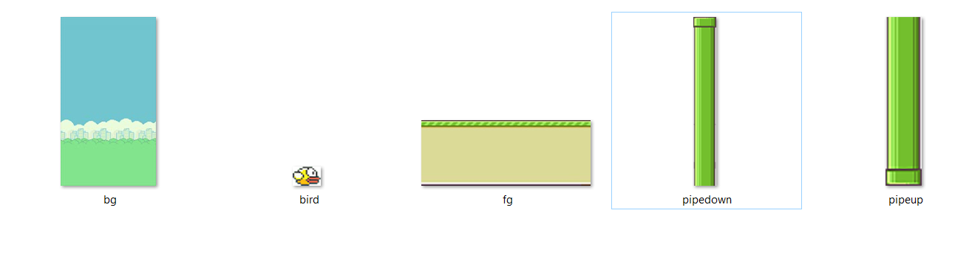
Sprites are Images :)
So We load them in very first line of our code

Slide 9
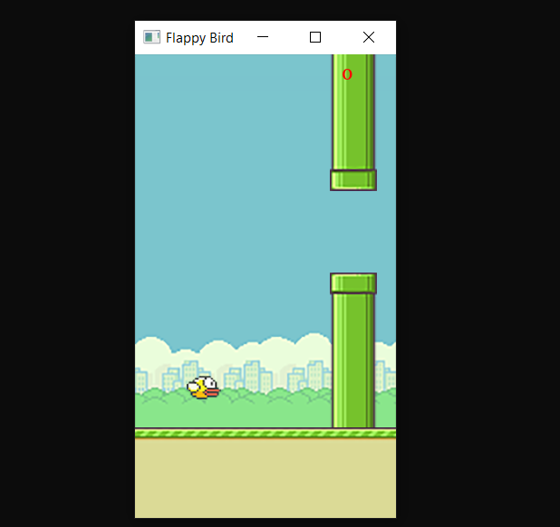
1.Background
2.pipes
3.Bird
4.Footer Background

Slide 10
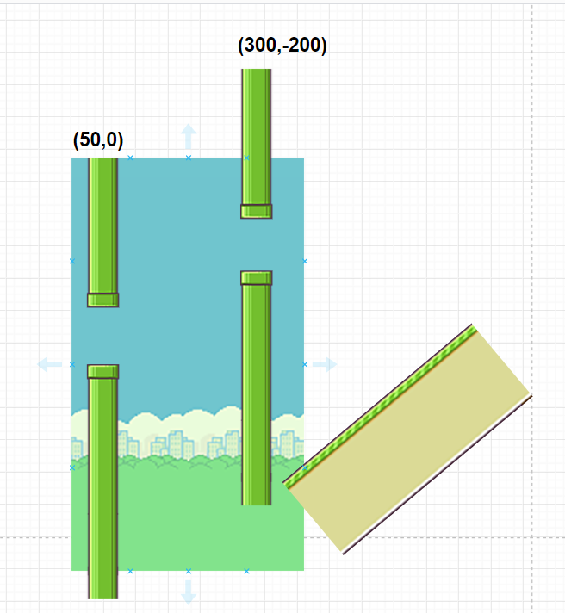
Drawing Pipes
X is continuously decreasing from WIDTH to Zero
Y is generated randomly from 0 t0 -260 for each cycle.
There are only two pipes in game.
Smart Drawing :)
Image made with https://draw.io

Slide 11
Drawing Bird
bird.move(0,(float) 2.3); //every time
case Keyboard::Space: //if space is pressed
bird.move(0, -23);

Slide 12
Collisions
if (bird.getGlobalBounds().intersects(pipeNorth.getGlobalBounds()) ||
bird.getGlobalBounds().intersects(pipeSouth.getGlobalBounds()) ||
bird.getGlobalBounds().intersects(floor.getGlobalBounds()))
{
isGameOver = true;
}

Slide 13
Play Again
isWindowOpen {
isGameStart{ starting template } // event breaks this loop
isGameOver { Actual Game } //event breaks this loop
Event to restart Game // isGameOver = true
}

Slide 14
Let’s Discover Real Code

Slide 15
Thank You

