Slide 1
IILM UNIVERSITY
School of Computer Science & Engineering
Blockchain Development
& Web3 Integration
Gaurav Pandey
Roll No: 25SCS1003002339
Section: 2CSE15
Session: 2025 – 2029
Blockchain Developer Internship Training Report
B.Tech – Computer Science & Engineering
INTERNSHIP DURATION
June 2026 – August 2026 (92 Days)

Slide 2
Candidate & Program Overview
Candidate Details
Internship Profile
STUDENT NAME
PROGRAM NAME
GAURAV PANDEY
BlockseBlock Blockchain Developer Internship
ROLL NUMBER
25SCS1003002339
SPECIALIZATION DOMAIN
Blockchain Development & Web3 Integration
SECTION
2CSE15
ROLE
Blockchain Developer Intern
DEGREE
B.Tech (Computer Science & Engineering)
DURATION
ACADEMIC SESSION
92 Days (1 Jun 2026 – 31 Aug 2026)
2025 – 2029
UNIVERSITY
ISSUING ORGANIZATION
IILM University
BlockseBlock (www.blockseblock.com)
BlockseBlock Internship Report | Gaurav Pandey
2

Slide 3
Organization Profile: BlockseBlock
BlockseBlock is a blockchain-focused technology and training organization offering hands-on internship programs in decentralized technologies, operating under the vision of building industry-ready blockchain talent.
1
2
3
Practical Training Model
Industry Alignment
Core Focus Domains
Delivers project-based internship tracks focused on real-world blockchain development rather than theory alone.
Structures its curriculum around in-demand decentralized technology skills sought by Web3 employers.
Blockchain fundamentals, Smart Contracts, Decentralized Applications (DApps), and Web3 integration.
Contact: associations@blockseblock.com | +91 89682-32722 | www.blockseblock.com
BlockseBlock Internship Report | Gaurav Pandey
3

Slide 4
Problem Statement & Industry Context
The Industry Challenge
The Solution Scope
While academic curriculum introduces core programming and data structures, students rarely get hands-on exposure to decentralized systems, cryptographic protocols, or how blockchain networks reach consensus without a central authority.
This internship covers the practical lifecycle of blockchain development: distributed ledger fundamentals, writing and testing smart contracts, connecting front-end applications via Web3 libraries, and deploying decentralized applications to live test networks.
BlockseBlock Internship Report | Gaurav Pandey
4

Slide 5
Core Project Objectives
1
2
3
4
Blockchain Fundamentals
Smart Contract Development
Web3 Integration
DApp Deployment
Understand distributed ledgers, consensus mechanisms, and cryptographic principles underpinning blockchain networks.
Write, test, and deploy Solidity smart contracts covering tokens, access control, and business logic.
Connect front-end applications to blockchain networks using Web3.js / Ethers.js and wallet providers.
Deploy and verify decentralized applications on Ethereum test networks using Hardhat and Remix IDE.
BlockseBlock Internship Report | Gaurav Pandey
5

Slide 6
Technologies & Blockchain Toolchain
Languages & Contracts
Web3 Libraries
Dev & Testing Tools
Networks & Storage
Solidity (Smart Contracts)
Python
JavaScript
Web3.js
Ethers.js
MetaMask Wallet API
Remix IDE
Hardhat
Truffle & Ganache
Ethereum Test Networks
OpenZeppelin Contracts
IPFS Decentralized Storage
BlockseBlock Internship Report | Gaurav Pandey
6

Slide 7
Blockchain Architecture Overview
Blockchain Layer
Distributed ledger maintained by network nodes reaching consensus on transaction validity.
Smart Contract Layer
Solidity contracts encoding business logic, deployed immutably on-chain.
Web3 Integration Layer
Web3.js / Ethers.js bridging front-end applications with the blockchain network.
Application (DApp) Layer
User-facing interface enabling wallet-based interaction with smart contracts.
Wallet & Security Layer
MetaMask-based key management and transaction signing for end users.
BlockseBlock Internship Report | Gaurav Pandey
7

Slide 8
Curriculum Timeline (Weeks 1 to 4)
WEEK 1
WEEK 3
Blockchain Fundamentals
Testing & Security
Distributed ledgers, consensus algorithms, cryptographic hashing.
Unit testing with Hardhat and common vulnerability patterns.
WEEK 2
WEEK 4
Solidity & Smart Contracts
Web3.js & Ethers.js
Syntax, data types, functions, and deployment basics.
Connecting DApps to the Ethereum network and wallets.
BlockseBlock Internship Report | Gaurav Pandey
8

Slide 9
Curriculum Timeline (Weeks 5 to 8)
WEEK 5
WEEK 7
DApp Frontend Integration
Testnet Deployment
React front-end wired to contracts via Web3 providers.
Deploying and verifying contracts on Ethereum testnets.
WEEK 6
WEEK 8
Decentralized Storage
Capstone Project
Storing files off-chain with IPFS and linking on-chain.
End-to-end DApp build, integration, and final deployment.
BlockseBlock Internship Report | Gaurav Pandey
9

Slide 10
Key Projects & Demonstrated Skills
Smart Contract Development:
Designed and deployed ERC-20 and ERC-721 token contracts in Solidity, following secure coding patterns.
Decentralized Application (DApp):
Built an end-to-end DApp connecting a Web3 front-end to on-chain smart contract logic.
Wallet Integration:
Implemented MetaMask wallet connectivity for user authentication and transaction signing.
Testnet Deployment & Verification:
Deployed and verified smart contracts on Ethereum test networks using Hardhat.
Smart Contract Security:
Applied security best practices to guard against common vulnerabilities such as reentrancy.
BlockseBlock Internship Report | Gaurav Pandey
10

Slide 11
Certification & Official Verification
Verification Metric | Official Record / Credential Details
Internship Title | Blockchain Developer Internship
Issuing Organization | BlockseBlock
Role | Blockchain Developer Intern
Duration | 1 June 2026 – 31 August 2026 (92 Days)
Candidate | Gaurav Pandey (Roll No: 25SCS1003002339, Section: 2CSE15)
Contact | associations@blockseblock.com | 89682-32722
BlockseBlock Internship Report | Gaurav Pandey
11

Slide 12
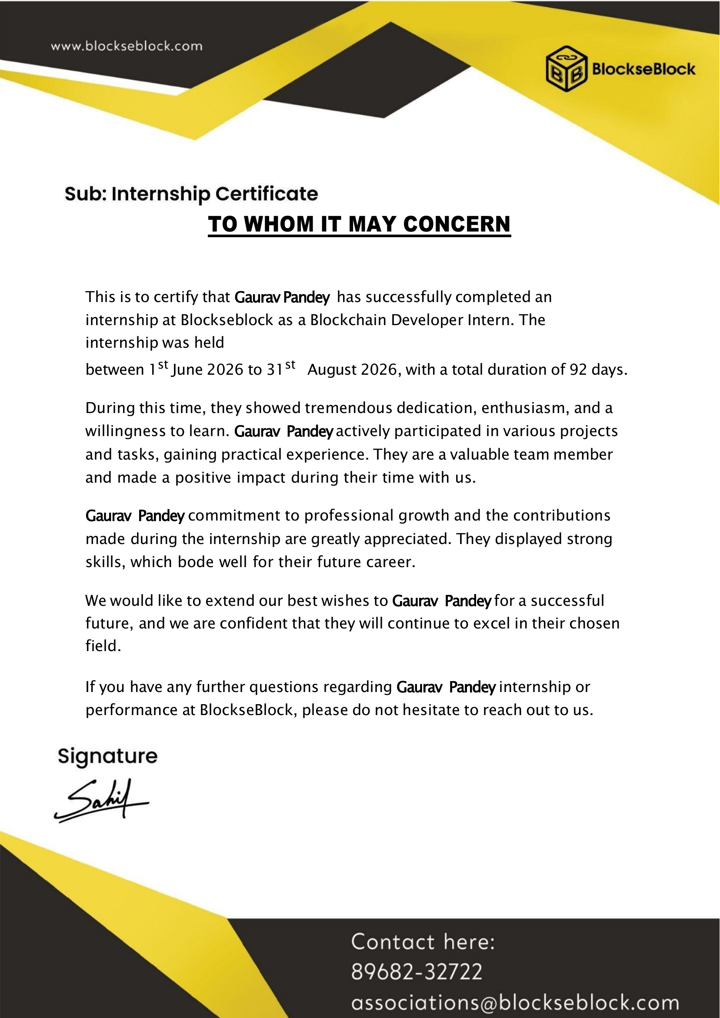
Internship Completion Certificate
BlockseBlock Internship Report | Gaurav Pandey
12

Slide 13
Thank You!
Gaurav Pandey
School of Computer Science &
Engineering
Roll No: 25SCS1003002339
IILM University
Session: 2025 – 2029
Section: 2CSE15

