Slide 1

INSE 6180 : Security & Privacy Implications of Data Mining
Implementation of An Intelligent Question Answering Conversational Agent (Chatbot) using RNN Algorithms
Submitted By :
Samir Anghan – 40040308
Naresh Dudhat – 40043135
Hirangi Naik – 40041365
Gaurav Parvadiya – 40040310
Submitted To :
Prof. Nizar Bouguila

Slide 2
Outline
Introduction
Environment & Dataset
Data Preprocessing
Sequence to Sequence Model
RNN(Recurrent Neural Network) Algorithm
Output
Conclusion
References

Slide 3

Introduction
Intelligent Question answering (QA) is the study on the methodology that returns exact answers to natural language questions.
Objective of our project is to build a model that predicts the "Answer Sequence" from "Question Sequence”.

Slide 4
Continue…
Data Mining Process | Detail
Data Pre-Processing | MovieLines.txt MovieConversations.txt
Feature Extraction | Dictionary for the frequency of the Words
Model Selection | Sequence to Sequence Model using RNN
Evaluation | User’s input -> Bot’s Prediction
Post-processing | WordId -> Word

Slide 5
Environment & Dataset
Environment :
Python 3.5
Tensorflow 1.0.0
All experiments are under environment of OS X10.13@64bit, Intel Core i7 CPU@2.7GHz, 16GB RAM@2133MHz, 512GB SSD hard disk.
Dataset :
Movie-Dialogs Corpus by Cornell University
https://www.cs.cornell.edu/~cristian/Cornell_Movie-Dialogs_Corpus.html

Slide 6
Continue…
Dataset File Name | Fields
MovieLines.txt | lineID characterID (who uttered this phrase) movieID character name text of the utterance
MovieConversations.txt | UserId1 UserId2 MovieId Conversation Array

Slide 7
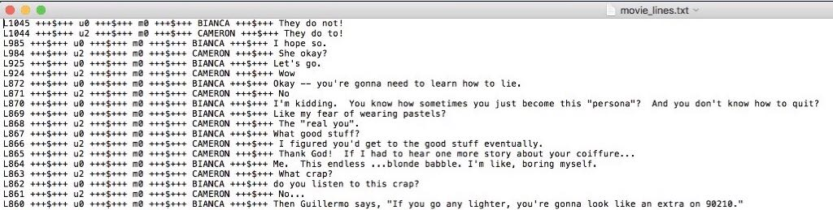
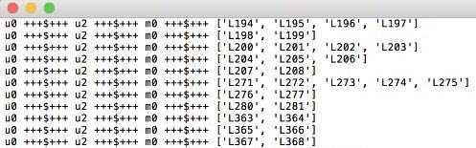
Continue…

Slide 8


Data Preprocessing
Map LineID -> Conversation Line
Build Questions &
Answer array

Slide 9

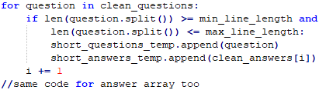
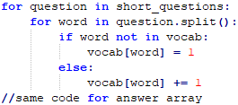

Data
Cleaning
Remove unnecessary characters and altering the format of words
Remove questions and answers that are < 2 words and > 20 words
Create a dictionary for the frequency of the vocabulary
Remove rare
words

Slide 10



Create dictionaries to provide a unique integer for each word
Add the unique tokens to the vocabulary dictionaries
Create inverse
dictionary

Slide 11
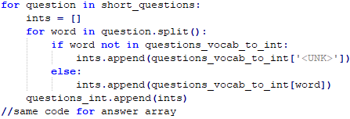

Replace any words that are not in the respective vocabulary with <UNK>
Sort questions and answers by the length of questions.

Slide 12
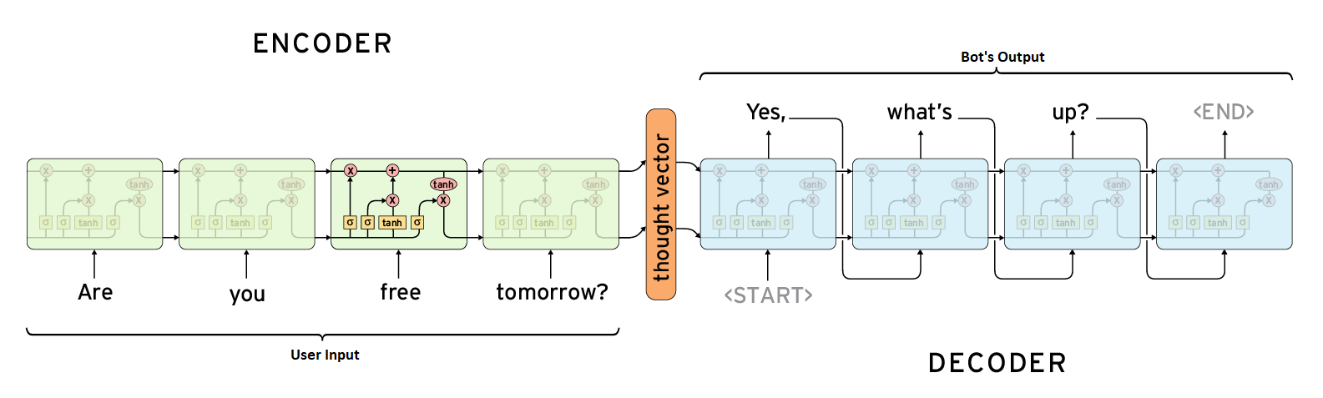
Sequence to Sequence Model
The Sequence to Sequence model (seq2seq) consists of two RNNs - an encoder and a decoder.
Each box in the picture above represents a cell of the RNN, a LSTM cell.
The Encoder - reads the input sequence, word by word and emits a context.
The Decoder - generates the output sequence, one word at a time while looking at the context and the previous word during each time step.
Seq2seq model usually reserve the spots for these elements: <PAD>, <EOS>, <UNK>, <GO>.

Slide 13
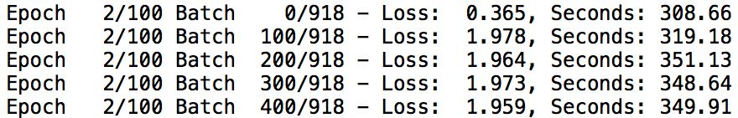
Continue…
Batching
Batches allow us to run a model more efficiently due to scaling by increasing the amount of data you give the model each iteration.
Input : Dictionary of Questions
Dictionary of Answers
Batch Size (here we are using 128)
Output : Divide dataset in given batch size.

Slide 14
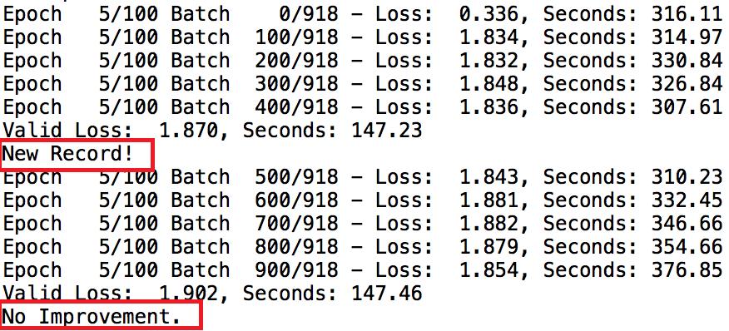
Continue…
Training the Model
We are using 15% of data for validating the training.
Check training loss after every 100 batches
If the validation loss does decrease in 5 consecutive checks, stop training

Slide 15
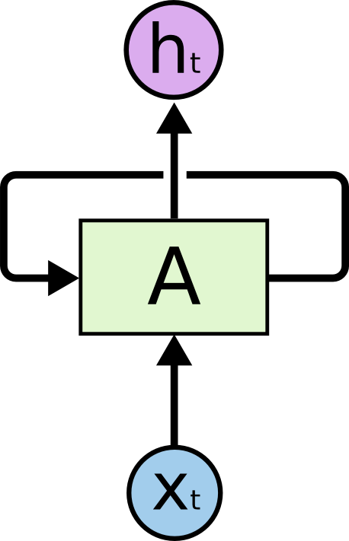
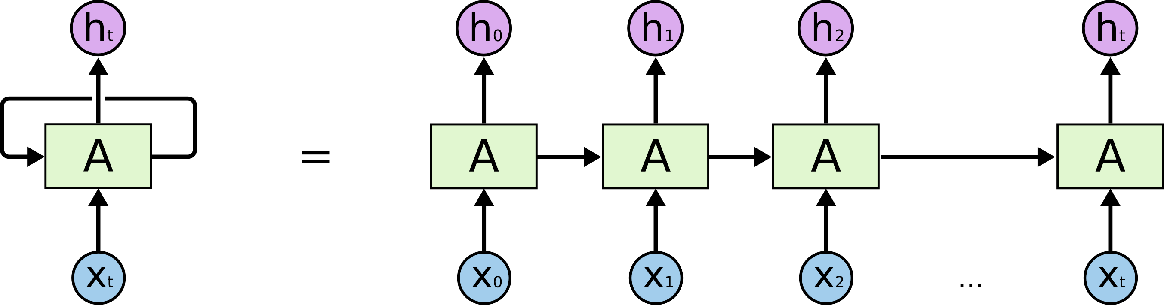
RNN Algorithm
The idea behind RNNs is to make use of sequential information.
RNNs are called recurrent because they perform the same task for every element of a sequence, with the output being depended on the previous computations.
A = a chunk of neural network, x_{t} = Input, h_{t} = Output

Slide 16
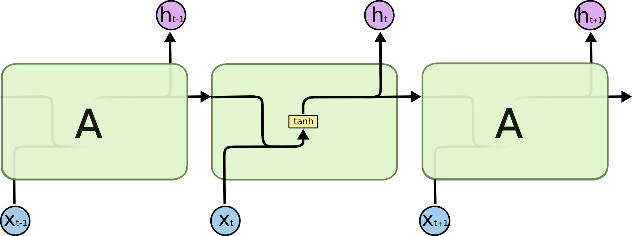

Continue…
The naive version of RNN, is typically called a Vanilla RNN, which is pretty pathetic in remembering long sequences.
The main problem with basic version of RNN is the Problem of Long-Term Dependencies.
In Chatbot, It’s entirely possible for the gap between the relevant information and the point where it is needed to become very large.
So we have used a special kind of RNN called – LSTM (Long Short Term Memory networks).

Slide 17

Continue…
LSTMs are explicitly designed to avoid the long-term dependency problem.
Instead of having a single neural network layer, there are four, interacting in a very special way.
An LSTM cell consists of multiple gates, for remembering useful information, forgetting unnecessary information and carefully exposing information at each time step.

Slide 18
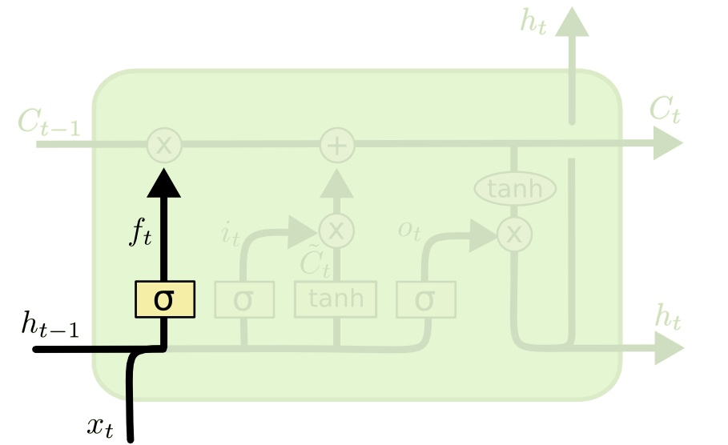
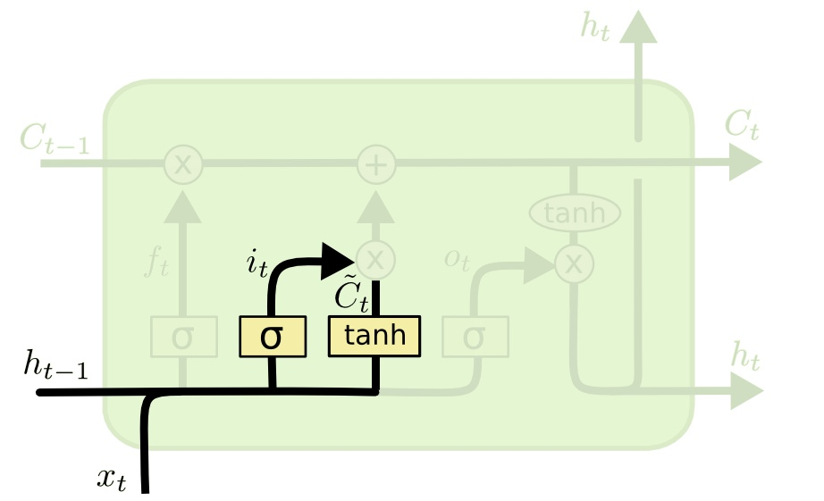
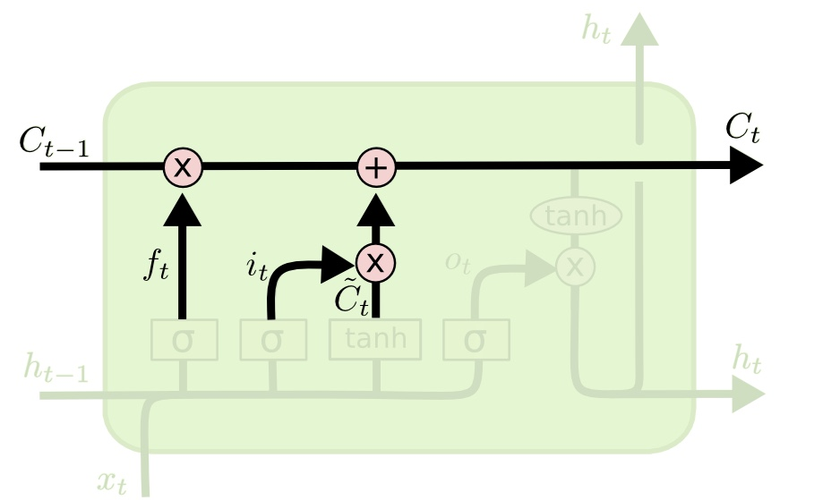
Continue…
Layer 1: The first step in our LSTM is to decide what information we’re going to throw away from the cell state. This decision is made by a sigmoid layer called the “forget gate layer.” It looks at h_{t-1} and x_{t}, and outputs a number between 0 and 1 for each number in the cell state C_{t−1}. A 1 represents “completely keep this” while a 0 represents “completely get rid of this.”
Layer 2: The next step is to decide what new information we’re going to store in the cell state. This has two parts.
Step : 1 Step : 2

Slide 19
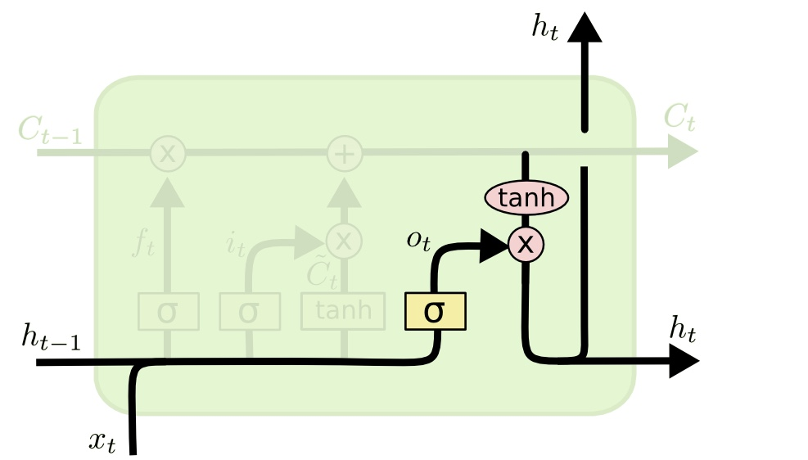
Continue…
Layer 3: Finally, we need to decide what we’re going to output.
First, we run a sigmoid layer which decides what parts of the cell state we’re going to output.
Then, we put the cell state through tanh, so that we only output the parts we decided to.

Slide 20
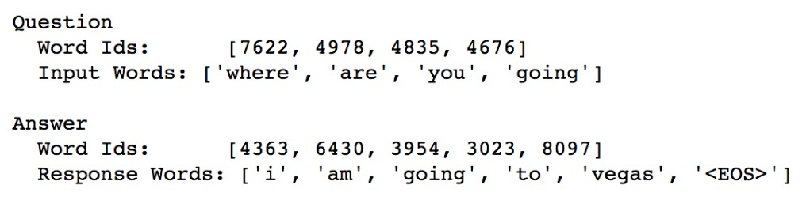
Output

Slide 21
Conclusion
Seq2Seq is the most diverse model used and the best fitted model for Chatbot.
The input is often reversed. This helps a model to produce better outputs because when the input data is being fed into the model, the start of the sequence will now become closer to the start of the output sequence.
LSTM version of RNN is best fitted for Larger Distance Problems that usually Chatbot faces.

Slide 22
References
https://arxiv.org/pdf/1409.3215.pdf
https://tutorials.botsfloor.com/how-to-build-your-first-chatbot-c84495d4622d
https://deeplearning4j.org/lstm.html
https://acolyer.org/2016/06/02/sequence-to-sequence-learning-with-neural-networks/
https://towardsdatascience.com/sequence-to-sequence-model-introduction-and-concepts-44d9b41cd42d

Slide 23
Thank You Any Questions?

