Slide 1
Short Solutions for Large Rubik’s Cubes and Squares
Eight solvers on one open engine, from exact search to a competition solver
Gaurav Rai · Kashvi Tak · Sharanya Gupta · Shaurya Sharma · Shree Gattani · Sunaina Goel
Notes:
Introduce the team and the one-line pitch: we compare eight solvers for Rubik’s Cubes and Squares of every size on one engine; our symmetry portfolio, SymPort, beats the best published competition solutions on average up to 7×7×7, and we show why it stops winning beyond.

Slide 2
Given any scrambled N×N×N cube or N×N×1 Square, return a short move sequence that solves it
PROBLEM STATEMENT
e^Θ(N²)
NP-complete
Θ(N²/log N)
states, only Θ(N) moves
to solve optimally
God’s number
A 20×20×20 has 2,400 stickers, 9 wing and 81 center clusters, all to be solved.
Deciding if a cube can be solved in k moves is hard (Demaine, Eisenstat, Rudoy 2018).
Known exactly only for N = 3: 20 face turns, 26 quarter turns.
Learned solvers stop at N = 5. The best large-cube solutions come from a programming competition, Kaggle Santa 2023.
Notes:
Set up the problem: the state space explodes with N, optimal solving is NP-complete, and the true worst case is known only for the 3×3×3. On the learned side, nothing reports beyond 5×5×5; the strongest large-cube solutions are from team KMCoders in Kaggle’s Santa 2023 competition.

Slide 3
Four questions, answered on common ground
WHAT WE ASK
1
What does it take to cover every size, for both the cube and the Square?
2
Which approach gives the shortest solutions at each size?
3
Can any method beat the published competition solutions?
4
How far is everything from optimal?
Same seeded random states and the same Santa 2023 puzzles for every method. Every number is generated by script from result files.
Notes:
These four questions structure the talk. Stress the fairness: one engine, one harness that re-applies and verifies every solution, the same instances for every method.

Slide 4
Three new methods, a bound and an open engine
OUR CONTRIBUTIONS
SymPort
Symmetry portfolio, our main method: best at every Square size and at Santa cube sizes 4–7
NetGain
Net-gain scheduling of bulk commutators: strongest single solver at large N
OneNet
One cluster-token transformer that solves Square sizes it never saw
Counting bound
How far from optimal, for every N, calibrated on new exact God’s numbers
Open engine
Both puzzles, every N, a verifying harness and an exact Santa 2023 adapter
Plus 5 reproductions of known methods and 3 external baselines, all run through the same harness.
Notes:
Walk through the five contributions. SymPort is the headline: around KMCoders’ own program it beats their published best-of-many solutions on average at every Santa size up to 7×7×7, and is second to them at 8×8×8 and 9×9×9. NetGain wins on random large cubes. OneNet is the size-general learned model. The bound tells us how much room is left. Everything is released.

Slide 5
Two puzzles, one structure: clusters
BACKGROUND
N×N×N Rubik’s Cube
N×N×1 Rubik’s Square
Clusters
6N² stickers, 3N slices. A quarter, half or three-quarter turn of one slice is one move: 9N moves.
An N×N grid. Each of its 2N moves flips one row or column by 180°. Row flips commute with row flips.
A cubie only ever moves within its own cluster. Solving the puzzle means solving every cluster.
HTM
QTM
Goal
any turn of one slice counts 1 (random states)
a half turn counts 2; this is the Santa 2023 score
random: any solved orientation; Santa: one exact state
Notes:
Introduce the Square as Demaine et al.’s flat relative of the cube: it shares the cluster structure but is small enough that we can compute exact answers. Explain clusters, since every method later works cluster by cluster. Mention the two metrics: random-state results in HTM, Santa results in QTM, which is exactly the competition score.

Slide 6
Four lines of work we build on
RELATED WORK
Optimal 3×3×3
Large cubes
Korf’s IDA* with pattern databases; Kociemba’s two-phase algorithm; Rokicki’s nxopt.
Reduction (centers, edges, then a 3×3×3). Demaine et al.: one shared move sequence fixes many clusters, Θ(N²/log N).
Learned solvers
Santa 2023 · KMCoders
DeepCubeA and CayleyPy: one network per size on the full sticker array, up to 5×5×5.
Annealing, then commutators and 3-cycles inserted anywhere in the sequence. Best of many runs; a 33×33×33 in 4,719 QTM.
Notes:
Keep this short: these are the four families we reproduce or build on. The key gap: learned solvers are per-size and stop at N = 5, Demaine’s algorithm is asymptotic, and the competition solutions are best-of-many runs of a heavily tuned program.

Slide 7
One engine for both puzzles and every N
SYSTEMS · THE ENGINE
Moves from geometry
N-invariant clusters
Pure 3-cycles
Rotate one slab by an integer matrix; the result is a sticker permutation.
Found by union-find. The same cluster type has the same signature at every N.
All 4,048 per cluster, generated automatically from commutators and setups.
Canonical form
Solvability checker
Verifying harness
Commuting same-axis moves merged; also prunes search.
Colour counts, parities and exact cluster tables.
Re-applies every solution, external programs included; a crash counts as a failure.
Notes:
The engine is what makes the comparison fair. Everything is generic over cuboid dimensions, so the cube and the Square come from the same code. The harness never trusts a solver: it replays the moves and decides solved itself. External programs (KMCoders, dwalton76, nxopt) run behind the same interface.

Slide 8
Eight solvers and three baselines
SYSTEMS
Name | Kind | What it is | Puzzles
IDA*-PDB | reproduction | Korf’s optimal search with pattern databases | Square N ≤ 5
Reduction | reproduction | centers, wings, then Kociemba’s two-phase | both, N ≤ 20
Demaine | reproduction | parallel cluster algorithm, batched 3-cycles | both, N ≤ 20
CayleyPy | reproduction | per-size network + wide beam search | Square N ≤ 8
KMC-Repro | reproduction | KMCoders’ pipeline rebuilt from its write-up | Santa cubes
OneNet | new | one cluster-token network for every size | Square N ≤ 14
NetGain | new | net-gain scheduling of bulk commutators | both, N ≤ 20
SymPort | new · main | symmetry portfolio around a deterministic solver | Santa cubes, Square
KMC-published | baseline | KMCoders’ published best-of-many solutions | Santa cubes
KMC-one run | baseline | one run of KMCoders’ own program | Santa cubes
dwalton76 | baseline | open NxNxN reduction solver | Santa cubes
Notes:
One slide for the whole cast. The five reproductions are our own implementations of published methods; the three new methods are highlighted; the three baselines are other people’s code or solutions run unchanged through our harness. KMC-Repro is useful because comparing it with KMCoders’ real program shows what their write-up leaves out.

Slide 9
IDA*-PDB: exact search with pattern databases
SYSTEMS · REPRODUCTION 1 OF 5
How it works
ORIGIN
Korf’s optimal 3×3×3 solver (1997), with Culberson and Schaeffer’s pattern databases
IN OUR RUNS
Optimal on all random Squares up to 5×5×1 (13 s each); 0/10 at N = 6. Solves 91/100 twelve-move 3×3×3 scrambles, no random 3×3×3 in 30 min.
Pattern databases by breadth-first search: 8 corners (88.2M entries) and two sets of 6 edges (42.6M each)
Heuristic = max of the three lookups: admissible and consistent
IDA* with canonical move pruning, in Numba: 1.2·10⁷ nodes/s on 4 cores
Square: max over clusters of each cluster’s exact distance
Breadth-first search over all states gives God’s numbers for N ≤ 5
Notes:
The exact baseline. It gives us the true optimum on small Squares, which is what every other method is measured against in Table 7, and the God’s numbers that calibrate the counting bound. The database sizes match Korf’s exactly; our reproduction is correct but not fast enough for random 3×3×3 states on four cores.

Slide 10
Reduction: shrink the cube to a 3×3×3
SYSTEMS · REPRODUCTION 2 OF 5
How it works
ORIGIN
The standard method for big cubes, used by humans and by solvers like dwalton76
COST
Θ(N²) moves; each 3-cycle fixes O(1) pieces. Seconds to minutes at 20×20×20.
IN OUR RUNS
Longest of the cluster methods: 1,885 HTM on a random 10×10×10.
Wing parity: one inner-slice quarter turn per odd wing cluster
Centers: pure 3-cycles, greedily, the one fixing the most pieces per move
3×3×3 stage: corners, middle edges and fixed centers by Kociemba’s two-phase
Wings: pure 3-cycles, greedily
Square: frame exactly, then each interior cluster with Demaine’s commutators
Notes:
Reduction is the reference point for large cubes. Stages never undo each other: outer-face turns keep centers on their faces, and pure 3-cycles touch nothing else. It solves clusters one at a time, which is why it grows as N squared.

Slide 11
Demaine: one move sequence, many clusters
SYSTEMS · REPRODUCTION 3 OF 5
How it works
ORIGIN
Demaine et al. (ESA 2011); 3-cycle batching as KMCoders suggest
COST
Θ(N²/log N) in theory; our batching has no such guarantee
IN OUR RUNS
1,490 HTM at 10×10×10, 21% under Reduction. But on 20×20×20, 244 of 292 rounds fix one cluster.
Square: round t applies every cluster’s t-th commutator; clusters needing the same one share a bulk sequence over columns X and rows Y
Cube: identical cluster states are too rare (≈3·10¹⁵ each), so we batch 3-cycles instead
A commutator type [A_I, B C_J B′] fixes every cluster in the block I×J for 2|I|+2|J|+4 moves
Each round applies the type with the most pieces fixed per move
Notes:
Demaine’s idea is the only one with the optimal asymptotic rate. Batching requires every cluster in a block to need the same fix; as clusters diverge, blocks shrink to single cells and batching fades. That observation is what NetGain fixes.

Slide 12
CayleyPy: a learned distance and a wide beam
SYSTEMS · REPRODUCTION 4 OF 5
How it works
ORIGIN
Chervov et al., NeurIPS 2025: near-optimal 3×3×3, first learned 4×4×4 and 5×5×5
COST
A new model and training run for every size
IN OUR RUNS
Optimal on every 3×3×1 and 4×4×1. Square only: cubes need 8 billion examples.
Data: random walks from the solved state; each state labelled with its walk length
Model: one residual MLP per size on one-hot stickers, trained with MSE
Search: beam of width W (up to 4,096), children scored by the network, duplicates removed by hash
Square models: 0.25–0.45M parameters, 1–4 min of CPU training; a larger GPU model at N = 8
Notes:
CayleyPy is the state of the art for learned solvers. We reproduce it on the Square, where per-size networks are cheap to train. It is the strongest method at small sizes, but each size needs its own network, which is the limitation OneNet addresses.

Slide 13
OneNet: one network for every size
SYSTEMS · NEW METHOD
Cluster tokens
Set transformer
Additive head
Beam search
One token per cluster, shared projection per type
No positional order: tokens form a set
Per-cluster costs, summed
Full for N ≤ 7, staged outside-in for N ≥ 8
N = 4–8
14×14×1
r ≥ 0.70
the only sizes it was trained on
largest unseen Square it solves
distance correlation at unseen N = 10, 14, 20
Notes:
CayleyPy needs a new network for every size. OneNet reads the puzzle as a set of cluster tokens, so the same weights apply at any N; the engine’s N-invariant cluster signatures make that possible. Its per-cluster costs also guide a staged search on large Squares, solving the frame first and then clusters a few at a time, outside in.

Slide 14
NetGain: batch a bulk move when it pays
SYSTEMS · NEW METHOD
The problem with Demaine
The net-gain rule
A bulk commutator is applied to a block of layers only if every cell helps. Clusters soon diverge, so blocks shrink to single cells.
max Σ gain(i,j) − λ · moves(X, Y)
λ = pieces per move of the best single 3-cycle. Apply the block when it beats that, even if some cells do not help.
Exact scoring, setup sharing, one step of lookahead.
On the 20×20×20, 244 of 292 center rounds fixed one cluster.
Same 20×20×20: 229 of 333 center rounds are bulk moves. Only the schedule changes; everything else is Demaine.
Notes:
NetGain is a one-line change of principle: instead of requiring unanimous need, a block is worth applying when its pieces fixed per move beat the best single fix. Cells that do not help, or slightly hurt, are accepted when the block still pays. Everything else is shared with Demaine, so the difference in the results is the schedule alone.

Slide 15
KMC-Repro: the competition pipeline, from its write-up
SYSTEMS · REPRODUCTION 5 OF 5
How it works
THE INSERTION IDENTITY
Solve the special parts optimally: corners (even N) or the central 3×3×3 (odd N)
Fix wing parity, then simulated annealing over parity-safe edits (6000N² steps)
Greedily insert 4-move commutators at the best time in the sequence
Finish every cluster with QTM-optimal 3-cycles, each at its cheapest time
C = inv_t ∘ B ∘ suf_t
Inserting B before move t acts on the final state as C. With all suffixes stored, any insertion time is scored by one gather, no replay.
Result: 1.6–1.7× the published lengths, yet our best non-KMCoders cube method from N = 6.
Notes:
We built this from KMCoders’ written description only, before looking at their code. It targets the exact Santa goal and the quarter-turn metric. Comparing it with their real program later tells us exactly what the write-up leaves out, which we come back to in the discussion.

Slide 16
SymPort: one scramble, seen from 48 sides
SYSTEMS · OUR MAIN METHOD
1
2
3
4
Rotate or reflect the scramble: 48 copies for the cube, 8 for the Square
Run the same deterministic solver on every copy
Map each answer back: it solves the original state, same length
Verify all, keep the shortest
Why lengths are preserved
Inner solver on the cube
R ∘ q ∘ R⁻¹ = φ_R(q)
KMCoders’ own program: beam variant, 1M instead of 20M annealing steps, and an optimal 3×3×3 stage from nxopt for odd N.
Every symmetry maps a slice turn to a slice turn of the same cost, so HTM, QTM and STM are unchanged.
Notes:
The insight: a deterministic solver that is far from optimal is not equally far on every input. The 48 symmetries give 48 equivalent but different inputs, a seed-free source of diversity. On the Square the inner solvers are our own strongest ones: CayleyPy and NetGain for N ≤ 8, NetGain and Demaine above.

Slide 17
A counting lower bound for every N
SYSTEMS · NEW ANALYSIS
Every state at distance d ends some canonical move word of length d. So the words up to length L must cover all |G| states.
Calibrated on Squares we solve exactly
N | states | bound | God’s no. | ratio
3 | 768 | 4 | 6 | 1.50
4 | 82,944 | 6 | 10 | 1.67
5 | 10,616,832 | 8 | 12 | 1.50
L ≥ ln|G| / ln b
b = ((3/2)^(1/2N) − 1)^(−1)
By breadth-first search. 4×4×1 and 5×5×1: first exact values we know of.
|G| counted cluster by cluster. Gives a number for every N, even where no optimal solver exists.
Notes:
This answers question 4. The counting argument is Demaine’s lower bound made quantitative: with exact state counts and the exact growth of canonical quarter-turn words we get a concrete number for every N. Where we can compute the truth, the Squares up to 5×5×1, the true worst case is 1.5 to 1.7 times the bound.

Slide 18
SymPort is best at all 18 Square sizes
RESULTS · RUBIK’S SQUARE
N | SymPort | Optimal | CayleyPy | OneNet | NetGain | Demaine | Reduction
3 | 3.6 | 3.6 | 3.6 | – | 4.2 | 4.2 | 4.2
5 | 8.8 | 8.8 | 8.8 | 9.1 | 20.7 | 20.7 | 20.7
8 | 18.8 | – | 18.8 | 54.2 | 53.8 | 54.4 | 58.0
10 | 78.6 | – | – | 87.8 | 84.8 | 85.6 | 94.4
14 | 148.4 | – | – | 187.6 | 155.2 | 156.4 | 180.4
20 | 276.0 | – | – | – | 295.6 | 304.0 | 379.6
N ≤ 5: reaches the exact optimum, like CayleyPy’s per-size networks.
N ≥ 9: no per-size network exists; SymPort beats NetGain, the best single solver.
Mean HTM, random states; 10 per size for N ≤ 12, 5 above. Six of 18 sizes shown.
Notes:
Read the table top to bottom. At small sizes everything learned is optimal and SymPort matches it. Above N = 8 CayleyPy has no network, and SymPort improves on NetGain by up to about 7 percent at N = 20. NetGain in turn beats our Demaine and reduction reproductions. OneNet is second only to per-size networks up to N = 7.

Slide 19
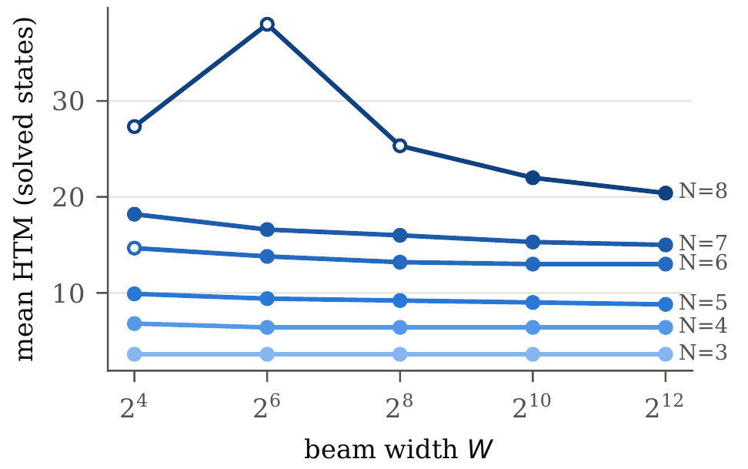
Our reproductions behave like the originals
RESULTS · REPRODUCTIONS AGAINST ORIGINALS
CayleyPy
Wider beams help: 8×8×1 solved 3/10 at W = 16, all from W = 1,024
IDA*-PDB
Database sizes exactly Korf’s; 3×3×1 diameter matches the published value
KMCoders
Their program, one run: 1.07–1.18× published. Our write-up rebuild: 1.61–1.71×
CayleyPy: mean HTM against beam width, Squares N = 3–8
Notes:
Before trusting comparisons, we check each reproduction against its original. CayleyPy’s per-size networks behave on the Square as the paper reports for cubes: optimal at small sizes, and wider beams help. Hollow markers on the plot mean not every state was solved at that width. IDA* matches Korf. For KMCoders, the gap between one run of their code and the published file is what many runs and tuning bought; the gap to our rebuild is what the write-up leaves out.

Slide 20
SymPort beats the published solutions up to N = 7
RESULTS · SANTA 2023 CUBES
N | n | SymPort | KMC pub. | KMC 1 run | dwalton76 | KMC-Repro | NetGain | Reduction
4 | 43 | 64.1 | 66.7 | 77.0 | 88.6 | 109.4 | 217.5 | 266.9
5 | 19 | 95.0 | 97.1 | 114.2 | 160.2 | 159.3 | 282.5 | 361.1
6 | 6 | 158.3 | 161.0 | 179.3 | 324.0 | 276.0 | 503.0 | 696.3
7 | 4 | 205.2 | 208.8 | 232.8 | 539.0 | 356.2 | 593.8 | 880.2
8 | 3 | 294.7 | 291.3 | 310.7 | 923.3 | 468.7 | 856.0 | 1,297.3
9 | 3 | 361.3 | 354.7 | 390.0 | 1,311.3 | 572.7 | 1,020.0 | 1,594.0
10 | 4 | – | 461.5 | 485.5 | 1,935.5 | 743.0 | 1,314.5 | 2,107.5
Mean QTM, the competition’s score; bold: best. SymPort is best at N = 4–7; at N = 8–9 the published solutions win and SymPort is second; not run at N = 10.
Notes:
The main cube result. KMC-published is KMCoders’ best-of-many submission; one run of their program is 5 to 18 percent longer. SymPort, built around that same program, is shorter on average than the published best at N = 4 to 7. At 8×8×8 and 9×9×9 the published solutions win and SymPort is second, ahead of one run of their program; we did not run SymPort at 10×10×10. The next slides show why. dwalton76 and our cluster methods are far behind because Santa demands the exact goal and the quarter-turn metric.

Slide 21
Shorter in total, though not at every size
RESULTS · SYMPORT PUZZLE BY PUZZLE
8,302
−1.8%
QTM over the 78 puzzles of N = 4–9, against 8,452 published
fewer quarter turns in total; 43 wins, 14 ties, 21 losses
N = 4–7 · 72 puzzles
8×8×8 · 3 puzzles
9×9×9 · 3 puzzles
2.8% saved (6,334 vs 6,514); 41 wins, 14 ties, 17 losses
1.1% longer (294.7 vs 291.3); 1 win, 2 losses
1.9% longer (361.3 vs 354.7); 1 win, 2 losses
Notes:
Over all 78 puzzles where SymPort ran, N = 4 to 9, it is still 1.8 percent shorter in total than the published solutions, because the small sizes have most of the puzzles. But the per-size picture changes: 2.8 percent saved over N = 4 to 7, and 1 to 2 percent longer at 8×8×8 and 9×9×9, where it wins one puzzle of three at each size.

Slide 22
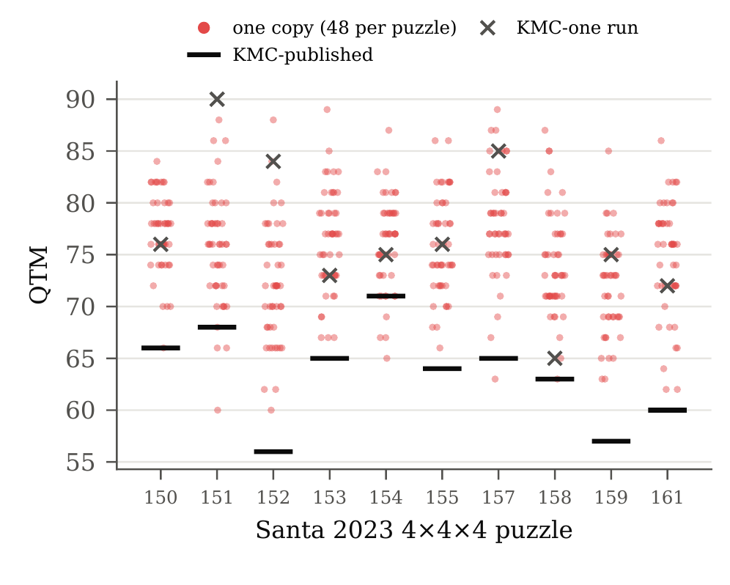
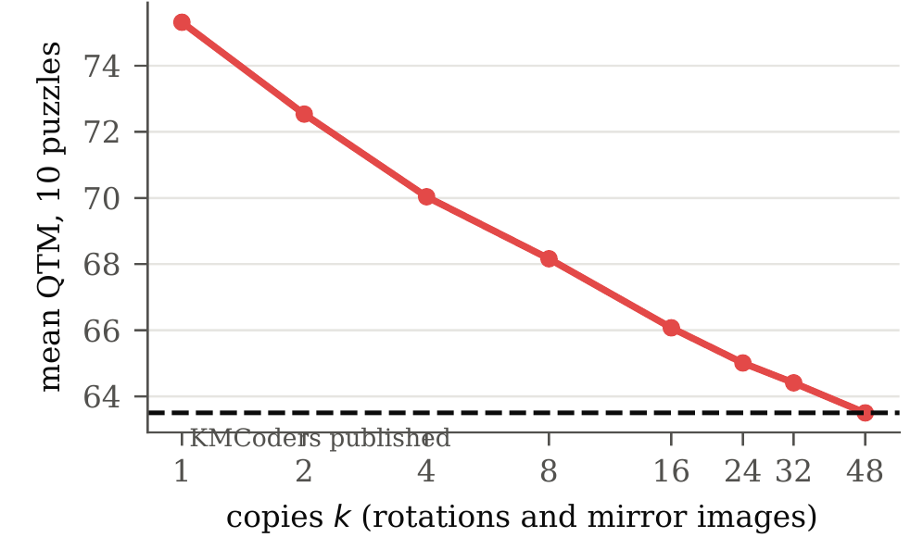
Symmetric copies give different lengths
RESULTS · WHY THE PORTFOLIO WORKS
Best of k copies: still falling at k = 48
One run sits far above the published bar; the shortest copy reaches below it. Diversity of the whole run is what pays.
48 copies per 4×4×4 spread over 18–28 QTM
Notes:
Left: each column is one Santa 4×4×4 puzzle, each dot one of the 48 symmetric copies run through KMCoders’ program, the bar their published best and the cross one run on the unrotated puzzle. The spread is large, and the published solution sits in its lower tail. Right: taking the best of k random copies, the mean falls quickly and has not flattened by 48, so more symmetric copies would keep helping.

Slide 23
Above N = 7, the copies vary too little
RESULTS · WHERE SYMPORT STOPS WINNING
The gain falls below the gap
The spread does not grow
Best copy vs a typical copy: 14.2% at N = 4, 5.8% at N = 7, only 3.3% at N = 8–9, where a typical copy trails the published solution by 4.6–5.4%.
Copies differ by about 7 QTM (SD) at every N while lengths grow as N²: the relative spread falls from 6.0% to 2.0%.
Copies get expensive
Even 48 copies fall short at N = 9
0.3 CPU-min per copy at N = 4, but 31 and 47 at N = 8 and 9, so only 12 copies fit our budget instead of 24–48.
Projected best of all 48: 290.2 vs 291.3 published at N = 8 (just wins), 357.3 vs 354.7 at N = 9 (still loses), at 25–38 CPU-hours per puzzle.
Notes:
Why SymPort stops winning. Split its result into two numbers: the gap, how far a typical copy is behind the published solution, and the gain, how much picking the best copy buys over a typical copy. SymPort wins exactly where the gain exceeds the gap. Up to 7×7×7 it does; at N = 8 and 9 the gain is 3.3 percent against a 4.6 to 5.4 percent gap. Three reasons: the copies’ spread stays near 7 quarter turns while solutions grow as N squared; each copy costs 31 to 47 CPU-minutes, so we could afford only 12; and the published solutions are themselves the best of many runs. A normal model that matches our measurements says even all 48 symmetries would only just win at N = 8 and would still lose at N = 9. Symmetry alone runs out; the copies must become more diverse, or the base solver stronger.

Slide 24
NetGain’s lead over Demaine grows with N
RESULTS · NETGAIN ON RANDOM CUBES
Fewer moves than Demaine, mean HTM. N = 4–10: 20 states each, paired 95% intervals; significant from N = 5 (N = 4 is not). *N = 15 and 20: one state each.
Notes:
This is the random-cube result. With 20 states per size and paired 95 percent confidence intervals, NetGain is significantly shorter than Demaine from N = 5 on, and the gap grows steadily. Most of the gain comes from net-gain blocks alone: on the 20×20×20, 4,925 moves against Demaine’s 6,612; lookahead adds another 2 to 8 percent.

Slide 25
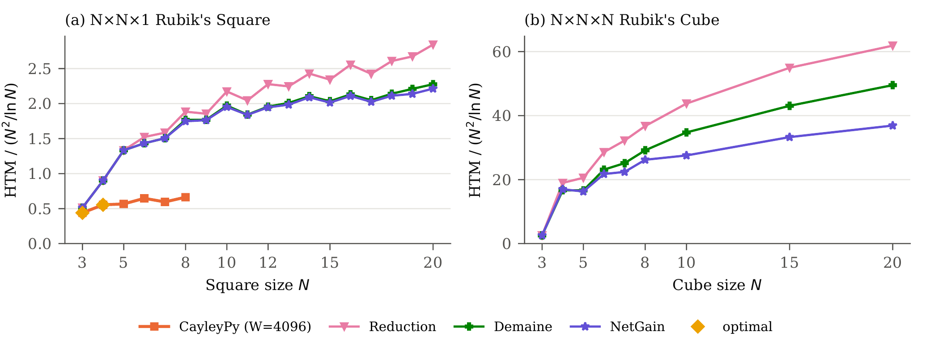
NetGain’s length grows most slowly
RESULTS · SCALING WITH N
A flat line would mean the optimal Θ(N²/log N) rate. Every curve still rises, so no method reaches it in practice; NetGain on the cube comes closest.
Notes:
Each mean length is divided by N squared over ln N, the growth rate of the worst case. On the Square, CayleyPy is far below everything else but only exists up to N = 8; Demaine and NetGain nearly coincide. On the cube, the three cluster methods separate clearly as N grows, and NetGain’s curve bends over the most.

Slide 26
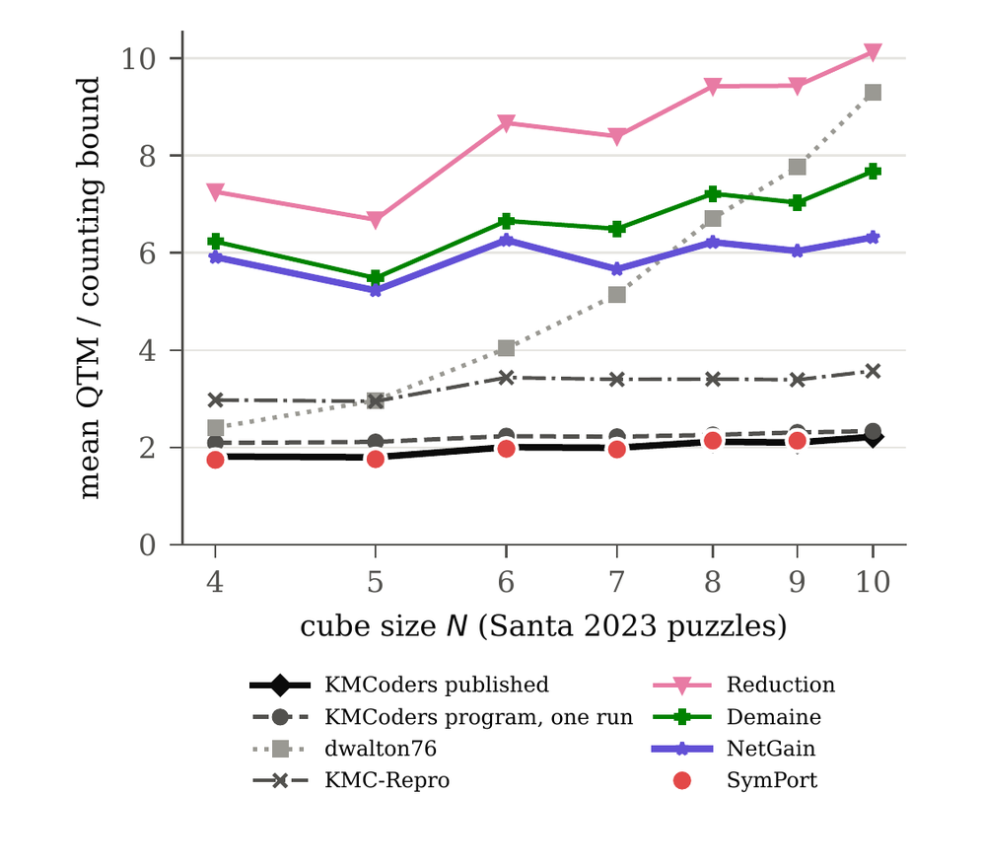
The room left grows like log N
RESULTS · HOW FAR FROM OPTIMAL
KMCoders’ published solutions are
1.81×
at N = 4
1.99×
at N = 7
2.22×
at N = 10
Lengths grow like N², the bound like N²/log N: the final stage fixes O(1) pieces per 3-cycle.
Notes:
KMCoders’ published lengths divided by the counting bound; SymPort is now shown at N = 4 to 9. On the Square, the true worst case is 1.5 to 1.7 times the bound, so at N = 4 the published solutions are within a small factor of optimal. The gap widens with N because their endgame fixes a constant number of pieces per 3-cycle; keeping Demaine-style parallelism into the endgame is how to close it.

Slide 27
What the comparison tells us
DISCUSSION
Write-ups leave things out
Diversity beats local repair
Rebuilt from the write-up: 1.6–1.7× published. Their code: 7–18% longer. The gap is bulk commutators, exact 3-cycle counting and an optimal 3×3×3.
Annealing and ruin-and-recreate on finished KMCoders solutions removed no move. Whole-run diversity is what pays.
At large N, structure wins
Learning helps at small N
On random states, fixing many clusters with one move sequence (NetGain) beats everything else.
Per-size networks are optimal up to N = 5. OneNet generalises, but above N = 7 hand-designed schedules are shorter.
Notes:
Four lessons. First, reproducing from a paper is not reproducing from code: our write-up reproduction is far behind their real program. Second, KMCoders’ solutions are locally tight; only running the whole pipeline on different inputs finds shorter ones. Third and fourth: the large-N winner is structural, the small-N winner is learned.

Slide 28
What we have not shown
LIMITATIONS
SymPort wins only up to N = 7
Second at N = 8–9, not run at N = 10; not every puzzle; 3–4 puzzles per size from N = 6; no equal-compute seed portfolio yet
Built on KMCoders’ solver
The core is theirs; we release only a wrapper and a two-line patch
Few large random states
Confidence intervals cover N ≤ 10; one cube each at N = 15 and 20
No optimal growth rate in practice
Every method’s length / (N²/ln N) still rises with N
A lower bound only
Cannot certify any single solution as near-optimal
Learned solvers: Square only
No cube networks at CayleyPy’s scale
Notes:
Be upfront here. The most important: SymPort wins only up to 7×7×7, and we did not run it at 10×10×10. We also lack an equal-compute baseline: 48 random seeds of the same program might give similar diversity.

Slide 29
What we would try next
FUTURE WORK
More diverse copies
Seeds, tie-breaks and beam widths inside KMCoders’ later stages; first, an equal-compute test of symmetries against seeds
Recombine, not just select
Map the copies to one frame and keep the shortest stage from each, not only the shortest whole solution
Spend the budget adaptively
Run the cheap early stages on all 48 copies; finish only the most promising (successive halving)
A stronger base solver
A wider beam, or NetGain’s bulk commutators in the endgame: needed at N = 9, where even 48 copies fall short
Finish the Santa sizes
N = 10, then 19 and 33
Learned solvers for cubes
Train CayleyPy and OneNet on cubes at scale
Notes:
Future work follows from the analysis. More diverse copies, since symmetry alone gives a spread that does not grow with N; recombining the best stage of each copy rather than picking one whole solution; spending the budget adaptively so all 48 copies become affordable; and a stronger base solver, which N = 9 needs whatever the number of copies. Then the remaining Santa sizes, and learned cube solvers.

Slide 30
One engine, eight solvers, three answers
CONCLUSION
Random states: the large-N winner is structural. Batch by net gain, not unanimous need (NetGain).
Santa 2023: the cube’s symmetries turn the competition’s solver into a portfolio that beats its published best up to N = 7 (SymPort); larger cubes need more diverse copies.
Optimality: little room at N = 4, a factor growing like log N beyond.
Next: more diverse SymPort copies, and NetGain’s bulk moves in the endgame of the insertion method.
github.com/gauravrai1704/Rubik
Notes:
Close with the three answers and the next steps: more diverse SymPort copies for large cubes, and NetGain’s parallel bulk moves inside KMCoders’ insertion endgame, where the two lines of the work meet. Then thank the audience and open for questions.

