Slide 1
DOM MANIPULATION
Fix the Code Challenge
5 mini clones of apps you use every day • Instagram • Zomato • Amazon • Ola • Netflix
You get the HTML + CSS. You write the JavaScript.

Slide 2
Quick Revision — JS DOM & Event Methods
document.getElementById()
document.getElementsByClassName()
document.getElementsByTagName()
document.querySelector()
Selects one element by its id
Selects all elements with a class
Selects all elements of a tag
Selects first match of a CSS selector
document.querySelectorAll()
element.getAttribute()
element.setAttribute()
element.removeAttribute()
Selects all matches of a selector
Reads an attribute's value
Sets/creates an attribute
Removes an attribute
classList.add()
classList.remove()
classList.toggle()
classList.contains()
Adds a CSS class
Removes a CSS class
Switches a class on/off
Checks if a class exists
element.textContent
element.innerHTML
element.style.property
addEventListener()
Reads/sets plain text inside
Reads/sets HTML markup inside
Sets an inline CSS style
Runs a function on an event
element.dataset
document.createElement()
parent.appendChild()
parent.removeChild()
Reads data-* attributes
Creates a new element
Inserts a node into the DOM
Removes a node from the DOM

Slide 3
How This Works
1
Copy the HTML + CSS
Each question gives you a ready index.html and style.css. Copy both into your own folder — don't change them.
2
Study the two screenshots
“Before” is what loads first. “After” is what it should look like once your JavaScript runs and the user interacts with it.
3
Write script.js yourself
Use getElementById / querySelector to grab elements, addEventListener to catch the click, and classList / textContent / setAttribute to make the change.
4
Test it
Open index.html in your browser, click around, and check it matches the “After” screenshot exactly.

Slide 4
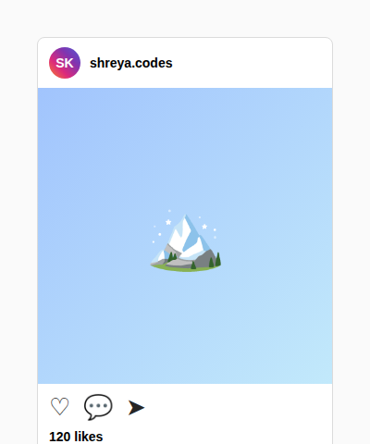
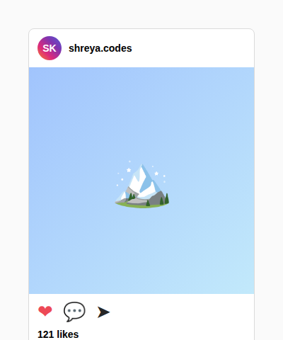
Q1
📸 Instagram — Like Button
Clicking the heart should toggle it filled/outline and update the like count by 1.
Methods you'll likely need: querySelector • classList.toggle • classList.contains • textContent
index.html
BEFORE (page loads)
<div class="insta-card">
<div class="insta-header">
<div class="insta-avatar">SK</div>
<div class="insta-username">shreya.codes</div>
</div>
<div class="insta-post-image">🏔️</div>
<div class="insta-actions">
<span id="heart" class="icon heart">&#9825;</span>
<span class="icon">&#128172;</span>
<span class="icon">&#10148;</span>
</div>
<p class="likes-count" id="likesCount">120 likes</p>
<p class="caption"><b>shreya.codes</b> Chasing sunsets 🌄</p>
</div>
AFTER (your JS working)
style.css
* { margin:0; padding:0; box-sizing:border-box; }
body { font-family: 'Segoe UI', Arial, sans-serif; background:#fafafa; display:flex; justify-content:center; padding:40px 0; }
.insta-card { width:320px; background:#fff; border:1px solid #dbdbdb; border-radius:8px; overflow:hidden; }
.insta-header { display:flex; align-items:center; gap:10px; padding:10px 12px; }
.insta-avatar { width:34px; height:34px; border-radius:50%; background:linear-gradient(45deg,#f58529,#dd2a7b,#8134af,#515bd4); display:flex; align-items:center; justify-content:center; color:#fff; font-weight:bold; font-size:14px; }
.insta-username { font-weight:600; font-size:14px; }
.insta-post-image { height:320px; background:linear-gradient(135deg,#a1c4fd,#c2e9fb); display:flex; align-items:center; justify-content:center; font-size:70px; }
.insta-actions { display:flex; align-items:center; gap:14px; padding:10px 12px 0 12px; }
.icon { font-size:26px; cursor:pointer; user-select:none; color:#262626; transition:transform 0.15s ease; }
.icon.heart.liked { color:#ed4956; }
.icon:active { transform:scale(1.2); }
.likes-count { font-weight:600; font-size:14px; padding:8px 12px 4px 12px; }
.caption { font-size:14px; padding:0 12px 14px 12px; color:#262626; }
.caption b { margin-right:4px; }

Slide 5
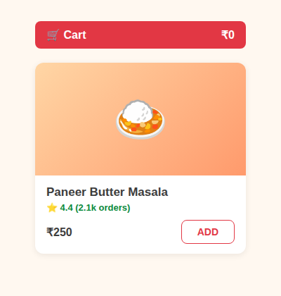
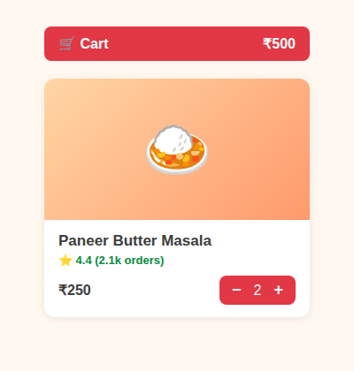
Q2
🍛 Zomato — Add to Cart Stepper
ADD should turn into a −/+ stepper. +/− should change quantity and update the cart total. Qty 0 should bring ADD back.
Methods you'll likely need: getElementById • classList.add/remove • textContent • parseInt
index.html
BEFORE (page loads)
<div class="nav-cart">
<span>🛒 Cart</span>
<span id="cartTotal">₹0</span>
</div>
<div class="food-card">
<div class="food-img">🍛</div>
<div class="food-info">
<h3>Paneer Butter Masala</h3>
<p class="rating">⭐ 4.4 (2.1k orders)</p>
<div class="price-row">
<span class="price">₹250</span>
<button id="addBtn" class="add-btn">ADD</button>
<div id="stepper" class="stepper hidden">
<button id="decreaseBtn">−</button>
<span id="qty">1</span>
<button id="increaseBtn">+</button>
</div>
</div>
</div>
</div>
AFTER (your JS working)
style.css
* { margin:0; padding:0; box-sizing:border-box; }
body { font-family: 'Segoe UI', Arial, sans-serif; background:#fff8f0; display:flex; flex-direction:column; align-items:center; padding:30px 0; }
.nav-cart { width:300px; background:#e23744; color:#fff; padding:10px 16px; border-radius:8px; font-weight:600; margin-bottom:20px; display:flex; justify-content:space-between; }
.food-card { width:300px; background:#fff; border-radius:12px; box-shadow:0 2px 10px rgba(0,0,0,0.08); overflow:hidden; }
.food-img { height:160px; background:linear-gradient(135deg,#ffd6a5,#ff9a6c); display:flex; align-items:center; justify-content:center; font-size:64px; }
.food-info { padding:14px 16px; }
.food-info h3 { font-size:17px; color:#3d3d3d; }
.food-info .rating { color:#0b8a3d; font-size:13px; font-weight:600; margin:4px 0; }
.price-row { display:flex; justify-content:space-between; align-items:center; margin-top:10px; position:relative; }
.price { font-size:16px; font-weight:700; color:#3d3d3d; }
.add-btn { background:#fff; border:1px solid #e23744; color:#e23744; font-weight:700; padding:8px 22px; border-radius:8px; cursor:pointer; font-size:14px; }
.stepper { display:flex; align-items:center; gap:14px; background:#e23744; color:#fff; border-radius:8px; padding:6px 14px; }
.stepper button { background:none; border:none; color:#fff; font-size:18px; font-weight:700; cursor:pointer; }
.hidden { display:none; }

Slide 6
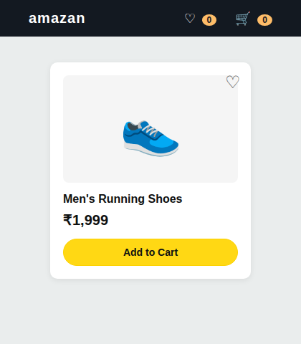
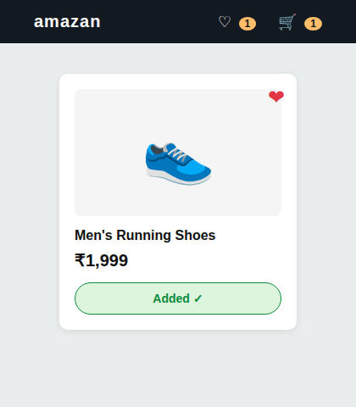
Q3
👟 Amazon — Wishlist + Add to Cart
Heart icon should toggle wishlist state and update the navbar count. Add to Cart should change its own text, disable itself, and bump the cart badge.
Methods you'll likely need: classList.toggle • setAttribute • getAttribute • innerHTML
index.html
BEFORE (page loads)
<div class="navbar">
<div class="brand">amazan</div>
<div class="nav-icons">
<span>♡ <span id="wishCount" class="count">0</span></span>
<span>🛒 <span id="cartCount" class="count">0</span></span>
</div>
</div>
<div class="product-card">
<span id="wishlistIcon" class="wishlist-icon">&#9825;</span>
<div class="product-img">👟</div>
<h3>Men's Running Shoes</h3>
<p class="price">1,999</p>
<button id="addToCartBtn">Add to Cart</button>
</div>
AFTER (your JS working)
style.css
* { margin:0; padding:0; box-sizing:border-box; }
body { font-family: 'Segoe UI', Arial, sans-serif; background:#eaeded; display:flex; flex-direction:column; align-items:center; }
.navbar { width:100%; background:#131921; color:#fff; display:flex; justify-content:space-between; align-items:center; padding:14px 40px; }
.brand { font-size:20px; font-weight:700; letter-spacing:1px; }
.nav-icons { display:flex; gap:26px; font-size:18px; }
.nav-icons span.count { background:#febd69; color:#131921; border-radius:50%; padding:1px 7px; font-size:12px; font-weight:700; margin-left:4px; }
.product-card { width:280px; background:#fff; border-radius:10px; margin-top:36px; padding:18px; position:relative; box-shadow:0 2px 8px rgba(0,0,0,0.08); }
.wishlist-icon { position:absolute; top:14px; right:14px; font-size:24px; cursor:pointer; color:#555; }
.wishlist-icon.active { color:#e23744; }
.product-img { height:150px; display:flex; align-items:center; justify-content:center; font-size:70px; background:#f5f5f5; border-radius:8px; }
.product-card h3 { margin-top:14px; font-size:16px; color:#0f1111; }
.product-card .price { font-size:20px; font-weight:700; color:#0f1111; margin:8px 0 14px 0; }
.product-card .price::before { content:"₹"; }
#addToCartBtn { width:100%; background:#ffd814; border:1px solid #fcd200; border-radius:20px; padding:10px; font-weight:600; cursor:pointer; font-size:14px; color:#0f1111; }
#addToCartBtn.added { background:#dcf5dc; border-color:#0b8a3d; color:#0b8a3d; cursor:default; }

Slide 7
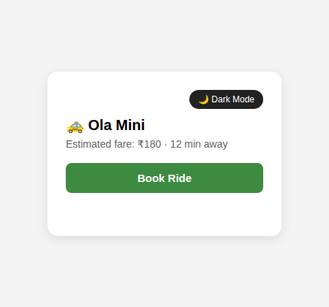
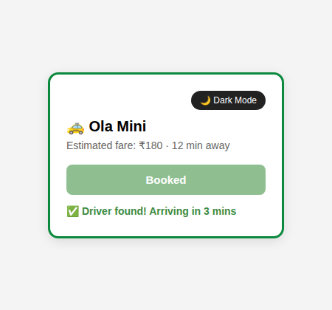
Q4
🚕 Ola — Dark Mode + Book Ride
Theme button should toggle dark mode on card + page. Book Ride should disable itself, show a searching message, then confirm after a short delay.
Methods you'll likely need: classList.toggle • addEventListener • setTimeout • disabled
index.html
BEFORE (page loads)
<div class="ride-card" id="rideCard">
<div class="theme-toggle">
<button id="themeBtn">🌙 Dark Mode</button>
</div>
<h2 class="ride-title">🚕 Ola Mini</h2>
<p class="fare">Estimated fare: ₹180 · 12 min away</p>
<button id="bookBtn">Book Ride</button>
<p id="status" class="status"></p>
</div>
AFTER (your JS working)
style.css
* { margin:0; padding:0; box-sizing:border-box; }
body { font-family: 'Segoe UI', Arial, sans-serif; background:#f4f4f4; display:flex; justify-content:center; align-items:center; height:100vh; transition:background 0.3s ease; }
body.dark { background:#121212; }
.ride-card { width:320px; background:#fff; border-radius:14px; padding:22px; box-shadow:0 4px 16px rgba(0,0,0,0.1); border:3px solid transparent; transition:all 0.3s ease; }
.ride-card.dark { background:#1e1e1e; color:#f1f1f1; }
.ride-card.confirmed { border-color:#0b8a3d; }
.theme-toggle { text-align:right; margin-bottom:10px; }
#themeBtn { background:#222; color:#fff; border:none; padding:6px 12px; border-radius:20px; font-size:12px; cursor:pointer; }
.ride-card.dark #themeBtn { background:#f1f1f1; color:#222; }
.ride-title { font-size:20px; margin-bottom:6px; }
.fare { color:#666; margin-bottom:18px; font-size:14px; }
.ride-card.dark .fare { color:#bbb; }
#bookBtn { width:100%; background:#3d8b40; color:#fff; border:none; padding:12px; border-radius:8px; font-size:15px; font-weight:600; cursor:pointer; }
#bookBtn:disabled { background:#8fbf90; cursor:not-allowed; }
.status { margin-top:14px; font-size:14px; font-weight:600; min-height:20px; color:#3d8b40; }

Slide 8
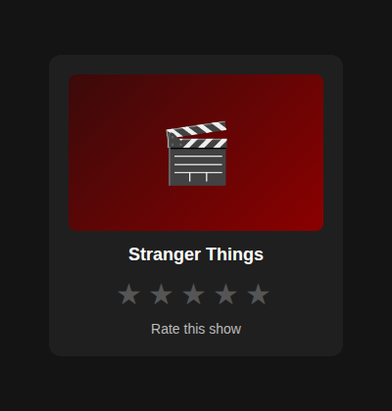
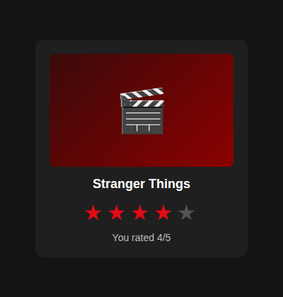
Q5
🎬 Netflix — Star Rating
Clicking a star should fill it and every star before it, clear the rest, and show 'You rated X/5'.
Methods you'll likely need: querySelectorAll • forEach • dataset/getAttribute • classList
index.html
BEFORE (page loads)
<div class="movie-card">
<div class="movie-poster">🎬</div>
<h3>Stranger Things</h3>
<div class="stars" id="stars">
<span class="star" data-index="1">★</span><span class="star" data-index="2">★</span><span class="star" data-index="3">★</span><span class="star" data-index="4">★</span><span class="star" data-index="5">★</span>
</div>
<p id="ratingText">Rate this show</p>
</div>
AFTER (your JS working)
style.css
* { margin:0; padding:0; box-sizing:border-box; }
body { font-family:'Segoe UI', Arial, sans-serif; background:#141414; display:flex; justify-content:center; align-items:center; height:100vh; }
.movie-card { width:300px; background:#1f1f1f; border-radius:12px; padding:20px; text-align:center; color:#fff; }
.movie-poster { height:160px; background:linear-gradient(135deg,#3b0a0a,#8b0000); border-radius:8px; display:flex; align-items:center; justify-content:center; font-size:60px; margin-bottom:14px; }
.movie-card h3 { font-size:18px; margin-bottom:12px; }
.stars { font-size:30px; letter-spacing:6px; margin-bottom:10px; }
.star { color:#555; cursor:pointer; transition:color 0.15s ease; }
.star.filled { color:#e50914; }
#ratingText { font-size:14px; color:#bbb; }

Slide 9
Your Turn 🚀
Write all 5 script.js files, test them in the browser, then we'll review the solutions together.

