Slide 1
DOM MANIPULATION
Answer Key — script.js Solutions

Slide 2
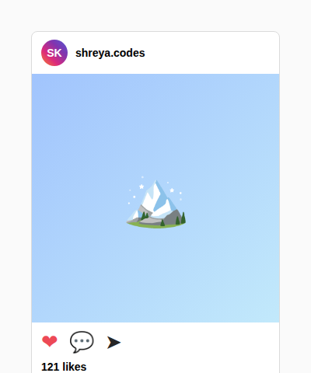
Q1
📸 Instagram — Like Button
Expected result:
script.js (solution)
const heart = document.getElementById("heart");
const likesCount = document.getElementById("likesCount");
heart.addEventListener("click", function () {
const isLiked = heart.classList.contains("liked");
let count = parseInt(likesCount.textContent);
if (!isLiked) {
heart.classList.add("liked");
heart.innerHTML = "&#10084;";
count = count + 1;
} else {
heart.classList.remove("liked");
heart.innerHTML = "&#9825;";
count = count - 1;
}
likesCount.textContent = count + " likes";
});
Clicking the heart should toggle it filled/outline and update the like count by 1.

Slide 3
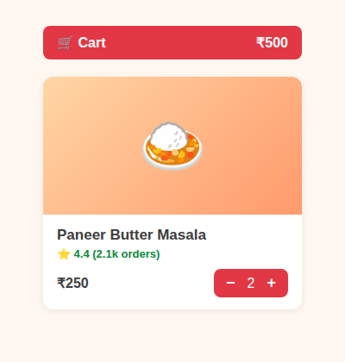
Q2
🍛 Zomato — Add to Cart Stepper
Expected result:
script.js (solution)
const addBtn = document.getElementById("addBtn");
const stepper = document.getElementById("stepper");
const decreaseBtn = document.getElementById("decreaseBtn");
const increaseBtn = document.getElementById("increaseBtn");
const qtyEl = document.getElementById("qty");
const cartTotalEl = document.getElementById("cartTotal");
const PRICE = 250;
let cartTotal = 0;
function updateCart() {
cartTotalEl.textContent = "₹" + cartTotal;
}
addBtn.addEventListener("click", function () {
addBtn.classList.add("hidden");
stepper.classList.remove("hidden");
qtyEl.textContent = "1";
cartTotal = cartTotal + PRICE;
updateCart();
});
increaseBtn.addEventListener("click", function () {
let qty = parseInt(qtyEl.textContent);
qty = qty + 1;
qtyEl.textContent = qty;
cartTotal = cartTotal + PRICE;
updateCart();
});
decreaseBtn.addEventListener("click", function () {
let qty = parseInt(qtyEl.textContent);
qty = qty - 1;
cartTotal = cartTotal - PRICE;
if (qty === 0) {
stepper.classList.add("hidden");
addBtn.classList.remove("hidden");
} else {
qtyEl.textContent = qty;
}
updateCart();
});
ADD should turn into a −/+ stepper. +/− should change quantity and update the cart total. Qty 0 should bring ADD back.

Slide 4
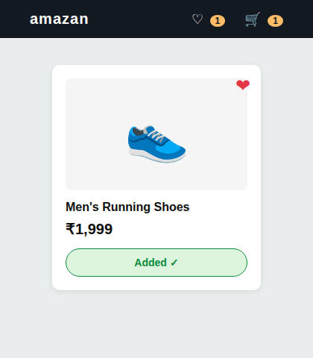
Q3
👟 Amazon — Wishlist + Add to Cart
Expected result:
script.js (solution)
const wishlistIcon = document.getElementById("wishlistIcon");
const wishCount = document.getElementById("wishCount");
const addToCartBtn = document.getElementById("addToCartBtn");
const cartCount = document.getElementById("cartCount");
wishlistIcon.addEventListener("click", function () {
wishlistIcon.classList.toggle("active");
if (wishlistIcon.classList.contains("active")) {
wishlistIcon.innerHTML = "&#10084;";
wishCount.textContent = parseInt(wishCount.textContent) + 1;
} else {
wishlistIcon.innerHTML = "&#9825;";
wishCount.textContent = parseInt(wishCount.textContent) - 1;
}
});
addToCartBtn.addEventListener("click", function () {
addToCartBtn.textContent = "Added ✓";
addToCartBtn.classList.add("added");
addToCartBtn.setAttribute("disabled", "true");
cartCount.textContent = parseInt(cartCount.textContent) + 1;
});
Heart icon should toggle wishlist state and update the navbar count. Add to Cart should change its own text, disable itself, and bump the cart badge.

Slide 5
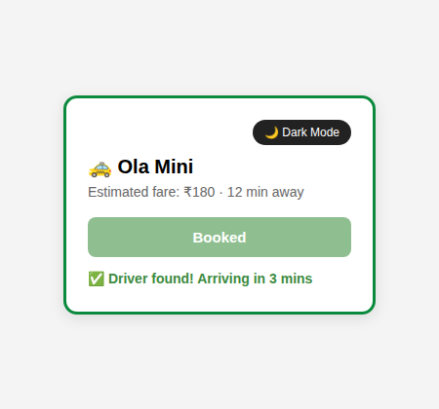
Q4
🚕 Ola — Dark Mode + Book Ride
Expected result:
script.js (solution)
const themeBtn = document.getElementById("themeBtn");
const rideCard = document.getElementById("rideCard");
const bookBtn = document.getElementById("bookBtn");
const status = document.getElementById("status");
themeBtn.addEventListener("click", function () {
document.body.classList.toggle("dark");
rideCard.classList.toggle("dark");
if (rideCard.classList.contains("dark")) {
themeBtn.textContent = "☀️ Light Mode";
} else {
themeBtn.textContent = "🌙 Dark Mode";
}
});
bookBtn.addEventListener("click", function () {
bookBtn.setAttribute("disabled", "true");
status.textContent = "🔍 Searching for a driver...";
setTimeout(function () {
status.textContent = "✅ Driver found! Arriving in 3 mins";
rideCard.classList.add("confirmed");
bookBtn.textContent = "Booked";
}, 1500);
});
Theme button should toggle dark mode on card + page. Book Ride should disable itself, show a searching message, then confirm after a short delay.

Slide 6
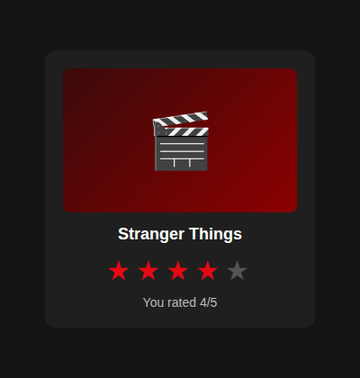
Q5
🎬 Netflix — Star Rating
Expected result:
script.js (solution)
const stars = document.querySelectorAll(".star");
const ratingText = document.getElementById("ratingText");
stars.forEach(function (star) {
star.addEventListener("click", function () {
const selectedIndex = parseInt(star.getAttribute("data-index"));
stars.forEach(function (s) {
const sIndex = parseInt(s.getAttribute("data-index"));
if (sIndex <= selectedIndex) {
s.classList.add("filled");
} else {
s.classList.remove("filled");
}
});
ratingText.textContent = "You rated " + selectedIndex + "/5";
});
});
Clicking a star should fill it and every star before it, clear the rest, and show 'You rated X/5'.

Slide 7
Great Work! 🎉
Compare your script.js with these solutions. Different approaches that reach the same AFTER state are equally correct.

